Slide 1
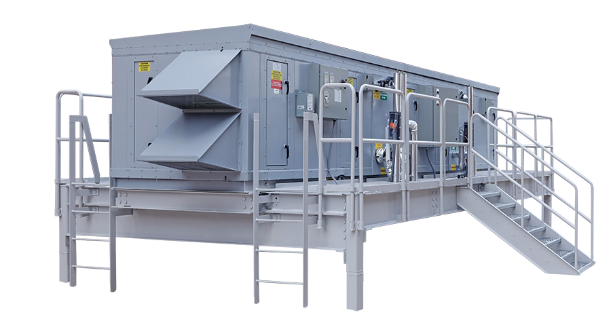

ASCENDANT® & GIGA
Active Dehumidification

Slide 2

Corporate Overview

Slide 3
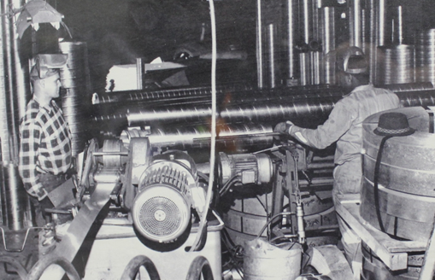
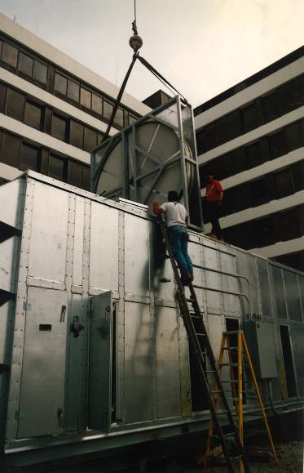
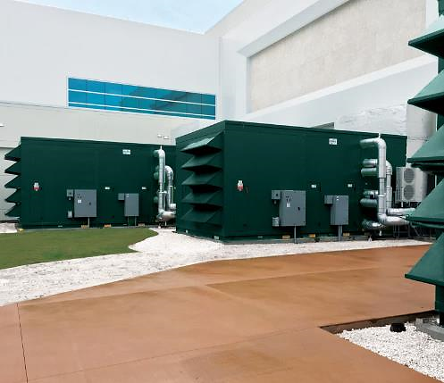









Who we are & what we do
Energy
& Environmental
Focus
Patented &
Certified
Products
U.S & Global
Footprint
Engineered
Air Quality &
Data Center
Solutions
Engineered
Air Distribution
& Sound
Solutions
OEM,
Key Account &
Sales Rep
Route To Market
Service
& Support
Award Winning
& Industry
Recognized
Notes:
In 1963 Salisbury Engineering and Manufacturing Company (SEMCO) was born in Salisbury, MO.
Began as SEMCO -- small sheet metal fabricator specializing in duct.
In the 59 years, evolved into a multi-million dollar company with a large product offering.
Headquartered in Columbia, MO, with 275,000 sq ft of manufacturing space in 3 plants in Arkansas and Virginia
We are a business unit of FläktGroup, and we are owned and backed by Triton Partners—which is a $17 billion annual revenue investment firm.
Innovation is core at FläktGroup SEMCO.
Certified by AHRI, SEMCO was won numerous awards – including multiple AHRI Innovation, Green Building, Dealer Design, School/College Planning & Management Awards
Hold numerous patents and trade secrets for our industry leading energy recovery wheels and systems.

Slide 4

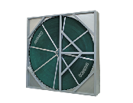
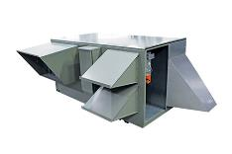
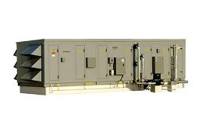


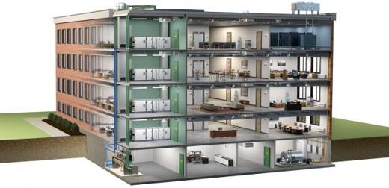
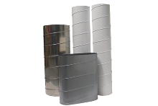
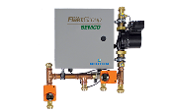
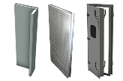

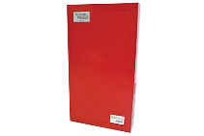
FläktGroup SEMCO Products For Commercial Applications
Energy Recovery Wheel
Unitary Energy Recovery Unit
Applied Energy Recovery Unit
NEUTON Pump
Ductwork
Chilled Beams
Fire-Rated Panels
Sound Attenuation Panels
Notes:
FläktGroup SEMCO provides solutions for a wide variety of applications including casinos, offices, laboratories, hotels, education, healthcare, retail, data centers, stadiums, manufacturing, agriculture & indoor farming, airports, and recreational facilities.
FläktGroup SEMCO products could be utilized in conjunction with one another, to provide the best possible air quality.
We offer energy recovery units & wheels which are engineered to be low maintenance, environmentally friendly, energy efficient & saves money over time as well as protects occupants from harmful contaminants.
We also offer chilled beams, pump modules, data centers, air handlers, duct and panels.
Leverage below if desired:
FläktGroup SEMCO products are designed to be utilized in conjunction with one another, to provide the best possible air quality. We show here:
Ductwork is laid within the walls and ceiling of the building, so supply air may be brought into the building and return air may be exhausted from the building.
Outdoor air is brought into the FV and pre-conditioned
Once the air is pre-conditioned with the FV it is filtered through the Pinnacle energy recovery unit, which will remove contaminants and dehumidify the incoming airstream with its True 3A wheel. Return air will also flow through the Pinnacle on its way out.
The chilled beams and the Neuton will work together with the supply air they receive from the Pinnacle to maintain a comfortable room temperature without condensation. (Together the Pinnacle, Neuton, and chilled beams make up 3fficiency).
During the construction of the building fire panels will be installed around an equipment room or elevator.
Sound attenuation panels are also installed during construction around noisy equipment or places where noise may be a concern

Slide 5
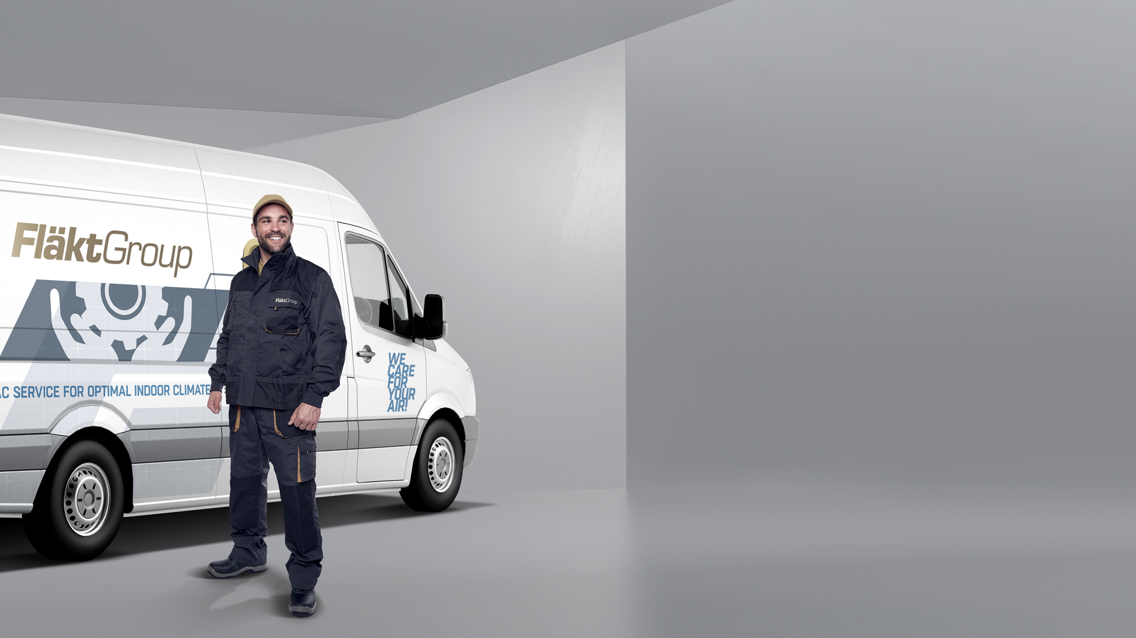

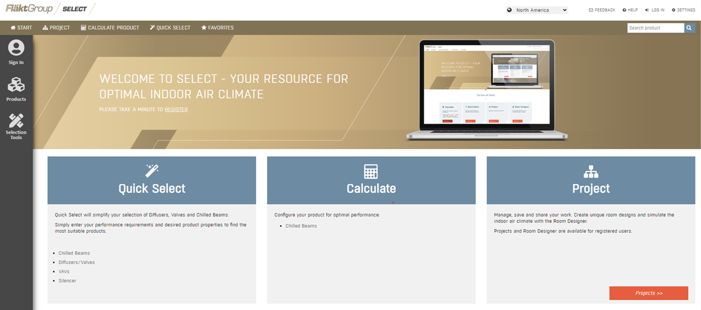
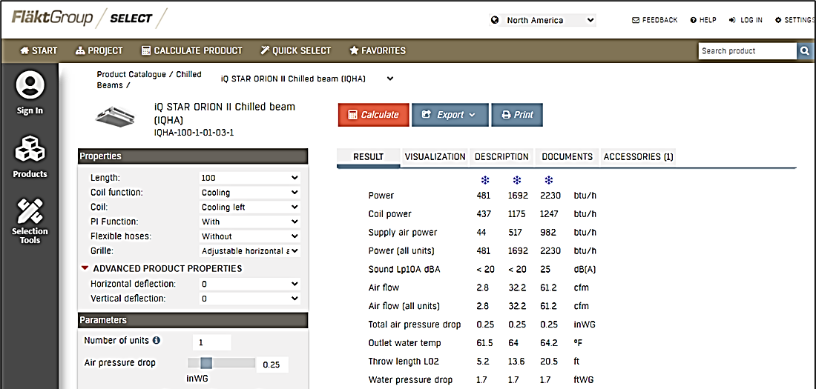
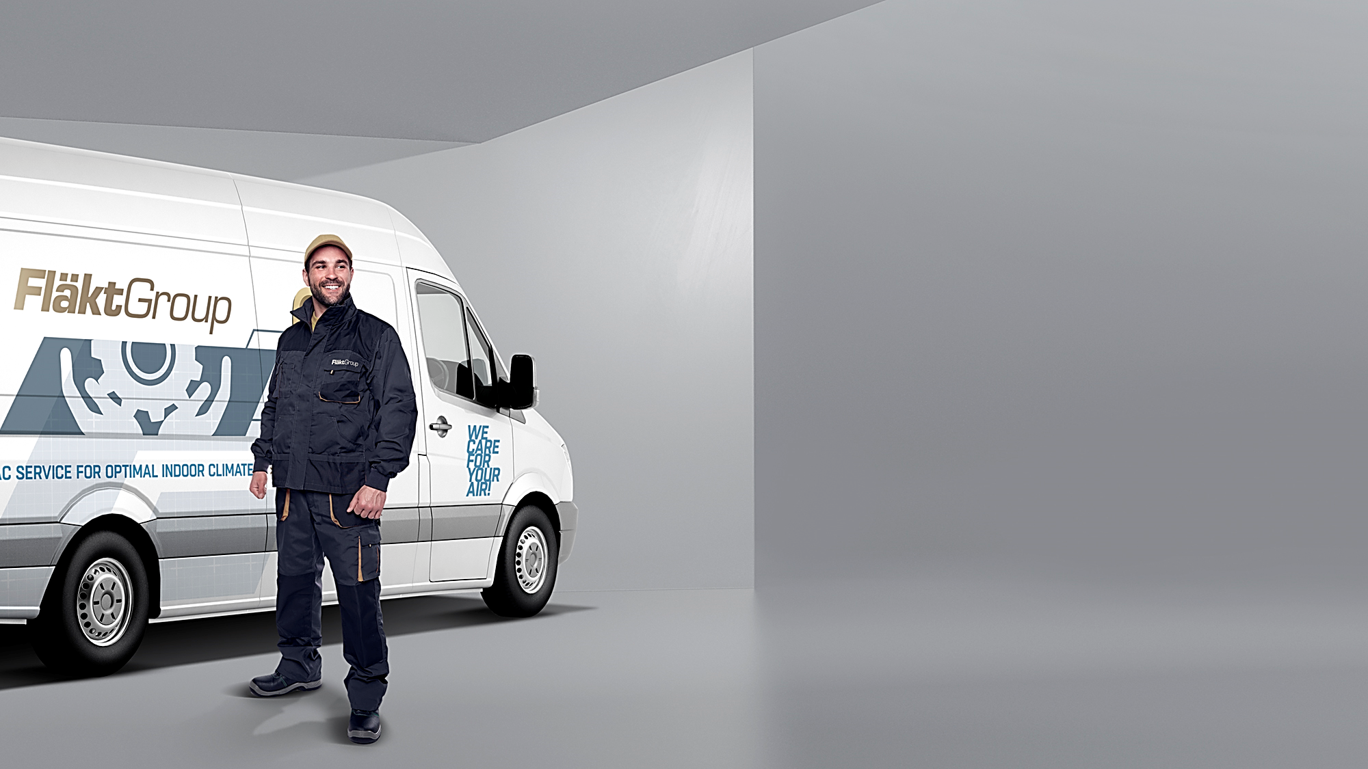
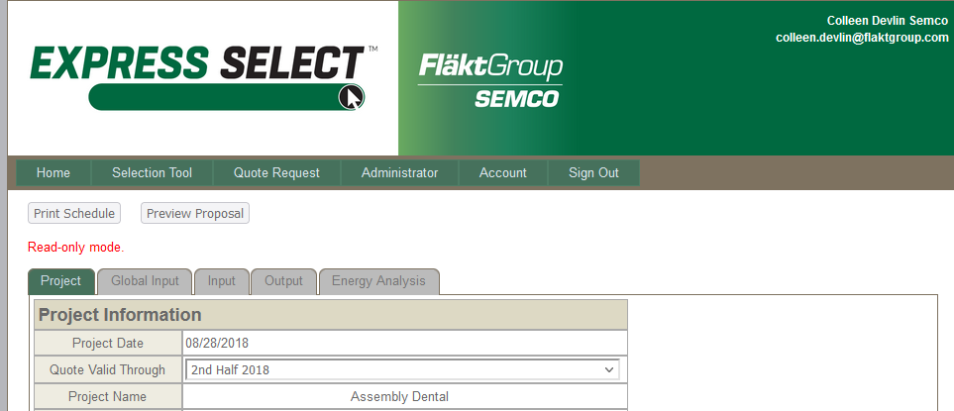
FläktGroup SEMCO Superior Sales Support & Service
Notes:
FläktGroup SEMCO prides ourselves on supplying exceptional sales support and service.
Accessible web-based literature and tools
Our experienced sales team are a phone call away and will help guide you through our selection programs to meet or exceed project specifications.
While all FläktGroup SEMCO products are relatively maintenance free throughout their lifecycle--we have a knowledgeable and dedicated service team available should you require it.

Slide 6
Introduction to the Ascendant & Giga

Slide 7
Introduction to the Ascendant® and Giga
What is an Ascendant®?
The Ascendant is a highly efficient, conventional cooling system which employs an, active desiccant hybrid system to deliver and maintain low dewpoints by minimizing regenerative energy input.
It may be used as a dedicated outdoor air system (DOAS) or a recirculated air system.

Slide 8
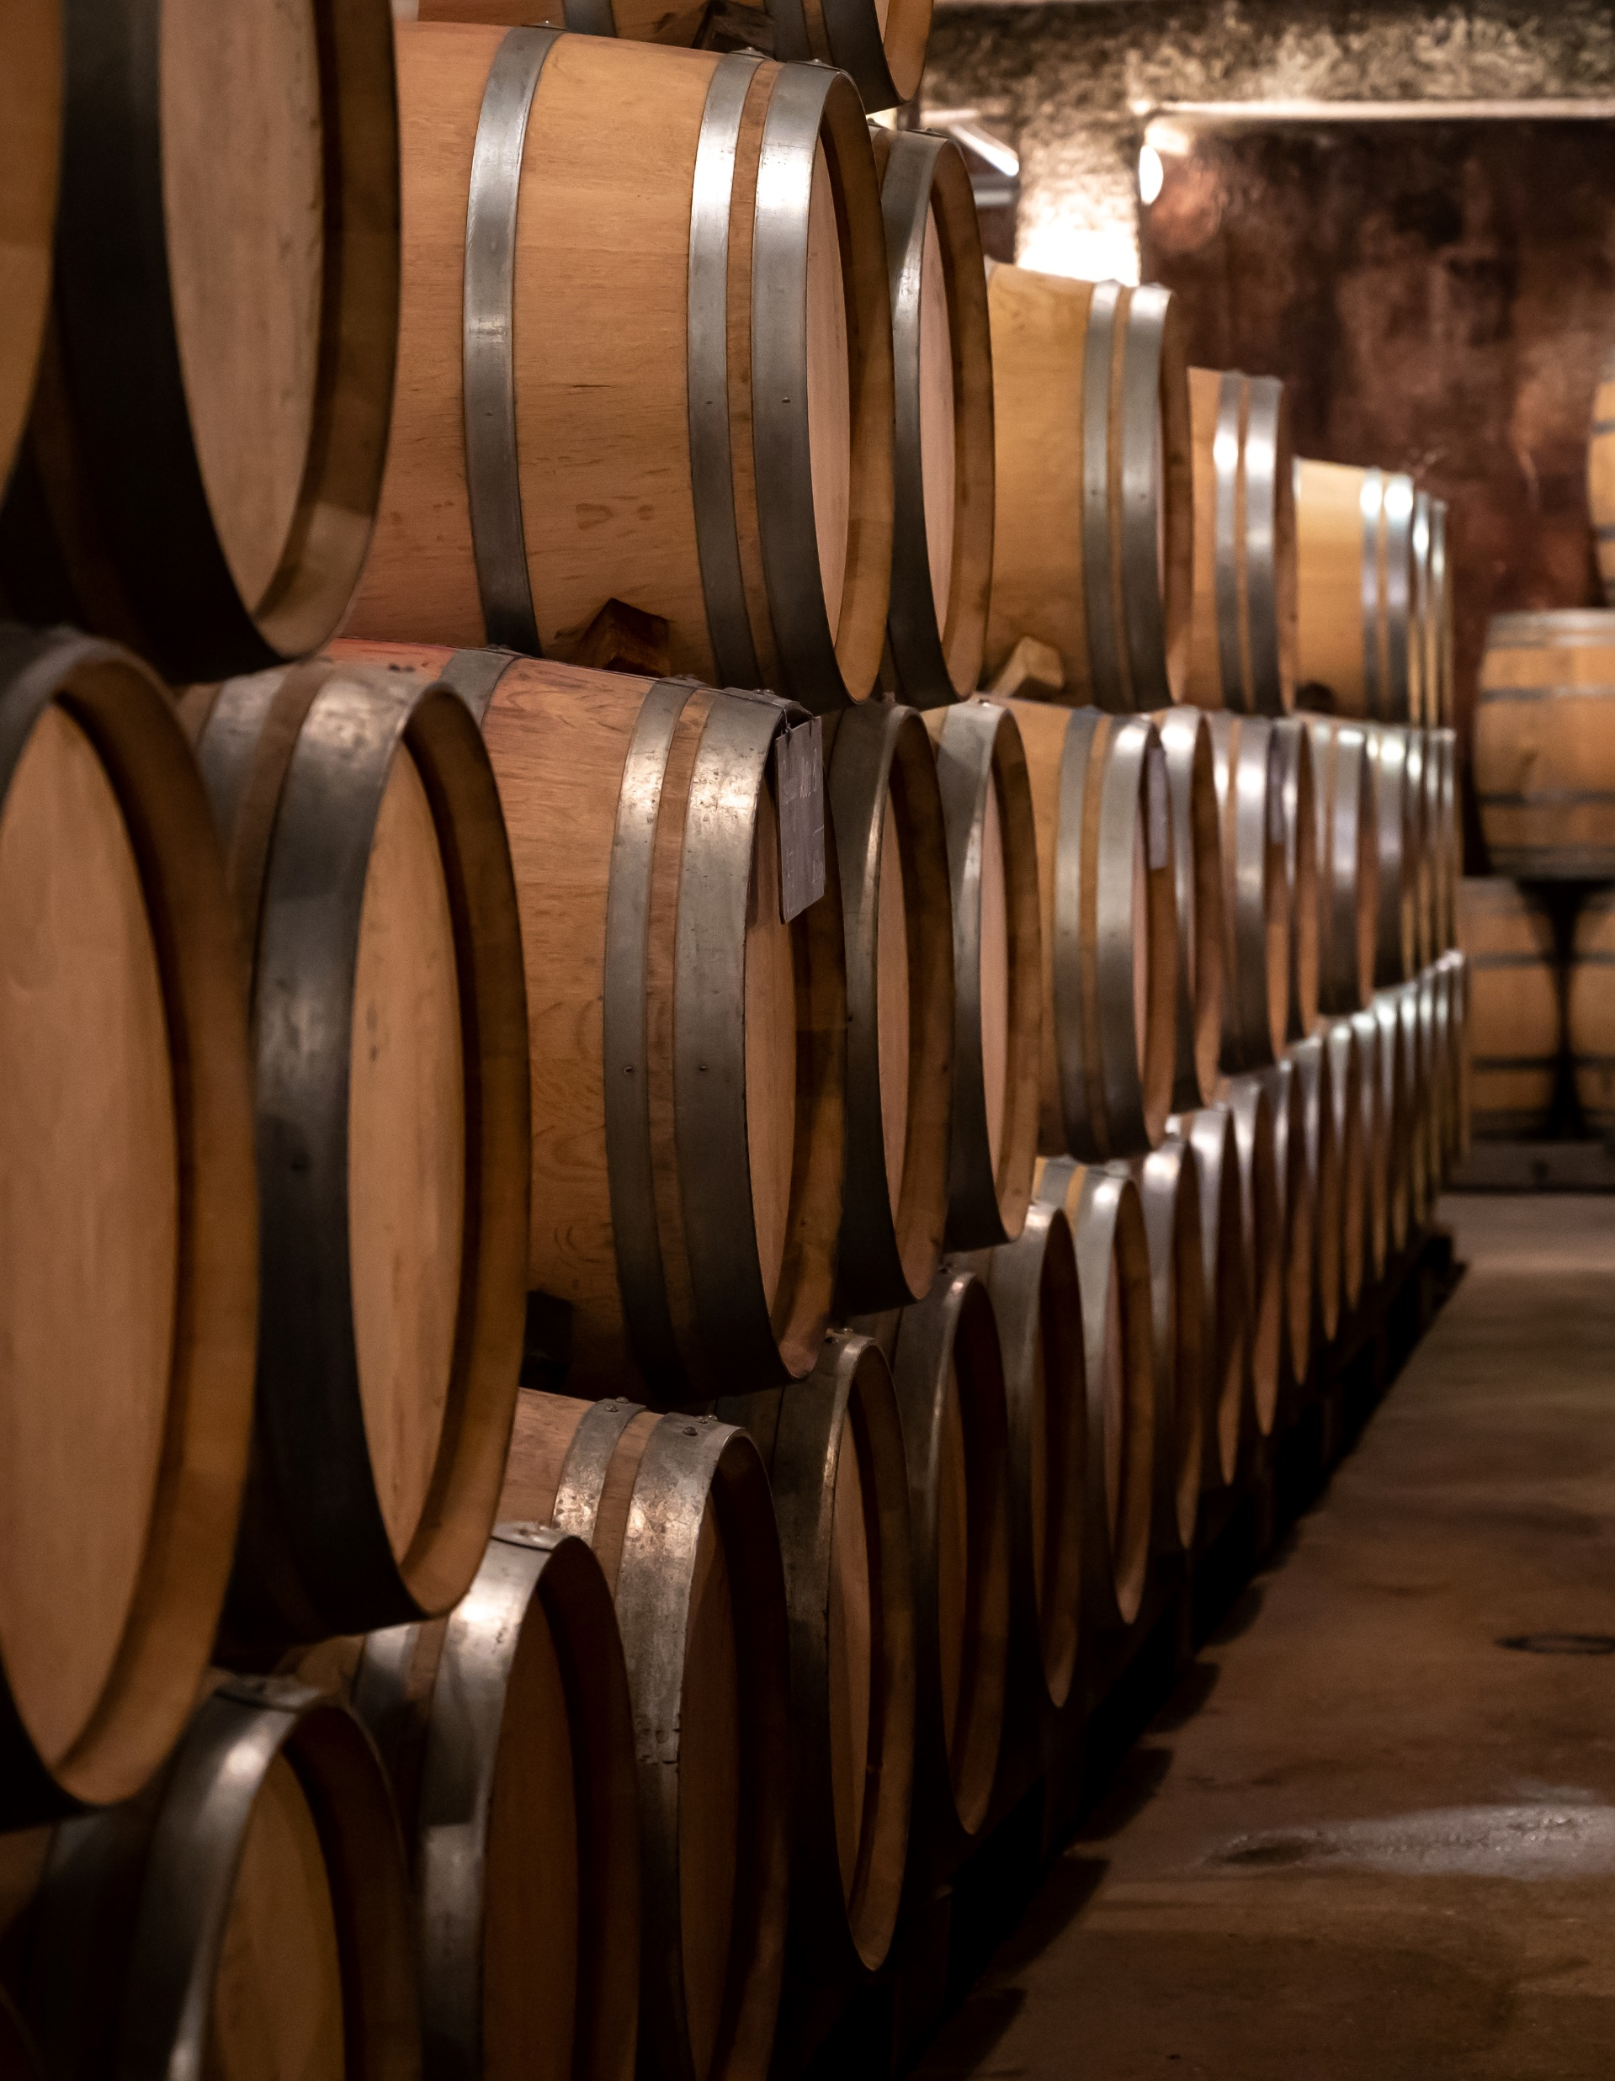
Ascendant® & Giga – Dehumidification
CHALLENGE:
Extreme dehumidification and precise is demanded by an application, to prevent contamination, corrosion, or spoilage during production or storage.
SOLUTION:
The Ascendant® has more than 3xs the dehumidification capacity of a DX cooling system.
Can provide dewpoints as low as 20°.
Dewpoints are tightly controlled with customized DDC controls, sensors and algorithms.
Notes:
Read from the slide

Slide 9
Ascendant Dehumidification Capacity
Dehumidification Capacity Comparisons
Notes:
gr 9.1 16.0 25 53
gr 55.9 65-49 65-40 65-67
dp 51.1 47.6 42 4.6
Since Ascendant can produce substantially drier air, the dehumidification capacity offered at a given airflow is many times greater than with cooling alone

Slide 10


Ascendant & Giga – Energy Savings
CHALLENGE:
Being able to achieve very low dewpoints without wasting energy and money.
SOLUTION:
The Ascendent expends 60% less tons of mechanical cooling than DX systems, to achieve very low supply air dewpoints.
Often, for several hours, no cooling is required to meet these dewpoints, with the only thing needed for dehumidification is the active desiccant wheel.
Leading to a substantial energy and first-cost savings.
Notes:
ASCENDANT™ achieves a high operating efficiency by utilizing conventional cooling where it is most efficient (cooling air to moderate temperatures) and active desiccant dehumidification where they are most beneficial and operates most efficiently (processing saturated air)

Slide 11
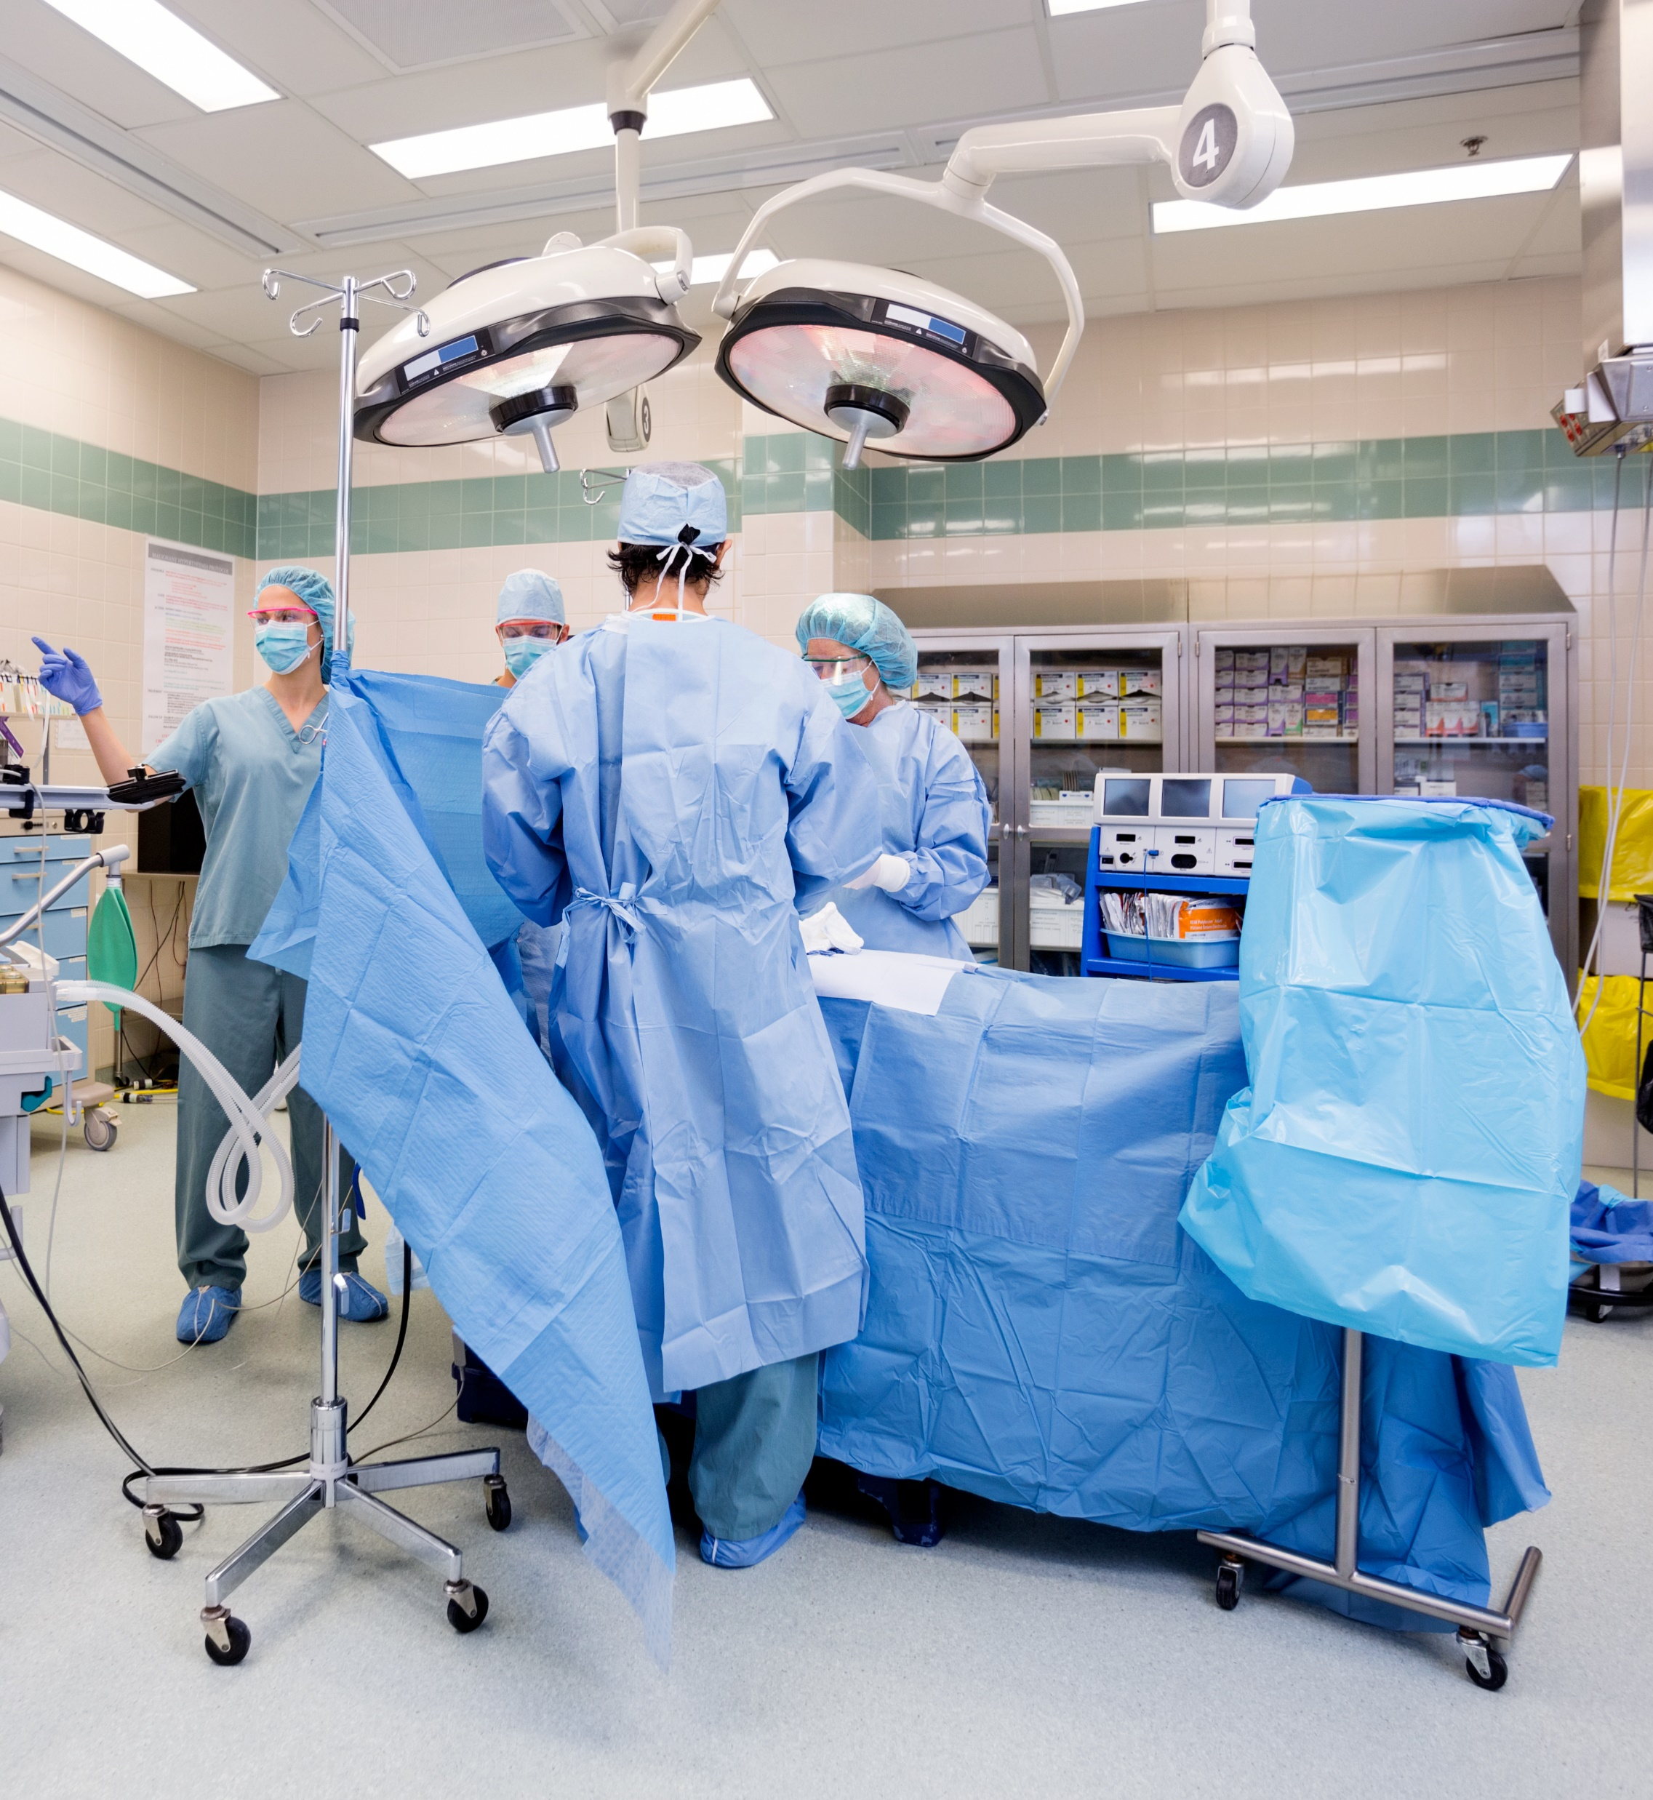
Ascendant – Healthcare Applications
CHALLENGE:
Healthcare facilities not only require strict temperature and dewpoint regulation, but also must eliminate airborne contaminants and odors.
SOLUTION:
The Ascendant comes with the option to add a True 3Å wheel in addition to the active desiccant wheel. Adding the True 3Å, virtually eliminates contaminant carry-over.
The Ascendant can simultaneously achieve and maintain standard operating room relative humidity at 50% ≥ relative humidity and a room temperature of 62˚ — unachievable with a chilled water system.
Notes:
Contaminant carry-over is 0.045%

Slide 12
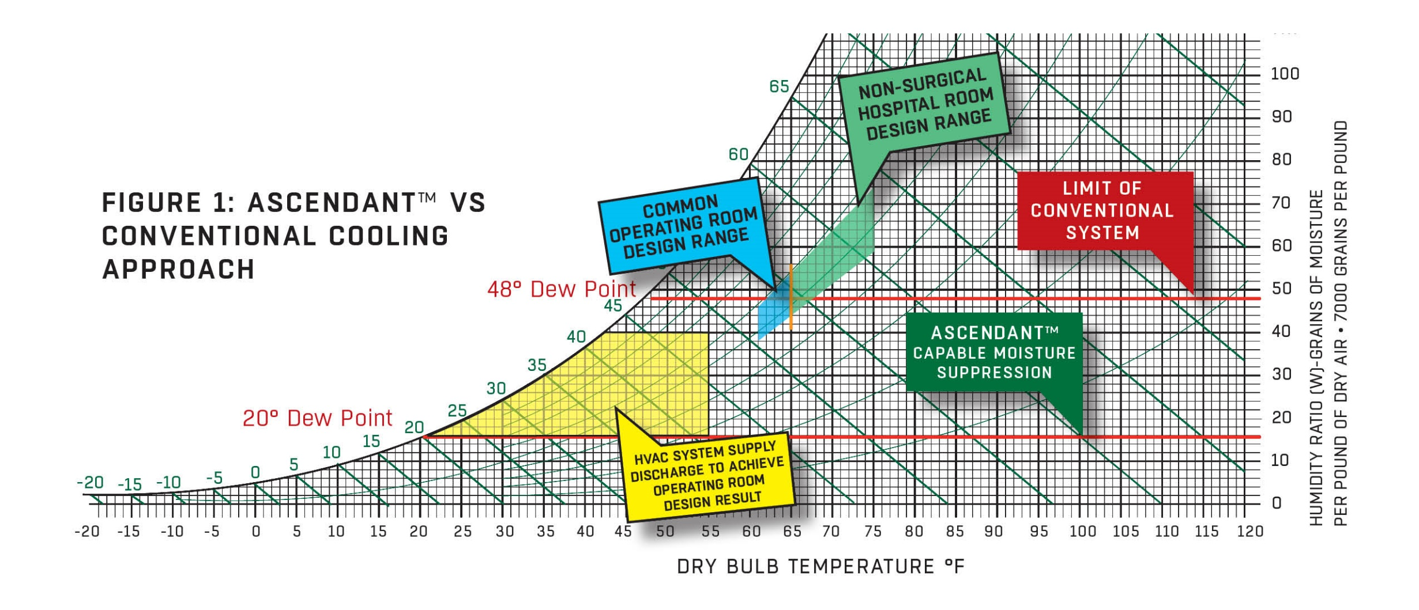
Low Dew point Spaces: Hospital

Slide 13
Ascendant & Giga Components

Slide 14
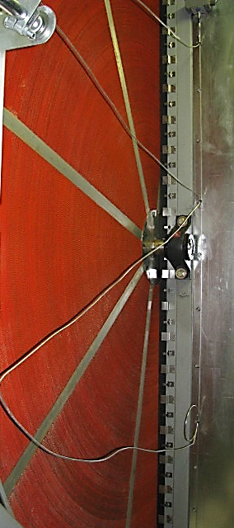
Ascendant - Active Desiccant Wheel
Effectively cycles moisture between 95% and 5% relative humidity (RH) to produce very low dewpoint air.
Non-metallic, fluted media constructed of glass fiber offers temperature stability and low heat transfer.
The heated regeneration airstream (20% - 40% of the supply airflow volume) heats up to 140°F - 200°F with the help of hot water, steam, a direct or indirect gas burner, or waste heat to remove relative humidity to less than 5%.
Very high desiccant loading — desiccant is 50% the weight of the wheel media.
Wheel speed typically 0.1 rpm vs 0.2 rpm

Slide 15

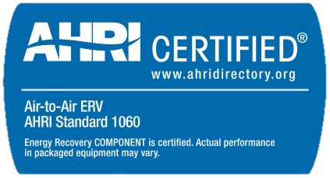
Ascendant - True 3Å (Optional)
Sensible & latent energy transfer
Substantially reduces the initial cost of the newly installed Ascendant and cuts down on chiller use.
Decreases cooling loads associated with outside air by 60%.
Limits contaminant carryover to 0.45%
Expected life greater than 20 years.
1,500 CFM – 70,000 CFM

Slide 16
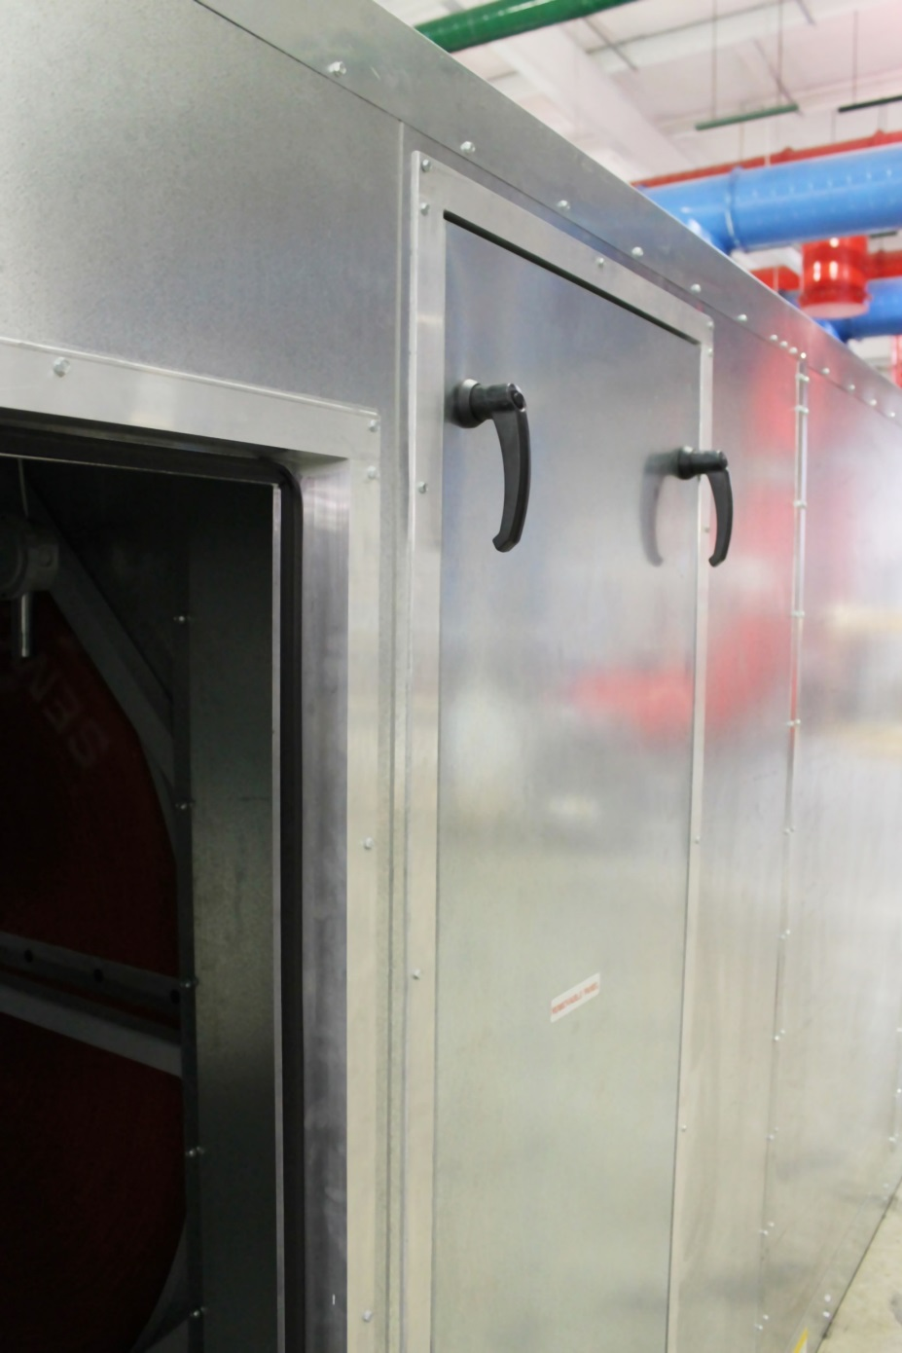
Ascendant - Panels
Double wall panels
  4 inch, high thermal resistance panel systems (R-15)
  18-gauge outer skin
  Eliminates exposed insulation and associated risk of bacterial growth
Double-wall removable panels provided for large internal components.
Gasketed double-wall access doors or removable panels for all compartments.
Welded structural steel base/floor, optional aluminum checker plate.

Slide 17
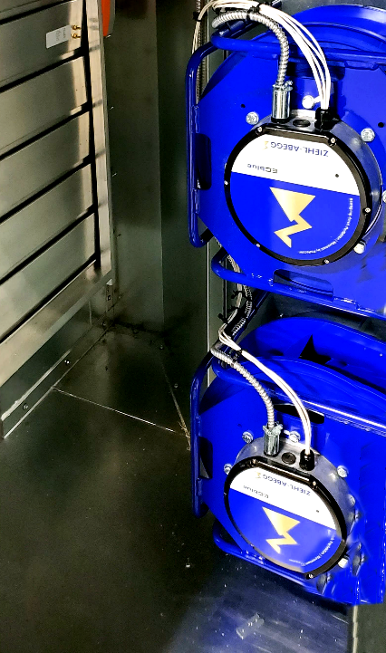
Ascendant - Fans
EC fans sized for quiet and efficient operation.
EC fans are built to include air-flow measuring.
No variable frequency drives (VFD) are required to control speed.
Requires minimal maintenance - effectively operating with low efficiency filters without impacting long term performance.
Optional:
Direct drive plenum supply and single inlet/outlet regeneration fans
Return fans for energy recovery systems

Slide 18
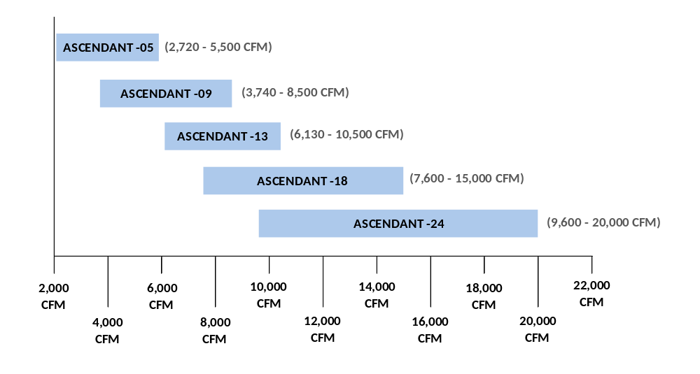
Airflow Capacity

Slide 19
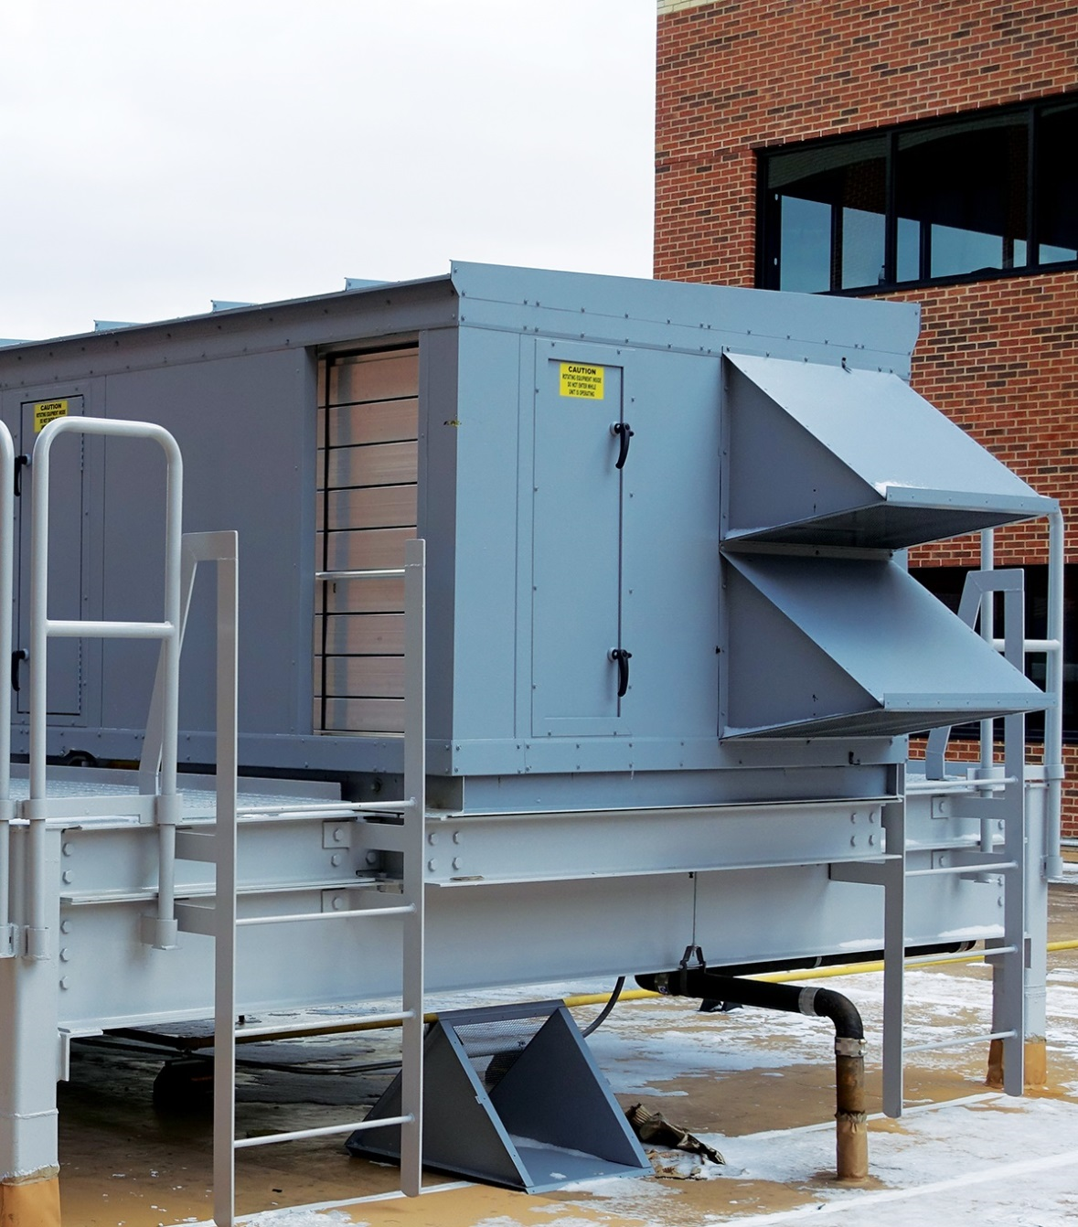
Ascendant - Hoods & Dampers
Modulating bypass damper
Low-leakage motorized fresh air damper and gravity exhaust air damper.
Outdoor units are provided with an intake and exhaust hood with bird screen
Optional:
Motorized exhaust damper available

Slide 20
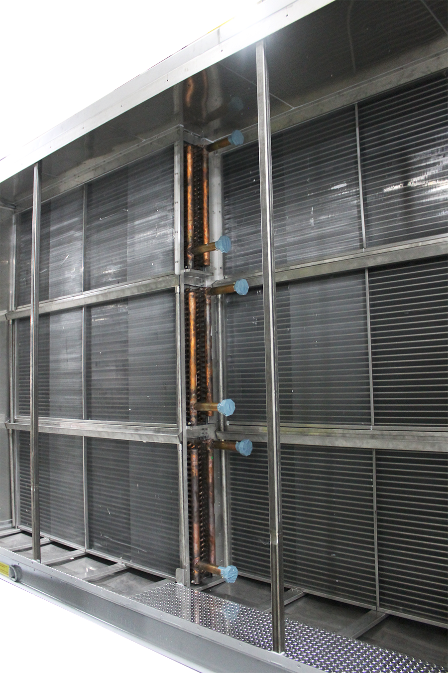
Ascendant - Heating & Cooling Options
DX or chilled water pre and/or post-cooling coils
Regeneration heat
  Hot water
  Steam
  Electric
  Gas (indirect or direct)
Process air heating options
  Hot water coil
  Steam coil, non-freeze type
  Electric coil (optional with separate electrical connection point)
  Indirect or direct gas burner

Slide 21
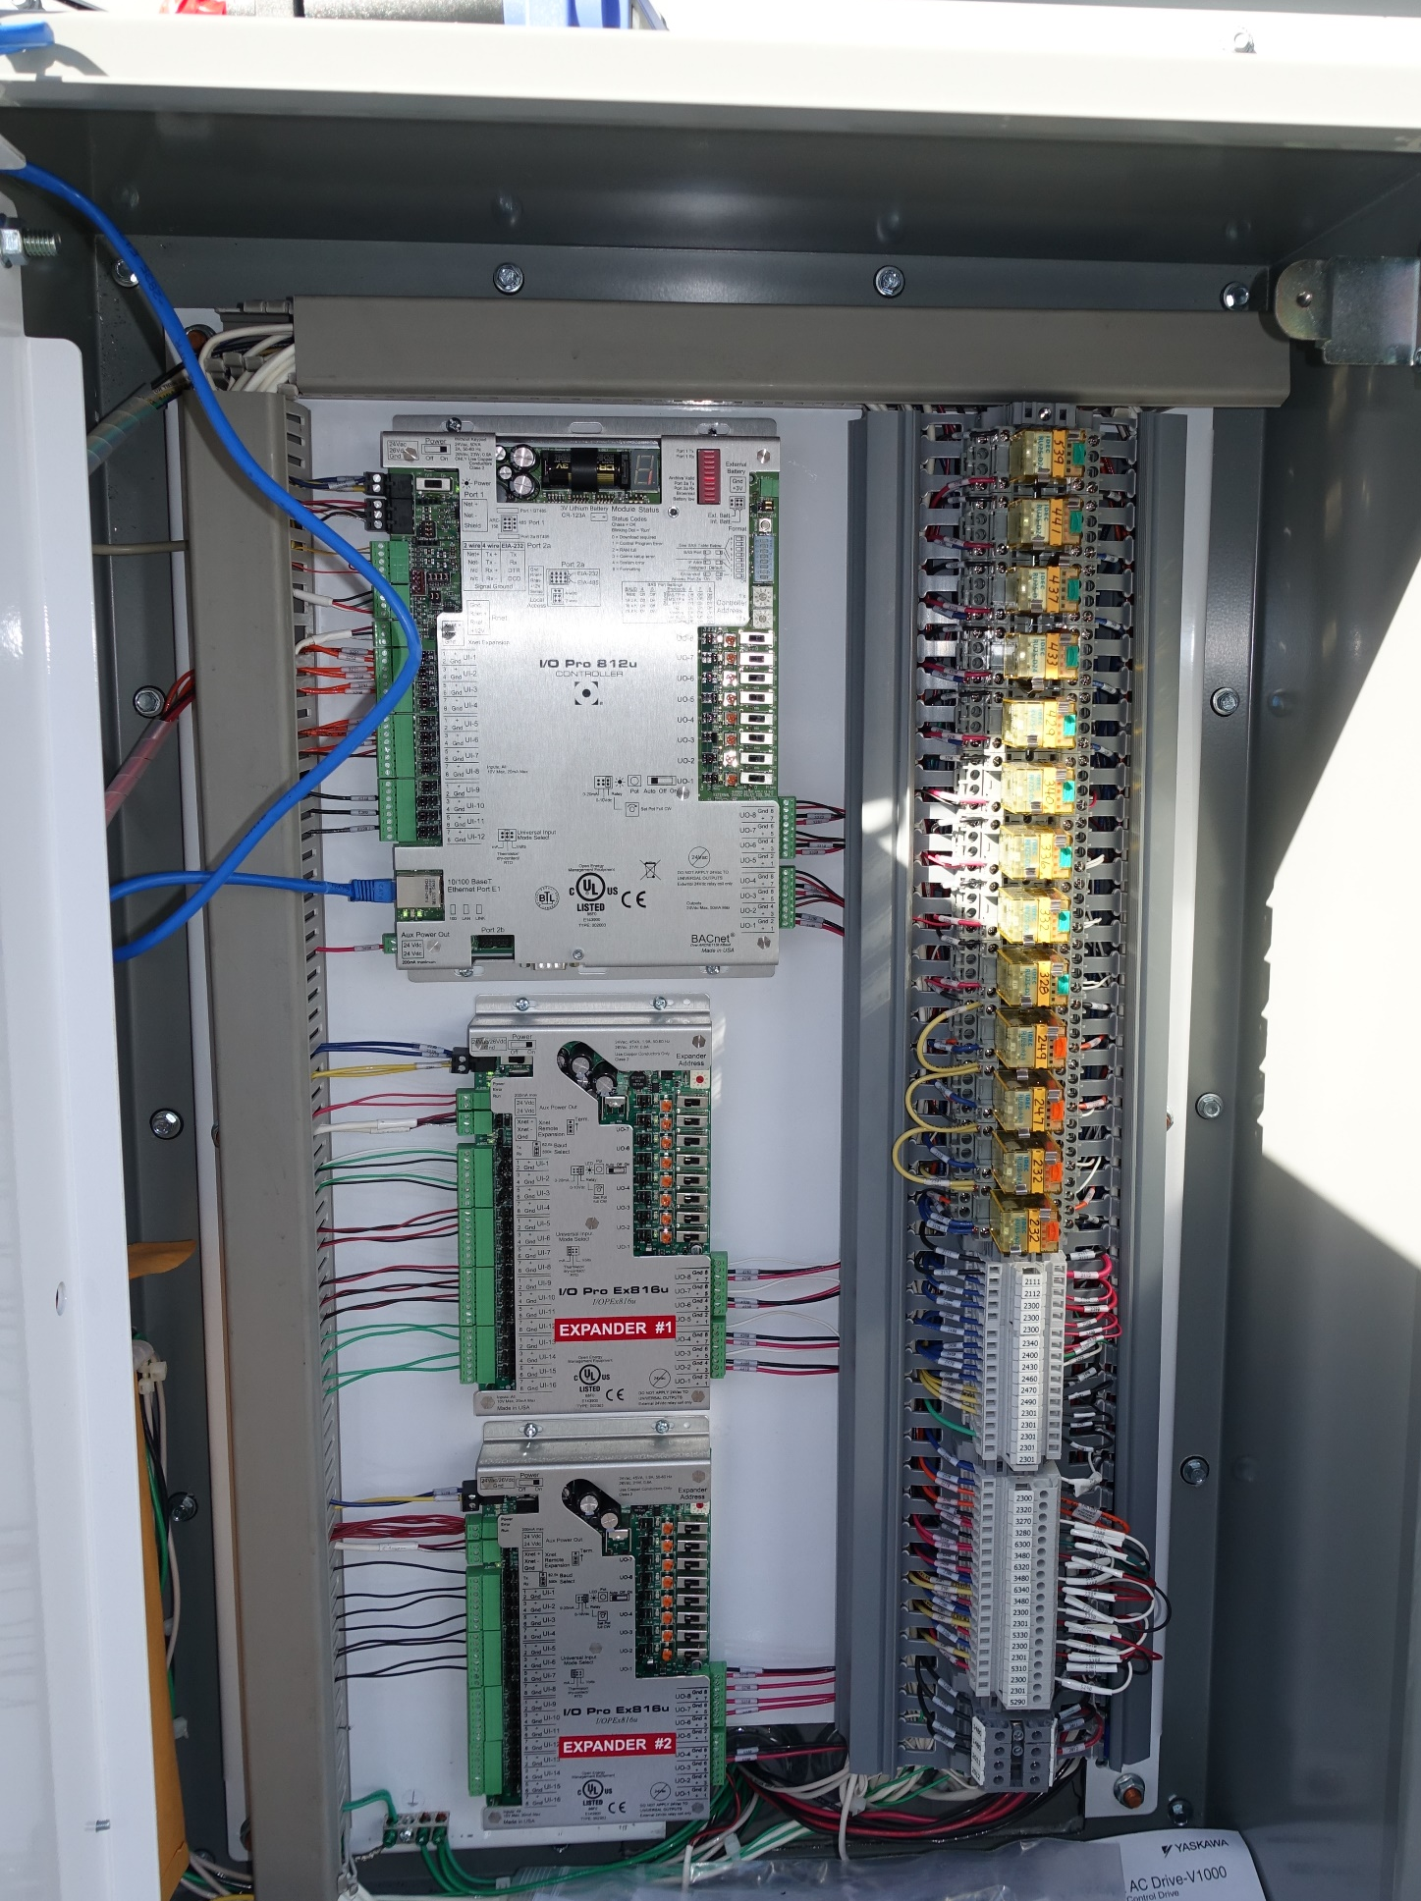
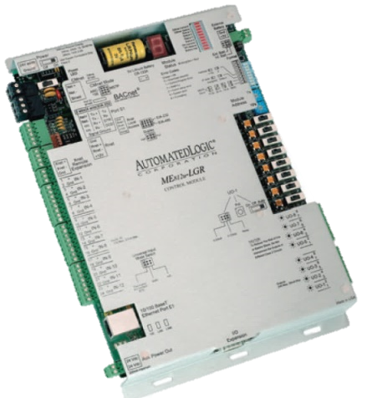
Ascendant - Controls Packages
Factory installed and tested advanced DDC controls and algorithms optimize performance achieve desired supply air humidity and temperature conditions while minimizing energy consumption
Five standard parameters that are controlled:
  The fraction of the supply airflow that is processed by the active desiccant wheel and the integral modulating bypass damper
  The temperature of the air leaving the pre-cooling coil
  The regeneration energy used (temperature)
  The supply airflow delivered
  The regeneration airflow utilized

Slide 22
Ascendant - How it Works

Slide 23
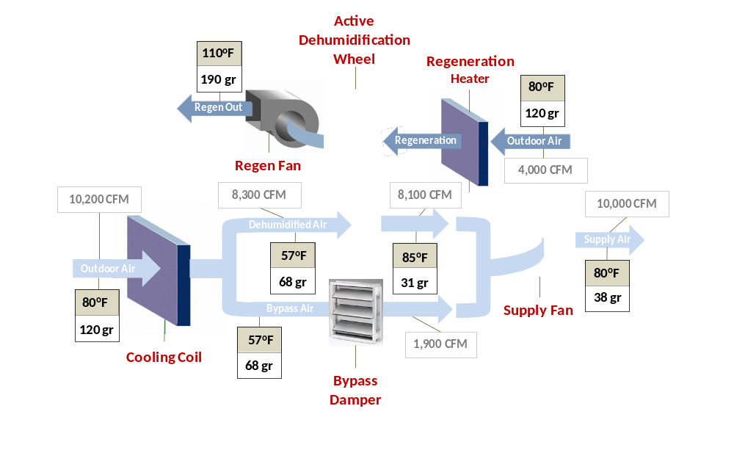
Ascendant - How It Works
Notes:
The benefits of green design can be summarized as follows:
The local and global environment benefits from protecting air quality, water quality, and overall biodiversity and ecosystem health.
Economic benefits are experienced in building operations, asset value, worker productivity, and the local economy.
Occupants benefit from health and safety features. This also relates to risk management and economics. The U.S. EPA found that average Americans spend more than 90% of their time indoors, and indoor air quality can be two to five times worse than outdoor air quality.¹
Community and municipal benefits include: lessened demand for large-scale infrastructure such as landfills, water supply, stormwater sewers, and their related development and operational costs; and decreased transportation development and maintenance burden (roads) and increased economic performance of mass transit systems.
Footnotes:
1. U.S. EPA Office of Air and Radiation, 1989, Report to Congress on Indoor Air Quality, Volume II: Assessment and Control of Indoor Air Pollution.

Slide 24
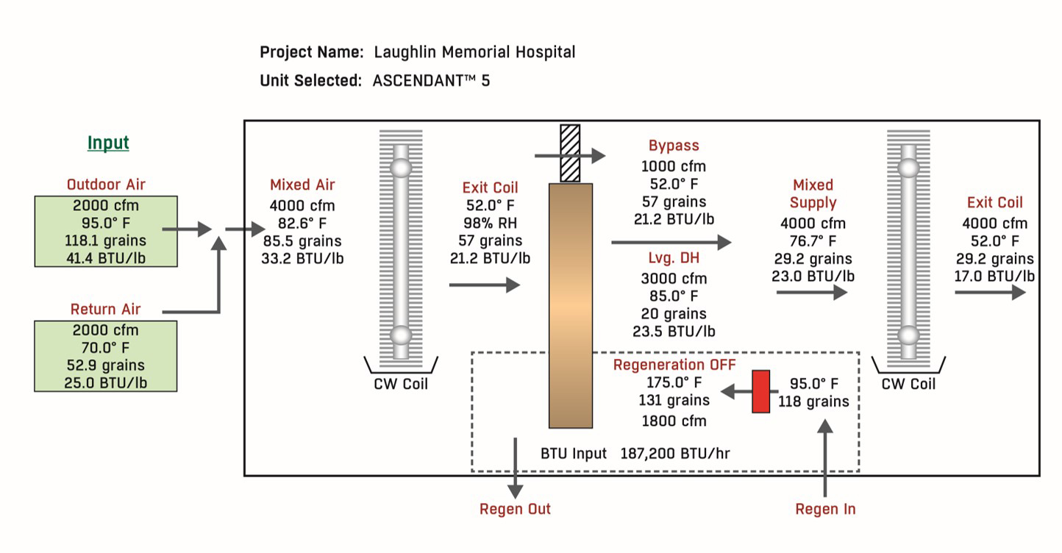
Ascendant - Example Performance

Slide 25
Ascendant - Configurations

Slide 26
Ascendant: Layout Configurations
Preconditioning Configuration
Delivers dehumidified outdoor air to other air handling units.
Most compact configuration.
Total Conditioning Configuration
Incorporates post cooling and final high efficiency filtration to allow for independent control of both temperature and humidity, providing total conditioning to spaces like laboratories or large operating theaters.
Preconditioning Configuration with Integrated Total Energy Recovery
Adds the benefit of total energy recovery for more energy efficient operation.
Provides preheat and humidification during the heating season.

Slide 27
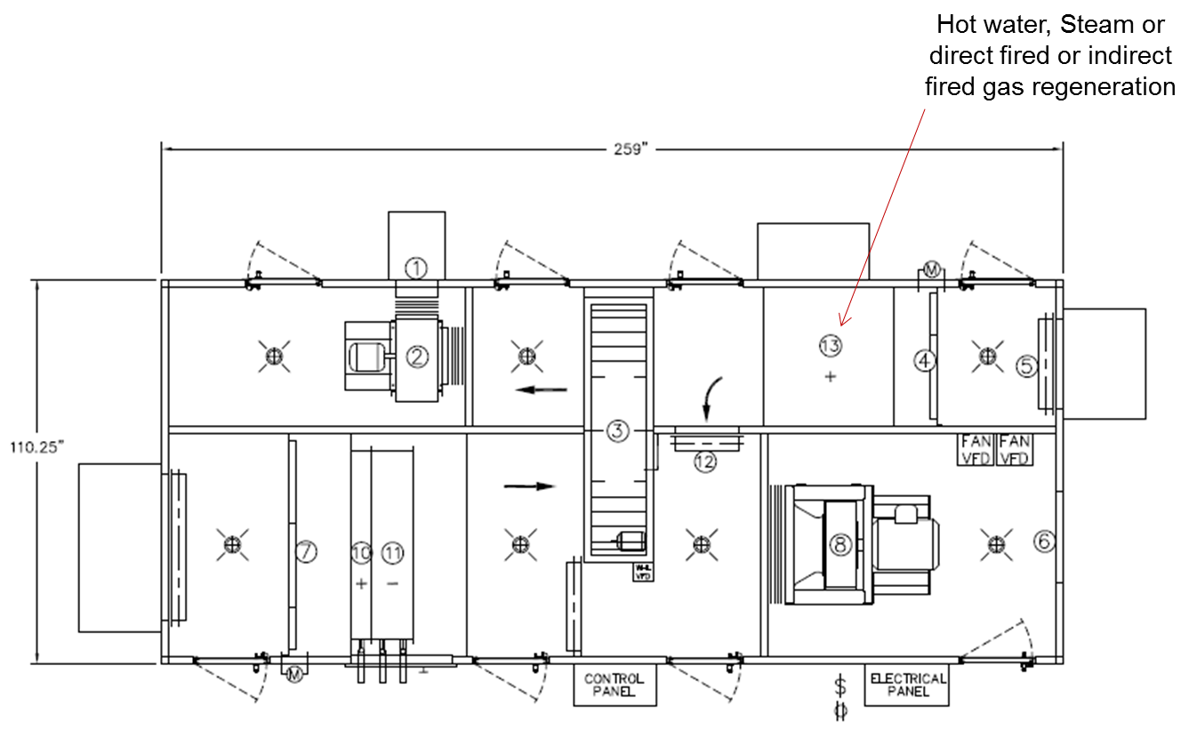
Ascendant - Basic Layout #1
Dedicated Outdoor Air System/Make Up Air Units
Exhaust Air Damper
Exhaust Air Fan
Active Desiccant Wheel
Regen Air Filtration
Regen Inlet Damper
Supply Air Connection
Outdoor Air Filter
Supply Air Fan
Wheel Bypass Damper
Heating Coil
Pre-Cooling Coil
Bypass Damper
Regeneration Heating Source

Slide 28
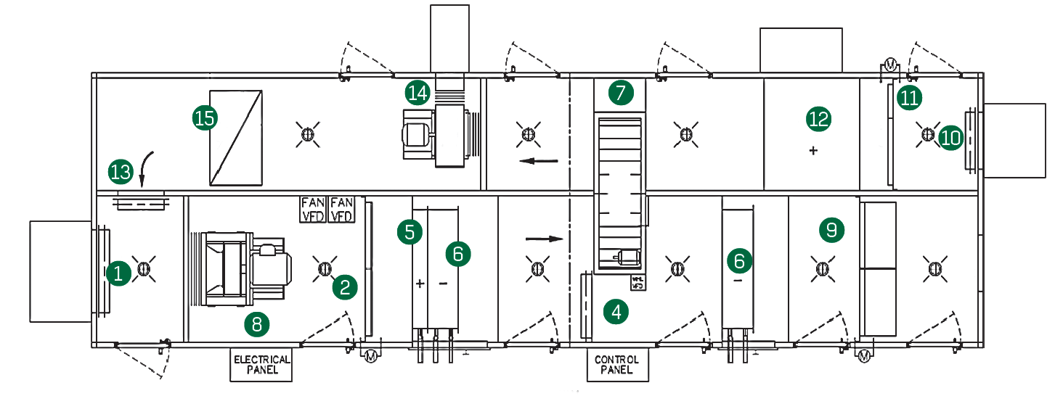
Ascendant - Basic Layout #2
Total Conditioning
Designed for Partial outside air or 100% O/A
100% Economizer Feature can be incorporated
1 Outdoor Air Damper
2 Outdoor Air Filter
3 Optional True 3Å Wheel
4 Wheel Bypass Damper
5 Heating Coil
6 Pre & Post Cooling Coil
7 Active Desiccant Wheel
8 Supply Air Fan
9 Final Filtration
10 Regen Inlet Damper
11 Regen Air Filtration
12 Regeneration Source
13 Recirculation Damper
14 Regen Fan
15 Optional Return Air Opening

Slide 29
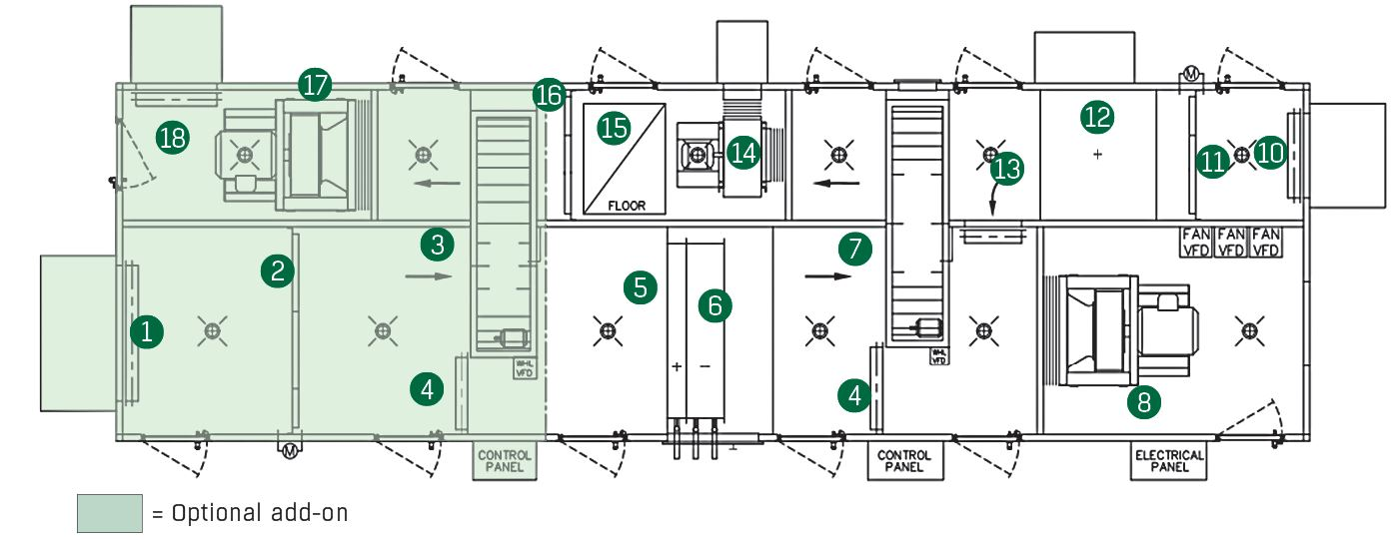
Ascendant - Basic Layout #3
Optional Integrated Total Recovery
1 Outdoor Air Damper
2 Outdoor Air Filter
3 Optional True 3Å Wheel
4 Wheel Bypass Damper
5 Heating Coil
6 Pre & Post Cooling Coil
7 Active Desiccant Wheel
8 Supply Air Fan
9 Final Filtration
10 Regen Inlet Damper
11 Regen Air Filtration
12 Regeneration Source
13 Recirculation Damper
14 Regen Fan
15 Optional Return Air Opening
16 Return Air Filtration
17 Exhaust Air Fan
18 Exhaust Air Damper
Could Designed for Partial outside air
100% Economizer Feature can be incorporated

Slide 30
Comparisons

Slide 31
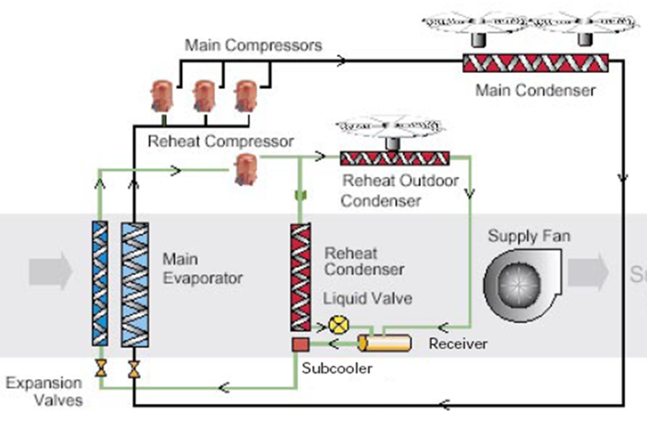
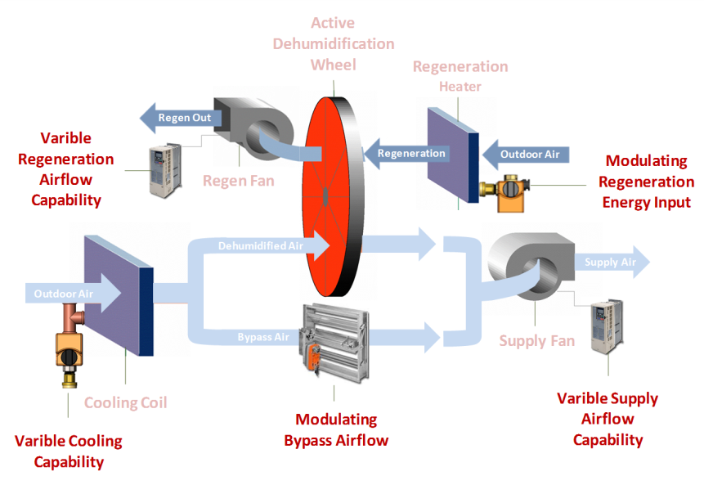
Comparing Custom DX and Ascendant
Custom DX units have a limited cooling capacity, because supply dew points are determined by the air leaving the cooling coil.
It is possible for DX units to deliver dew points as low as 45ºF, but this comes at a much higher cost than the Ascendant due to compressor inefficiency, capacity control issues, and potential coil frosting at partial load conditions.
Comparatively, the Ascendant, can deliver low dew points and operate efficiently using moderate coil leaving conditions (traditional chilled water conditions) and low regeneration energy input.
Custom Vapor Compression DOAS
Ascendant (optimized cooling/active desiccant)

Slide 32
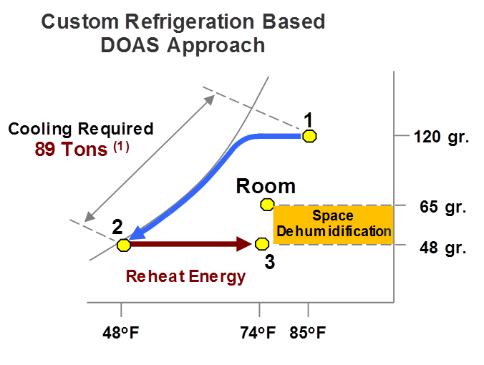
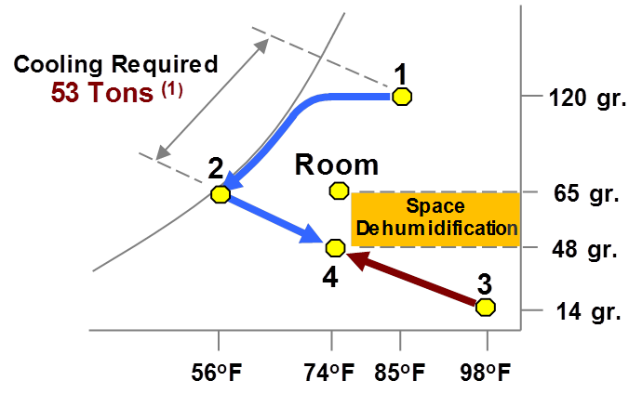
Comparing Technologies at Same Supply Conditions
Ascendant Approach
Custom DX Systems require 89 tons of compressor input. These compressors run inefficiently due to low suction conditions required
Capacity/frost control can be problematic at part load conditions
Operating cost/hour at condition shown $7.12 based on $.08/KWH
Ascendant only requires 53 tons of compressor input, and its compressors run efficiently due to high leaving coil air and suction temperatures
Regeneration energy required is 185,000 BTUs
Operating cost/hour at condition shown $5.40 based on $.08/KWH, $5.00/mm BTU (25% less than DX)
Note 1: Reflects 10,000 cfm systems, tons shown reflect suction temperature de-rate

Slide 33
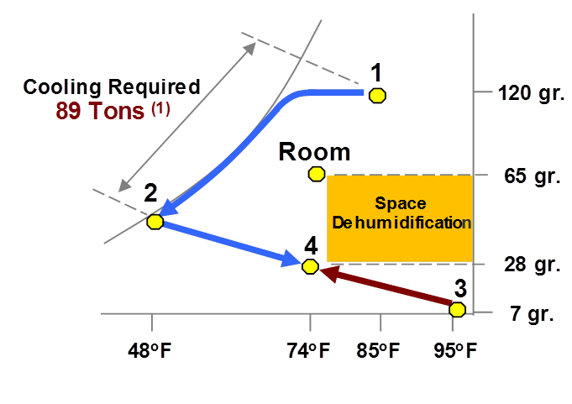
Comparing Technologies Using the Same Cooling Tons
Ascendant Approach
Custom DX Systems when operated to process the maximum dehumidification load provides 9.6 tons of space latent capacity
10,000 cfm * .68 * (65 gr -48 gr)/12,000 BTU/ton
Capacity/frost control can be problematic at partial load conditions
Ascendant when operated to process the maximum dehumidification load (using same cooling tons) provides 21 tons of space latent capacity and allows for very low space dew point/RH conditions
10,000 cfm * .68 * (65 gr -28 gr)/12,000 BTU/ton
Humidity conditions as low as 15 grains can be delivered with less bypass and reduced system flow
Note 1: Reflects 10,000 cfm systems, tons shown reflect suction temperature de-rate

Slide 34
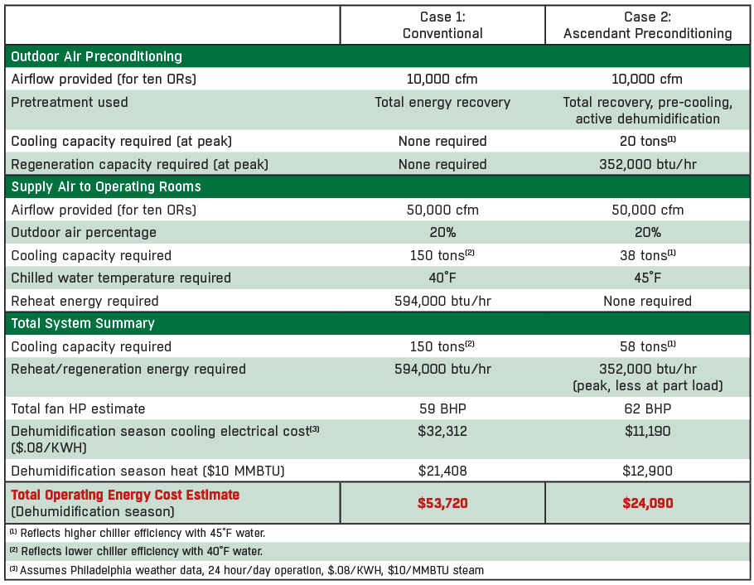
Energy Cost Comparison: Conventional vs. SEMCO Ascendant

Slide 35
Applications

Slide 36
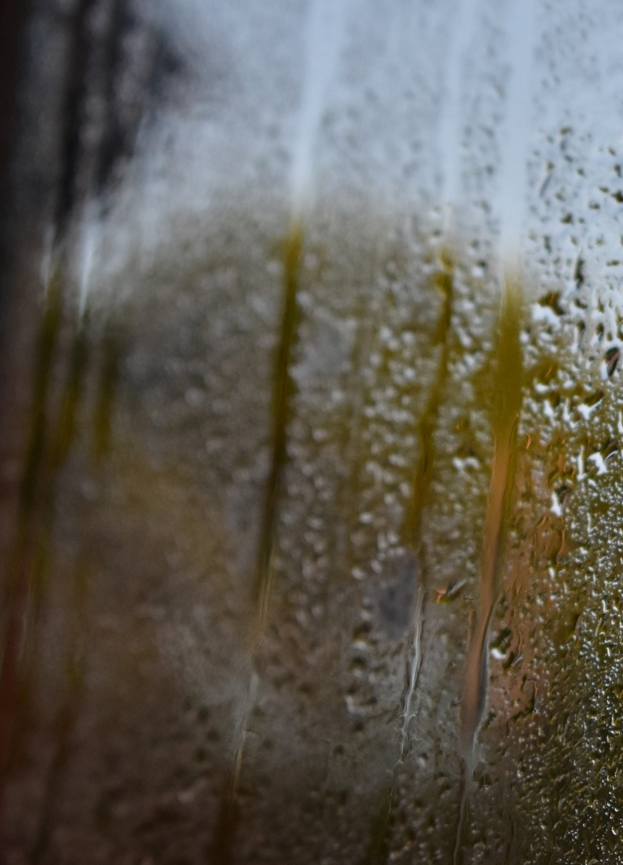
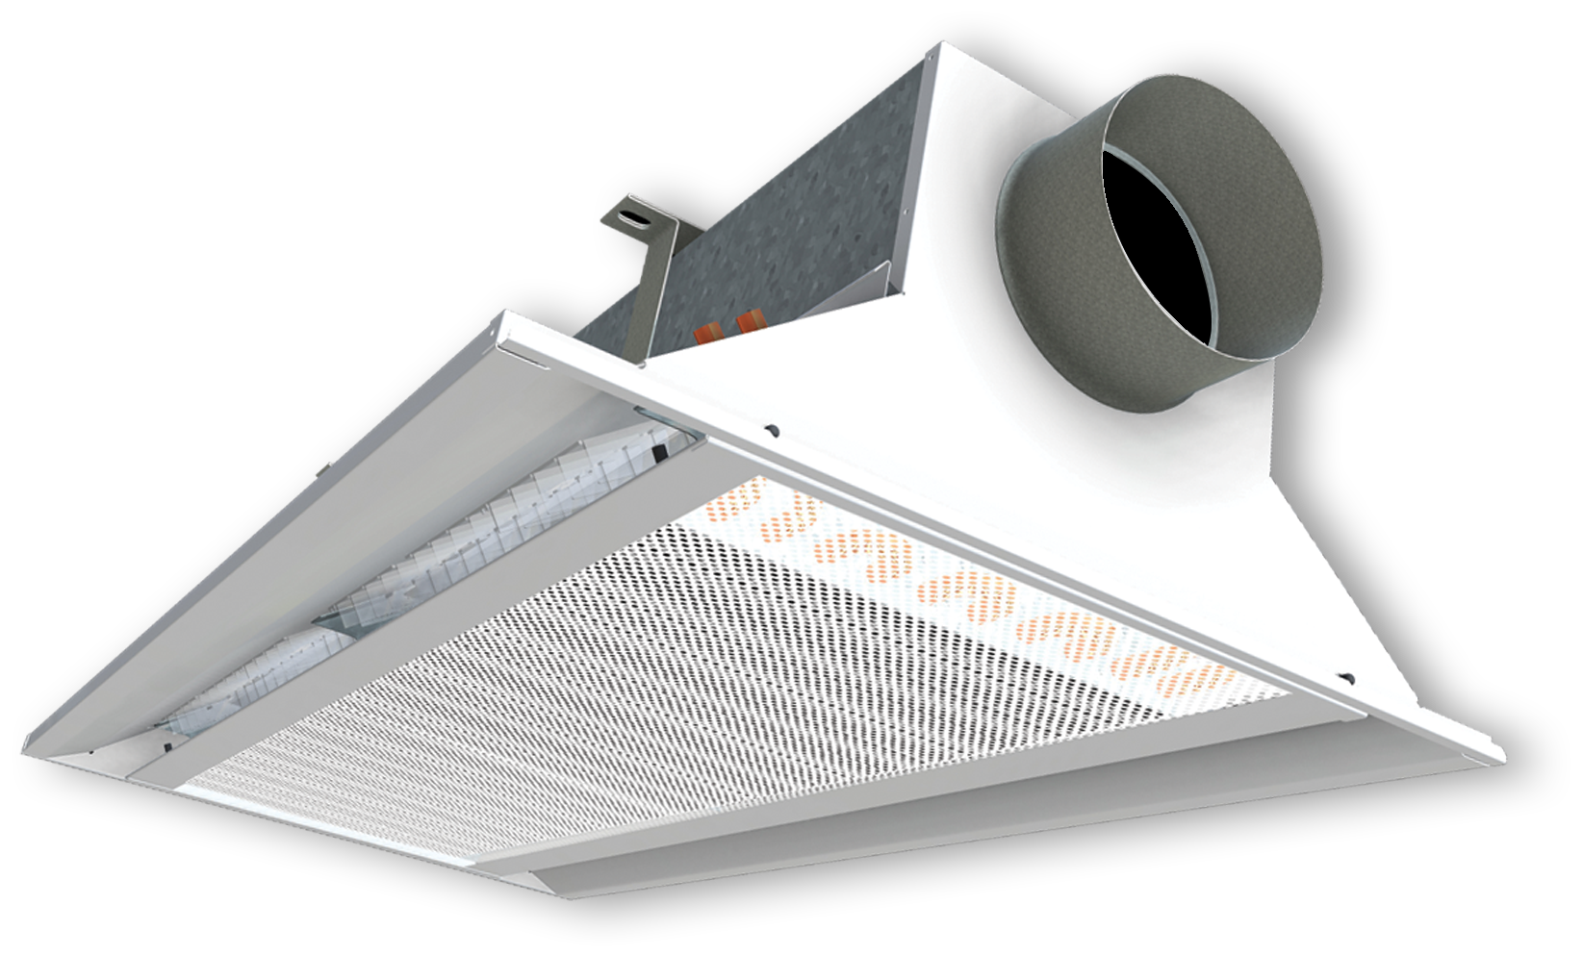
Chilled Beam Installations: Condensate Avoidance
Chilled beams can be used for sensible cooling only, not dehumidification.
Latent loads will need to be treated by an energy recovery system.
The latent load must still be resolved with supply air. The drier the air the less of it is required to remove moisture resulting in lower all-around energy use.
Ascendant can process three times the latent load of a custom refrigeration-based DOAS allowing it to prohibit beam condensation using the minimum possible outdoor air quantity.
Notes:
The Carnegie Mellon Intelligent Workplace employed Ascendant to dehumidify ventilation air to solve condensation issues on their passive chilled beams experienced before with a more conventional system

Slide 37
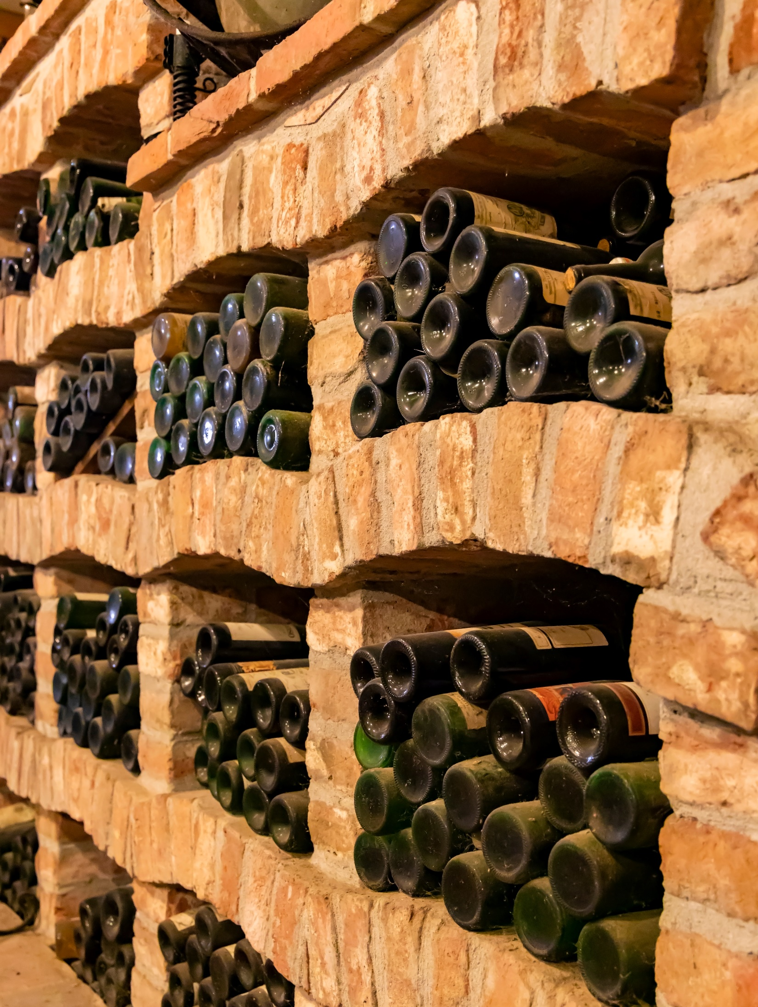
Dry Air Storage: Warehouse, Cave Storage, etc.
Untreated warehouses, cave storage, etc. can result in high RH conditions with potential condensation, ruining stored items.
Heating and cooling of these spaces is not always necessary if humidity is dealt with properly.
If warm, very dry air can be delivered to these spaces, it can substantially reduce any operating costs.
The Ascendant provides the dehumidification necessary with the smallest airflow.
Notes:
Since Ascendant can produce substantially drier air the dehumidification capacity offered at a given airflow is many times greater. As a result it can typically be operated with only one third to one forth the airflow required by more conventional systems

Slide 38
Dry Air Storage: Warehouse, Cave Storage, etc.
Dehumidification Capacity Comparisons
Example: A cave storage application requires dehumidified outdoor air to handle 360,000 BTUs of latent load, as well as for building pressurization.
They can use ONE 10,000 cfm Ascendant or FOUR 9,000 cfm custom DX cooling/reheat units.
The 4 custom DX units require 335 kW of energy input, while the Ascendant required only 100 kW plus 0.5 MMBTU of regeneration energy.
First cost is less for Ascendant - only one unit is needed, it requires smaller ductwork, and far less connected load.
Notes:
gr 9.1 16.0 25 53
gr 55.9 65-49 65-40 65-67
dp 51.1 47.6 42 4.6
Since Ascendant can produce substantially drier air, the dehumidification capacity offered at a given airflow is many times greater than with cooling alone

Slide 39
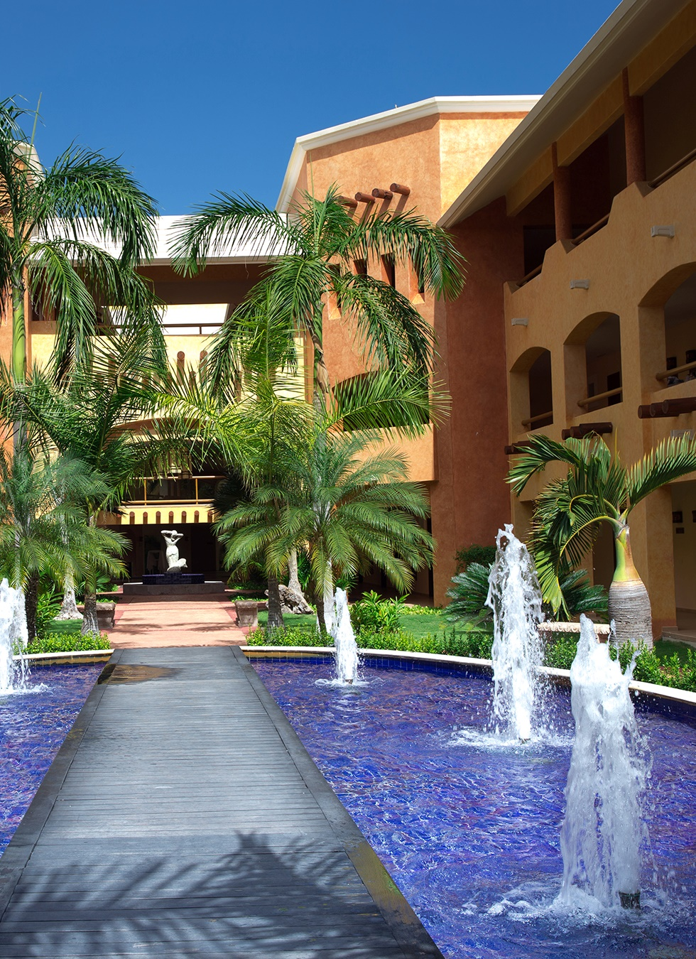
Drying Ventilated Air: Hotels/Condominiums
In humid climates, hotels and condos with ventilated air and infiltration tend to have very high latent loads.
Employing conventional heat pumps and fan coil units won’t properly process the latent load, especially when spaces are unoccupied. To compensate, units often tend to be oversized.
Using an Ascendant allows the ventilated air to control space humidity regardless of the internal sensible load.
With the Ascendant deep drying the ventilated air, packaged cooling units can be downsized, reducing the size of ductwork, noise, and energy consumption.
Notes:
Ascendant delivers extremely dry outdoor air to each hotel room/living space to manage the high infiltration load in hot/humid locations - improving comfort, extending the life furnishings and greatly reducing the risk of mold and mildew

Slide 40

Tight Humidity Control: Archives/Museums/Libraries
Maintaining RH at approximately 50%, preserves documents, artwork, and artifacts, helping to avoid any “preventable” premature damage.
Humidity spikes can cause chemical reactions accelerating deterioration.
Ascendant systems with post cooling will carefully track space conditions and use DDC controls regulate them, so low humidity levels will remain consistent.
Notes:
Ascendant has the capacity to deliver air dehumidified over a wide range to handle fluctuations in latent loads associated with infiltration and the on-board DDC controls and post cooling coil can track changes to ensure a steady and consistent indoor relative humidity

Slide 41
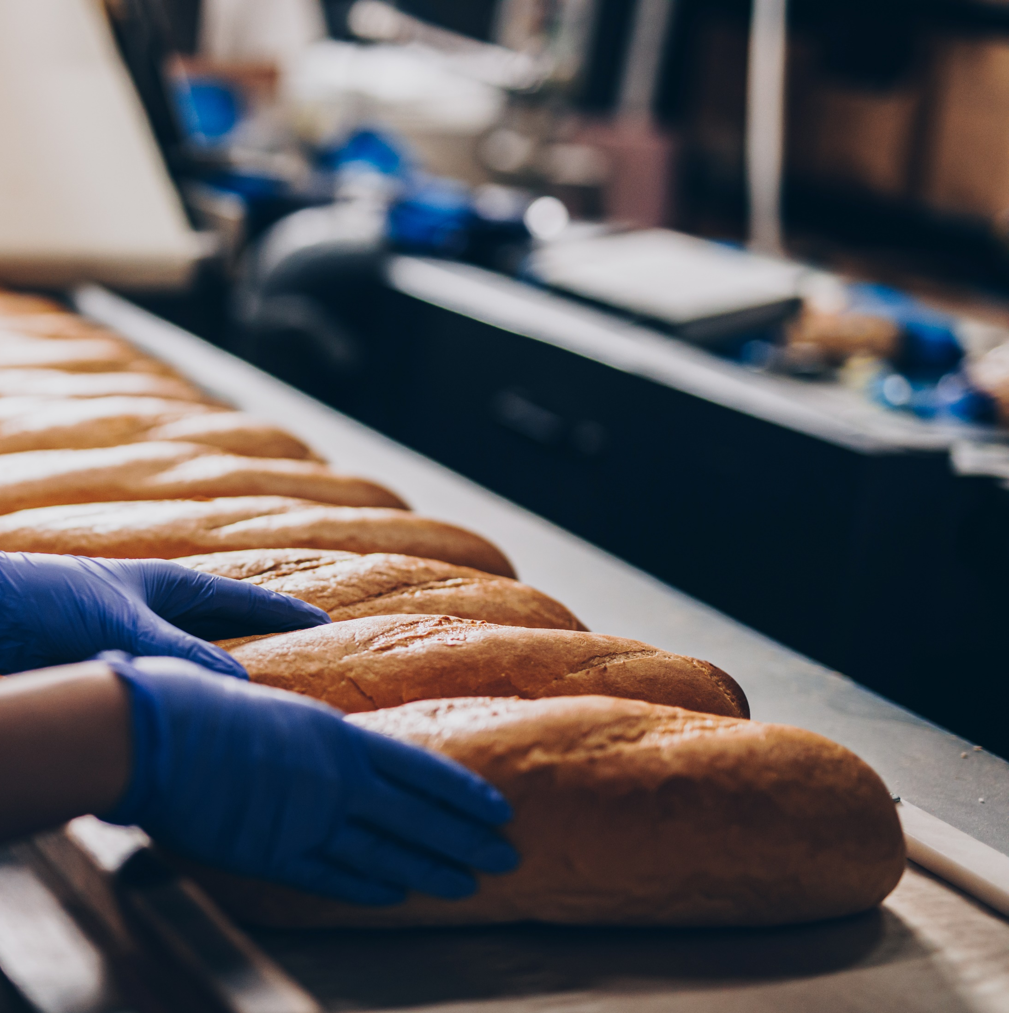
Other Targeted Industries
Hospital operating theaters
Code requires 50% RH even at 65 deg.
(45 deg dew point)
Clean rooms
Lower dew point provides maximum
DH capacity at min flow
Precision glass manufacturing
Tight humidity control
Food industry
Yeast production dry room
Hospital autoclave/sterilization room
Condensation prevention
Ophthalmology laboratory/manufacturing
Tight humidity control
School facility
Humidity control for mold remediation

Slide 42

Thank you for your attention!

