Slide 1
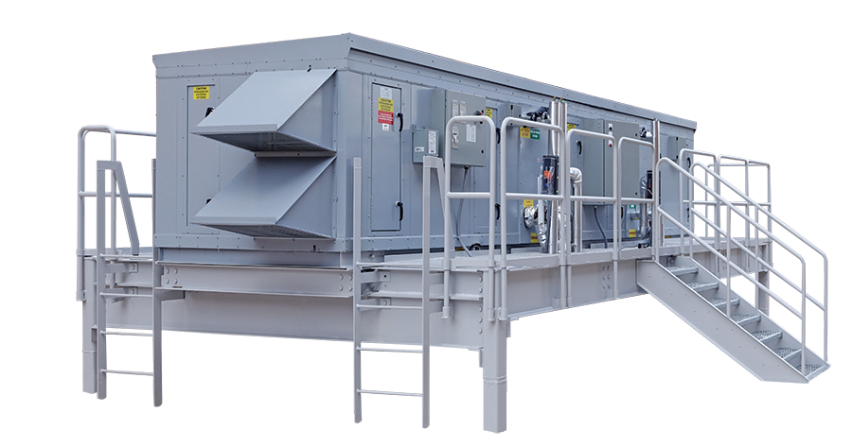

ASCENDANT® & GIGA
Active Dehumidification

Slide 2

Corporate Overview

Slide 3
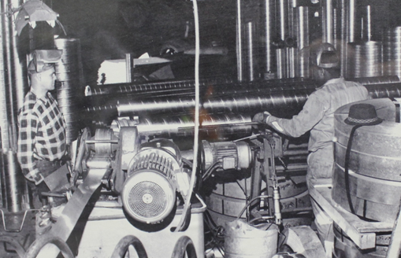
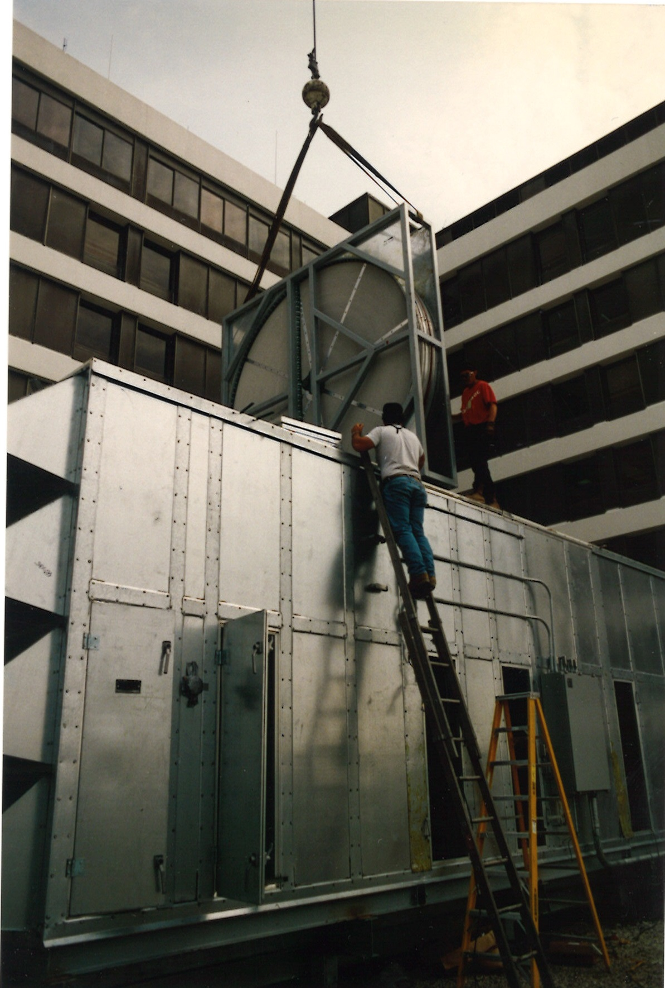
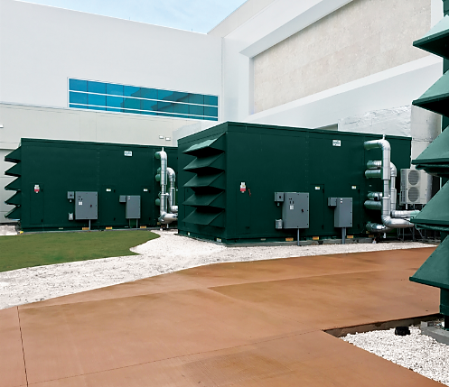






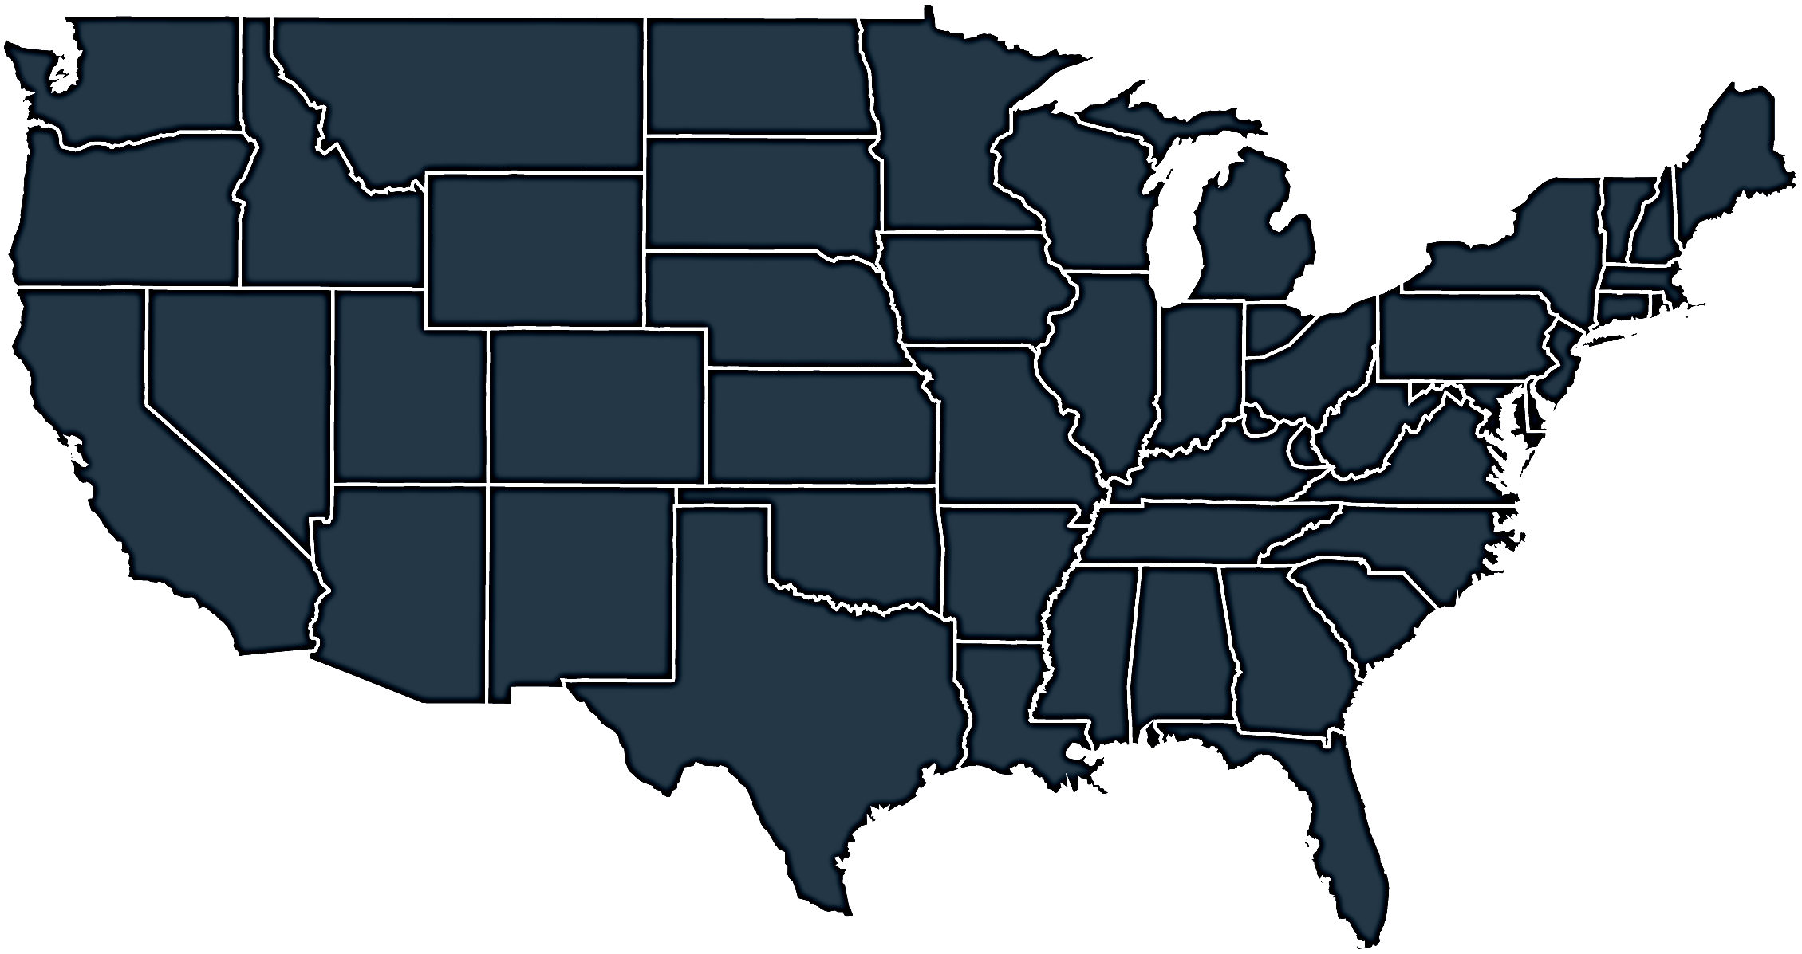


Who we are & what we do
Energy
& Environmental
Focus
Patented &
Certified
Products
U.S & Global
Footprint
Engineered
Air Quality &
Data Center
Solutions
Engineered
Air Distribution
& Sound
Solutions
OEM,
Key Account &
Sales Rep
Route To Market
Service
& Support
Award Winning
& Industry
Recognized
Notes:
In 1963 Salisbury Engineering and Manufacturing Company (SEMCO) was born in Salisbury, MO.
Began as SEMCO -- small sheet metal fabricator specializing in duct.
In the 59 years, evolved into a multi-million dollar company with a large product offering.
Headquartered in Columbia, MO, with 275,000 sq ft of manufacturing space in 3 plants in Arkansas and Virginia
We are a business unit of FläktGroup, and we are owned and backed by Triton Partners—which is a $17 billion annual revenue investment firm.
Innovation is core at FläktGroup SEMCO.
Certified by AHRI, SEMCO was won numerous awards – including multiple AHRI Innovation, Green Building, Dealer Design, School/College Planning & Management Awards
Hold numerous patents and trade secrets for our industry leading energy recovery wheels and systems.

Slide 4

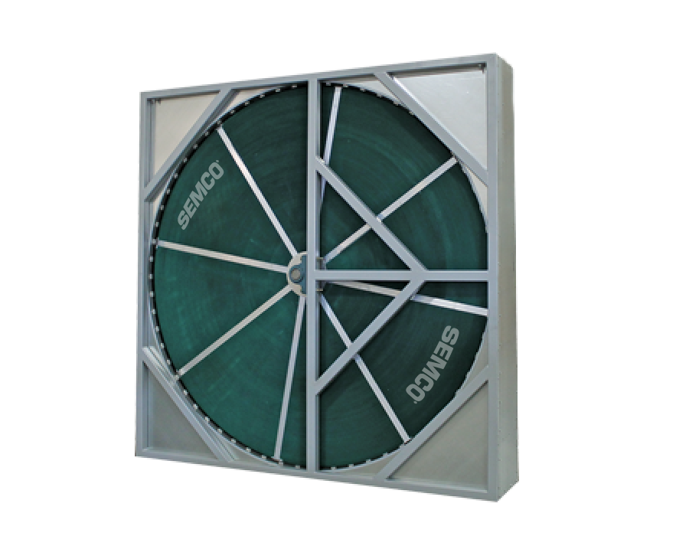
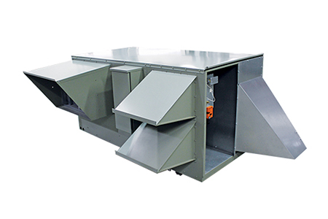
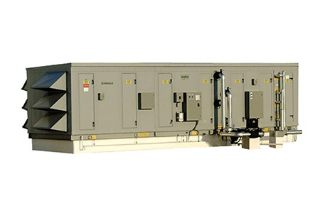
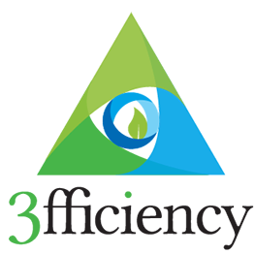
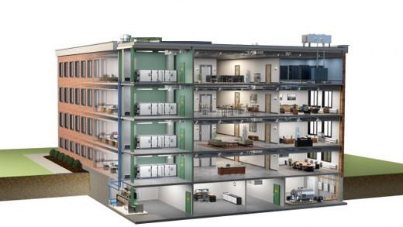
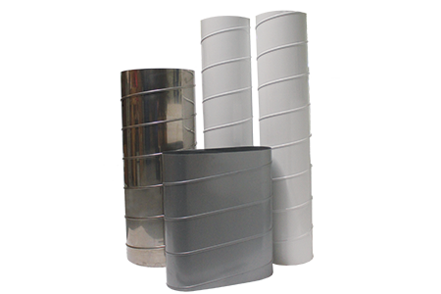
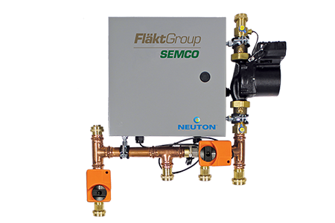
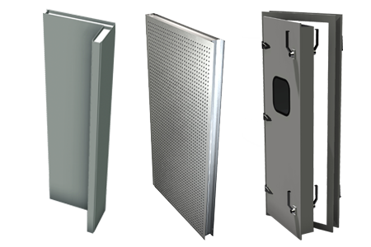
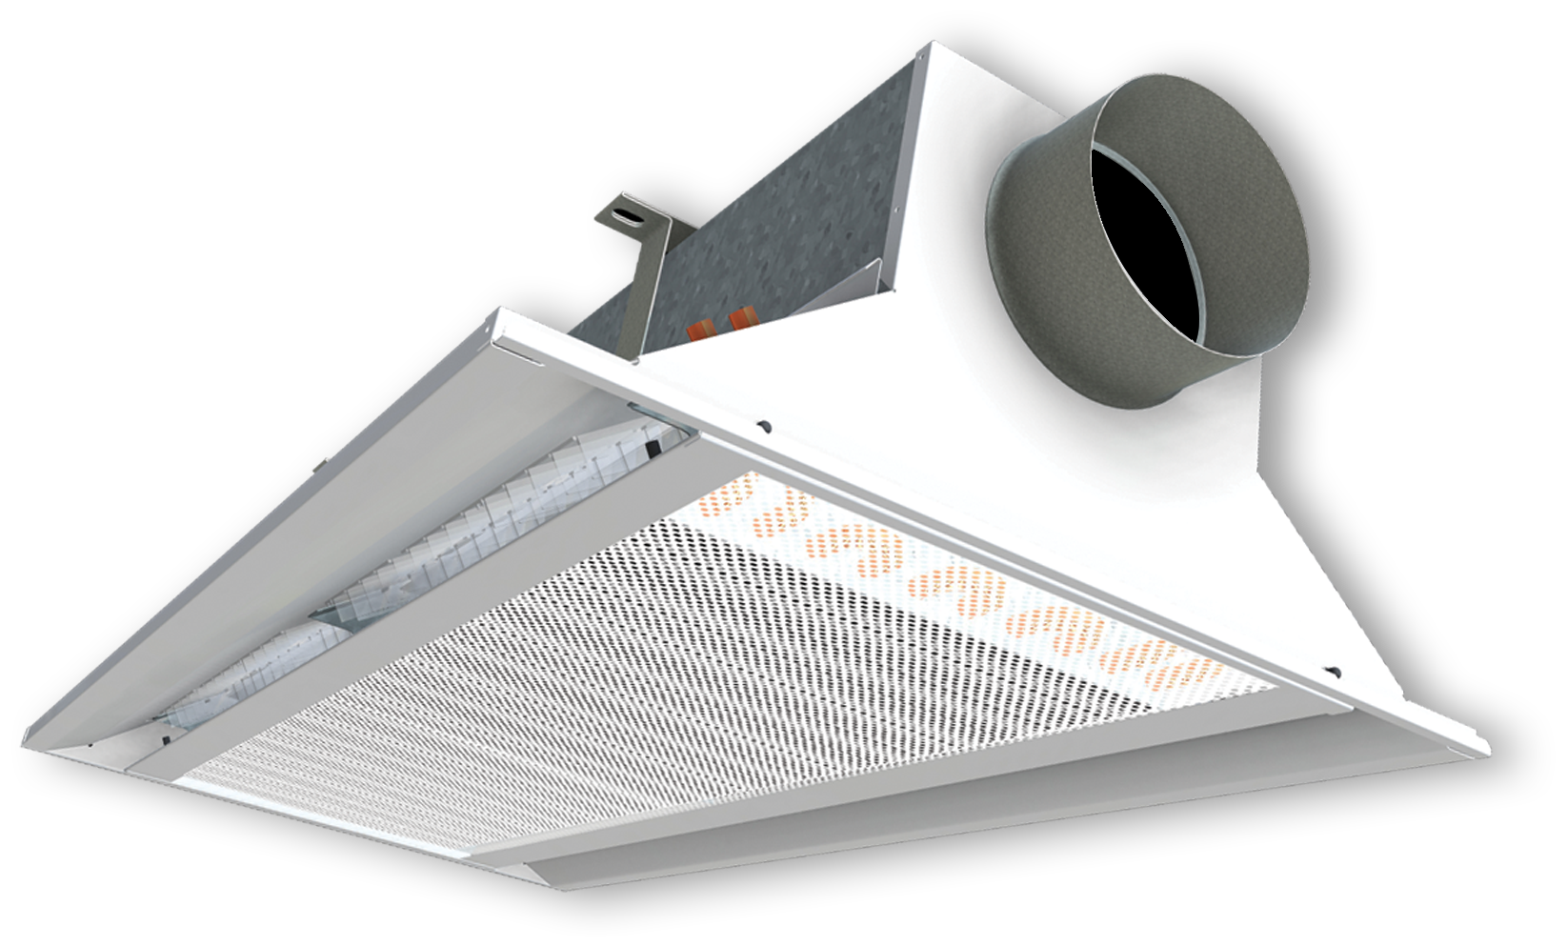
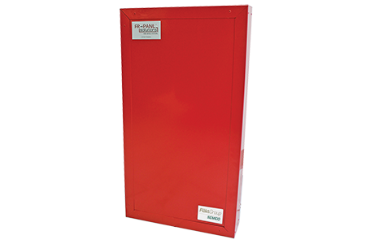
FläktGroup SEMCO Products For Commercial Applications
Energy Recovery Wheel
Unitary Energy Recovery Unit
Applied Energy Recovery Unit
NEUTON Pump
Ductwork
Chilled Beams
Fire-Rated Panels
Sound Attenuation Panels
Notes:
FläktGroup SEMCO provides solutions for a wide variety of applications including casinos, offices, laboratories, hotels, education, healthcare, retail, data centers, stadiums, manufacturing, agriculture & indoor farming, airports, and recreational facilities.
FläktGroup SEMCO products could be utilized in conjunction with one another, to provide the best possible air quality.
We offer energy recovery units & wheels which are engineered to be low maintenance, environmentally friendly, energy efficient & saves money over time as well as protects occupants from harmful contaminants.
We also offer chilled beams, pump modules, data centers, air handlers, duct and panels.
Leverage below if desired:
FläktGroup SEMCO products are designed to be utilized in conjunction with one another, to provide the best possible air quality. We show here:
Ductwork is laid within the walls and ceiling of the building, so supply air may be brought into the building and return air may be exhausted from the building.
Outdoor air is brought into the FV and pre-conditioned
Once the air is pre-conditioned with the FV it is filtered through the Pinnacle energy recovery unit, which will remove contaminants and dehumidify the incoming airstream with its True 3A wheel. Return air will also flow through the Pinnacle on its way out.
The chilled beams and the Neuton will work together with the supply air they receive from the Pinnacle to maintain a comfortable room temperature without condensation. (Together the Pinnacle, Neuton, and chilled beams make up 3fficiency).
During the construction of the building fire panels will be installed around an equipment room or elevator.
Sound attenuation panels are also installed during construction around noisy equipment or places where noise may be a concern

Slide 5
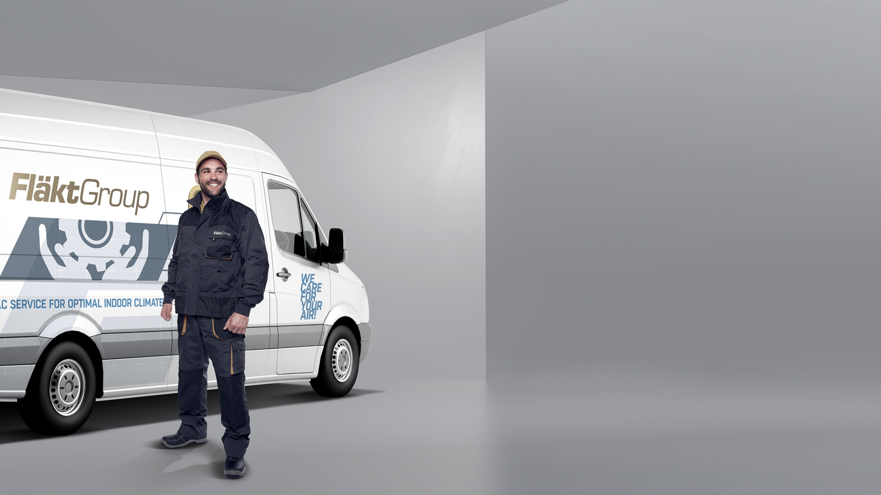
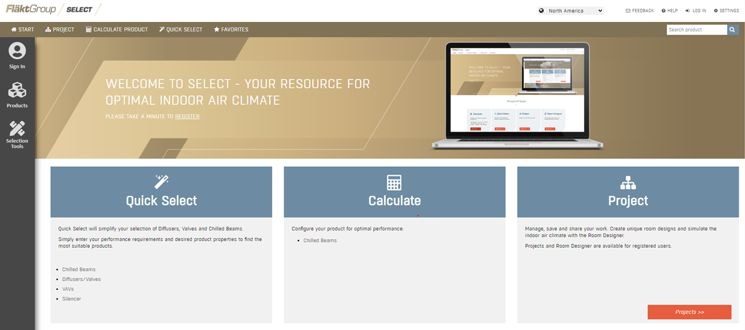

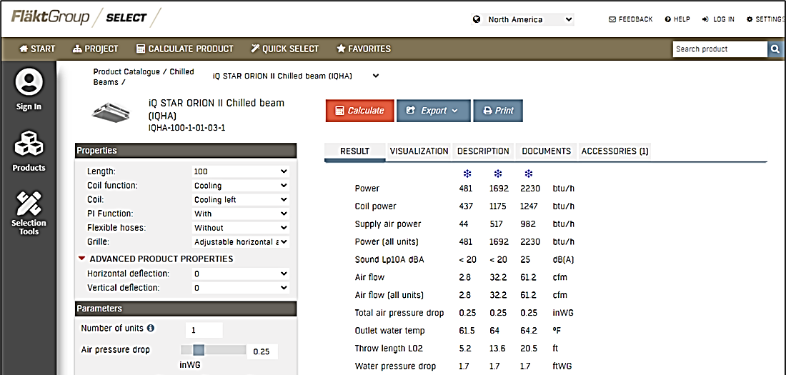
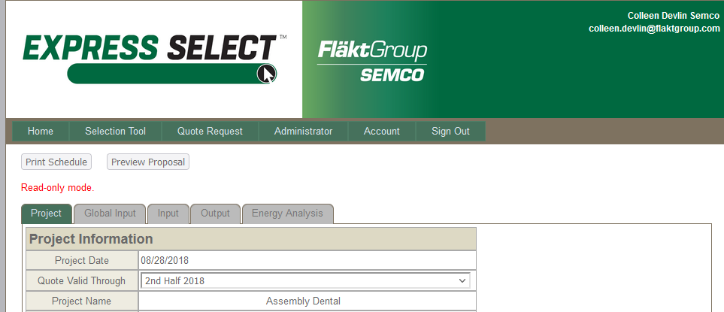
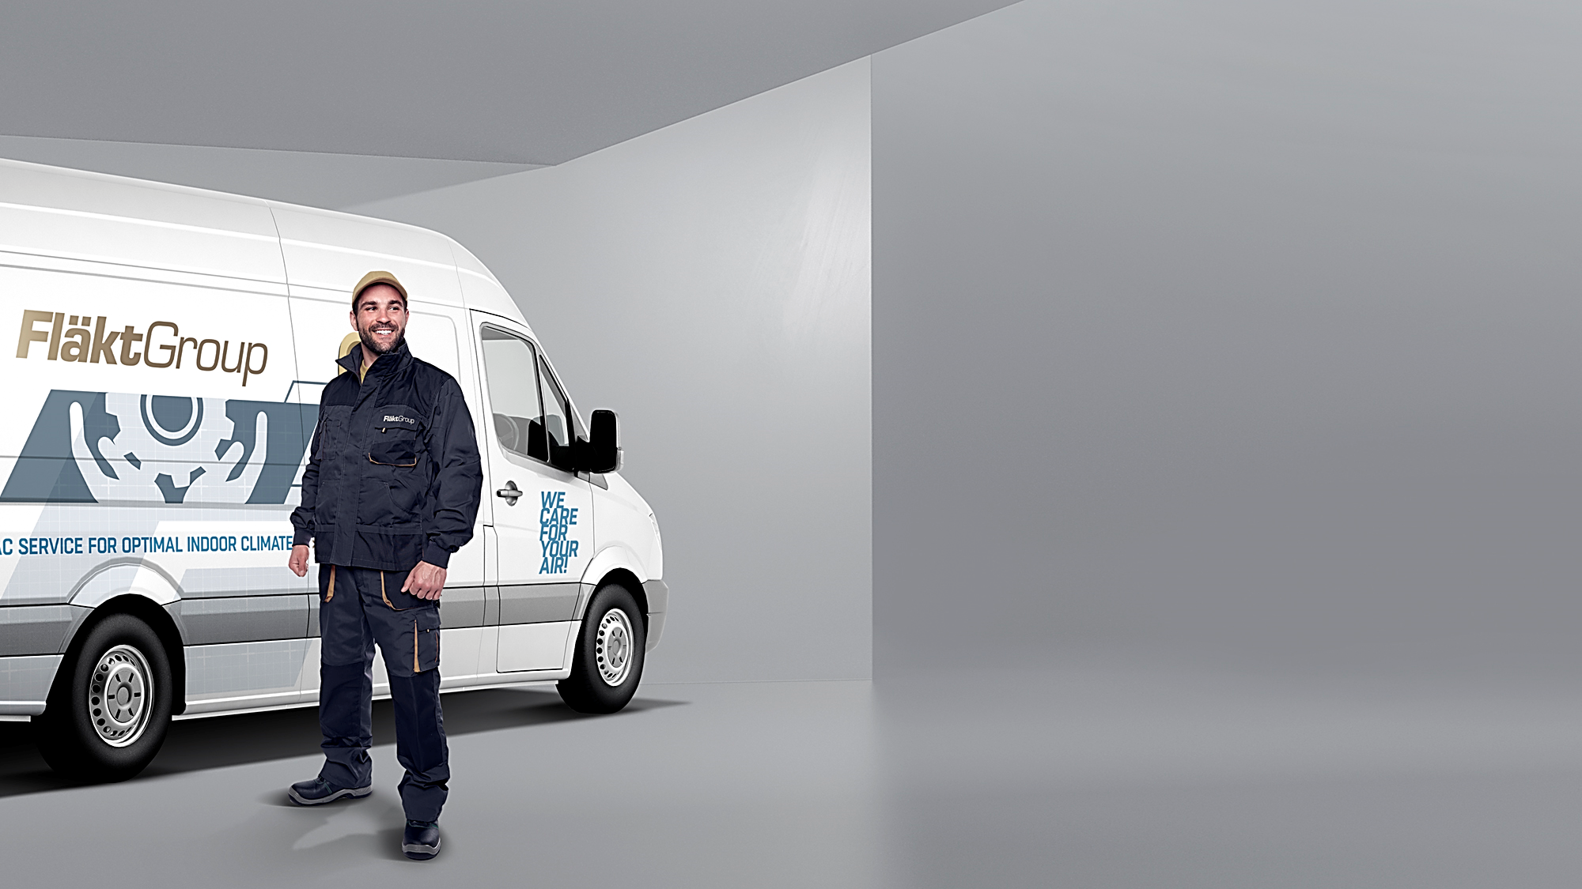
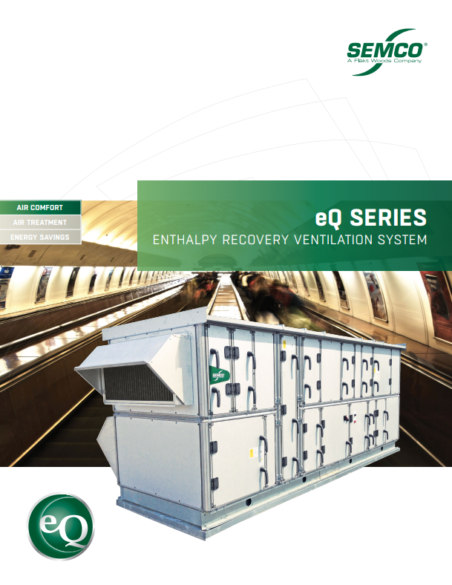
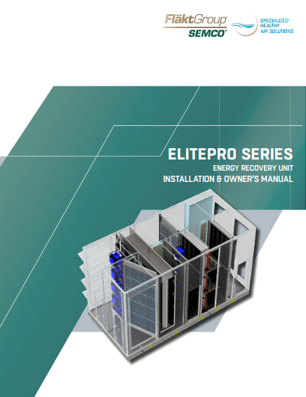
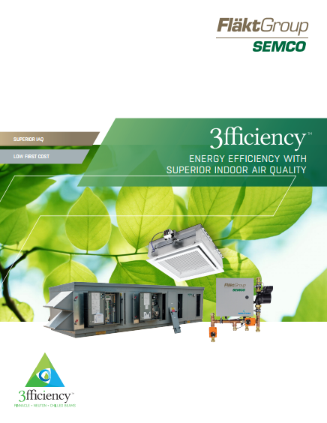
FläktGroup SEMCO Superior Sales Support & Service
Notes:
FläktGroup SEMCO prides ourselves on supplying exceptional sales support and service.
Accessible web-based literature and tools
Our experienced sales team are a phone call away and will help guide you through our selection programs to meet or exceed project specifications.
While all FläktGroup SEMCO products are relatively maintenance free throughout their lifecycle--we have a knowledgeable and dedicated service team available should you require it.

Slide 6
Introduction to the Ascendant & Giga

Slide 7
Introduction to the Ascendant® and Giga
What is an Ascendant®?
The Ascendant is a highly efficient, conventional cooling system which employs an, active desiccant hybrid system to deliver and maintain low dewpoints by minimizing regenerative energy input.
It may be used as a dedicated outdoor air system (DOAS) or a recirculated air system.

Slide 8
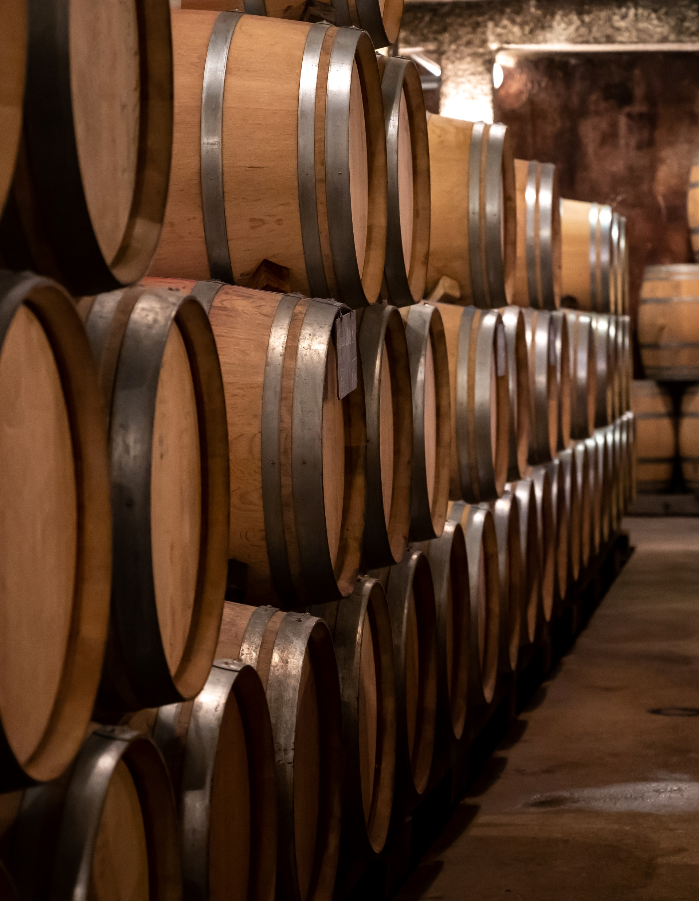
Ascendant® & Giga – Dehumidification
CHALLENGE:
Extreme dehumidification and precise is demanded by an application, to prevent contamination, corrosion, or spoilage during production or storage.
SOLUTION:
The Ascendant® has more than 3xs the dehumidification capacity of a DX cooling system.
Can provide dewpoints as low as 20°.
Dewpoints are tightly controlled with customized DDC controls, sensors and algorithms.
Notes:
Read from the slide

Slide 9
Ascendant Dehumidification Capacity
Dehumidification Capacity Comparisons
Notes:
gr 9.1 16.0 25 53
gr 55.9 65-49 65-40 65-67
dp 51.1 47.6 42 4.6
Since Ascendant can produce substantially drier air, the dehumidification capacity offered at a given airflow is many times greater than with cooling alone

Slide 10


Ascendant & Giga – Energy Savings
CHALLENGE:
Being able to achieve very low dewpoints without wasting energy and money.
SOLUTION:
The Ascendent expends 60% less tons of mechanical cooling than DX systems, to achieve very low supply air dewpoints.
Often, for several hours, no cooling is required to meet these dewpoints, with the only thing needed for dehumidification is the active desiccant wheel.
Leading to a substantial energy and first-cost savings.
Notes:
ASCENDANT™ achieves a high operating efficiency by utilizing conventional cooling where it is most efficient (cooling air to moderate temperatures) and active desiccant dehumidification where they are most beneficial and operates most efficiently (processing saturated air)

Slide 11
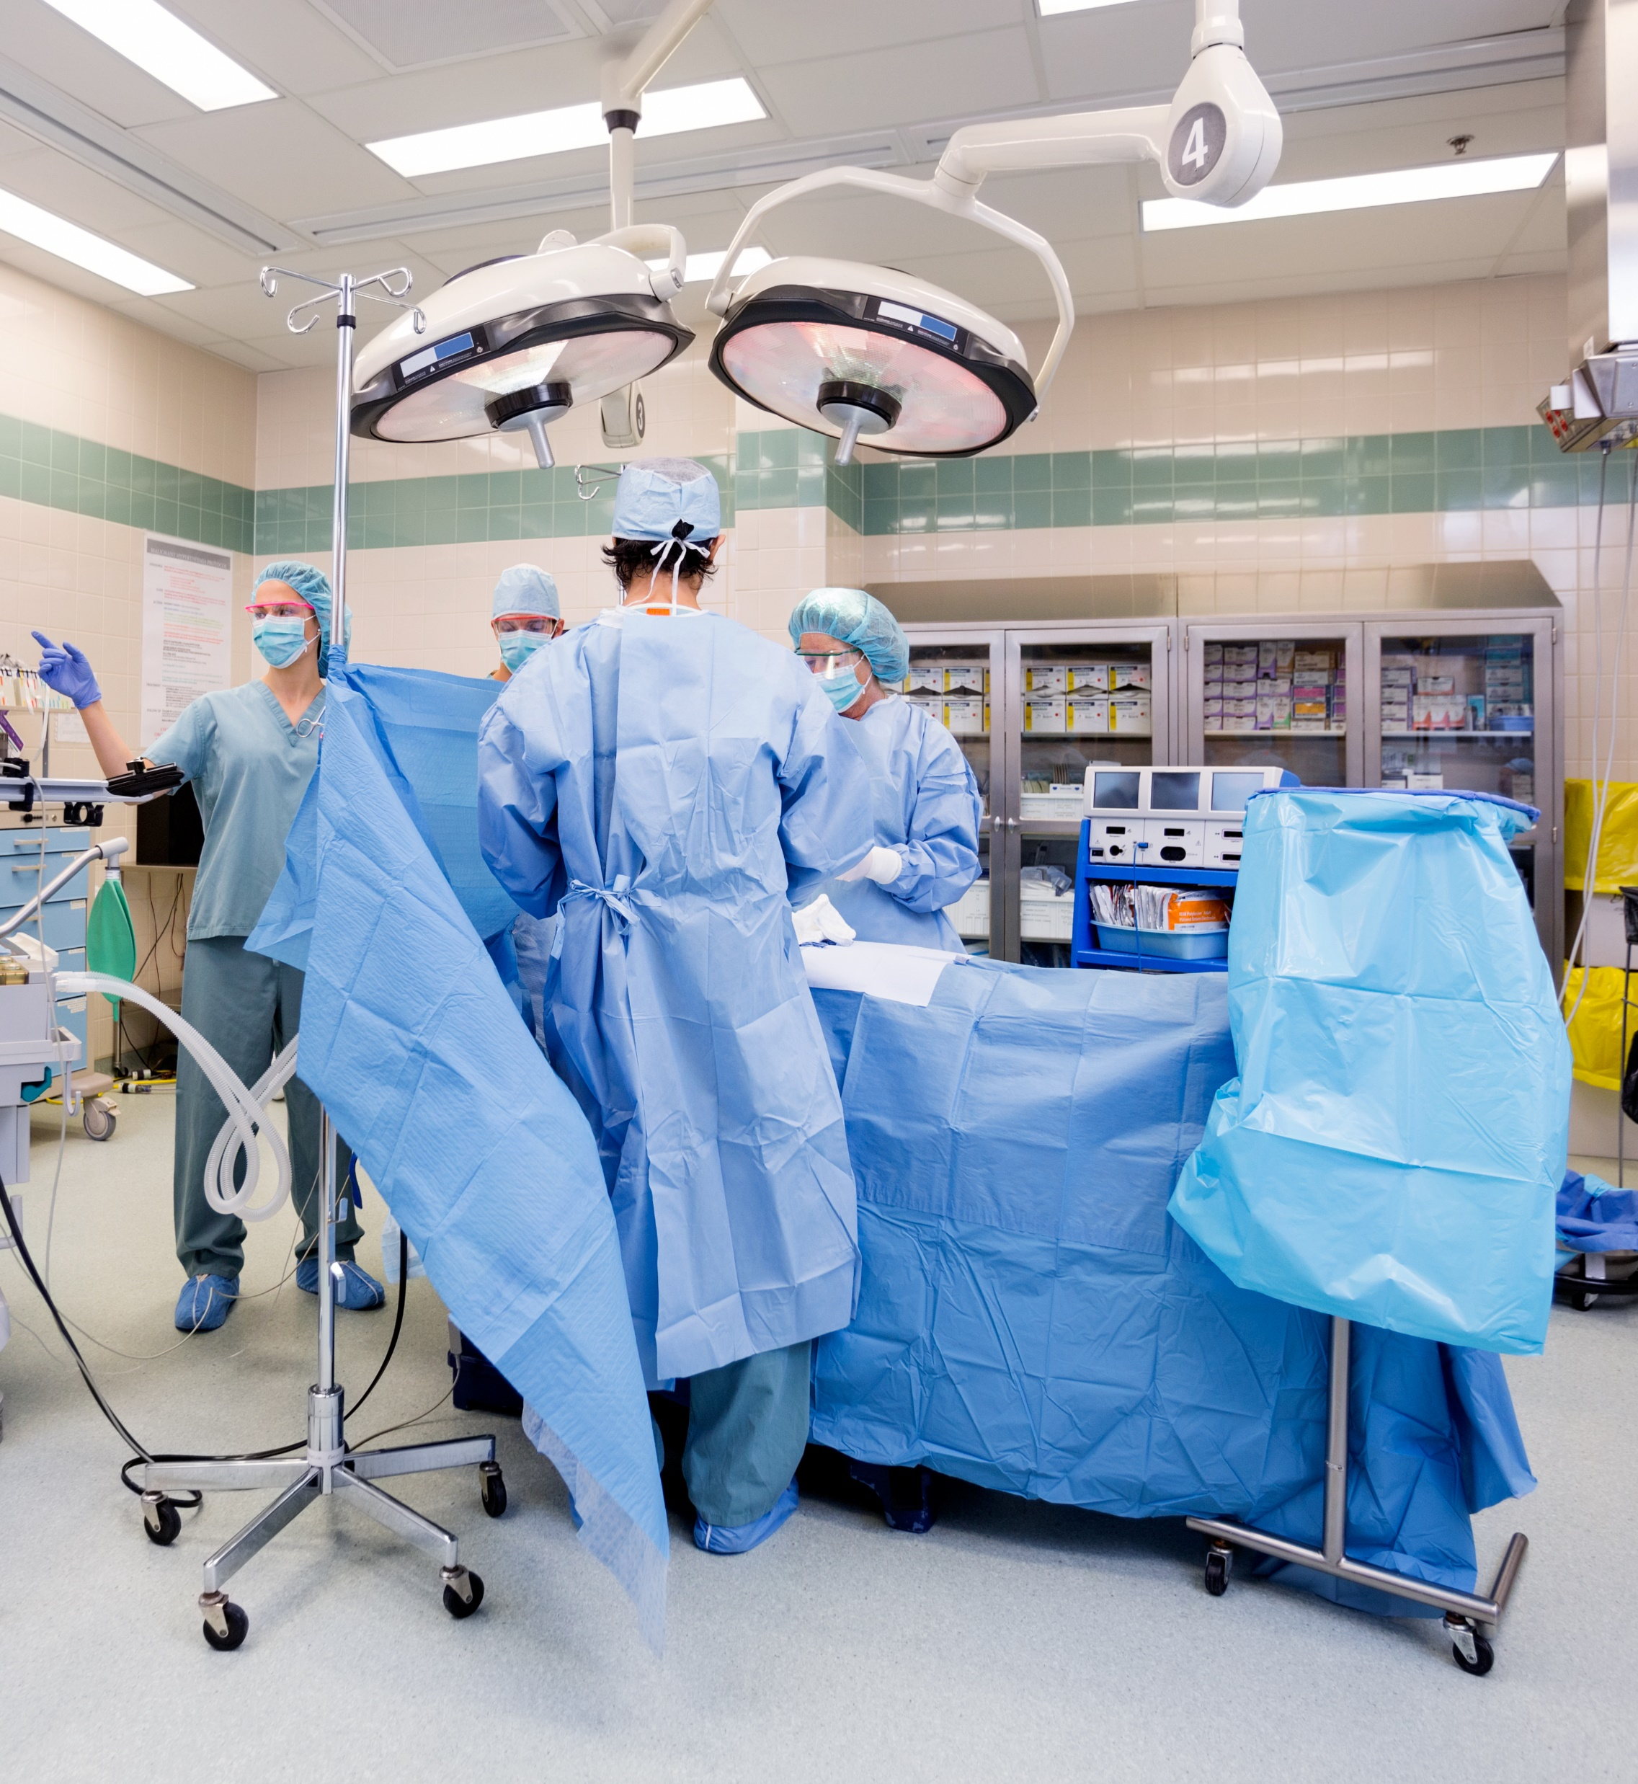
Ascendant – Healthcare Applications
CHALLENGE:
Healthcare facilities not only require strict temperature and dewpoint regulation, but also must eliminate airborne contaminants and odors.
SOLUTION:
The Ascendant comes with the option to add a True 3Å wheel in addition to the active desiccant wheel. Adding the True 3Å, virtually eliminates contaminant carry-over.
The Ascendant can simultaneously achieve and maintain standard operating room relative humidity at 50% ≥ relative humidity and a room temperature of 62˚ — unachievable with a chilled water system.
Notes:
Contaminant carry-over is 0.045%

Slide 12
Ascendant & Giga Components

Slide 13
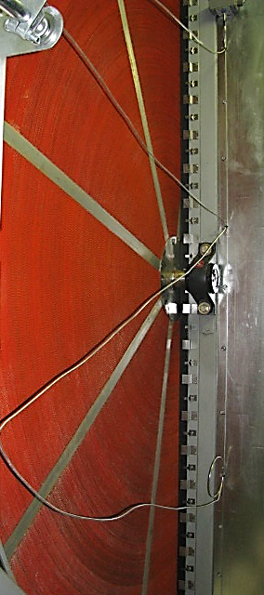
Ascendant - Active Desiccant Wheel
Effectively cycles moisture between 95% and 5% relative humidity (RH) to produce very low dewpoint air.
Non-metallic, fluted media constructed of glass fiber offers temperature stability and low heat transfer.
The heated regeneration airstream (20% - 40% of the supply airflow volume) heats up to 140°F - 200°F with the help of hot water, steam, a direct or indirect gas burner, or waste heat to remove relative humidity to less than 5%.
Very high desiccant loading — desiccant is 50% the weight of the wheel media.
Wheel speed typically 0.1 rpm vs 0.2 rpm

Slide 14
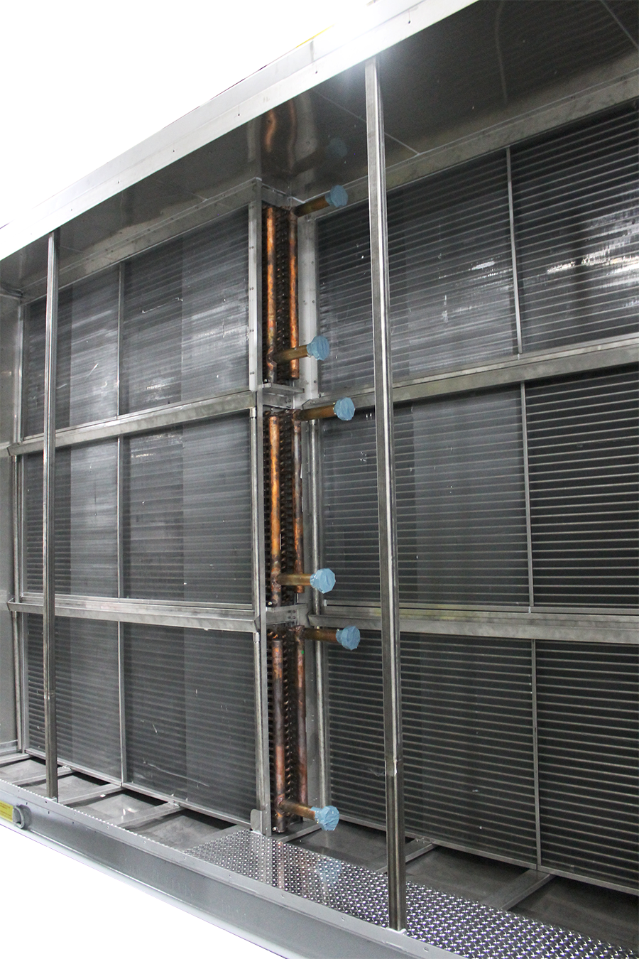
Ascendant - Heating & Cooling Options
DX or chilled water pre and/or post-cooling coils
Regeneration heat
  Hot water
  Steam
  Electric
  Gas (indirect or direct)
Process air heating options
  Hot water coil
  Steam coil, non-freeze type
  Electric coil (optional with separate electrical connection point)
  Indirect or direct gas burner

Slide 15
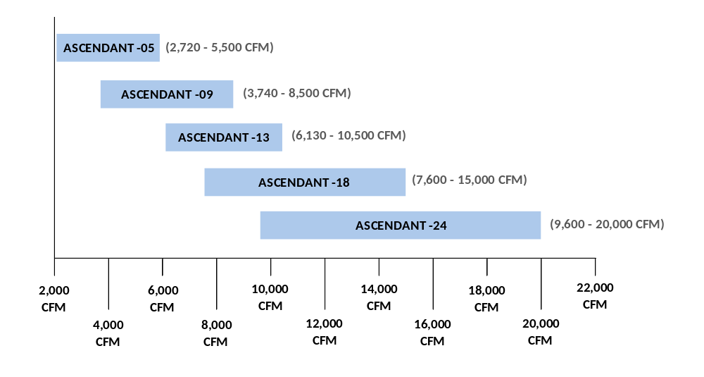
Airflow Capacity

Slide 16
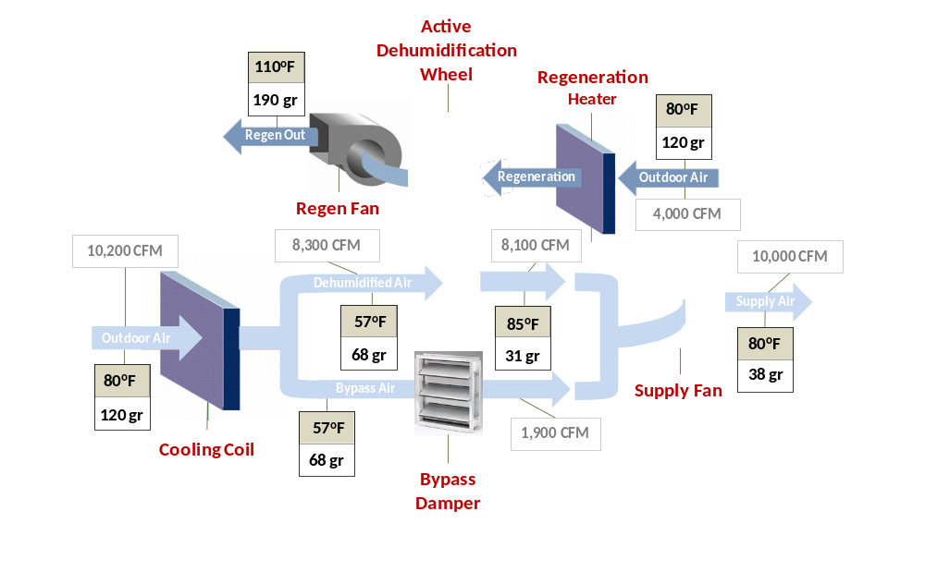
Ascendant - How It Works
Notes:
The benefits of green design can be summarized as follows:
The local and global environment benefits from protecting air quality, water quality, and overall biodiversity and ecosystem health.
Economic benefits are experienced in building operations, asset value, worker productivity, and the local economy.
Occupants benefit from health and safety features. This also relates to risk management and economics. The U.S. EPA found that average Americans spend more than 90% of their time indoors, and indoor air quality can be two to five times worse than outdoor air quality.¹
Community and municipal benefits include: lessened demand for large-scale infrastructure such as landfills, water supply, stormwater sewers, and their related development and operational costs; and decreased transportation development and maintenance burden (roads) and increased economic performance of mass transit systems.
Footnotes:
1. U.S. EPA Office of Air and Radiation, 1989, Report to Congress on Indoor Air Quality, Volume II: Assessment and Control of Indoor Air Pollution.

Slide 17
Applications

Slide 18

Targeted Industries
Hospital operating theaters
Code requires 50% RH even at 65 deg.
(45 deg dew point)
Chilled beam projects
40% less primary air at 30 grains vs. 45 grains (PVS)
Archival storage, libraries, and museums
Lower dew point provides maximum DH capacity at min flow
Hotels
Decouple all latent loads with outdoor air to downsized
heat pumps – smaller fan coils, less frequent refurbishments.
Clean rooms
Lower dew point provides maximum
DH capacity at min flow
Precision glass manufacturing
Tight humidity control
Food industry
Yeast production dry room
Hospital autoclave/sterilization room
Condensation prevention
Ophthalmology laboratory/manufacturing
Tight humidity control
School facility
Humidity control for mold remediation

Slide 19

Thank you for your attention!

