Slide 1
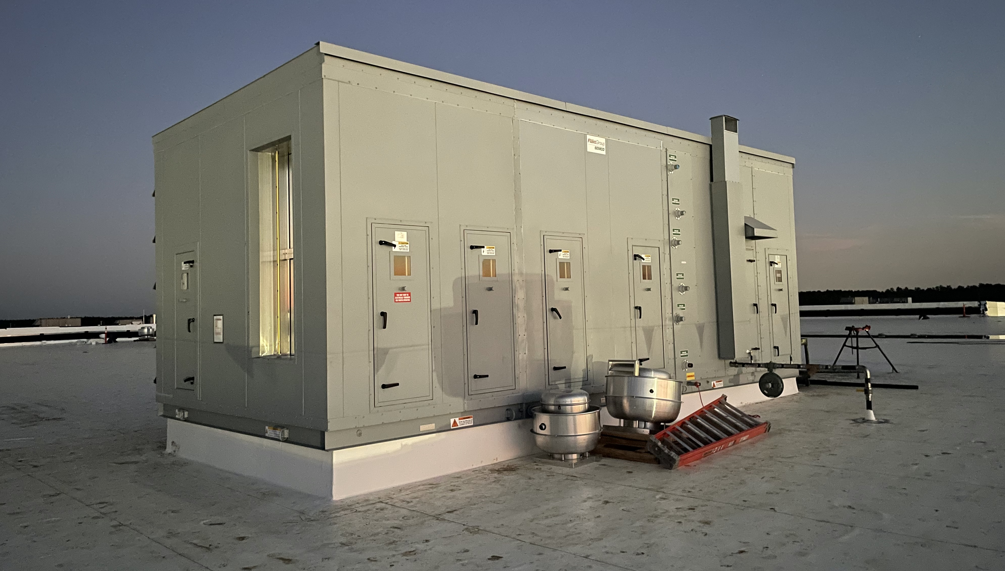
Custom Air Handling Units

Slide 2
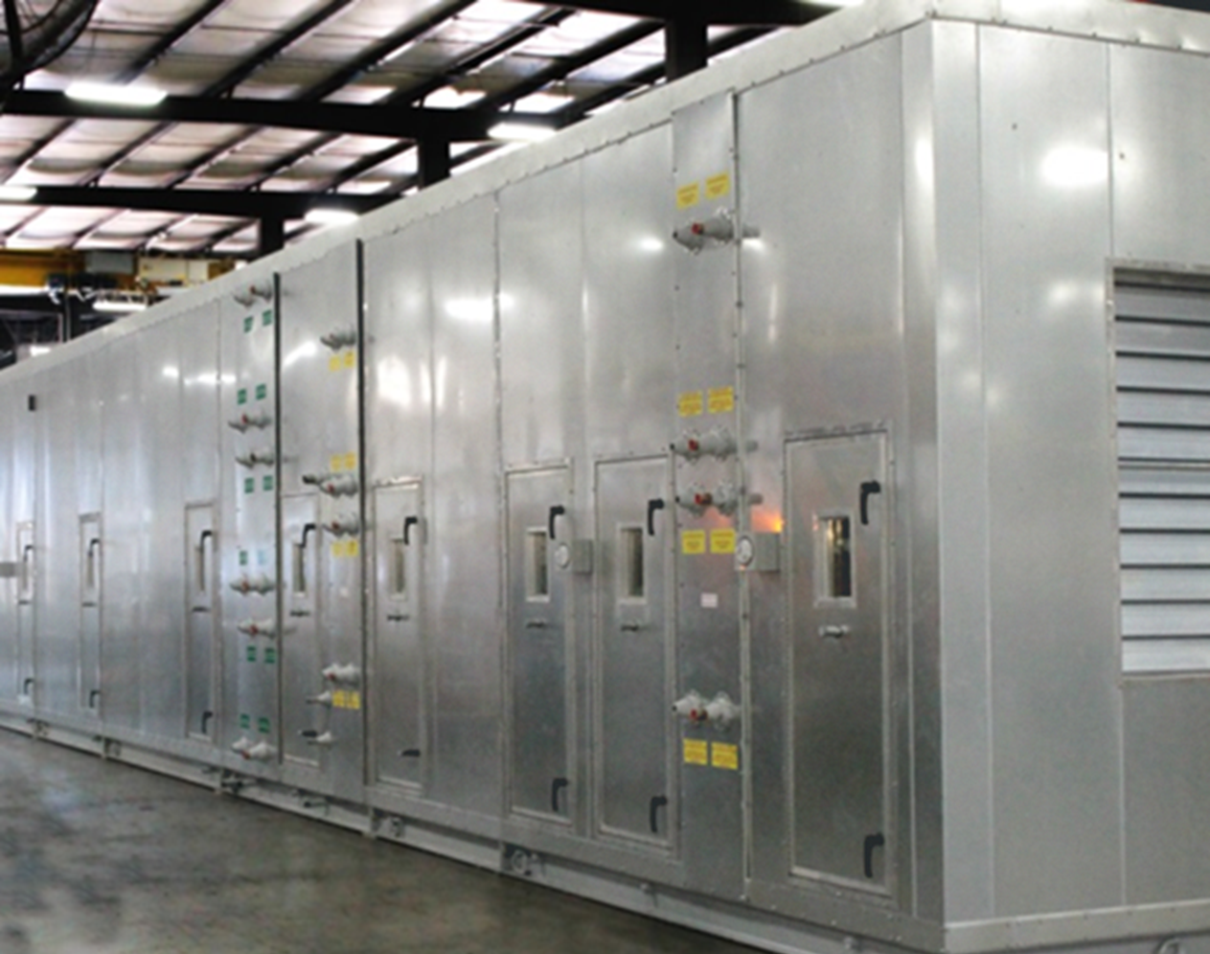
Wall and Ceiling Construction
What type of construction is needed?
Notes:
Read from the slide

Slide 3
Wall and Ceiling Construction
Thickness
1” R6.7
2” R10-R13
3” R20
4” R16.7-25
Insulation
3 PCF mineral wool
Foam
Panel Design
Thermal break
No thru metal
Galvanized, aluminum, and stainless options
Notes:
Read from the slide

Slide 4
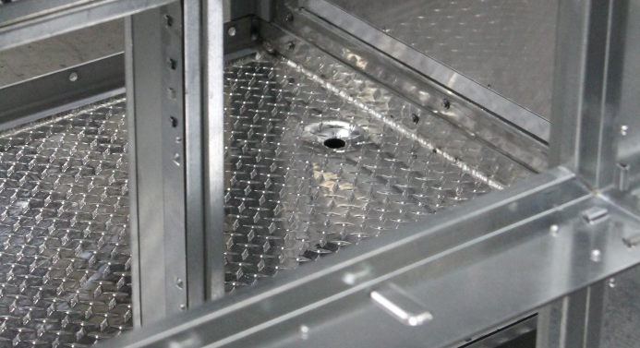
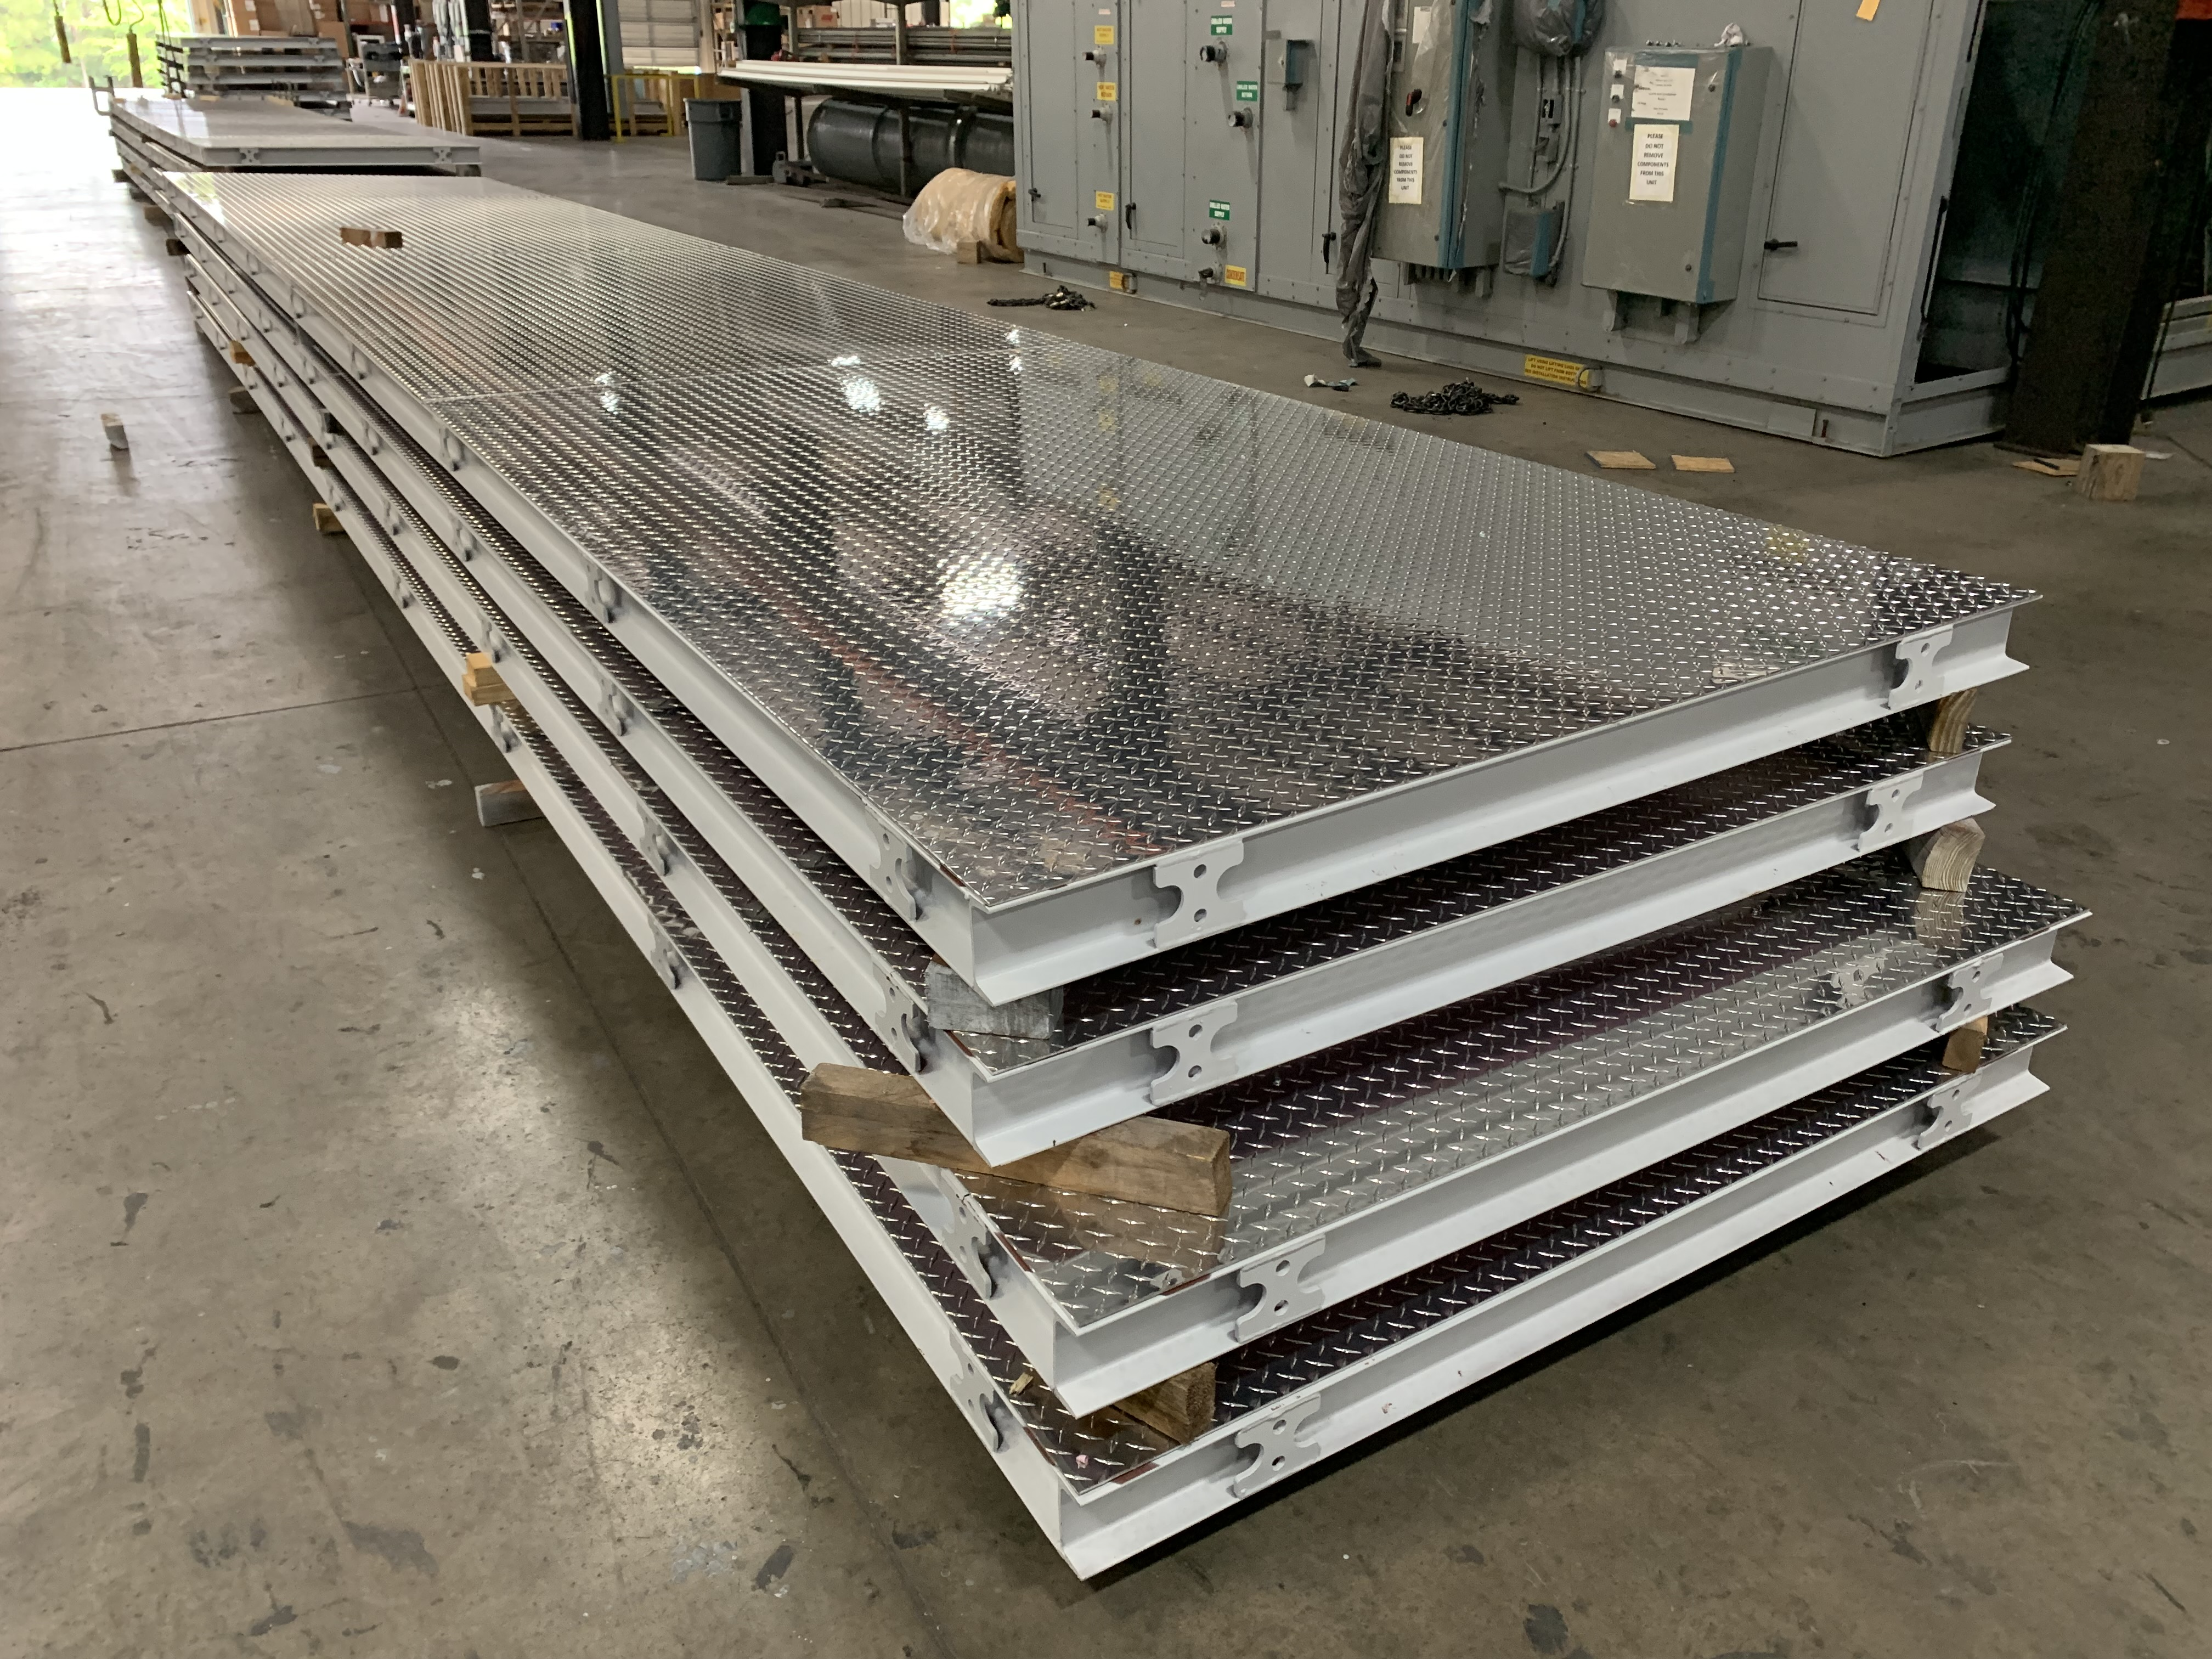
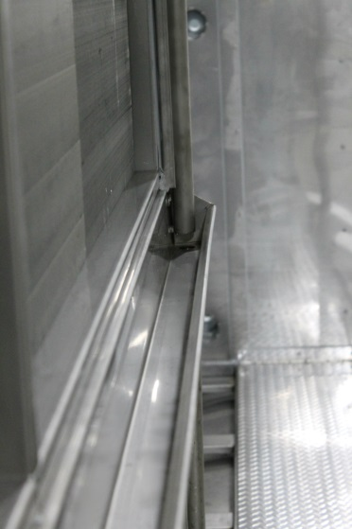
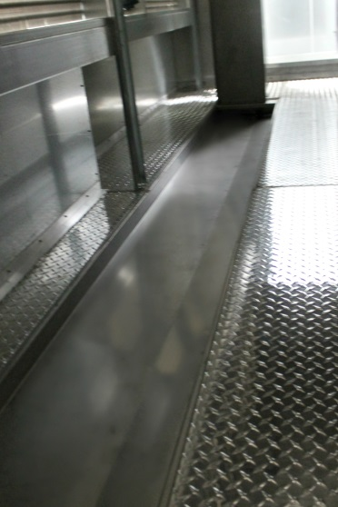
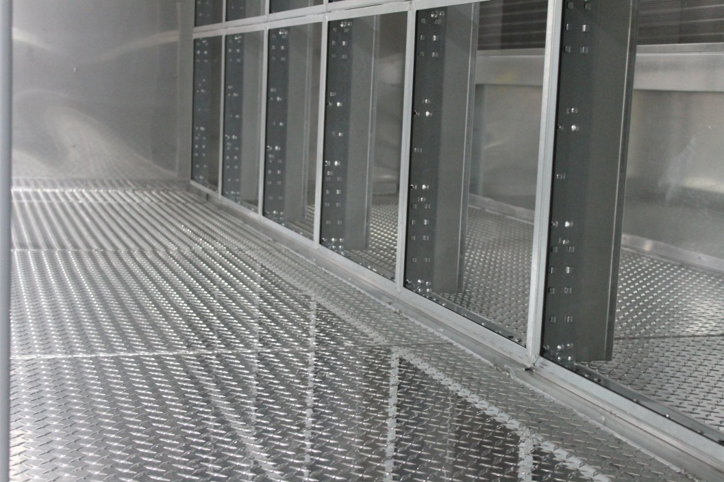
Base and Floor Construction
What type of construction is needed?
Notes:
Read from the slide

Slide 5
Base and Floor Construction
3/16” Aluminum Treadplate Standard
1/8” 304ss Treadplate Available
Smooth Galvanized Available
Drains in Sections as Required
Wash Down Construction Capable
304ss Drain Pans Standard
Intermediate Drain Pan Gutters
On Floor and Recessed Drain Pans
Notes:
Read from the slide

Slide 6
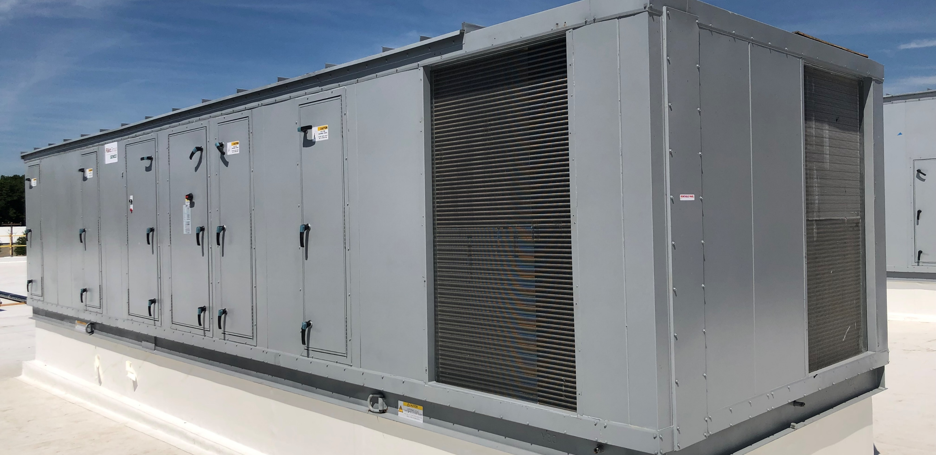
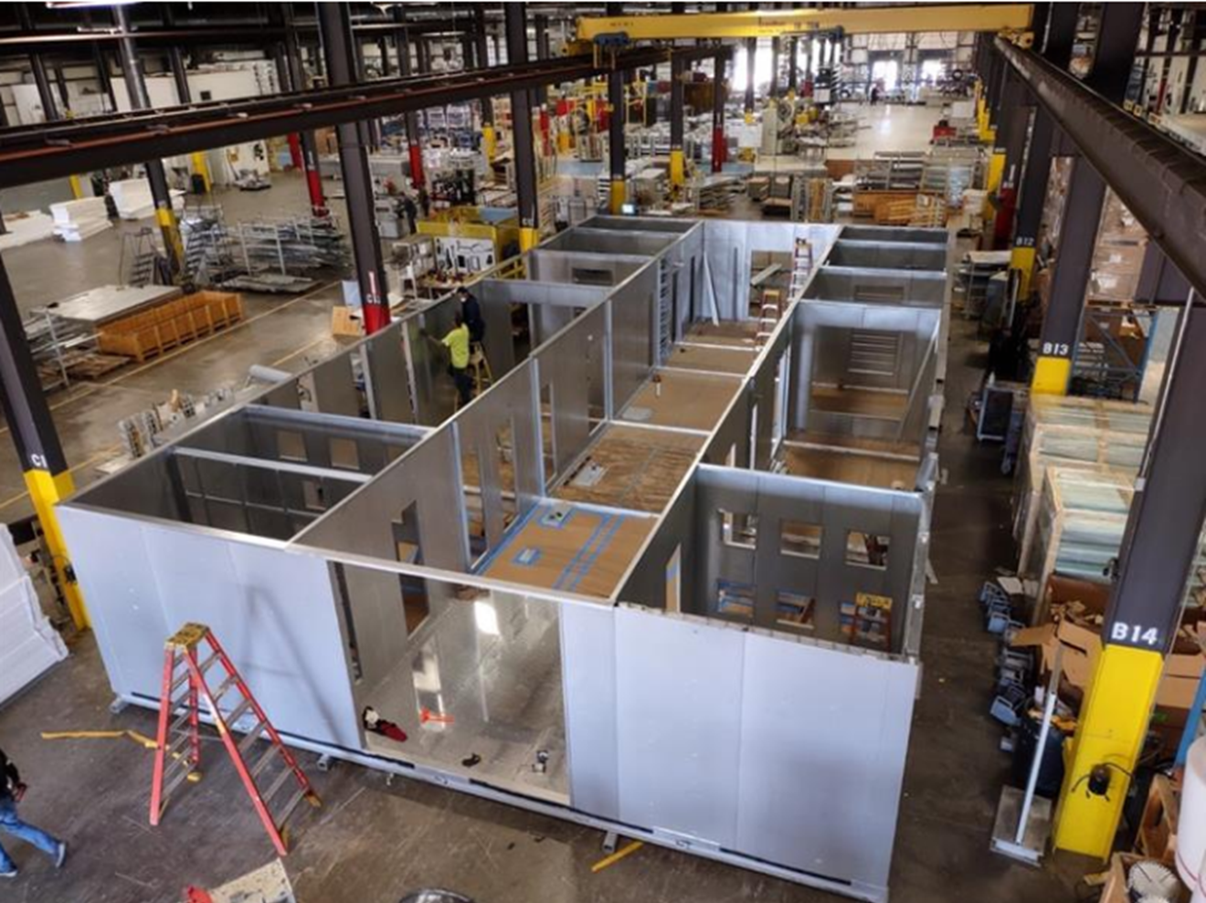
Installation Options
Outdoor
Notes:
Read from the slide

Slide 7
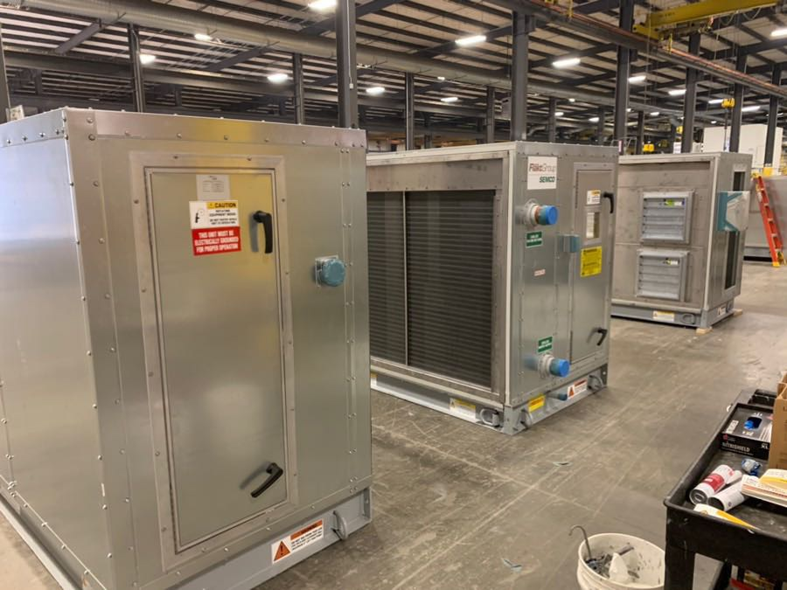
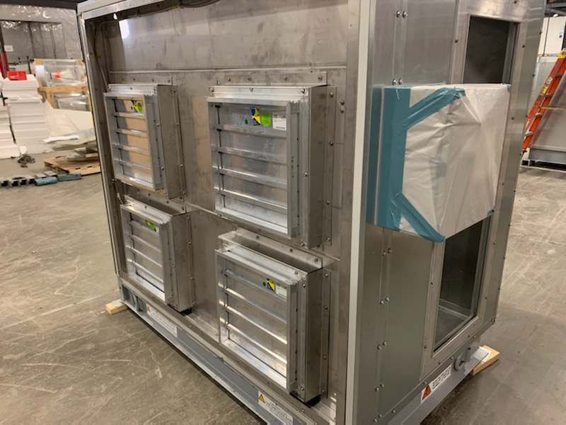
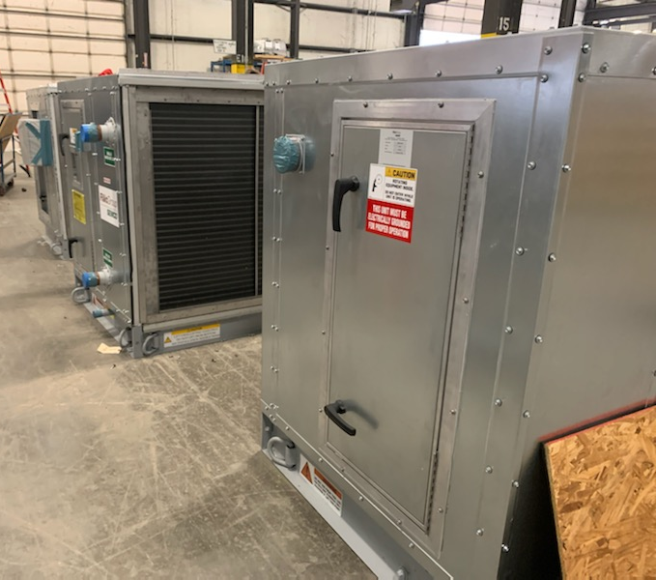
Installation Options
Modular
Notes:
Read from the slide

Slide 8
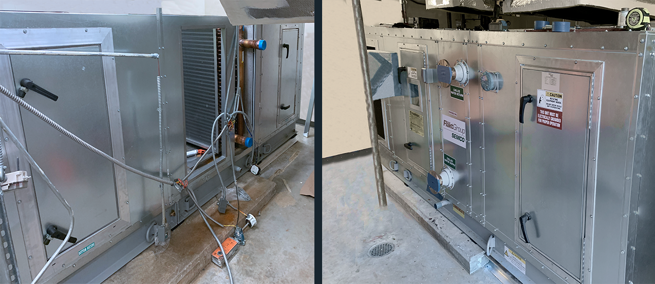
Installation Options
BEFORE
Knock Down/Flat Pack
AFTER
Notes:
Read from the slide

Slide 9
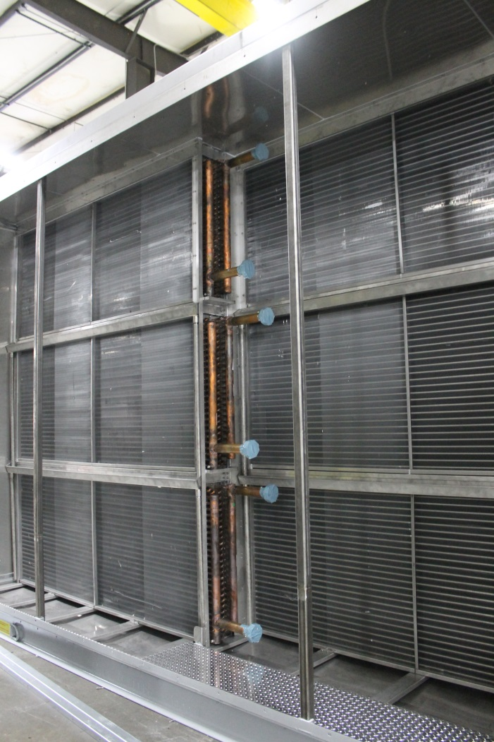
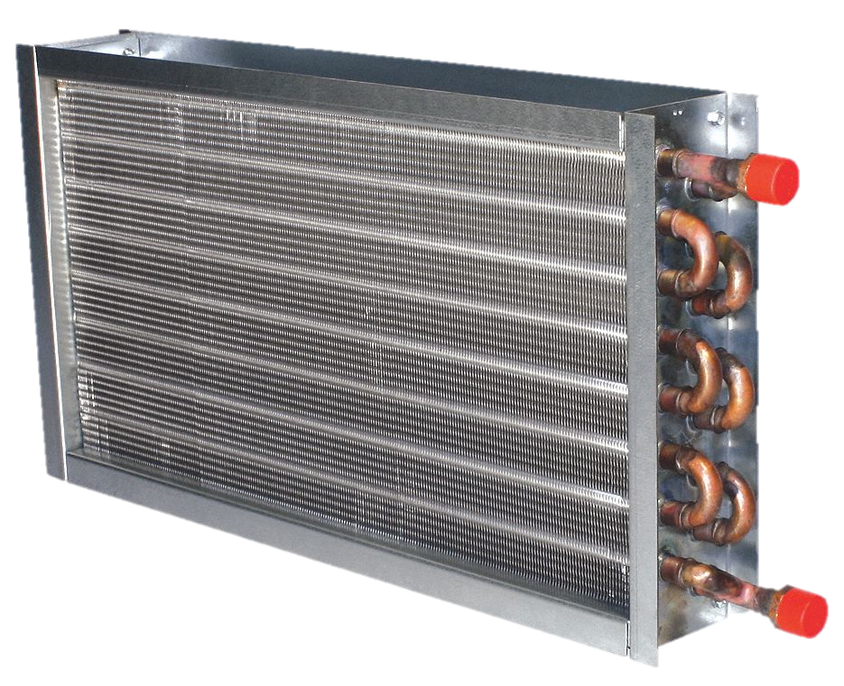
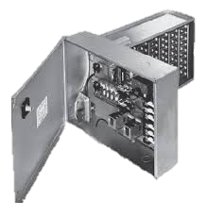
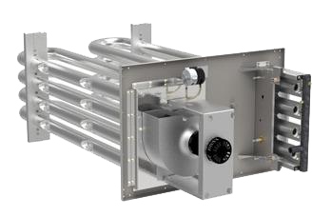
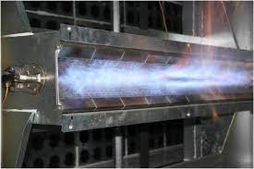
Auxiliary Cooling/Heating Components
Cooling
  Chilled Water
  DX (and VRF)
  Ammonia
Heating
  Hot Water
  Steam
  Electric Heat
  Indirect Gas
  Direct Fired Gas
  IFB
Notes:
Read from the slide

Slide 10
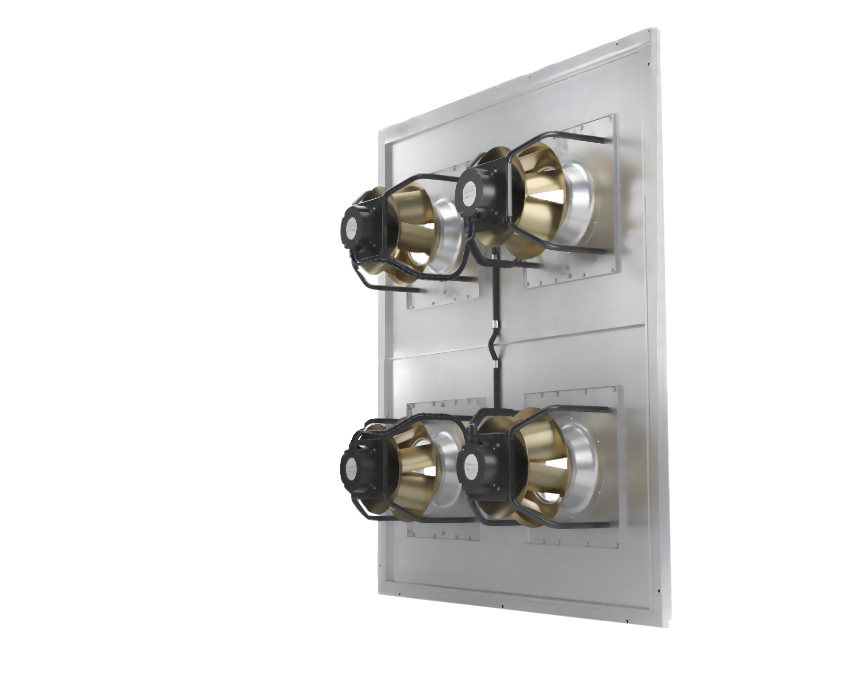
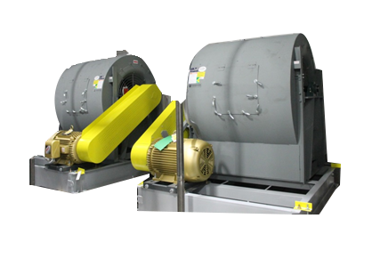
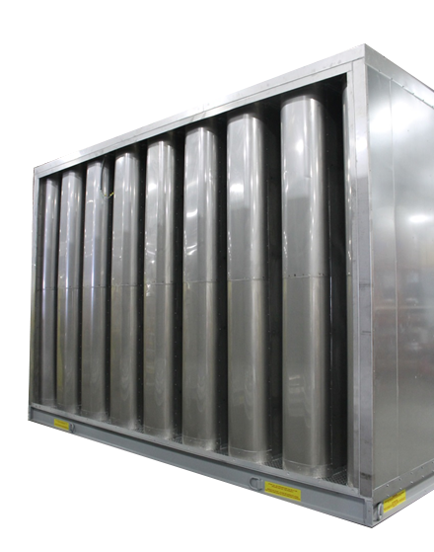
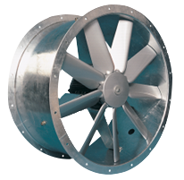
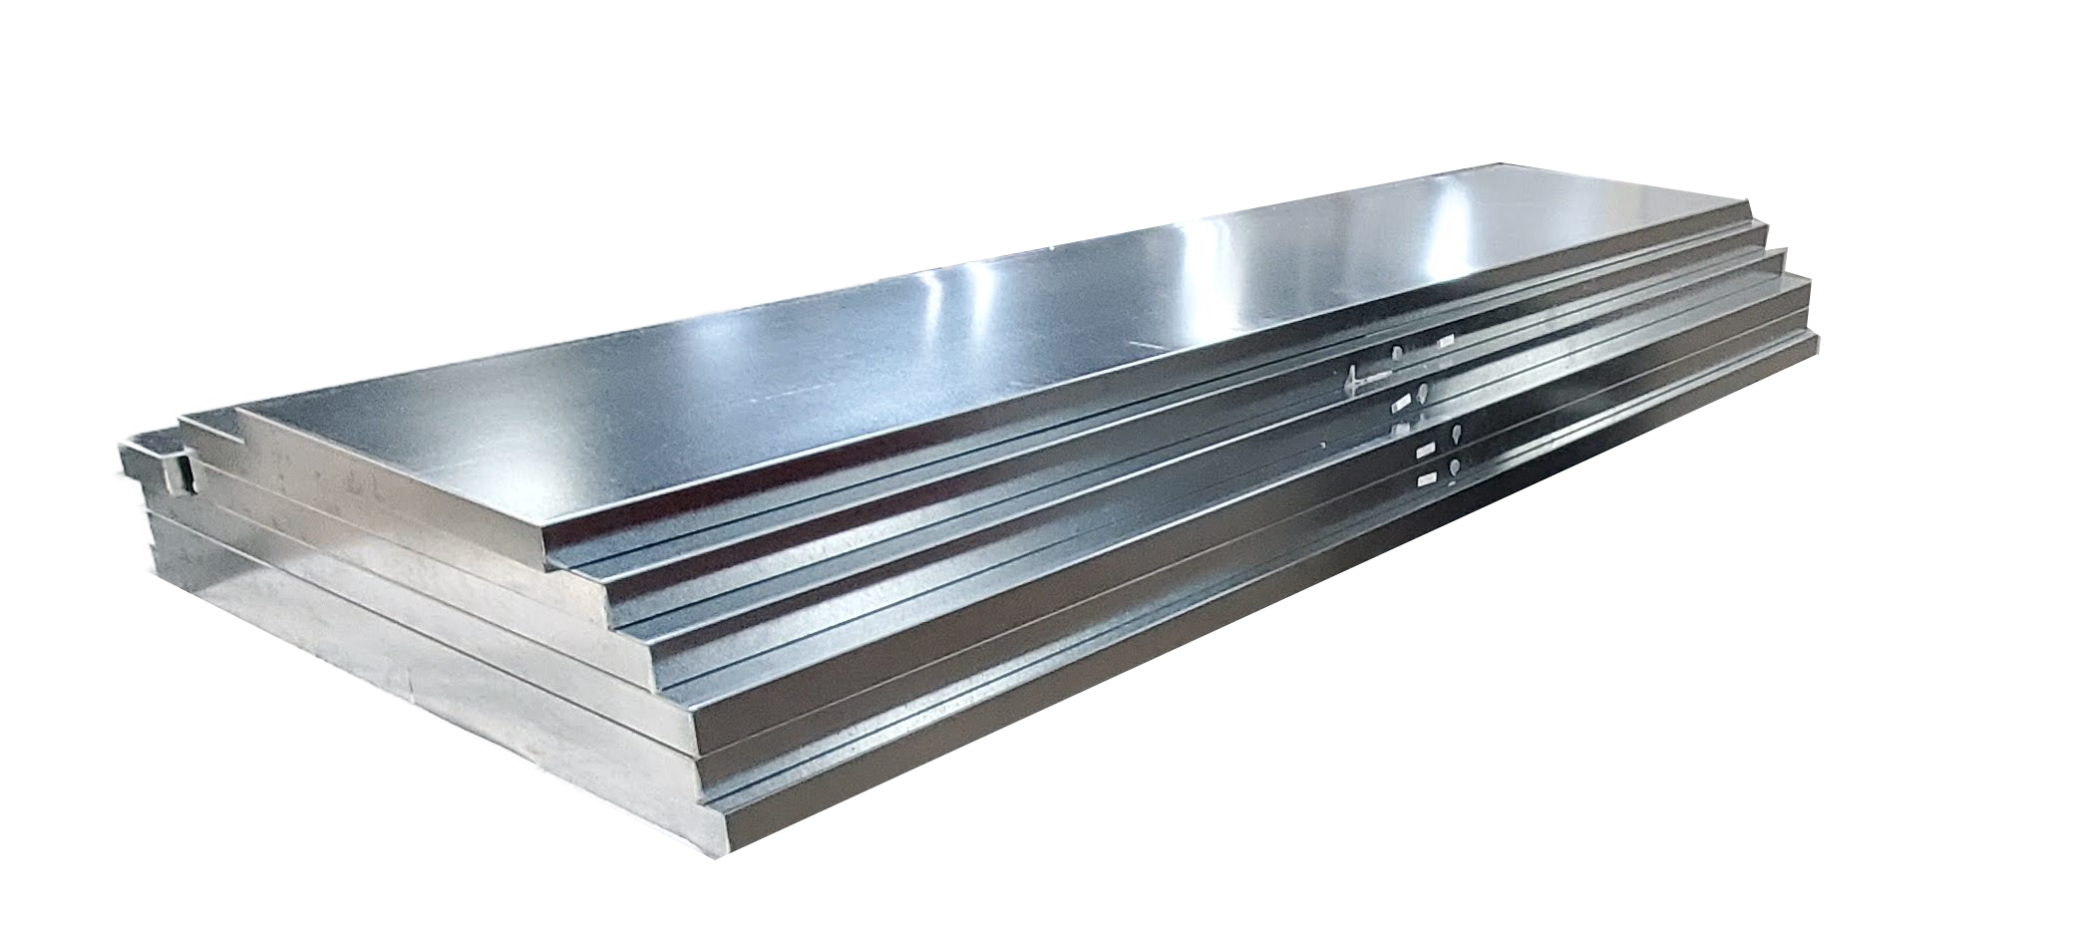
Components
Fans
  AC Direct Plenum
  AC DWDI / SWSI
  EC Direct Plenum
  Fan Arrays
  EC Prop
Sound Adsorption
  Attenuator Banks
  Perforated inner lining
Notes:
Read from the slide

Slide 11
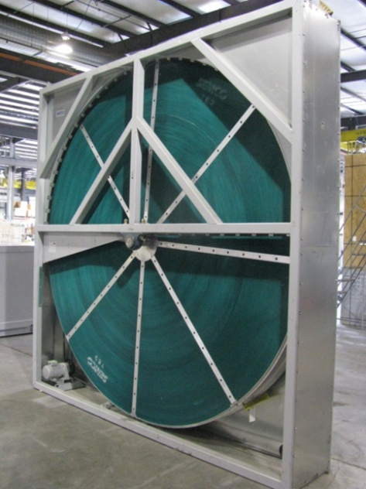
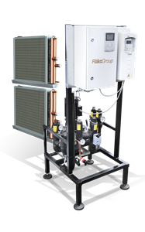
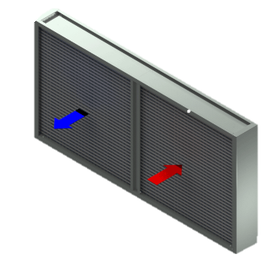
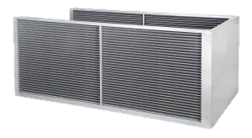
Energy Recovery, Dehumidification
SEMCO Wheels
  True3Å
  Sensible
  Passive Dehumidification
  Active Dehumidification
Heatpipe (straight/wrap around)
Econet Run Around
Notes:
Read from the slide

Slide 12
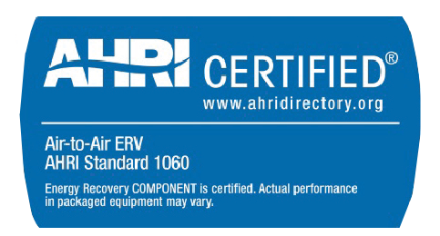




Application Certifications
Notes:
Read from the slide

