Slide 1
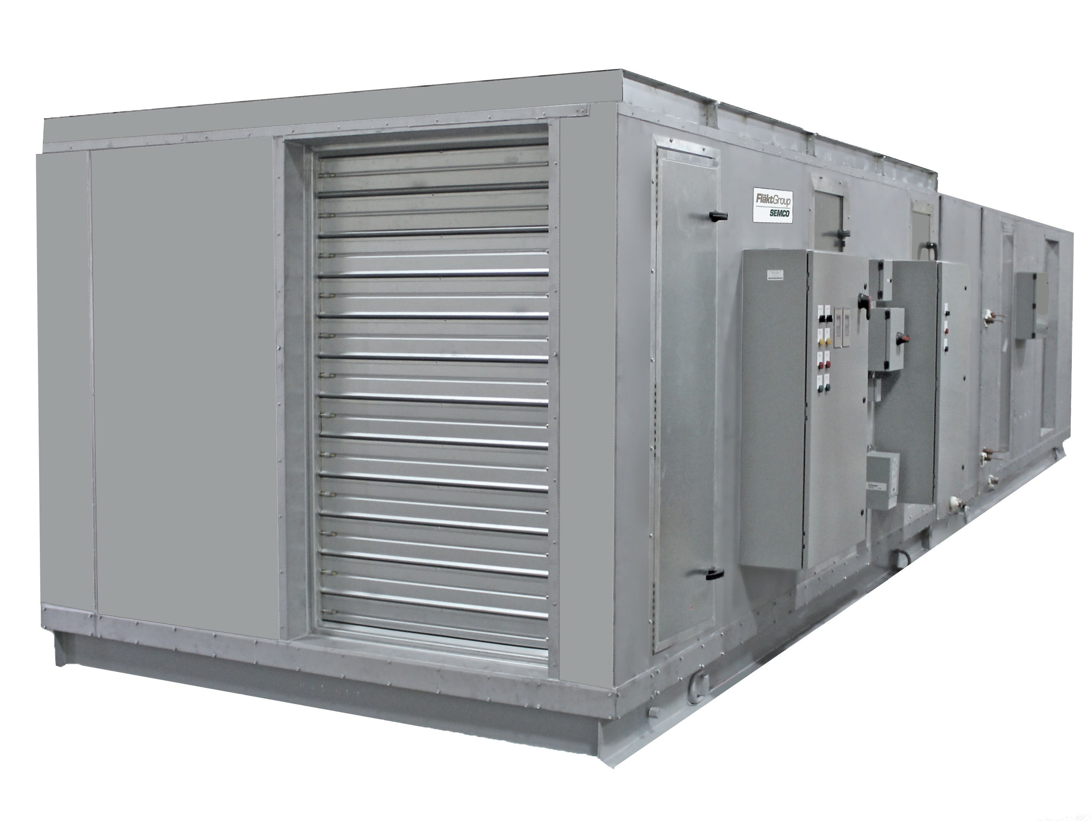

EP SERIES

Slide 2

Corporate Overview

Slide 3
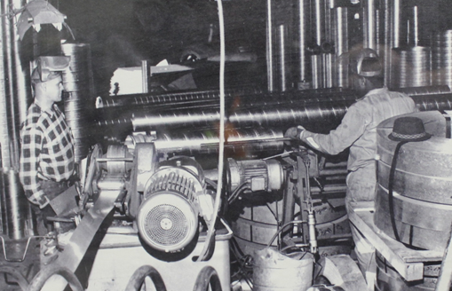
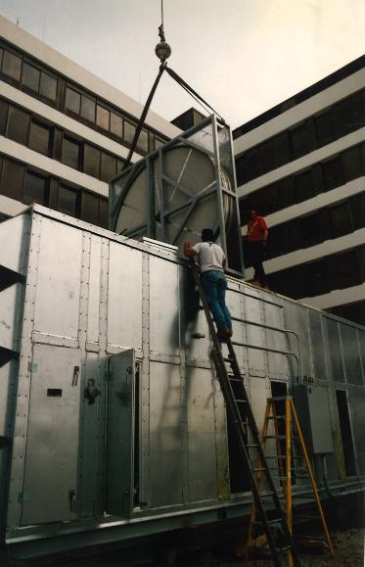
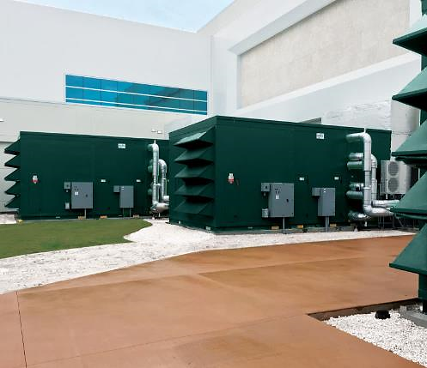









Who we are & what we do
Energy
& Environmental
Focus
Patented &
Certified
Products
U.S & Global
Footprint
Engineered
Air Quality &
Data Center
Solutions
Engineered
Air Distribution
& Sound
Solutions
OEM,
Key Account &
Sales Rep
Route To Market
Service
& Support
Award Winning
& Industry
Recognized
Notes:
In 1963 Salisbury Engineering and Manufacturing Company (SEMCO) was born in Salisbury, MO.
Began as SEMCO -- small sheet metal fabricator specializing in duct.
In the 59 years, evolved into a multi-million dollar company with a large product offering.
Headquartered in Columbia, MO, with 275,000 sq ft of manufacturing space in 3 plants in Arkansas and Virginia
We are a business unit of FläktGroup, and we are owned and backed by Triton Partners—which is a $17 billion annual revenue investment firm.
Innovation is core at FläktGroup SEMCO.
Certified by AHRI, SEMCO was won numerous awards – including multiple AHRI Innovation, Green Building, Dealer Design, School/College Planning & Management Awards
Hold numerous patents and trade secrets for our industry leading energy recovery wheels and systems.

Slide 4

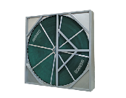
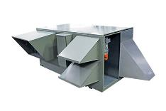
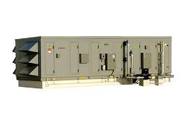


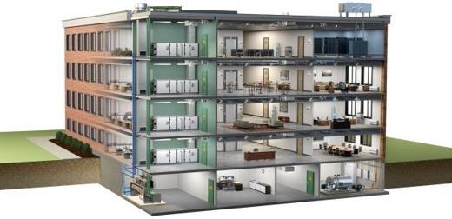
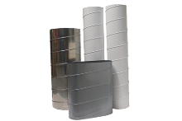
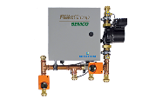
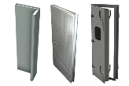

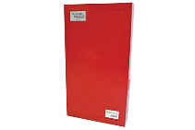
FläktGroup SEMCO Products For Commercial Applications
Energy Recovery Wheel
Unitary Energy Recovery Unit
Applied Energy Recovery Unit
NEUTON Pump
Ductwork
Chilled Beams
Fire-Rated Panels
Sound Attenuation Panels
Notes:
FläktGroup SEMCO provides solutions for a wide variety of applications including casinos, offices, laboratories, hotels, education, healthcare, retail, data centers, stadiums, manufacturing, agriculture & indoor farming, airports, and recreational facilities.
FläktGroup SEMCO products could be utilized in conjunction with one another, to provide the best possible air quality.
We offer energy recovery units & wheels which are engineered to be low maintenance, environmentally friendly, energy efficient & saves money over time as well as protects occupants from harmful contaminants.
We also offer chilled beams, pump modules, data centers, air handlers, duct and panels.
Leverage below if desired:
FläktGroup SEMCO products are designed to be utilized in conjunction with one another, to provide the best possible air quality. We show here:
Ductwork is laid within the walls and ceiling of the building, so supply air may be brought into the building and return air may be exhausted from the building.
Outdoor air is brought into the FV and pre-conditioned
Once the air is pre-conditioned with the FV it is filtered through the Pinnacle energy recovery unit, which will remove contaminants and dehumidify the incoming airstream with its True 3A wheel. Return air will also flow through the Pinnacle on its way out.
The chilled beams and the Neuton will work together with the supply air they receive from the Pinnacle to maintain a comfortable room temperature without condensation. (Together the Pinnacle, Neuton, and chilled beams make up 3fficiency).
During the construction of the building fire panels will be installed around an equipment room or elevator.
Sound attenuation panels are also installed during construction around noisy equipment or places where noise may be a concern

Slide 5


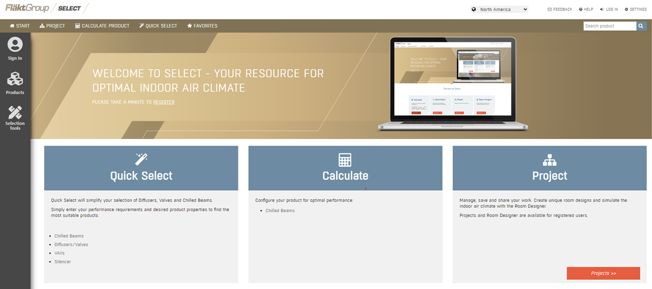
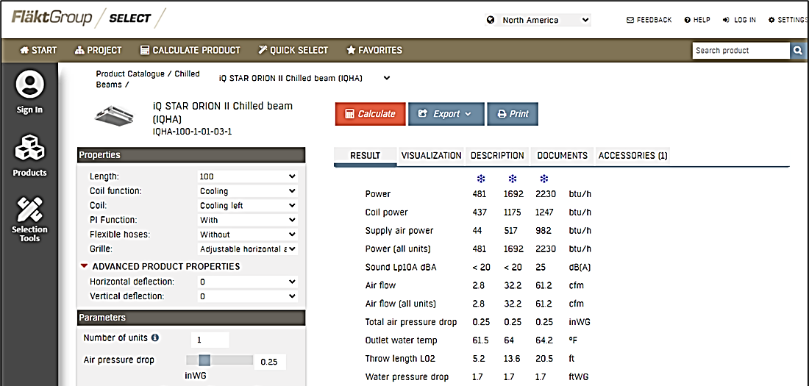

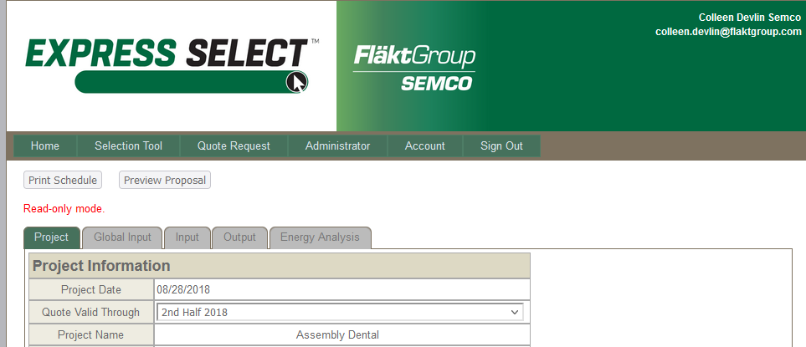
FläktGroup SEMCO Superior Sales Support & Service
Notes:
FläktGroup SEMCO prides ourselves on supplying exceptional sales support and service.
Accessible web-based literature and tools
Our experienced sales team are a phone call away and will help guide you through our selection programs to meet or exceed project specifications.
While all FläktGroup SEMCO products are relatively maintenance free throughout their lifecycle--we have a knowledgeable and dedicated service team available should you require it.

Slide 6
Introduction to the EP Series

Slide 7
Introduction to the EP Series
What is the EP Series?
The packaged energy recovery system (EP) Series is versatile line of energy recovery units, designed to bring in large quantities of outdoor air while treating both exhaust and supply air.
Available in several configuration options, it can be applied as a
pre-conditioner to traditional HVAC equipment or as part of an integrated system that provides total space conditioning and precise humidity control.

Slide 8

EP Series – Contaminants
CHALLENGE:
Incoming outdoor air needs to be treated, so it can be supplied to the space at ideal conditions, but it is also critical to remove any airborne contaminants for the health and safety of the space’s occupants.
SOLUTION:
Not only can the EP deliver supply air at an ideal temperature and RH, but the True 3Å wheel, can also remove 99.95% of all airborne contaminants.
This includes airborne pathogens, hazardous chemicals, and smoke.

Slide 9

EP Series– Energy Savings
CHALLENGE:
Being able to provide ideal indoor air quality without expending a lot of energy or money.
SOLUTION:
The True 3Å energy recovery wheel has a certified total energy recovery performance (sensible and latent) of up to 90% efficient.
While each EP configuration is energy efficient, the EP dual wheel system can generate up to 10 tons of latent cooling for every 3 tons input with no cost of reheating, due to its additional sensible energy wheel.

Slide 10

EP Series – Dealing With Variable Temperatures
CHALLENGE:
How to keep indoor space temperatures consistent while outdoor conditions are changing.
SOLUTION:
With several EP configurations to choose from, there is a n EP configuration for every climate and application. The EP is capable of heating, cooling, and dehumidification.
The EP has equal latent and sensible heat transfer.

Slide 11
EP Series Components

Slide 12
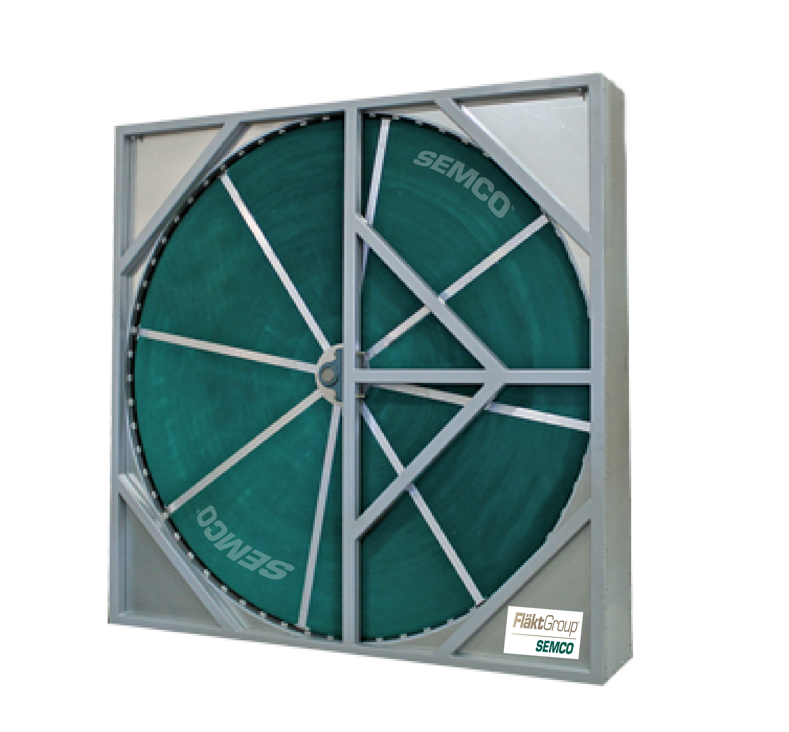
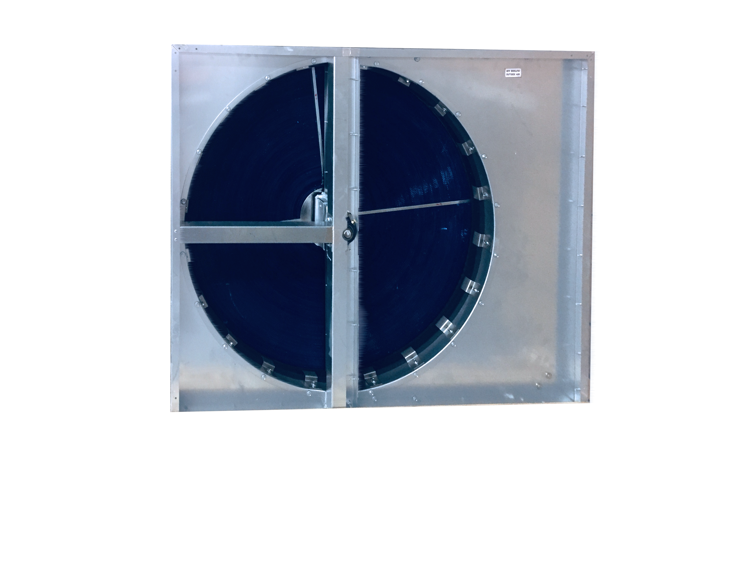
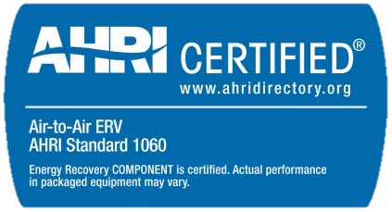
EP Series — Wheels
True 3Å Total Energy Wheel (TE) — all EPs
Patented 3Å molecular sieve-desiccant coating for independently certified cross-contamination less than 0.04%
All aluminum, structural spoke system eliminates mechanical fatigue and allows media replacement (sizes 13+)
Field adjustable purge section
NFPA 90A certified for flame spread and smoke generation based upon ASTM E84 fire test method
Independently certified wheel performance in accordance with ASHRAE Standard 84-91 and ARI Standard 1060 regarding:
  latent transfer efficiency
  sensible transfer efficiency
  pressure loss across wheel
Sensible Only (TS) Recovery Wheels — Dual Wheel Only
The TS wheel is polymer coated to avoid oxidation and moisture transfer
Field adjustable purge section

Slide 13
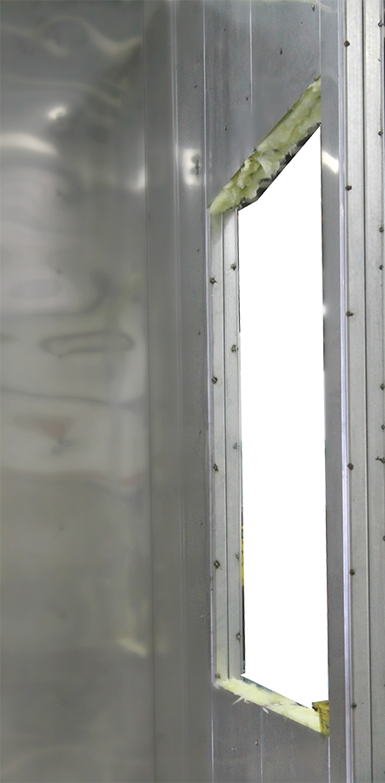
EP Series - Panels
Dual wall tongue and groove panels
  2 inches thick
  18-gauge outer skin
  Eliminates exposed mineral wool insulation and associated risk of bacterial growth.
Optional dual wall foam panels
Double-wall removable panels provided for large internal components.
Gasketed double-wall access doors for all compartments.
Secondary roof of continuous standing-seam panels standard on units designed for outdoor installation.
Fully welded cabinet floor with integrated floor drains.
Aluminum treadplate flooring

Slide 14
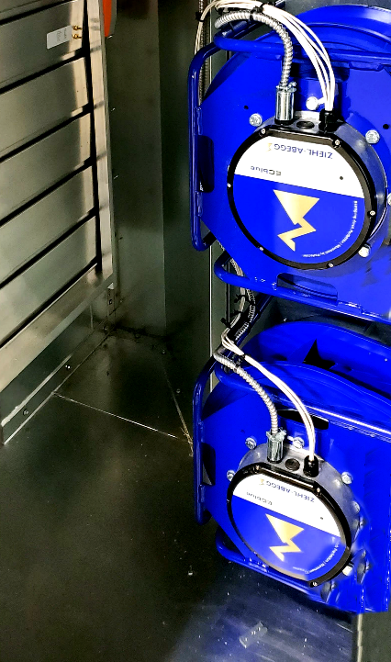
EP - Fans & Filters
Fans
EC fans sized for quiet and efficient operation.
EC fans are built to include air-flow measuring.
No variable frequency drives (VFD) are required to control speed.
Requires minimal maintenance - effectively operating with low efficiency filters without impacting long term performance.
Optional - Plenum fans
Filters
Filters that are 30% (MERV 8) efficient are provided for the outdoor air and return airstreams.

Slide 15
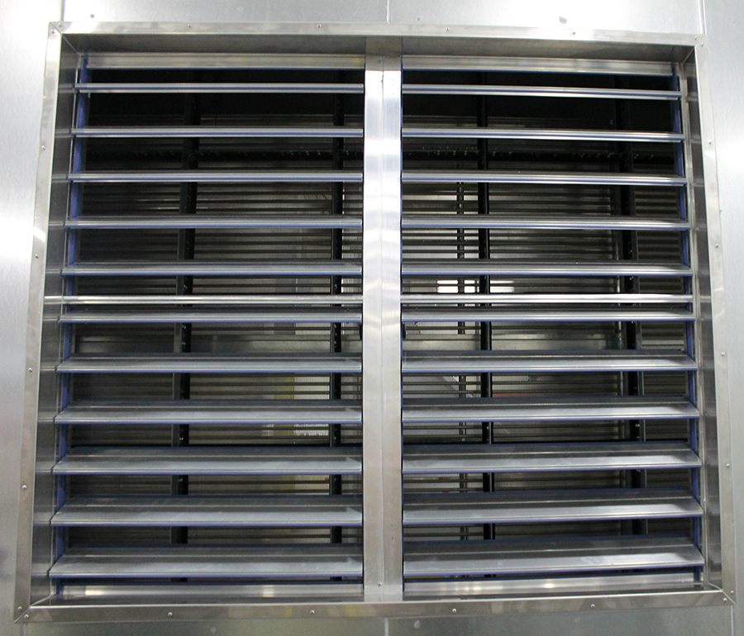
EP - Hoods & Dampers
Modulating bypass damper
Low-leakage motorized fresh air damper and gravity exhaust air damper.
Outdoor units are provided with an intake and exhaust hood with bird screen
Optional:
Motorized exhaust damper available

Slide 16
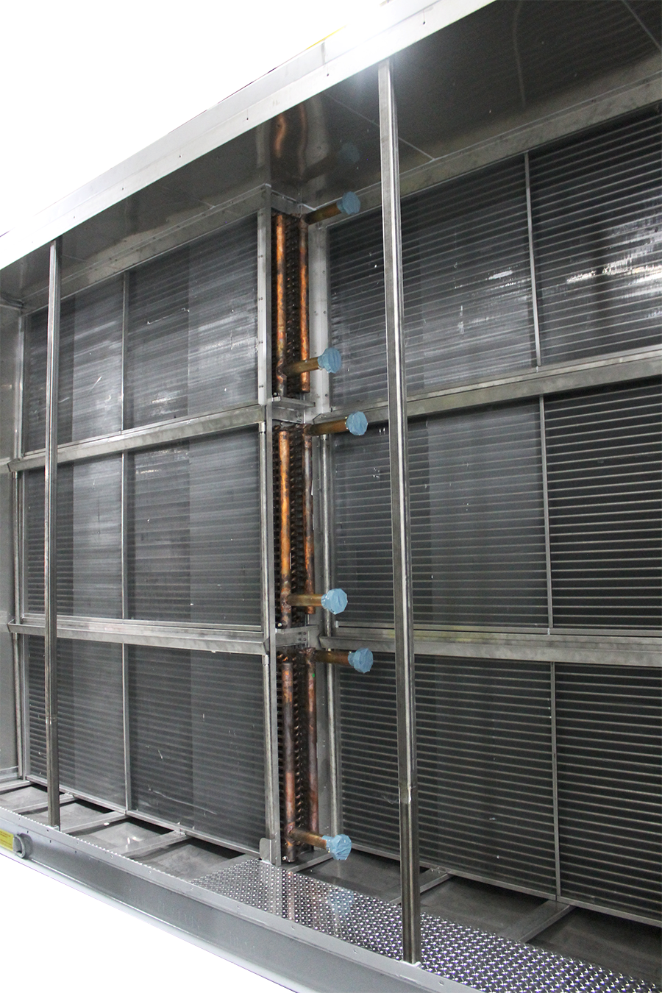
EP - Heating & Cooling Options
Heating Options
  Hot water coil
  Steam coil, non-freeze type
  Electric coil (optional with
  separate electrical connection point)
  Direct or indirect gas burner
Cooling Options
  Chilled water
  Direct expansion coil

Slide 17
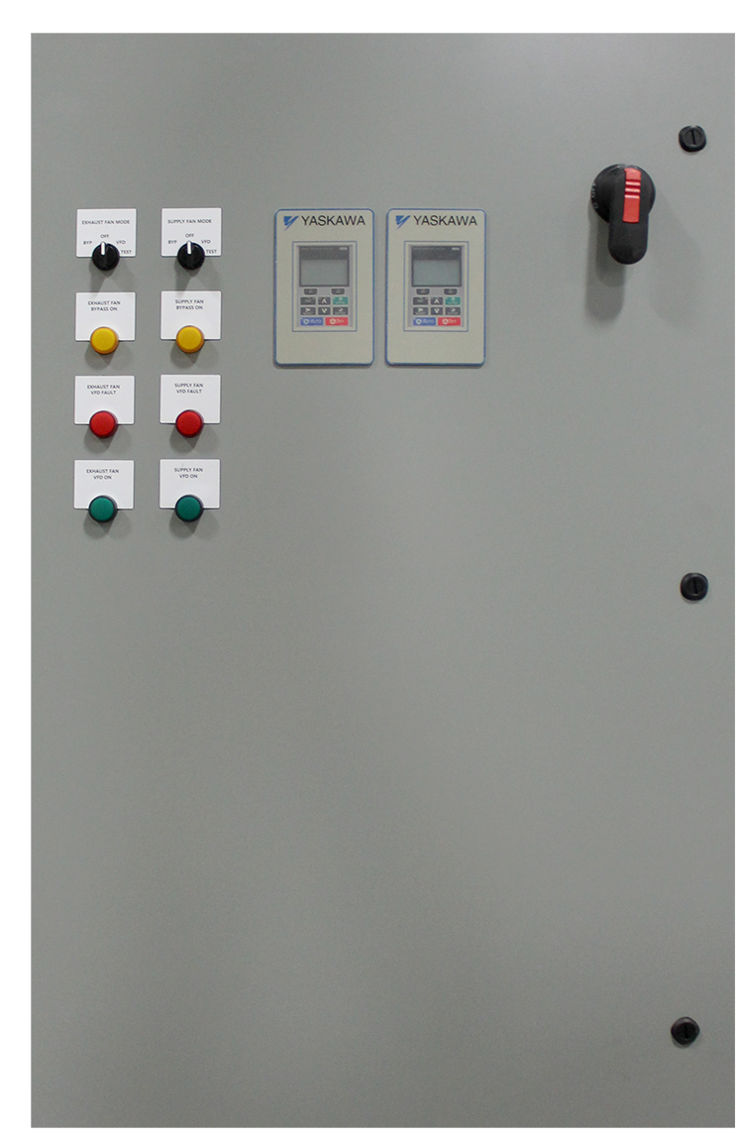
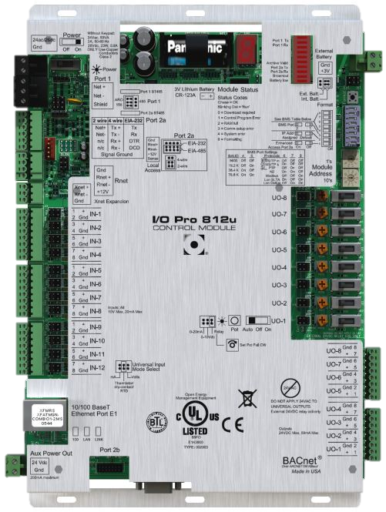
EP – Electrical & Controls Packages
Power distribution panel with non-fused disconnect and branch circuit protection for each motor and transformer. Motors are wired to starters or VFDs.
Custom control packages available.
208 or 480 volt single-point connections available.
Variable speed fans – constant or variable air volume
Variable speed wheel control package
  Frost protection option available
Line side lights and GFI outlet
Digital reading of temperatures
Proportional heating control
Automatic summer/winter changeover

Slide 18
EP Series: Airflow Capacity
Single Wheel EP Series Units
Base Effectiveness %
Notes:
2,000 CFM – 40,000 CFM range standard
Up to 70,000 CFM custom

Slide 19
EPD: Airflow Capacity
Dual Wheel EP Series Units
Base Effectiveness %
Notes:
2,000 CFM – 40,000 CFM range standard
Up to 70,000 CFM custom

Slide 20
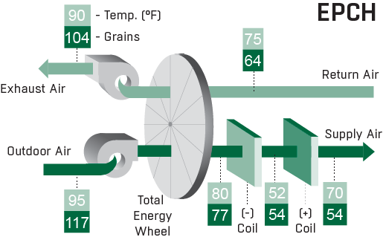
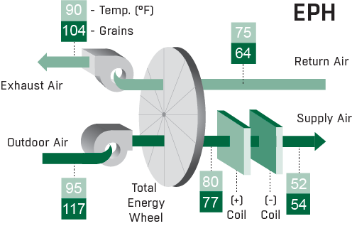
EP Series - Configuration Descriptions
EP – Total (sensible and latent) energy recovery
EPC – Total energy recovery with additional cooling
EPCH – Total energy recovery with sensible and latent control (may be code issues due to cooling and then reheating air)
EPH – Total energy recovery with additional heat
EPHC – Total energy recovery with additional heat and cooling (upstream heat protects coil from frosting and prevents us from simultaneously controlling db and gr)
EPD – Total energy recovery with sensible and latent control (TE and TS wheels)

Slide 21
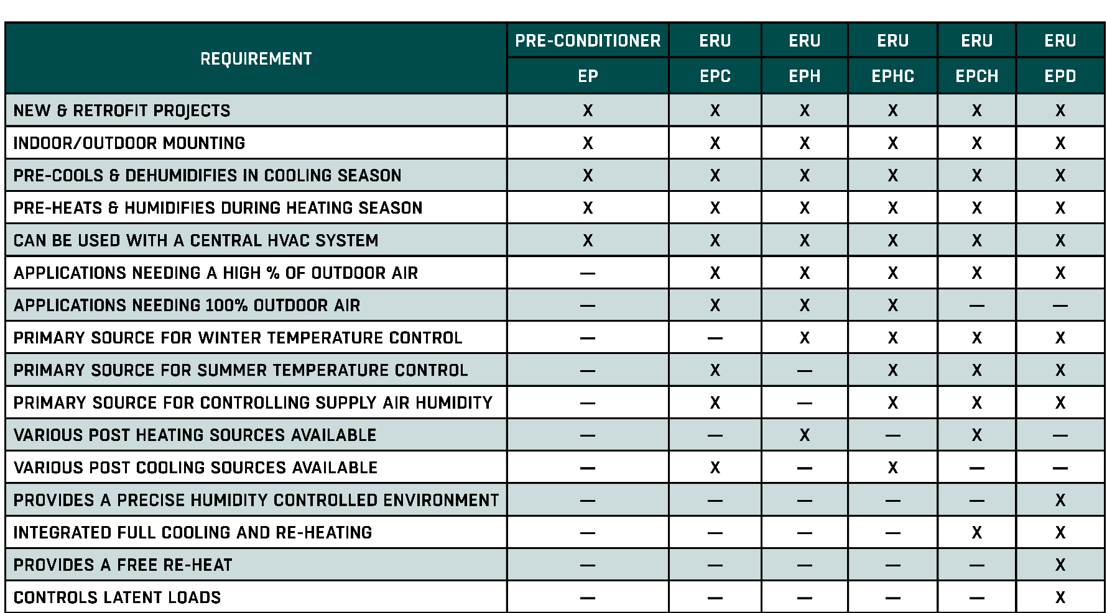
EP Series Configuration Grid

Slide 22
EP - How it Works

Slide 23
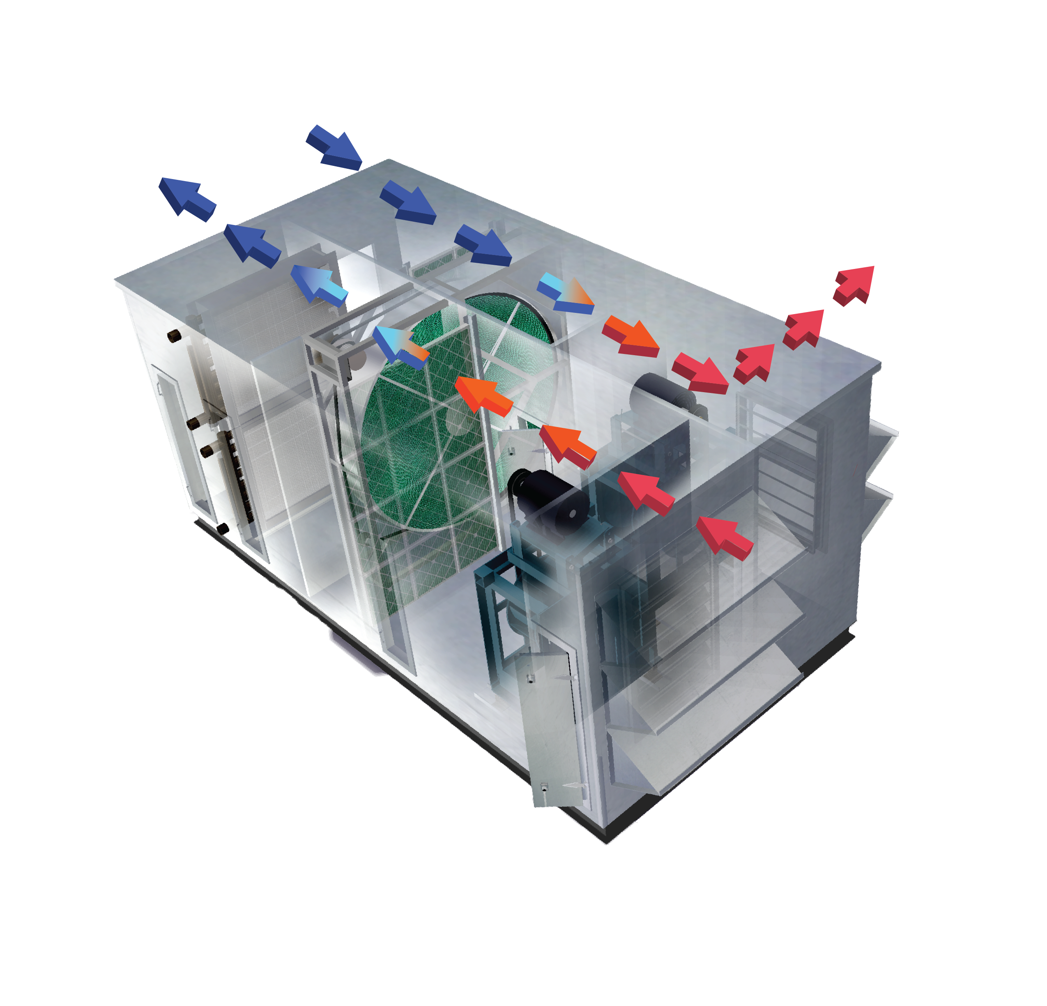
EP/EPD - Cooling Season
Hot, humid outside air is drawn in.
Fresh air is blown in through the slowly rotating True 3Å® wheel. The desiccant-coated fluted media captures heat and moisture.
The air can be further cooled or heated to space neutral conditions.
The cooled and dehumidified air enters the HVAC system or is delivered directly to the occupied space.
Cool, dry return air that is exhausted from the building enters the total energy recovery system.
As return air passes through the True 3Å wheel, it removes the heat and humidity captured by the wheel from the fresh air stream.
Warm, humidified exhaust air is blown out.
5
4
6
7
3
2
1

Slide 24
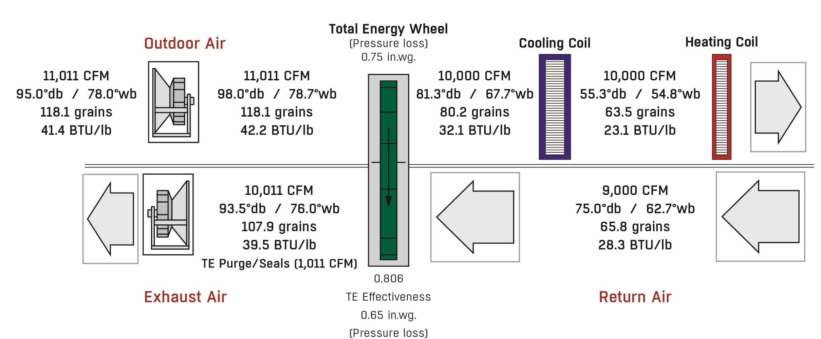
EPCH (Single Wheel) - Cooling Mode
REDUCES COOLING LOAD FROM 71.5 TONS TO 33.8 TONS

Slide 25
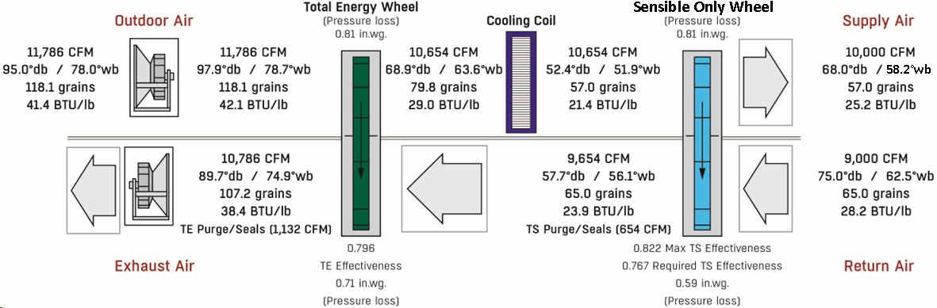
EPD (Dual Wheel) - Cooling Mode
REDUCED COOLING LOAD FROM 71.5 TONS TO 30.5 TONS
No reheat energy is required since it is provided by the sensible only wheel.

Slide 26
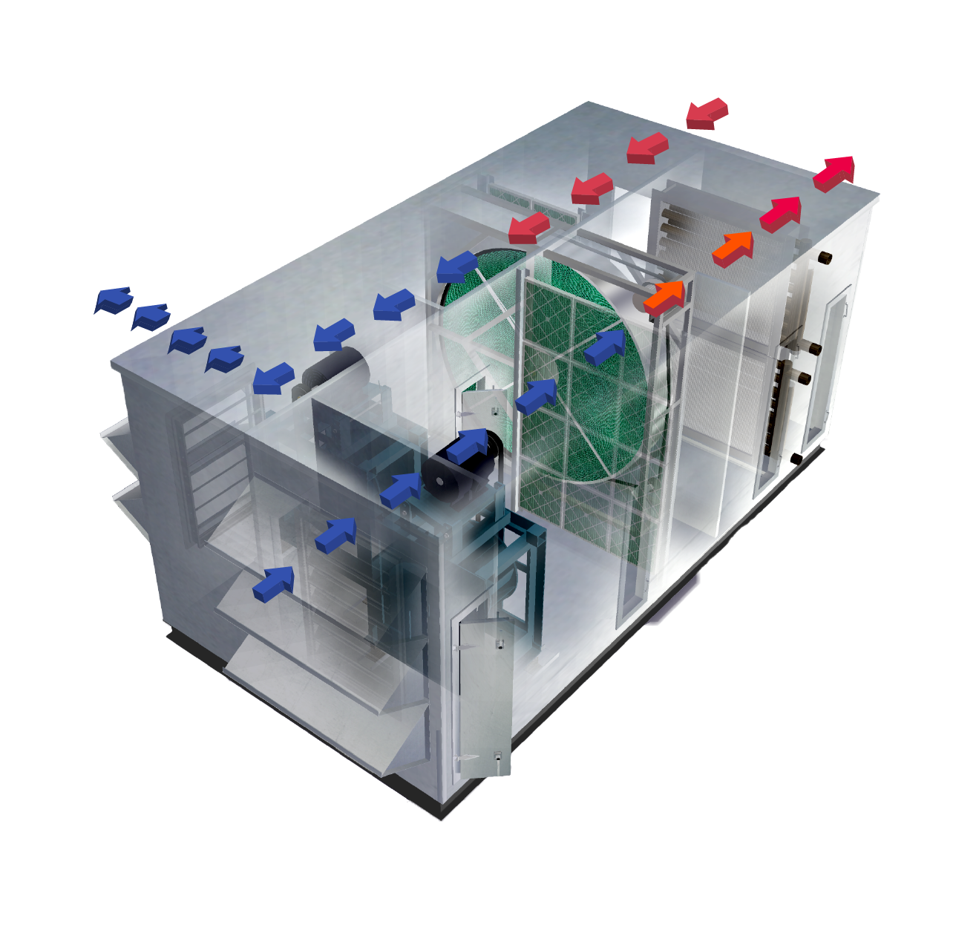
EP/EPD - Heating Season
Cold, dry outside air is drawn in.
Fresh air is blown in through the slowly rotating True 3Å wheel. The
desiccant-coated fluted media captures heat and moisture from the exhaust air and transfers it to the supply side.
The air can be further cooled or heated to space neutral conditions.
The warmed and humidified air enters the HVAC system or is delivered directly to the occupied space.
Warm, humid return air that is exhausted from the building enters the EP total energy recovery system.
As return air passes through the True 3Å wheel, it captures the heat and moisture to be transferred back to the supply air.
Cool, dry exhaust air is blown out.
5
4
7
6
3
2
1

Slide 27
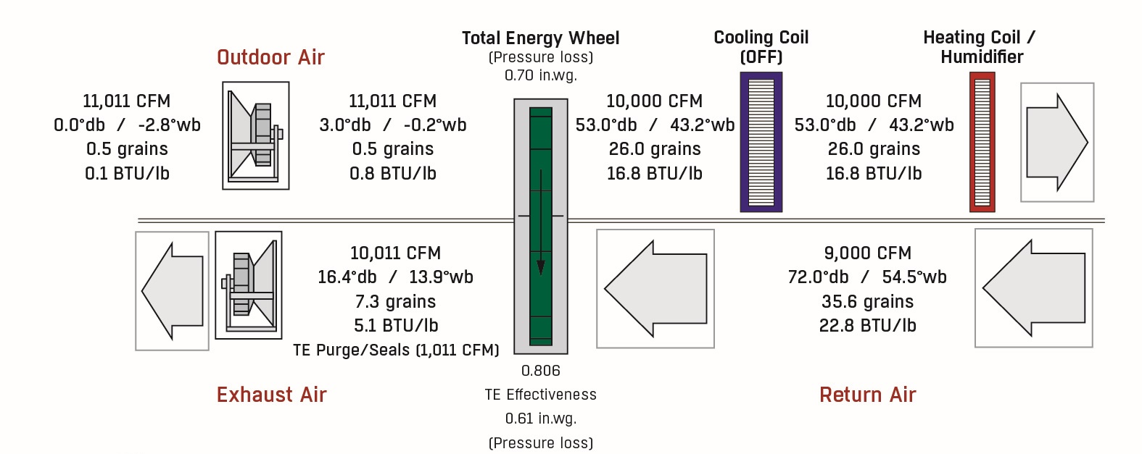
EPCH (Single Wheel): Heating Mode
REDUCES HEATING LOAD BY 542.5 MBH
THAT WOULD BE A 159 KW ELECTRIC HEATER
AND A 165.1 LB/HR HUMIDIFIER

Slide 28
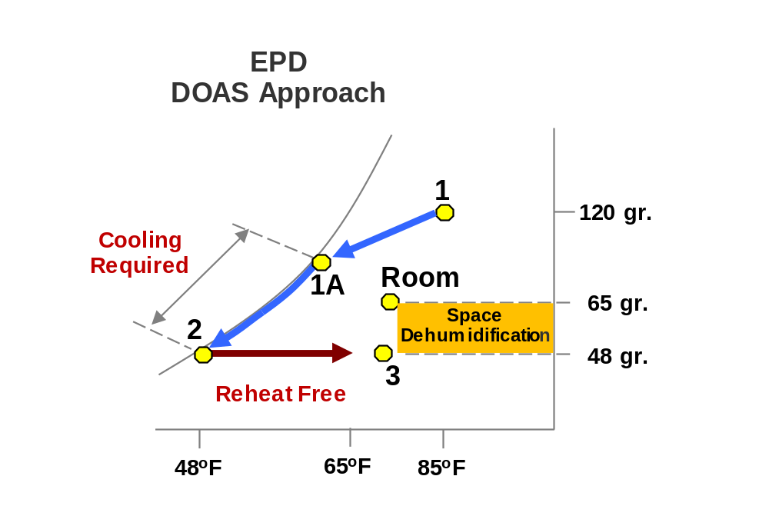
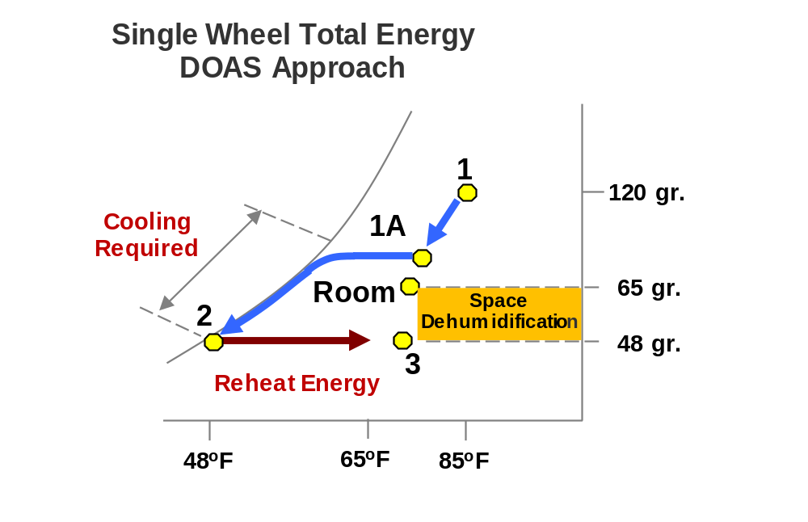
Psychrometric Comparison: Single Wheel vs EPD Cooling
Single Wheel approach needs 45 Tons of cooling input required for a 10,000-CFM system.
In addition, 184,000 BTU of reheat energy is required.
EPD approach needs only 32 Tons of cooling input for the same 10,000 cfm system.
No reheat energy is required since it is provided by the sensible only wheel.

Slide 29
Applications

Slide 30

EP Series: Applications & Target Markets
Data Centers
Hospitals
Laboratories
Nursing Homes
Universities
Classrooms
Dormitories
Hotels
Casinos
Manufacturing
Office Buildings
Retail

Slide 31
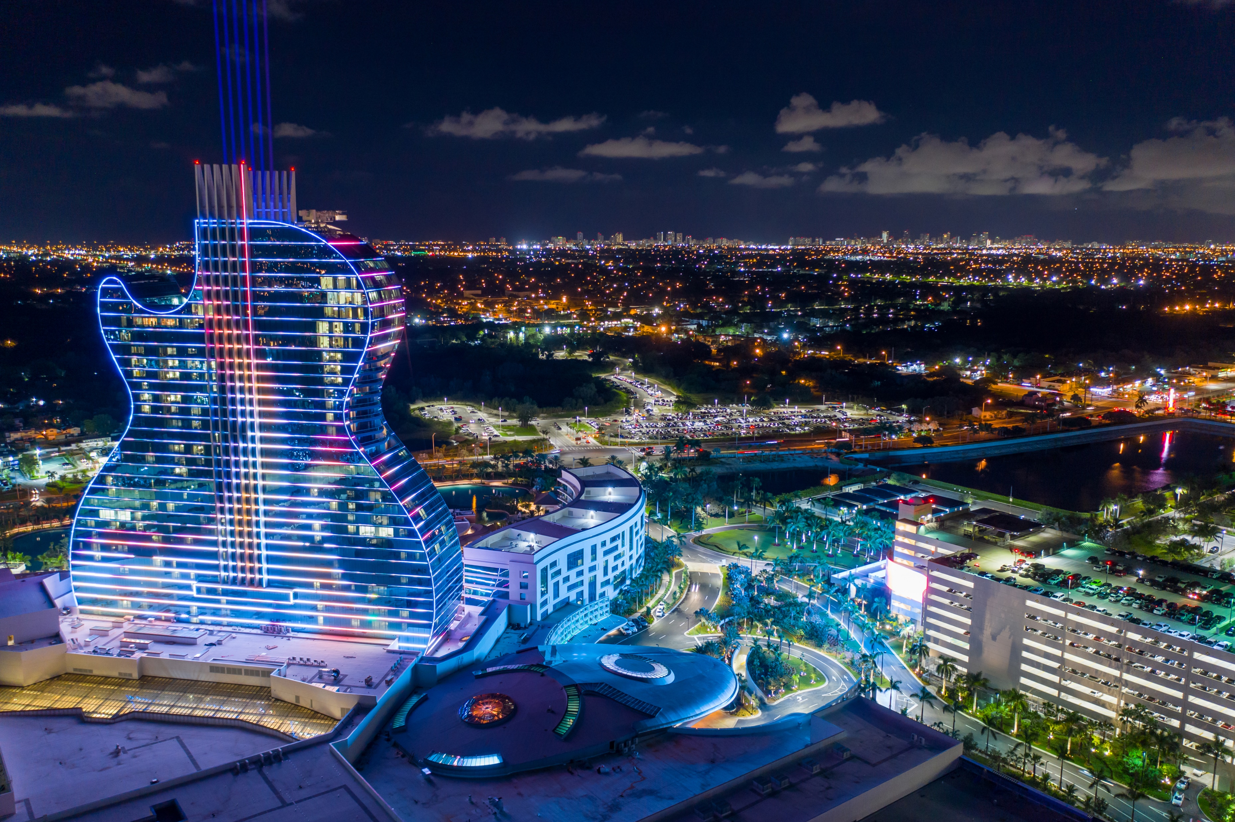
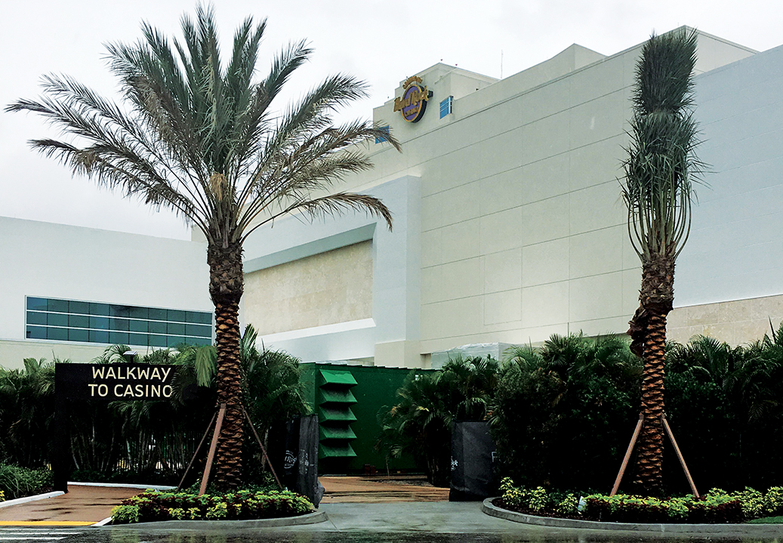
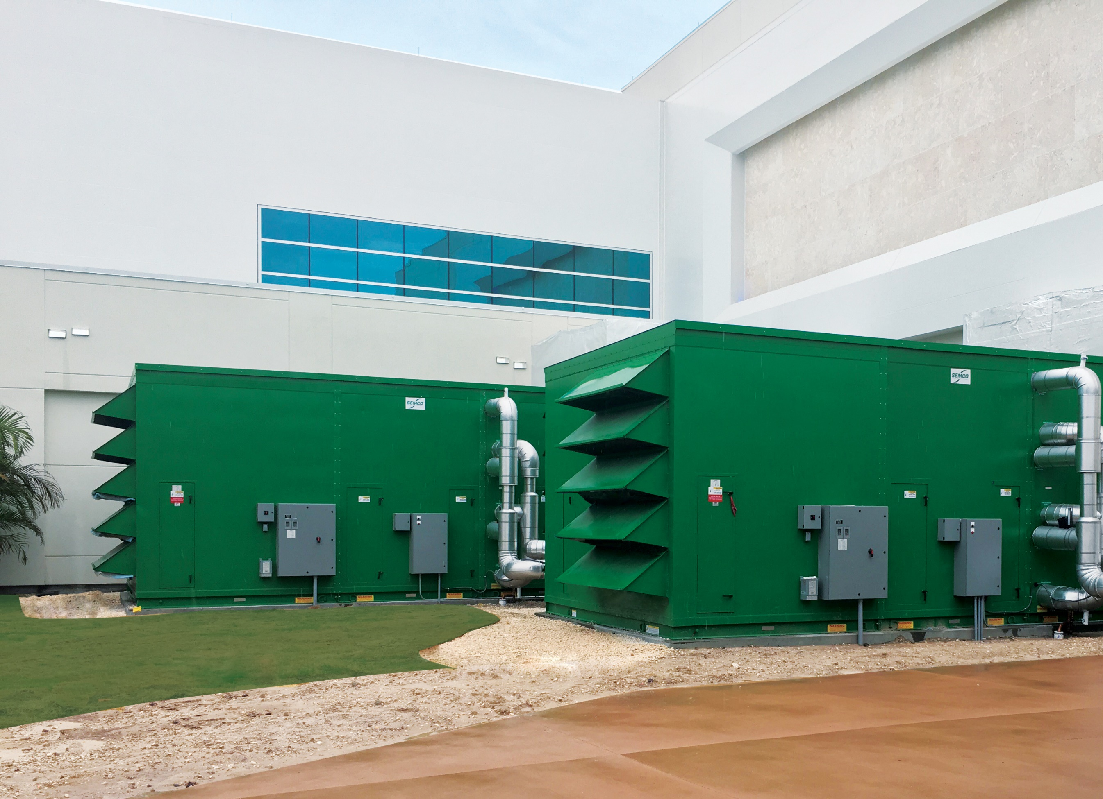
EP Series - Case Study Example
Seminole Hardrock – Hollywood, FL
3 systems size EPCH-43
Total CFM: 120,000
Total Cooling Tonnage Provided: 933
Total Cooling Saved by Enthalpy Wheel: 461 tons
Total Heat Provided by TE Wheel: 880,522 BTU/hr
Specializing in casinos, Giovanetti Shulman Associates Consulting Engineers (GSA), has insisted on using SEMCO units and wheels for their casino projects, since Peter Carney P.E., LEED AP, Vice President of Mechanical Engineering for GSA, stood downstream of a SEMCO True 3Å wheels in a casino and could not smell any cigarette smoke.

Slide 32

Thank you for your attention!

