Slide 1
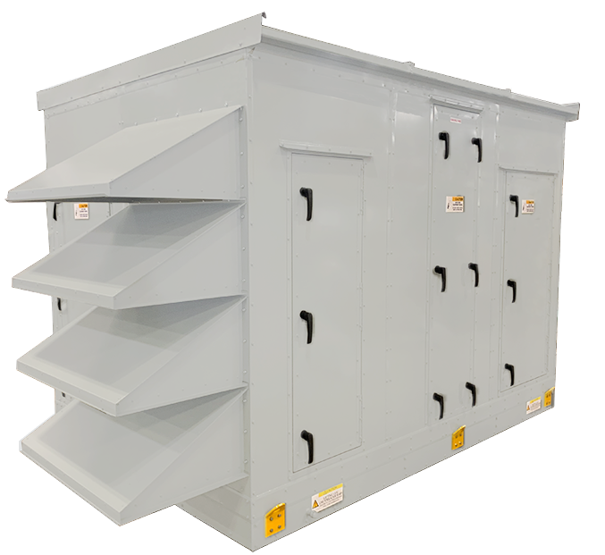


Air Handling Units

Slide 2

Technical Training

Slide 3



The Complete Package
CHALLENGE:
Energy recovery is not appropriate for the application or specific part of the system
SOLUTION:
FläktGroup SEMCO offers the configurable ElitePro AHU with optimized footprint
Can be incorporated into a system with the ElitePro ERV handling OA and ElitePro AHU focused on circulating conditioned air
Hundreds of standard configurable options that meet the requirements of almost every application, allowing for quick manufacturing turnarounds
Same high-quality components as the ElitePro ERV with optimized box size:
  Dual-wall R-13 foam panel structure
  World-class performance high-efficiency EC fans
  Standard BACnet compatible integrated controls
Notes:
With the addition of the AHU we are not able to offer the customer a complete package of ERV and AHUs
Not every job requires ERV and the ELT AHU provides a standardized solution for those applications

Slide 4

Applications
School classrooms
Offices
Dormitories, apartments
Retail stores
Churches
Day care facilities
Jails and prisons
Casinos
Restaurant dining areas
Movie theaters
Bowling centers
Light manufacturing areas
Notes:
31
26
26
Read the slide

Slide 5

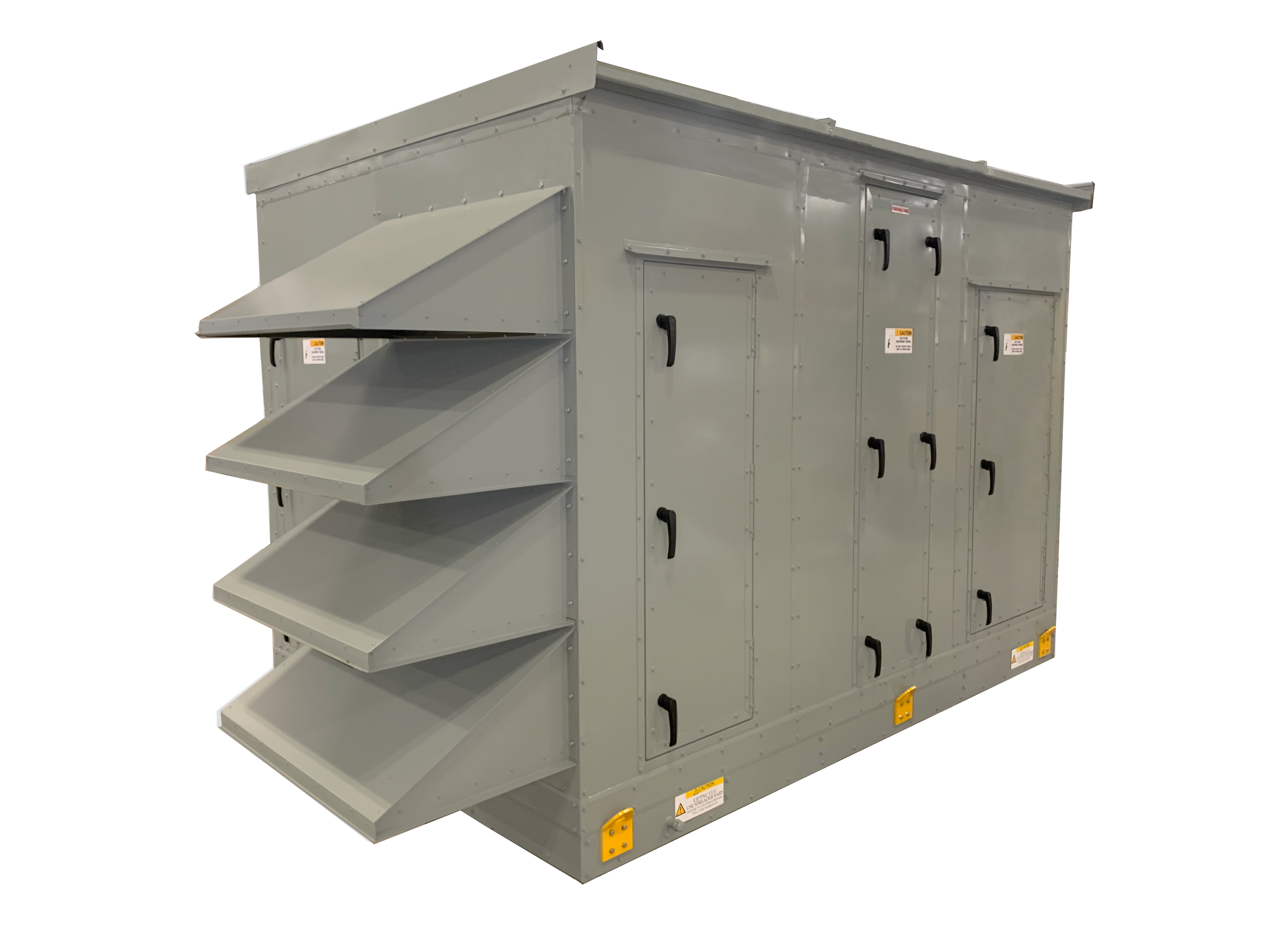
Model Numbers
AHU-XXX-C
  Cooling
AHU-XXX-CEH
  Cooling and Electric Heating
ECZ-XXX-HC
  Heating and Cooling w/ Economizer
AHU-XXX-CH-FF
  Cooling and Heating w/ Final Filter
MAU-XXX-GB-FF
  Make-up Air Unit, Gas Burner w/ Final Filter and Economizer
Notes:
The first sections call out if the Unit is an air handling unit, make up air unit, or AHU with economizer
2nd section designates the size of the unit
3rd section designation configuration
4th section designated Final filter

Slide 6
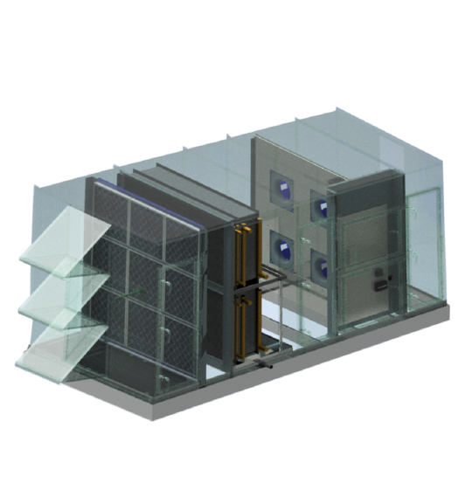
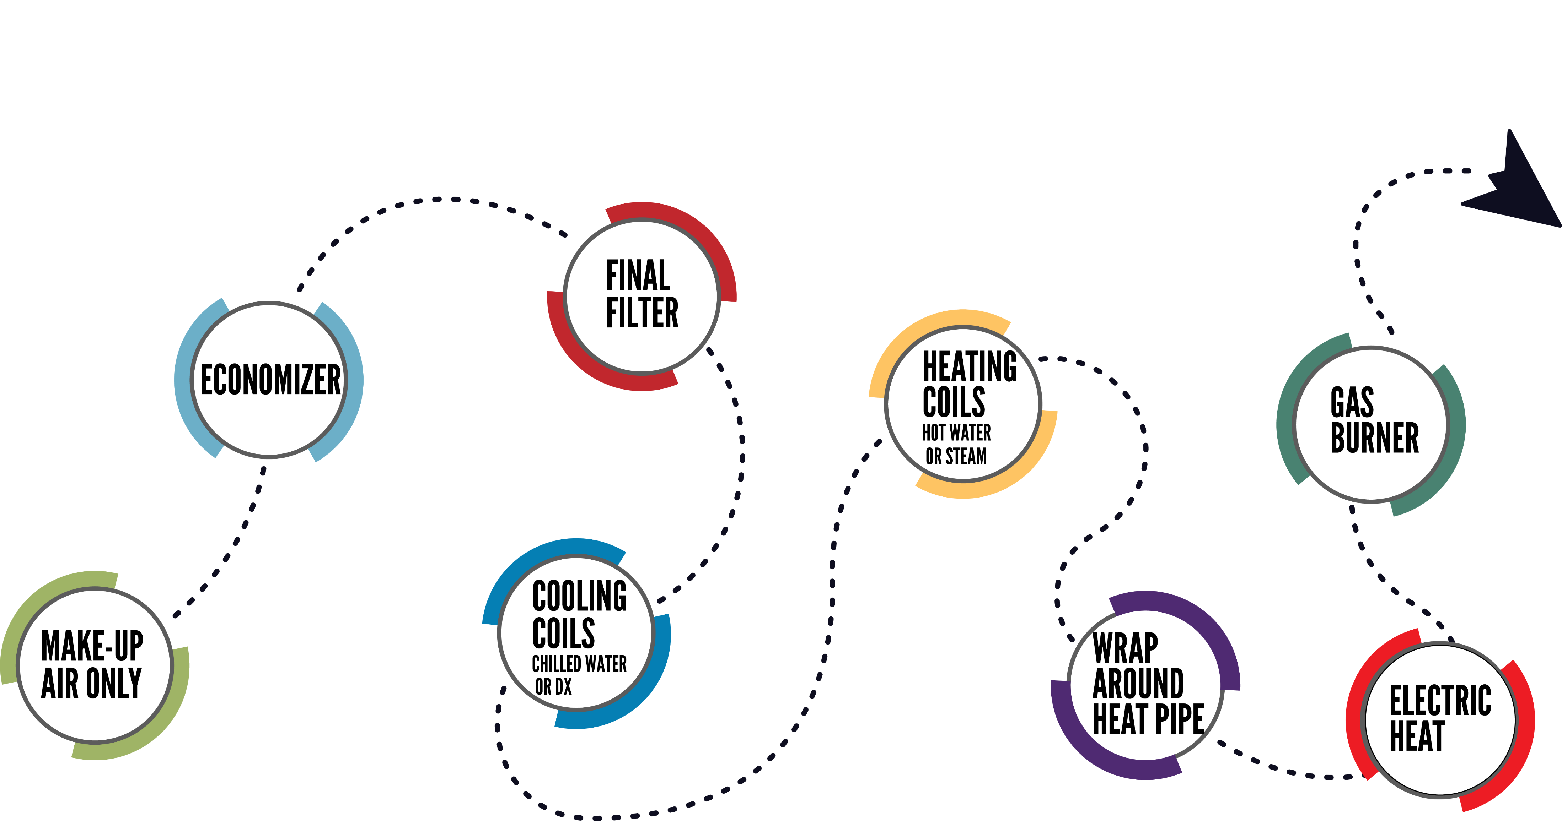
Optional Configurations
Notes:
Read from the slide.
Show visual of options we offer.
Point them to technical guide to see extra configuration

Slide 7
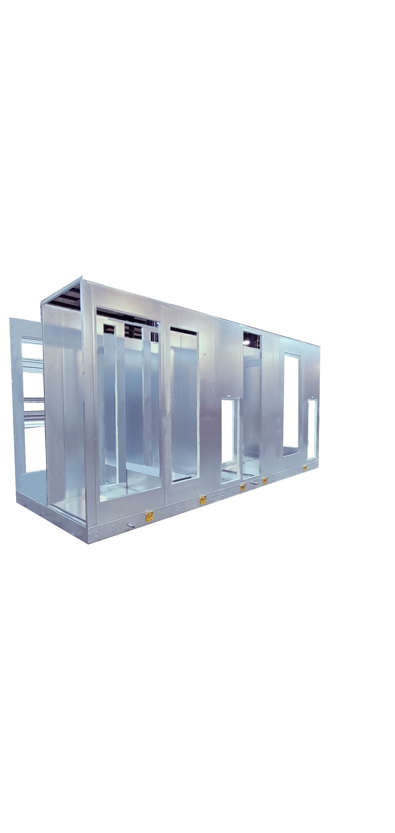
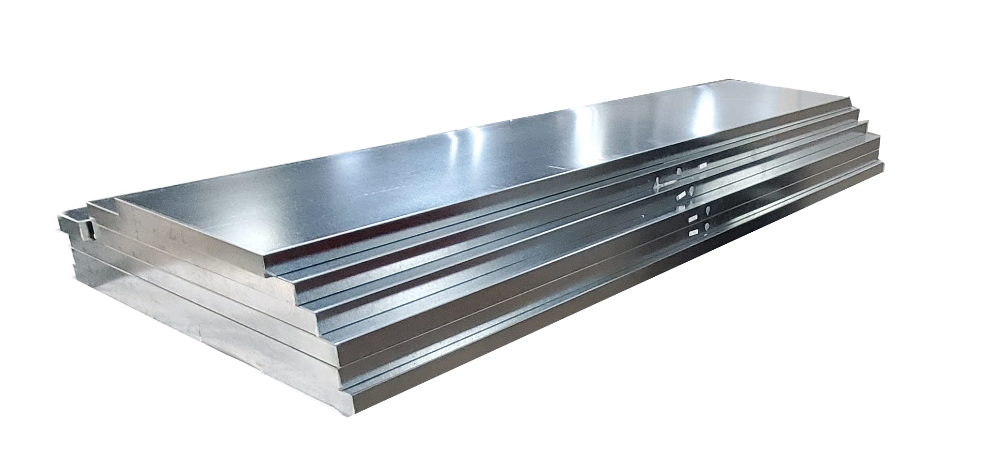
Casing
20 gauge galvanized inner and outer panel with 2” foam (R-13)
304SS inner and outer optional
Standard finish is unpainted (galvanized)
w/paint optional
Standard deflection is L/240
No thermal break
Access door location are pre-determined
Notes:
Read slide
Highlight that this is a one-piece unit. No bolting together of module in the field required.
One piece construction only no shipping splits allowed

Slide 8
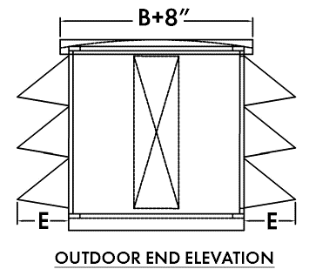
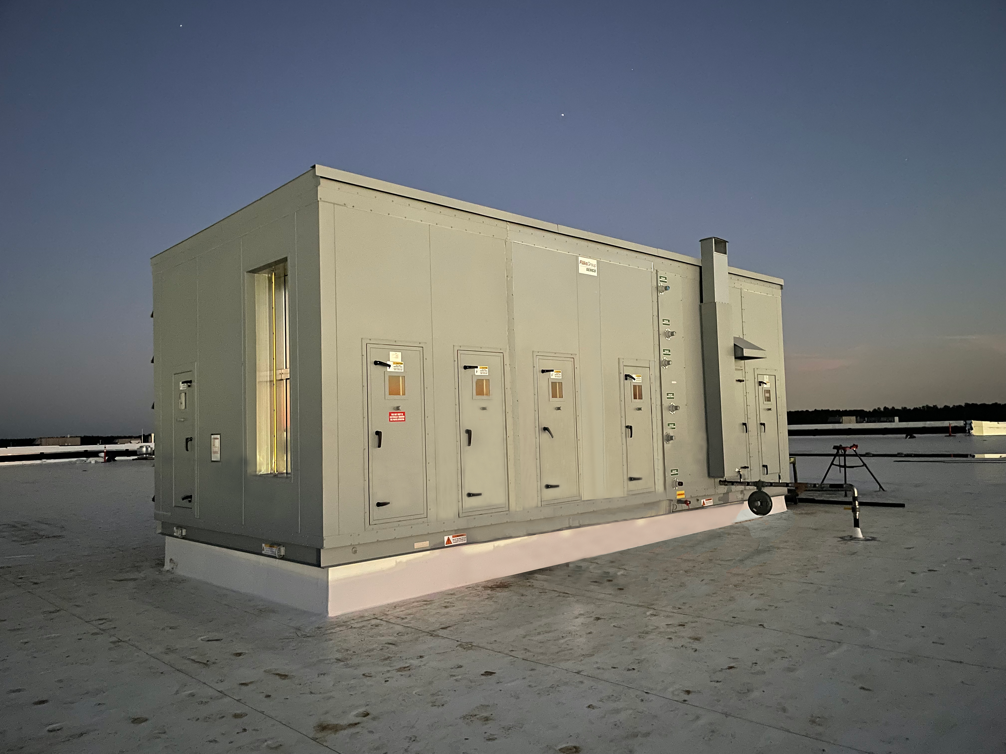
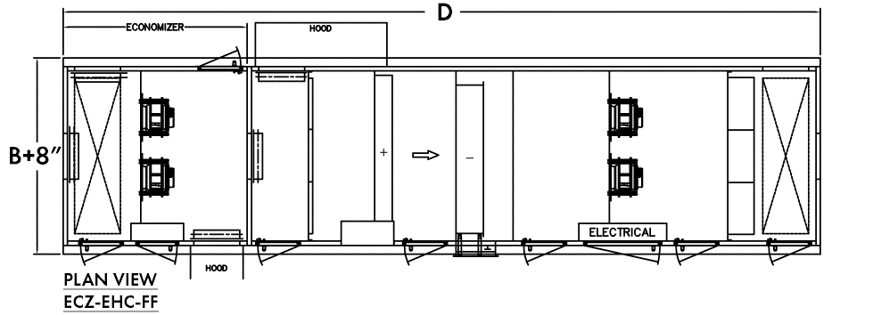
Outdoor Units
Pitched roof
Hoods with screen openings
Roof curb option
  14", 18" and 24" ducted insulated, ducted non-insulated, or open insulated
Notes:
Bullets call out items being added or that are selectable when choosing an outdoor unit

Slide 9
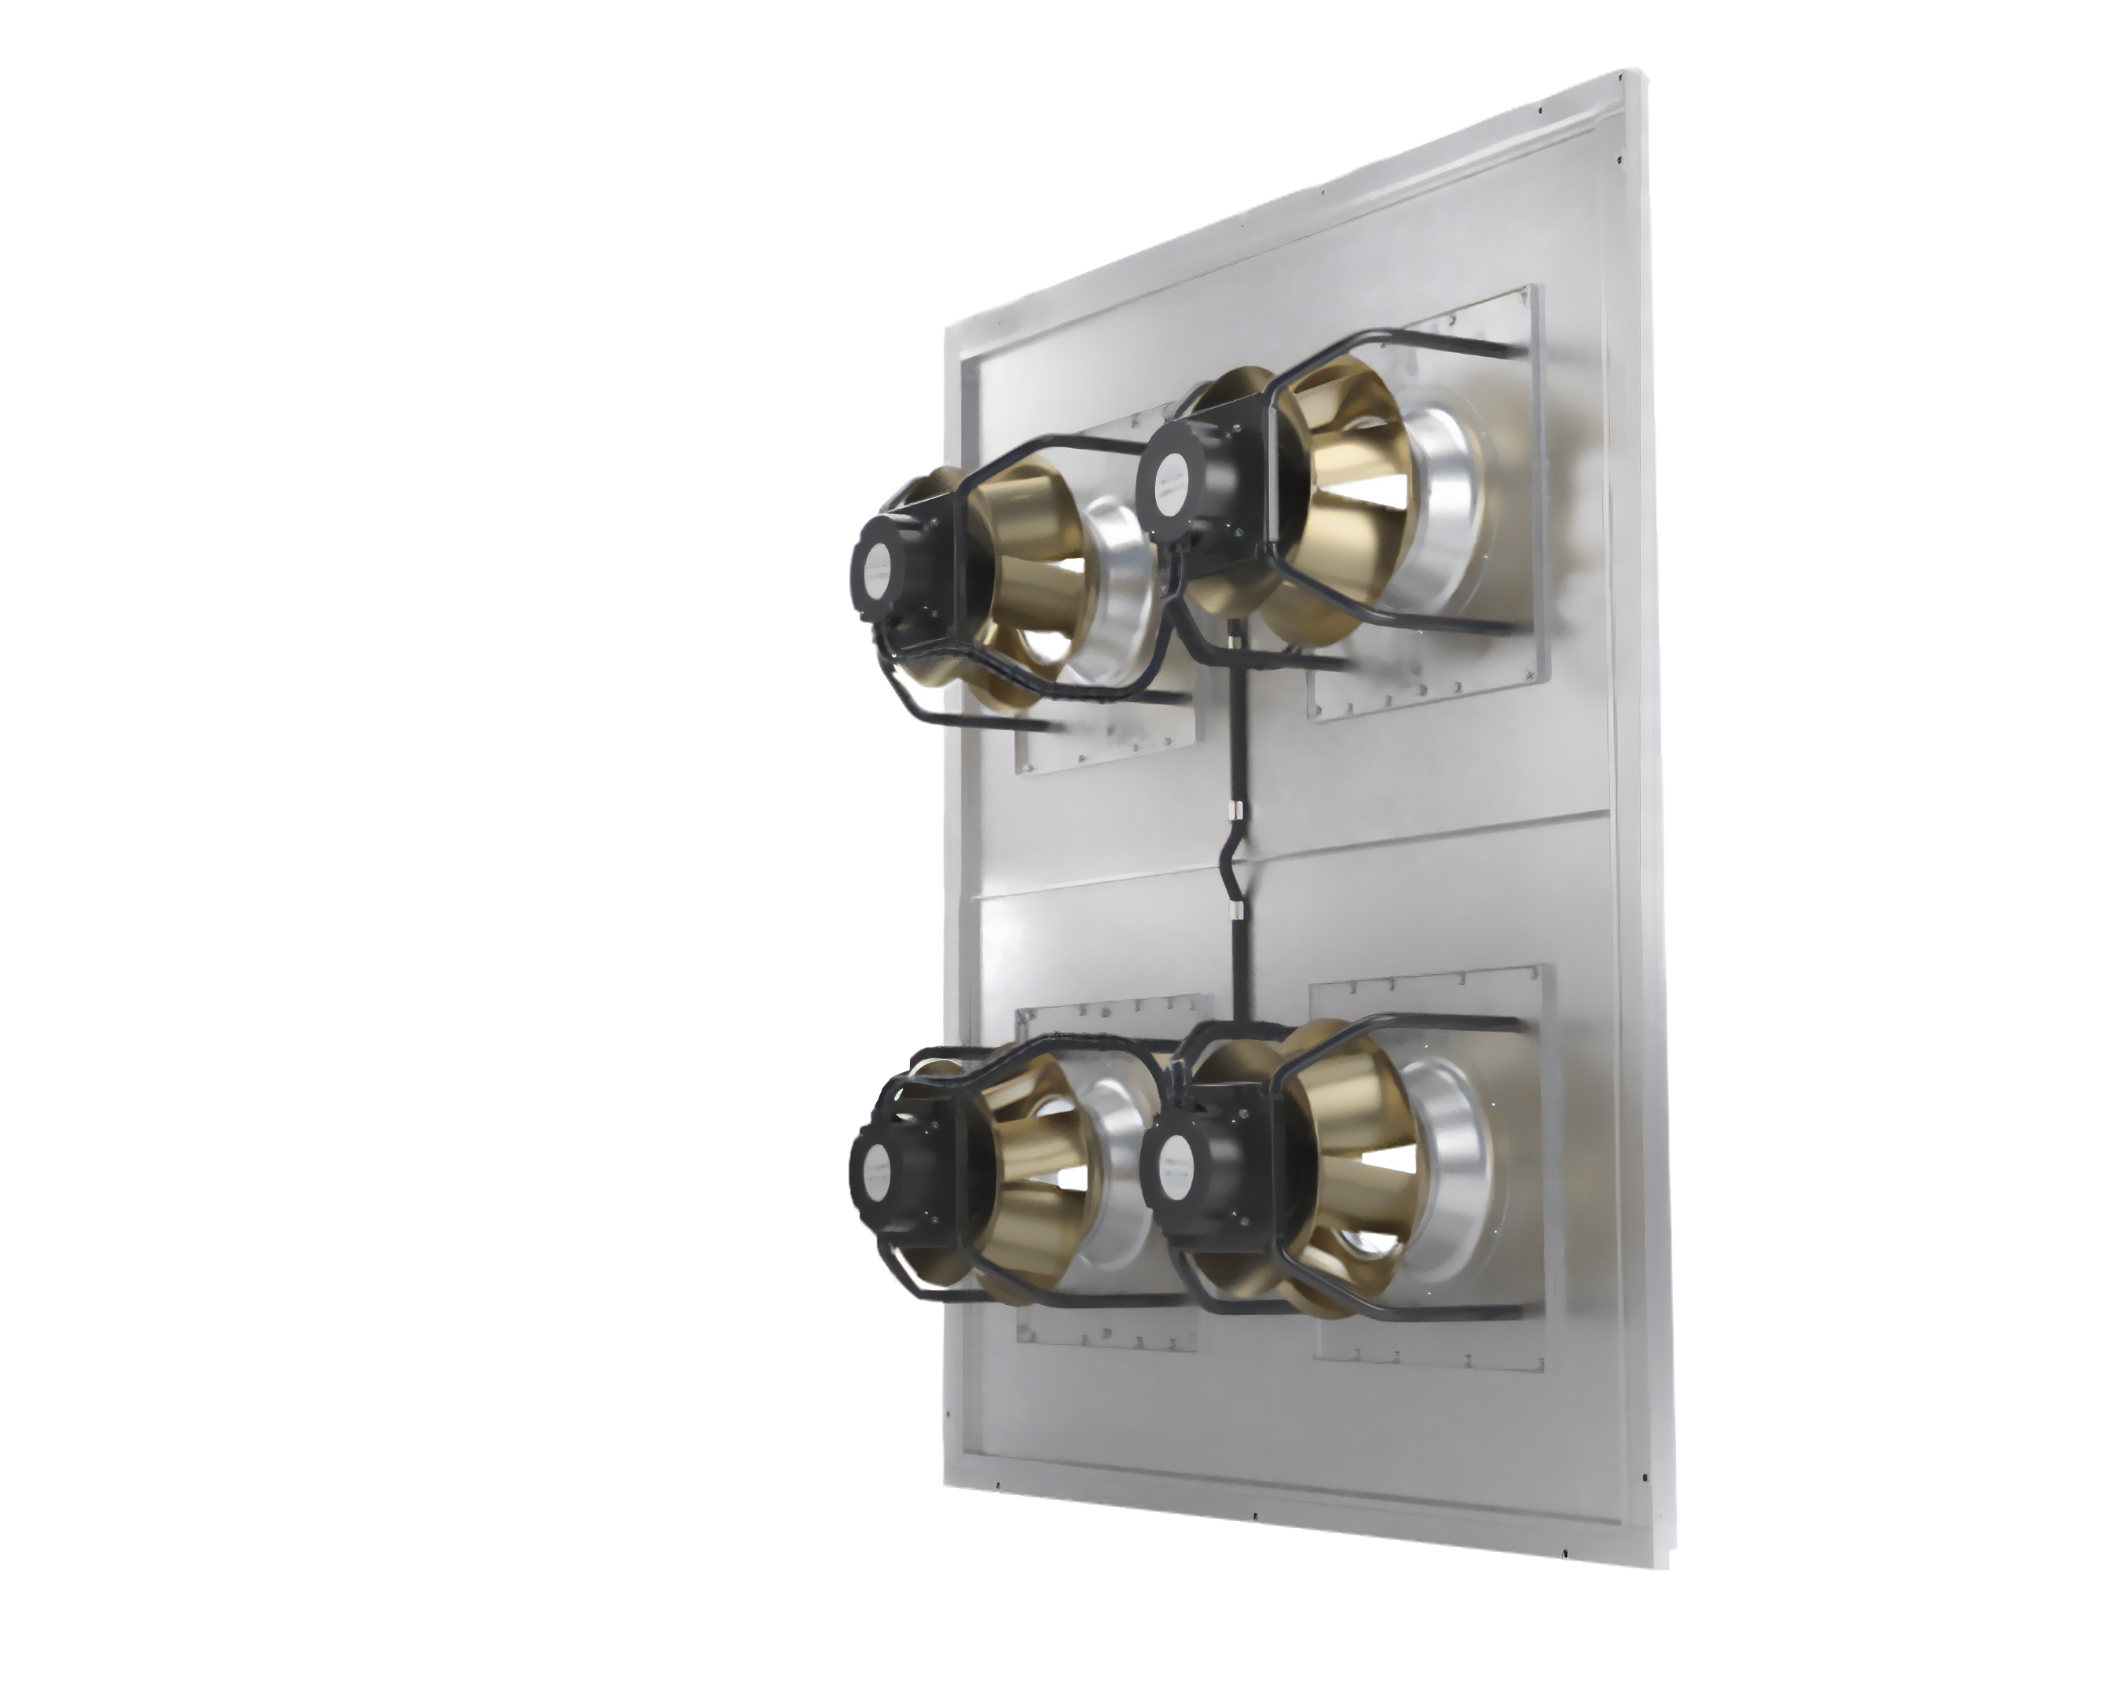
Fans Sections
Fan performance is based off of ZA but FläktGroup SEMCO reserves the right to substitute the ZA fan with a similarly performing brand.
Supply and exhaust EC fans are quiet and efficient.
EC fans are built to include air-flow measuring.
Compact footprint
Requires minimal maintenance - effectively operating with low efficiency filters without impacting long term performance.
Notes:
Read from the slide

Slide 10
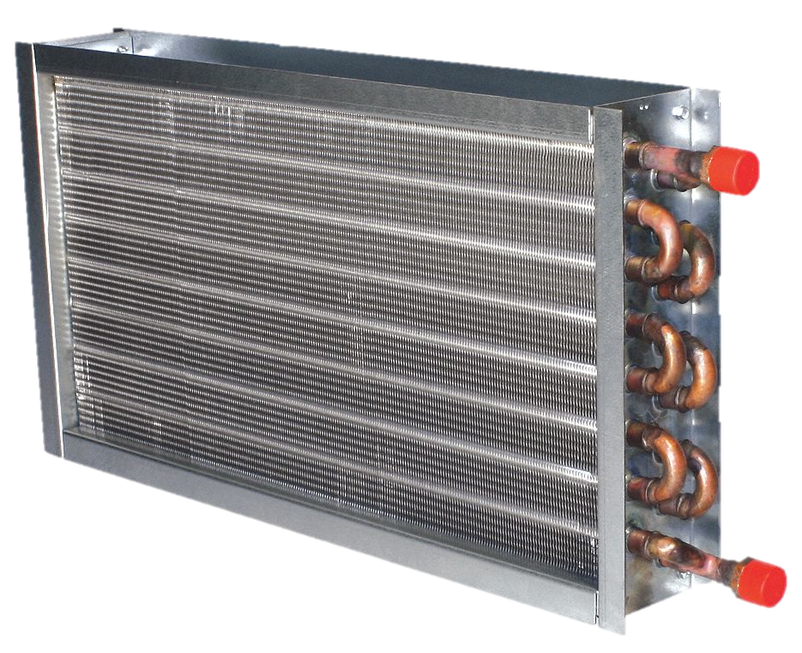
Cooling and Heating Coils
Coils will be selected based on conditions provided and desired performance
Default coil is 5/8” with 1/2” optional
Max FPI is 12
Max rows for cooling is 8 and heating 2
Steam, DX, and Glycol available
UV lights available
Selection process will be similar to EZ Coil
Notes:
Read from the slide
Highlight that the coil is optimized to match required conditions

Slide 11
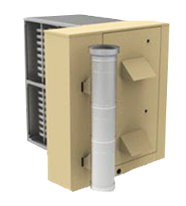
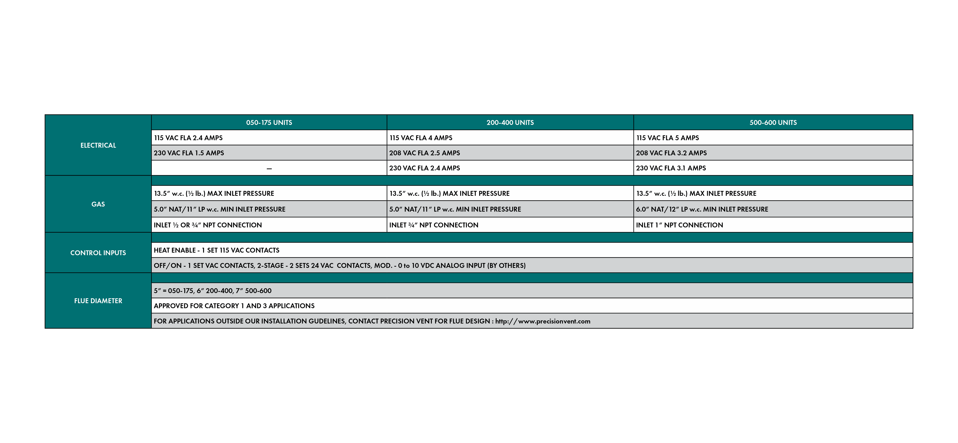
Gas Burner
Heatco Burners Model HMG
81% efficiency
Turndown 10:1
Minimum CFM increases to protect heating elements
Standard Venting
Notes:
Read from the slide
Highlight the increased min cfm. To find exact numbers refer to tech guide
This is the only burner option available

Slide 12
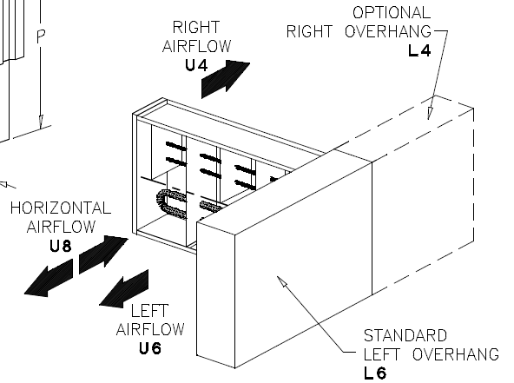
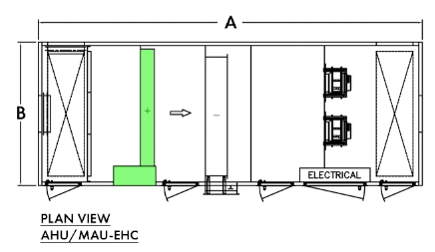

Electric Heat
Indeeco® duct heater
SCR control
Minimum CFM increases to protect heating elements
Notes:
Read from the slide
SCR allows for modulation control of heater
Highlight the increased min cfm. To find exact numbers refer to tech guide

Slide 13

Make Up Air Unit
No return air, 100% OA
All options same as AHU
Same footprint as AHU
Notes:
Read from the slide
Highlight that if a Make Up Air Unit is selected it’s the same footprint as ahu just no return opening

Slide 14
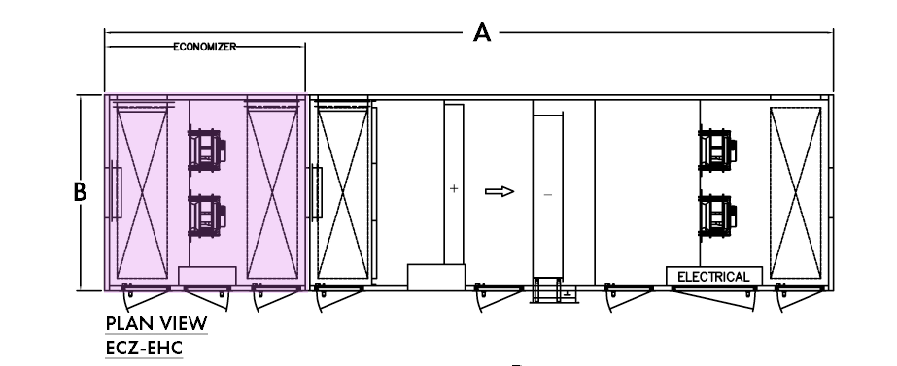
Economizer
Adds EC exhaust fan section
Additional length added to the unit
Exhaust fans sized the same as supply fans (size and quantity)
Notes:
Read from the slide
Refer to tech guide for exact dimension and increased dimension when selecting an economizer

Slide 15
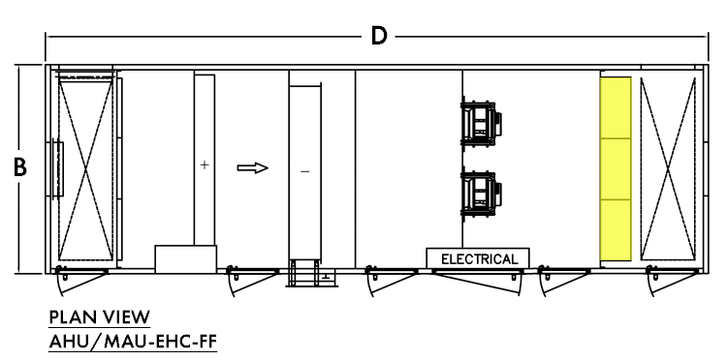
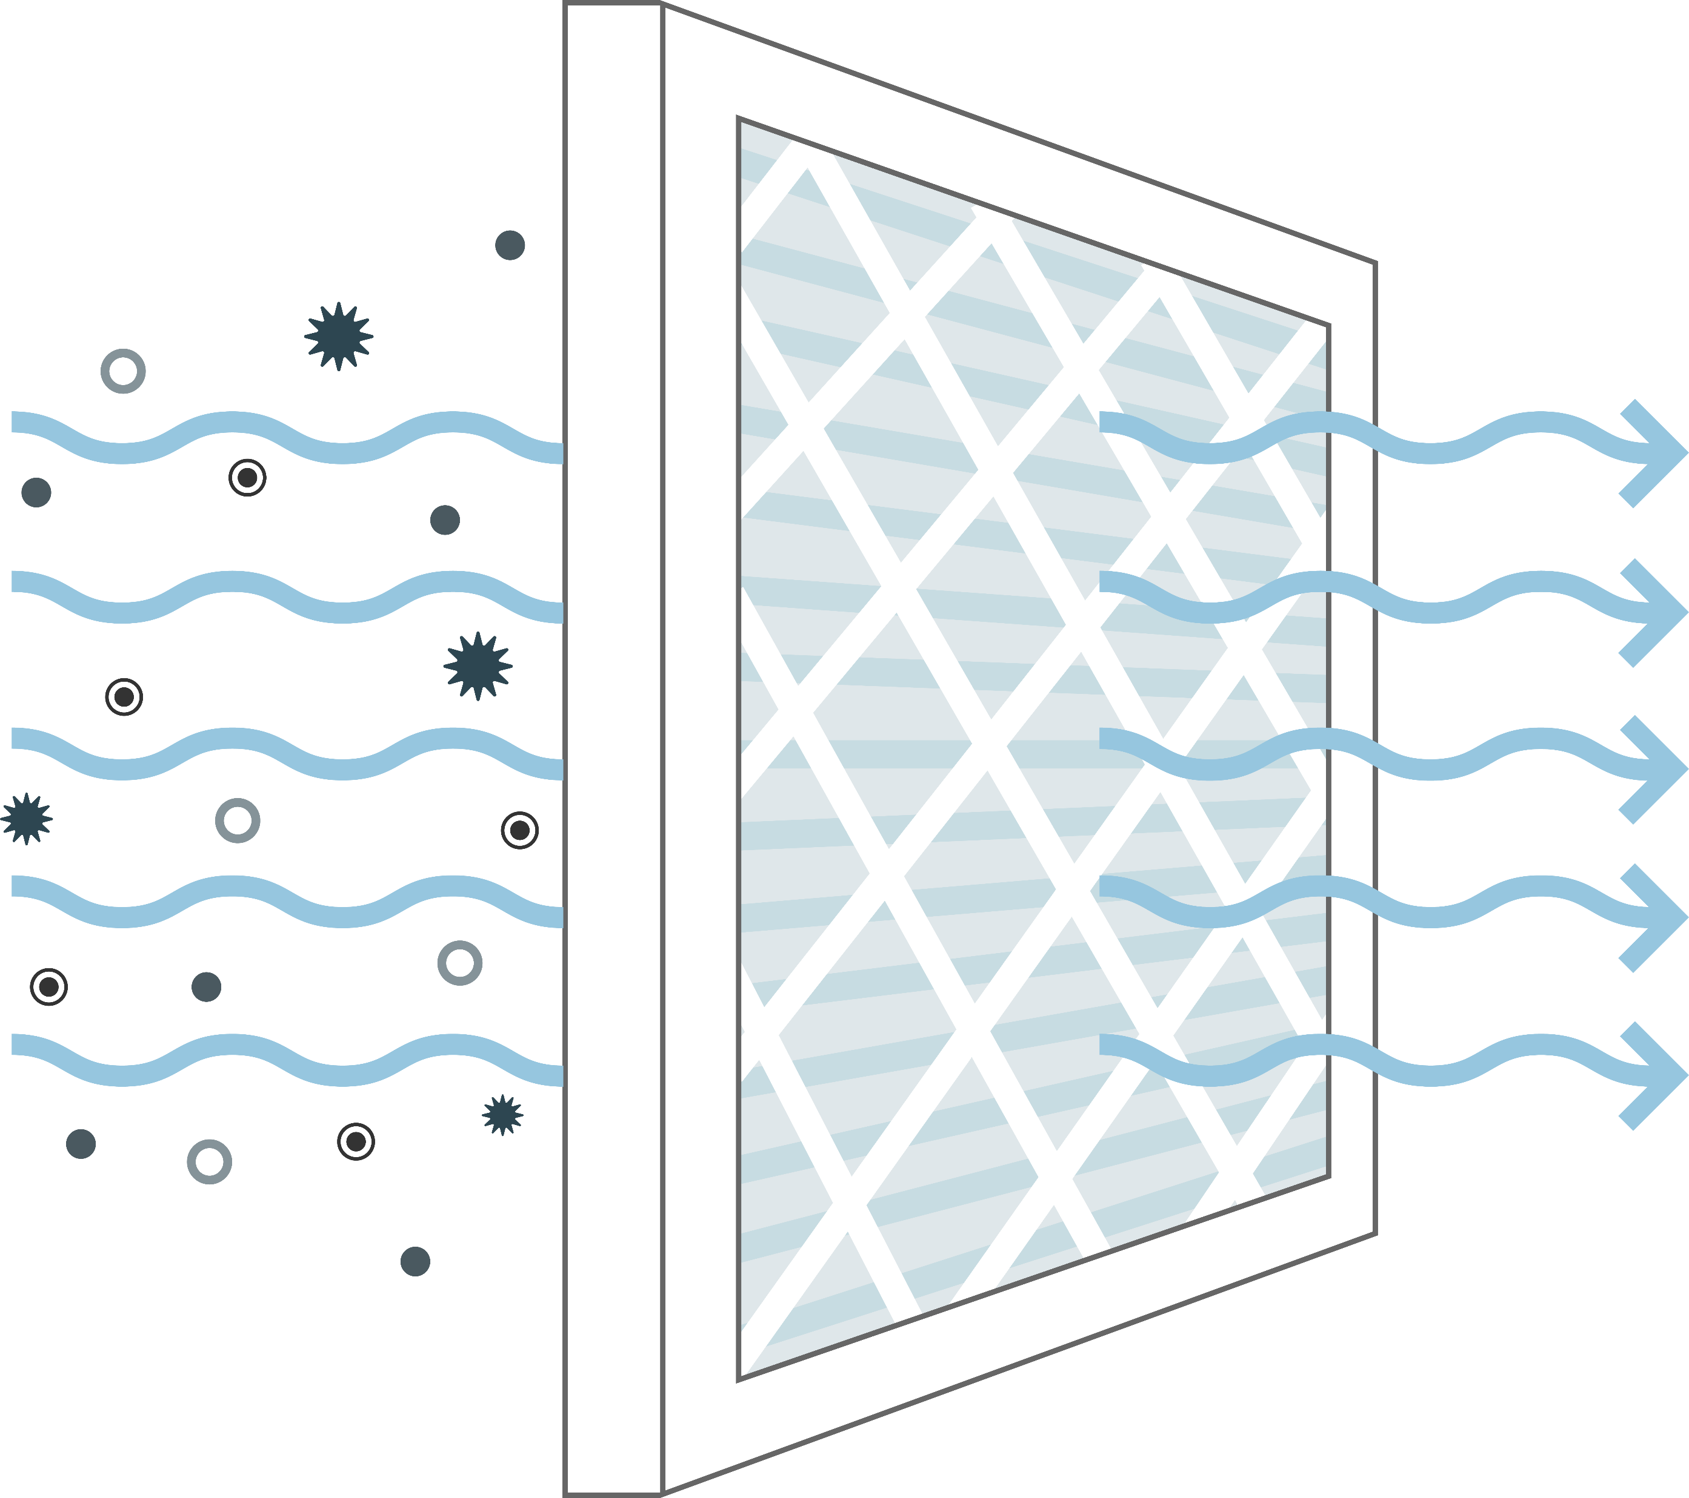
Final Filter
Adds section at the end of unit to filter air before leaving the unit
Allows for 12” MERV 13/14/15 filters
Additional length added to the unit
Notes:
Read from the slide
Refer to tech guide for exact dimension and increased dimension when selecting an final filter
Unit is standard with intake filter rack which has 2” MERV 8,12, 13 options

Slide 16
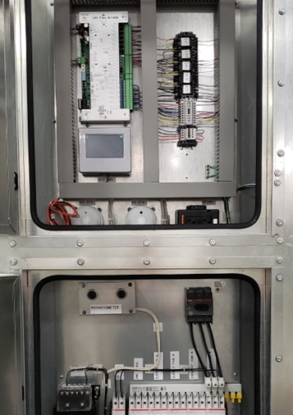
Electrical & Controls Packages
Electrical Package
Integrated electrical and controls panels
Internal disconnect
208/230 & 460/3/60 input power
Controls Packages
Supply temperature control
Communication to BAS via BACnet MS/TP
Standard full-control by FläktGroup SEMCO
Optional controls by others
EC variable speed fans
Notes:
Read the slide.
575V electrical are handled by a transformer provided by others.
If controls can be specified to be terminal strip only for controls by others

Slide 17
Airflow Ranges in CFM
21,250 – 25,000
The ElitePro AHU serves the largest market segment
18,000 – 22,500
16,000 – 20,000
13,125 – 17,500
8,125 – 12,500
6,500 – 10,000
4,875 – 7,500
3,000 – 5,000
1,200 – 2,000
1,800 – 3,000
Notes:
These are the air flow ranges that are available by unit size.

Slide 18

Thank you for your attention!

