Slide 1
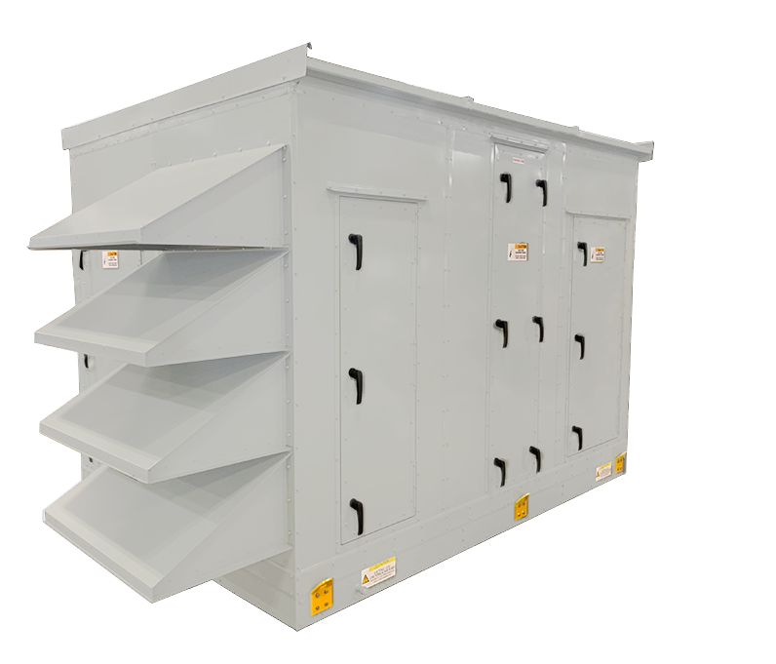


Air Handling Units

Slide 2
Technical Training

Slide 3



The Complete Package
CHALLENGE:
Energy recovery is not appropriate for the application or specific part of the system
SOLUTION:
FläktGroup SEMCO offers the configurable ElitePro AHU with optimized footprint
Can be incorporated into a system with the ElitePro ERV handling OA and ElitePro AHU focused on circulating conditioned air
Hundreds of standard configurable options that meet the requirements of almost every application, allowing for quick manufacturing turnarounds
Same high-quality components as the ElitePro ERV with optimized box size:
  Dual-wall R-13 foam panel structure
  World-class performance high-efficiency EC fans
  Standard BACnet compatible integrated controls
Notes:
Read the slide.

Slide 4

Applications
School classrooms
Offices
Dormitories, apartments
Retail stores
Churches
Day care facilities
Jails and prisons
Casinos
Restaurant dining areas
Movie theaters
Bowling centers
Light manufacturing areas
Notes:
31
26
26
Read the slide

Slide 5

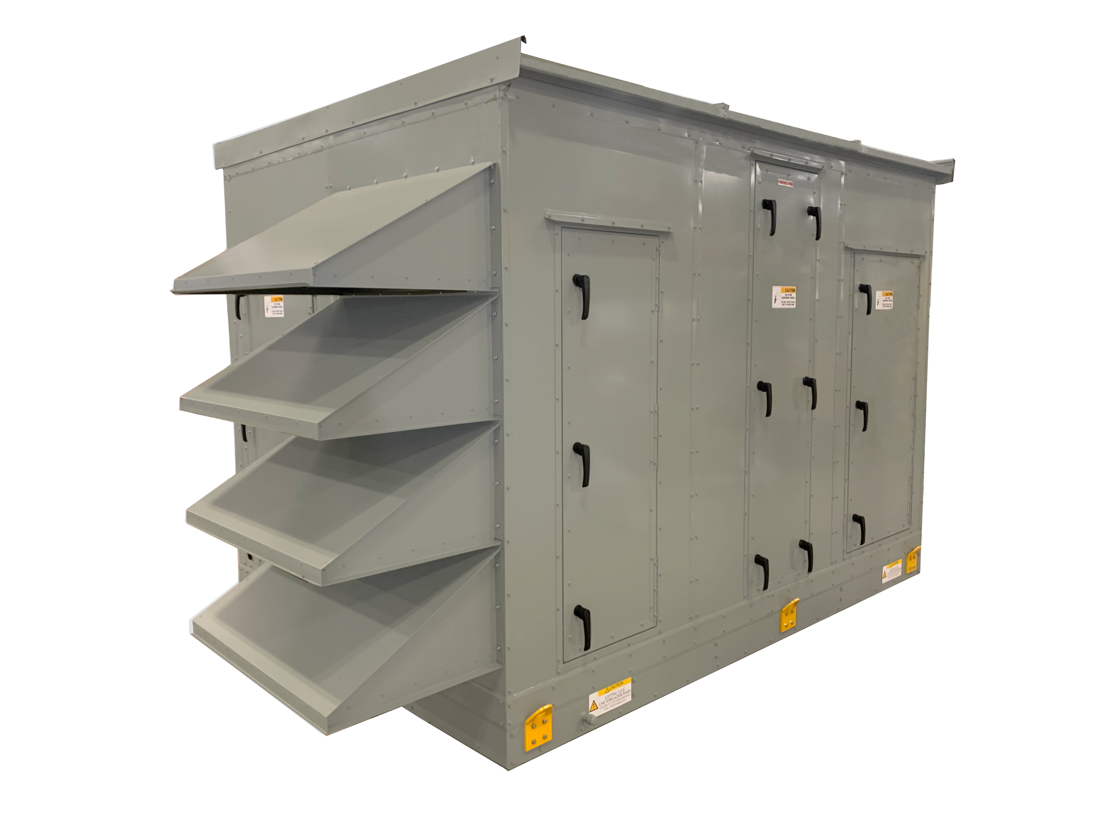
Model Numbers
AHU-XXX-C
  Cooling
AHU-CEH-XXX
  Cooling and Electric Heating
ECZ-XXX-HC
  Heating and Cooling w/ Economizer
AHU-XXX-CH-FF
  Cooling and Heating w/ Final Filter
MAU-XXX-GB-FF
  Make-up Air Unit, Gas Burner w/ Final Filter and Economizer
Notes:
Read from the slide

Slide 6
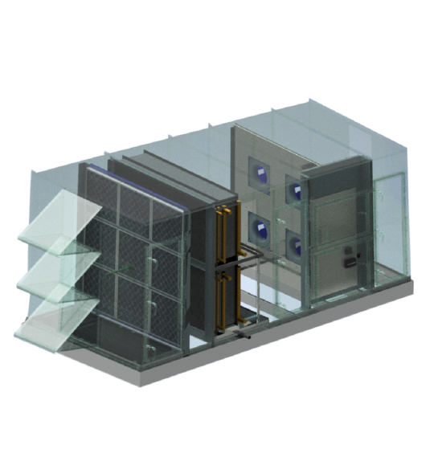
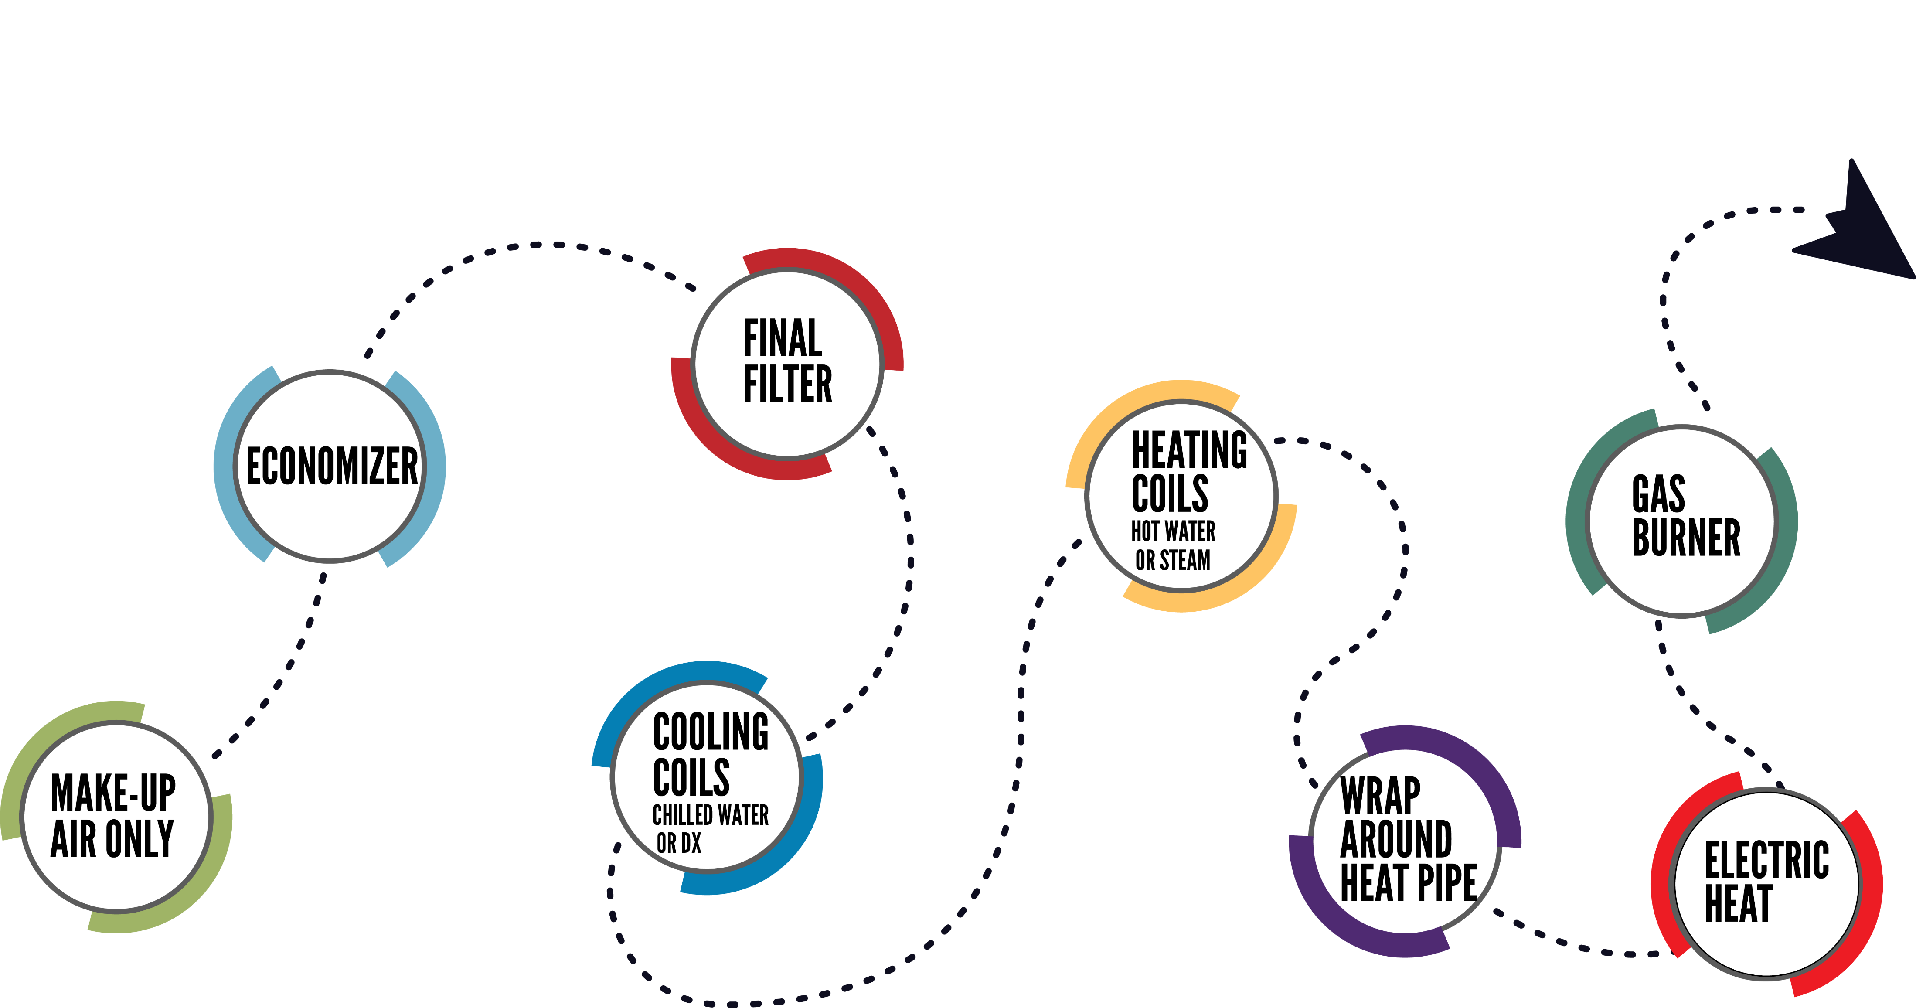
Optional Configurations
Notes:
Read from the slide

Slide 7
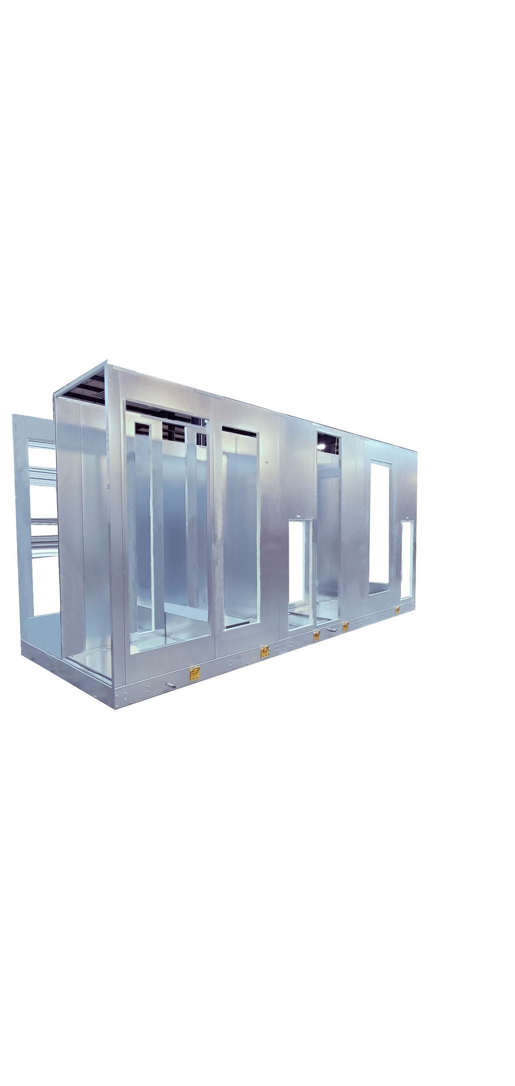
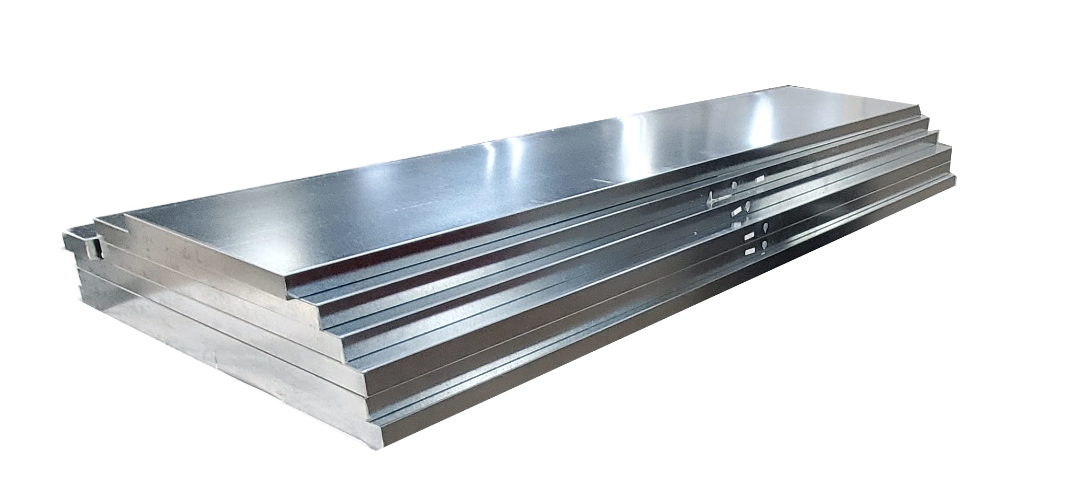
Casing
20 gauge galvanized inner and outer panel with 2” foam (R-13)
304SS inner and outer optional
Standard finish is unpainted (galvanized)
w/paint optional
Standard deflection is L/240
No thermal break
Access door location are pre-determined
Notes:
Read from the slide

Slide 8
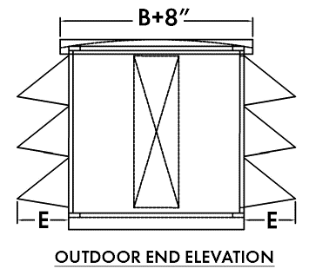
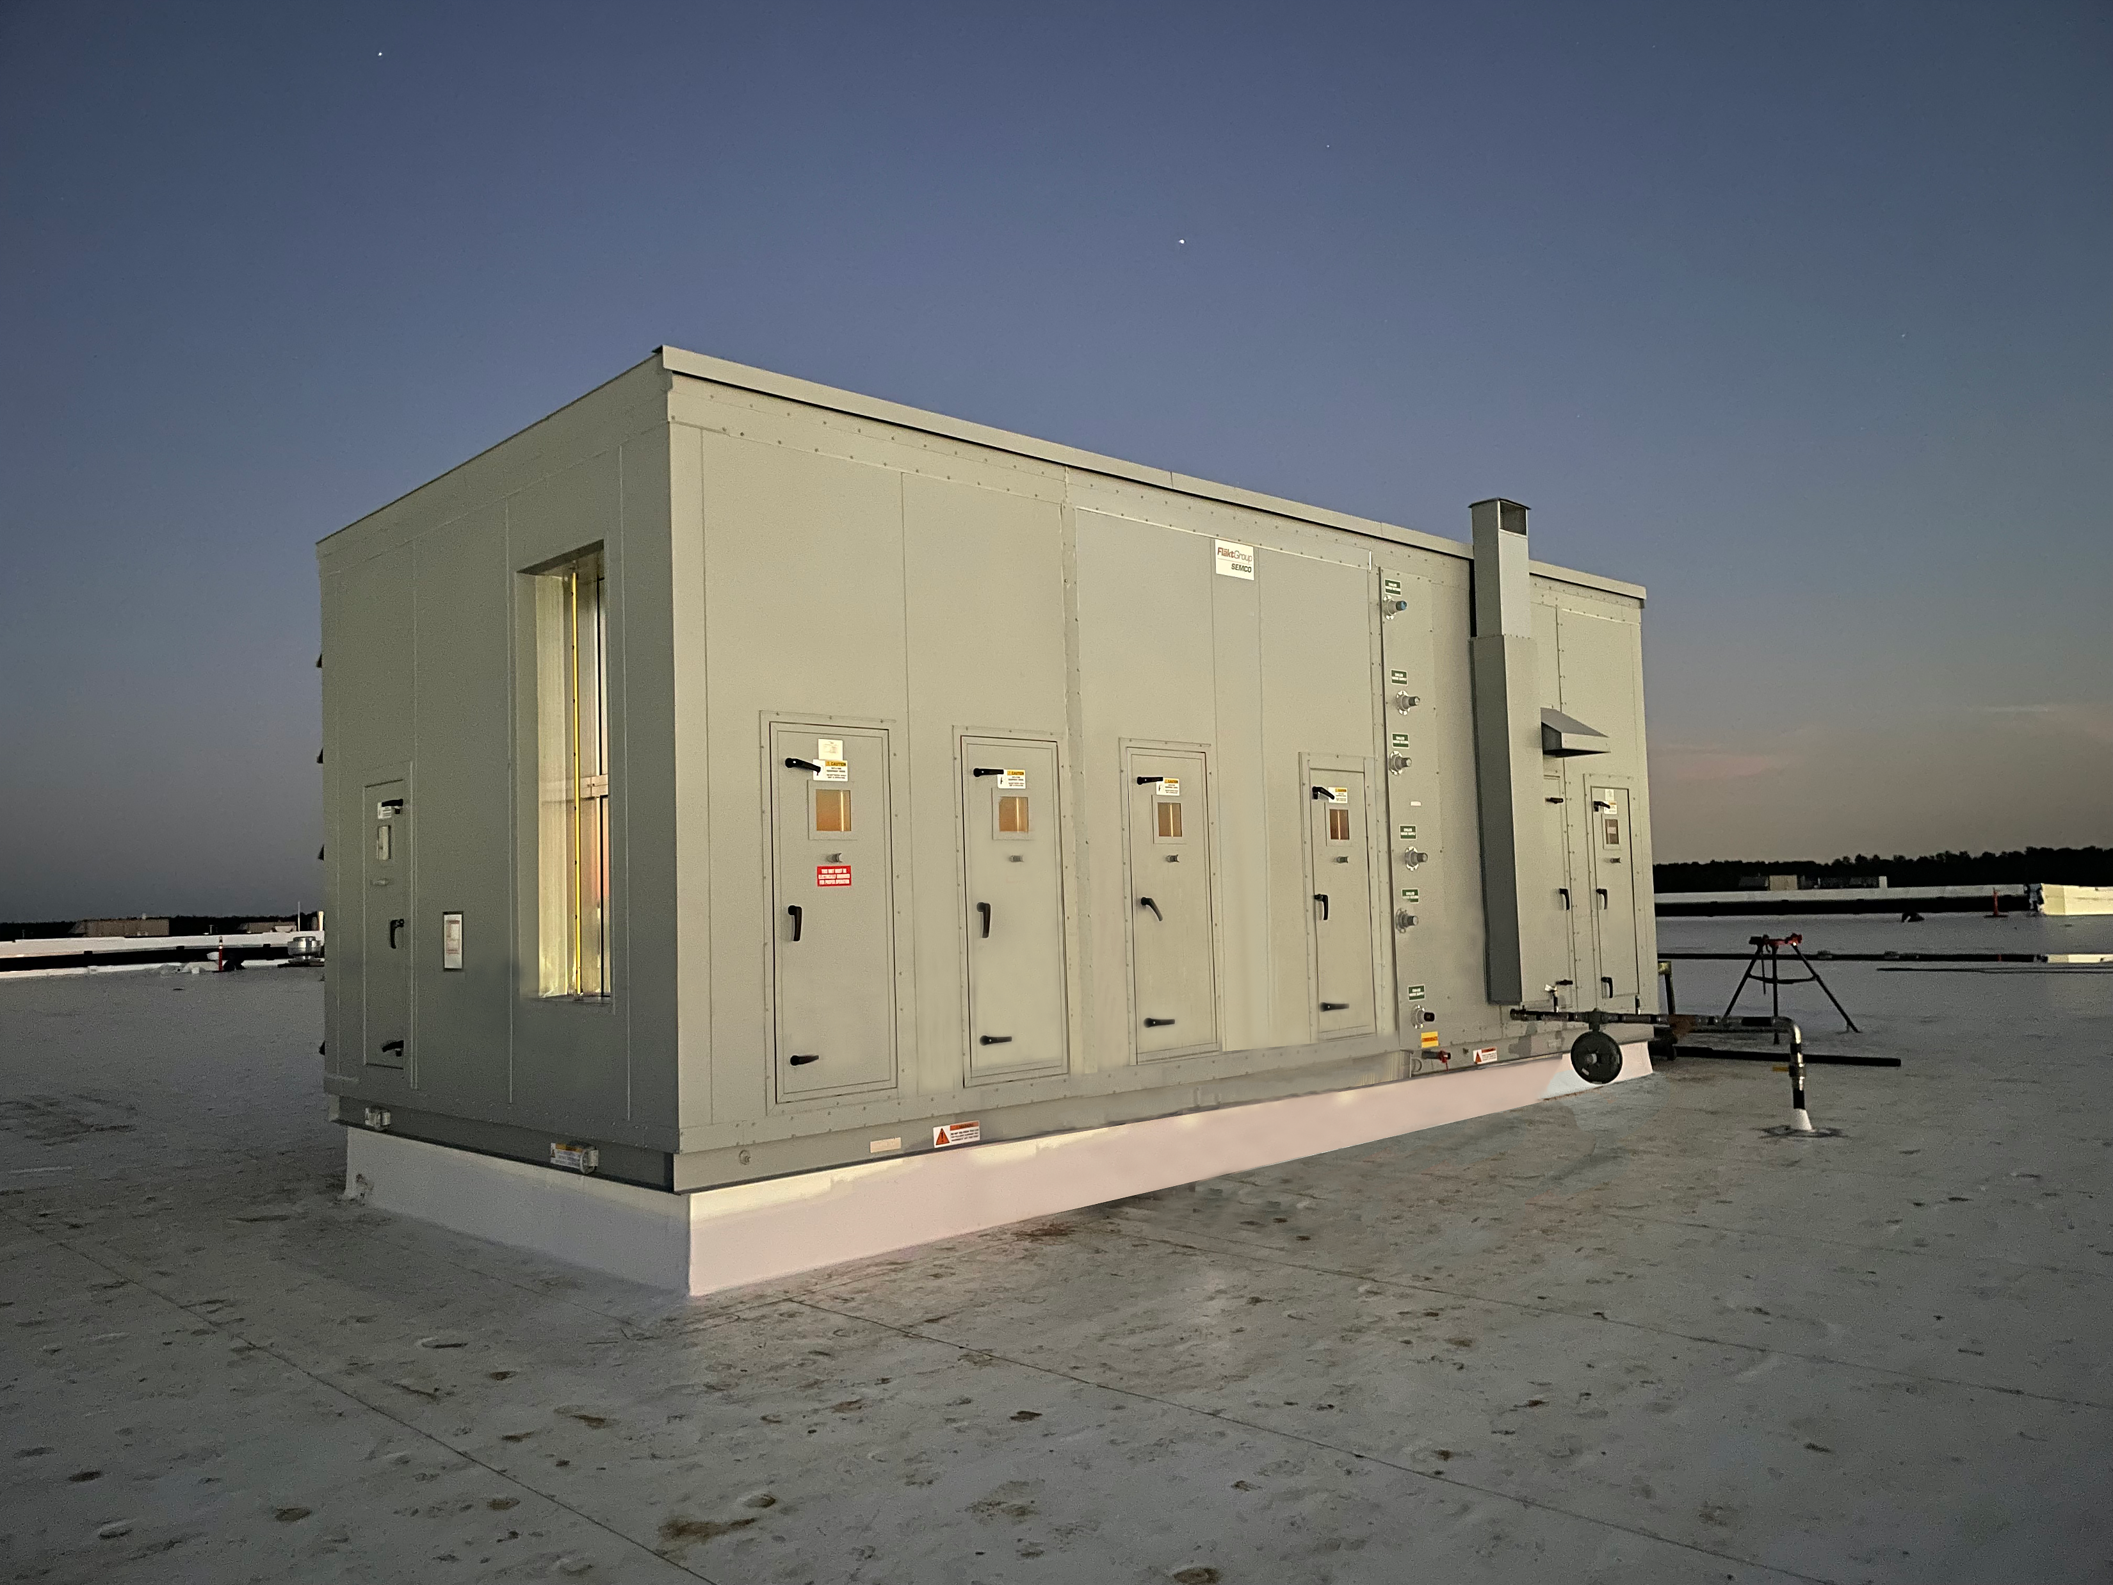
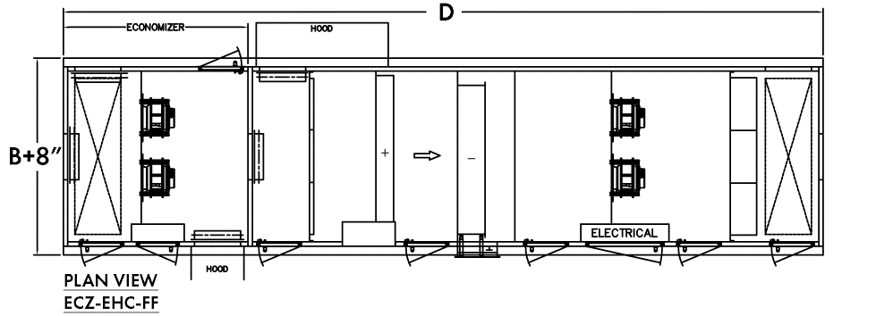
Outdoor Units
Pitched roof
Hoods with screen openings
Roof curb option
  14", 18" and 24" ducted insulated, ducted non-insulated, or open insulated
Notes:
Read from the slide

Slide 9
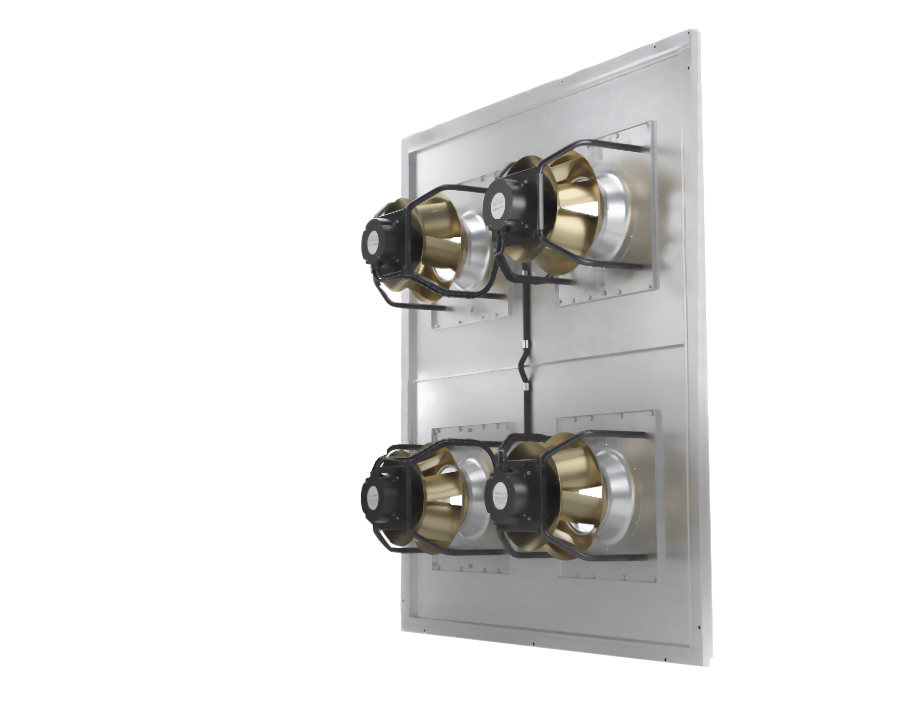
Fans Sections
Fan performance is based off of ZA but FläktGroup SEMCO reserves the right to substitute the ZA fan with a similarly performing brand.
Supply and exhaust EC fans are quiet and efficient.
EC fans are built to include air-flow measuring.
Compact footprint
Requires minimal maintenance - effectively operating with low efficiency filters without impacting long term performance.
Notes:
Read from the slide

Slide 10
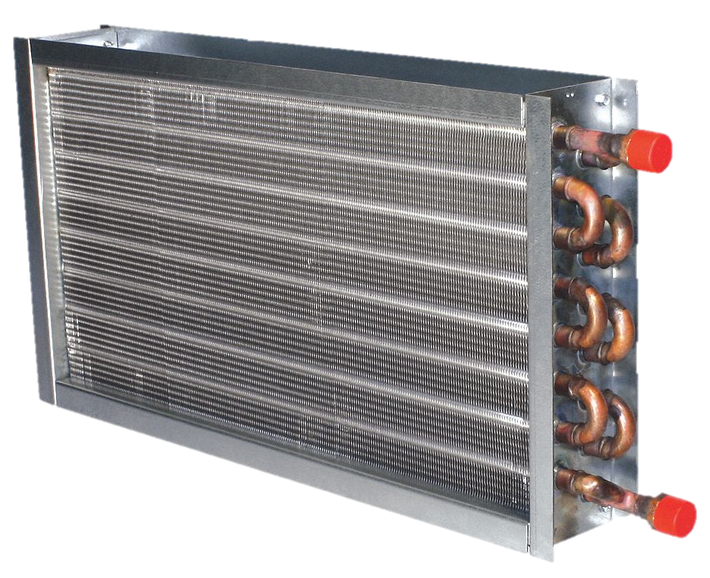
Cooling and Heating Coils
Coils will be selected based on conditions provided and desired performance
Default coil is 5/8” with 1/2” optional
Max FPI is 12
Max rows for cooling is 8 and heating 2
Steam, DX, and Glycol available
UV lights available
Selection process will be similar to EZ Coil
Notes:
Read from the slide

Slide 11

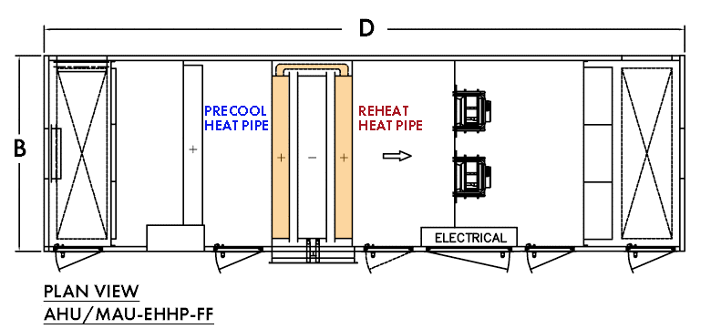
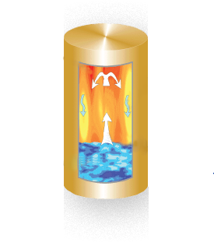
Warp Around Heat Pipe
Applications where the air temperature supplied to the space needs to be warmer than the air temperature coming off the DX (refrigerant) or chilled water coils in a conditioned air handling unit.
Notes:
Read from the slide

Slide 12
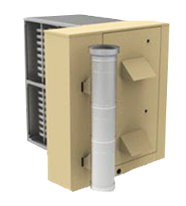
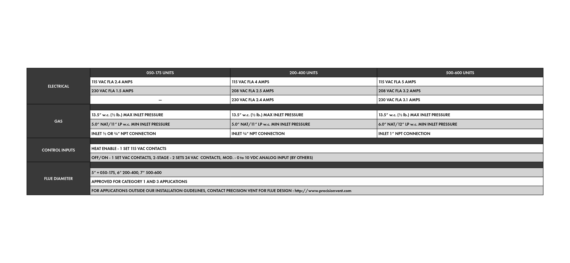
Gas Burner
Heatco Burners Model HMG
81% efficiency
Turndown
Minimum CFM increases to protect heating elements
Standard Venting
Notes:
Read from the slide

Slide 13
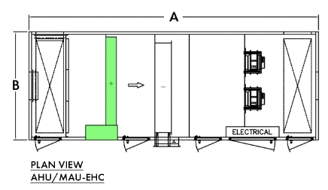
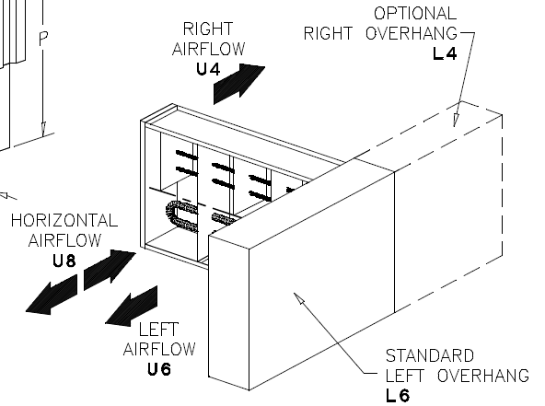
Electric Heat
Duct heater
SCR control
Minimum CFM increases to protect heating elements
Notes:
Read from the slide

Slide 14

Make Up Air Unit
No return air, 100% OA
All options same as AHU
Same footprint as AHU
Notes:
Read from the slide

Slide 15
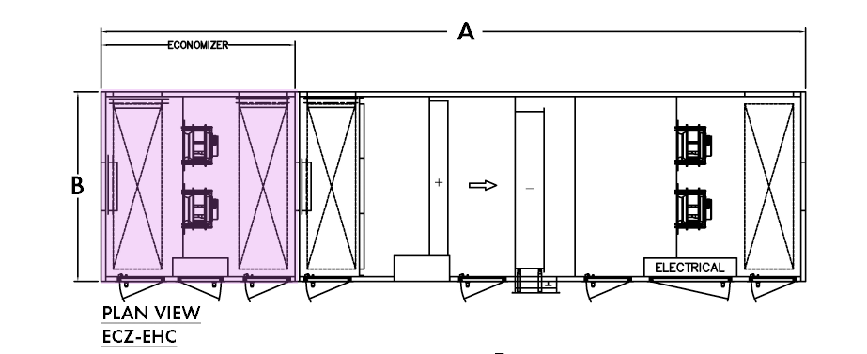
Economizer
Adds EC exhaust fan section
Additional length added to the unit
Exhaust fans sized the same as supply fans (size and quantity)
Notes:
Read from the slide

Slide 16
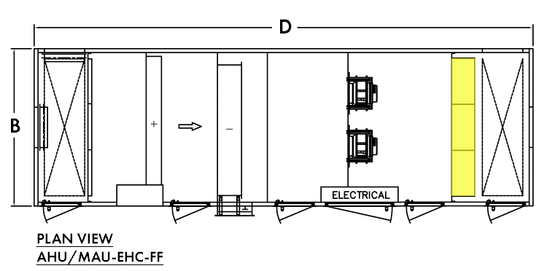
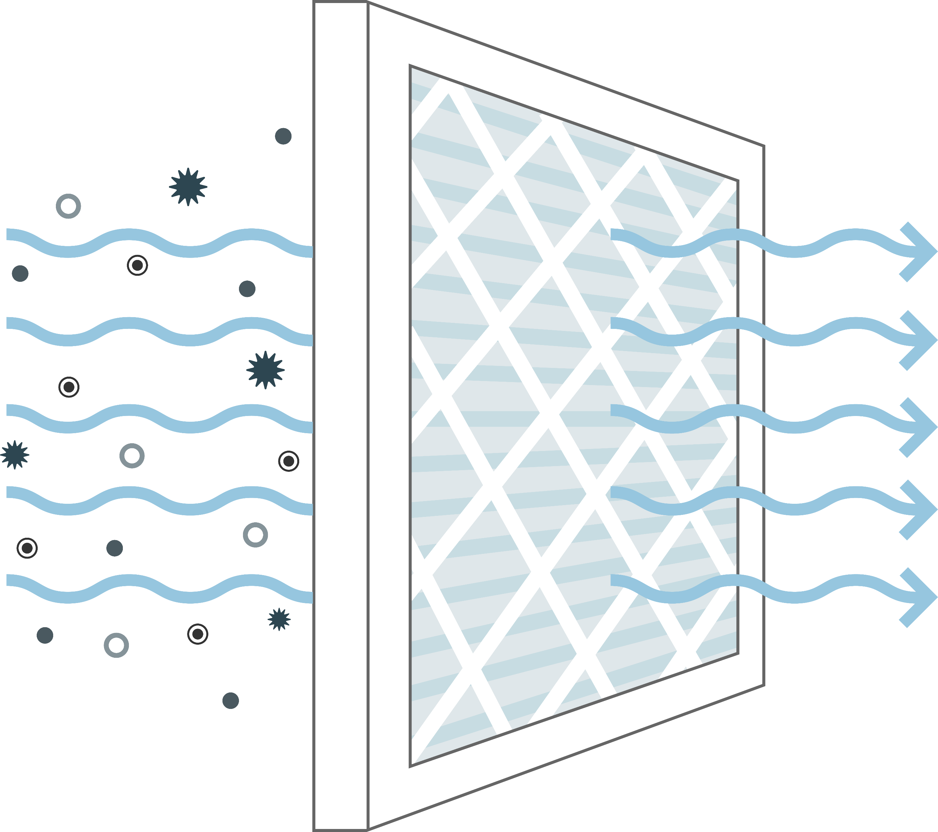
Final Filter
Adds section at the end of unit to filter air before leaving the unit
Allows for 12” MERV 13/14/15 filters
Additional length added to the unit
Notes:
Read from the slide

Slide 17
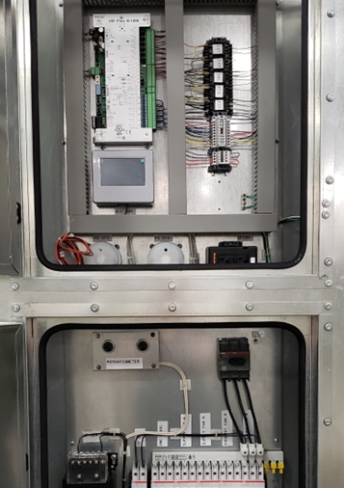
Electrical & Controls Packages
Electrical Package
Integrated electrical and controls panels
Internal disconnect
460/3/60 input power
Controls Packages
Supply temperature control
Communication to BAS via BACnet MS/TP
Standard full-control by FläktGroup SEMCO
Optional controls by others
EC variable speed fans
Notes:
Read the slide.
208V and 575V electrical are handled by a transformer provided by others.

Slide 18
Airflow Ranges in CFM
21,250 – 25,000
The ElitePro AHU serves the largest market segment
18,000 – 22,500
16,000 – 20,000
13,125 – 17,500
8,125 – 12,500
6,500 – 10,000
4,875 – 7,500
3,000 – 5,000
1,200 – 2,000
1,800 – 3,000
Notes:
These are the air flow ranges that are available by unit size.

Slide 19
Competitive Analysis

Slide 20
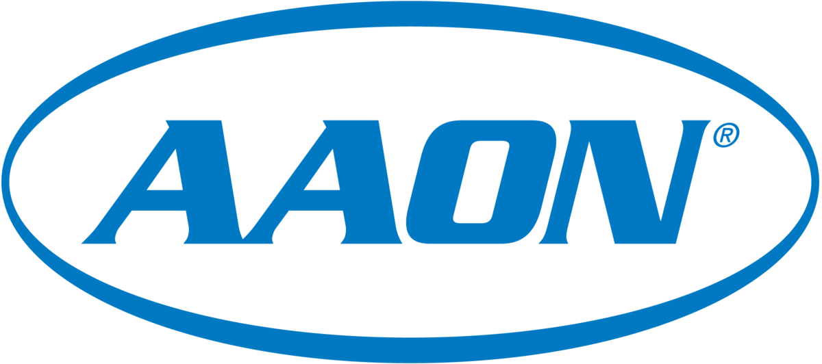
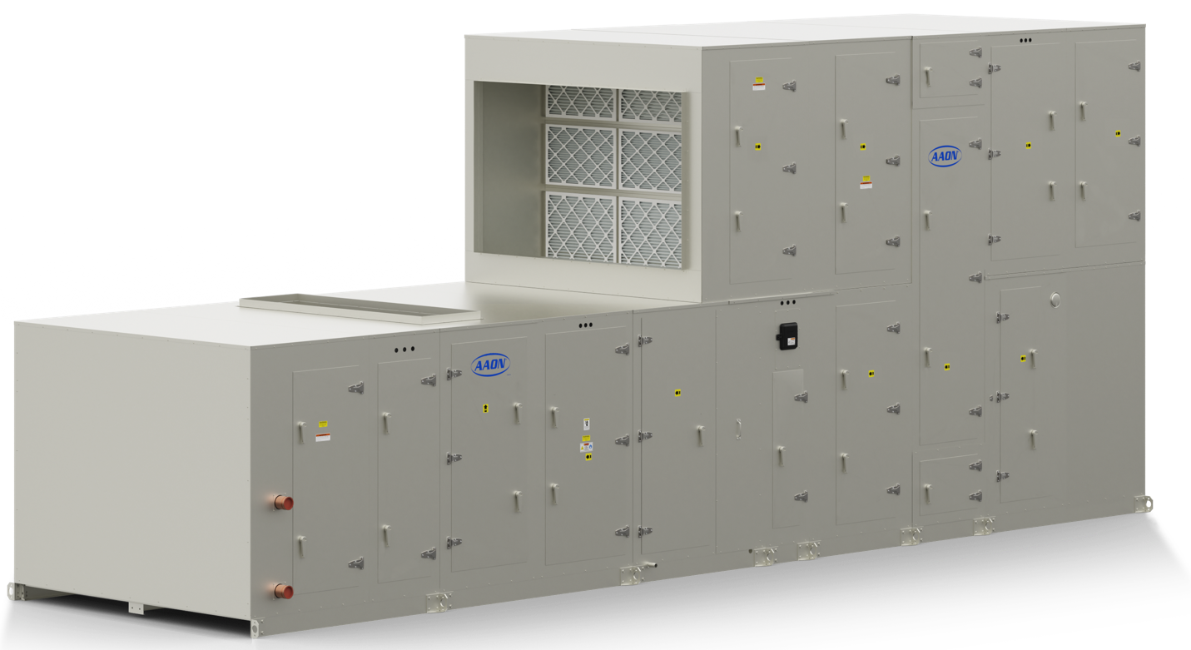
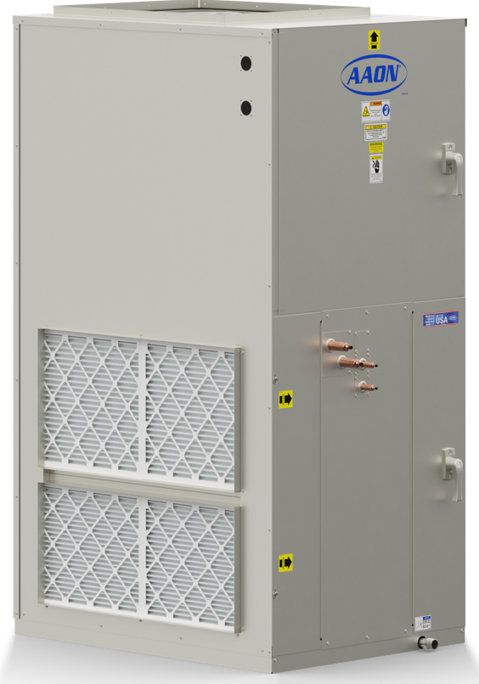
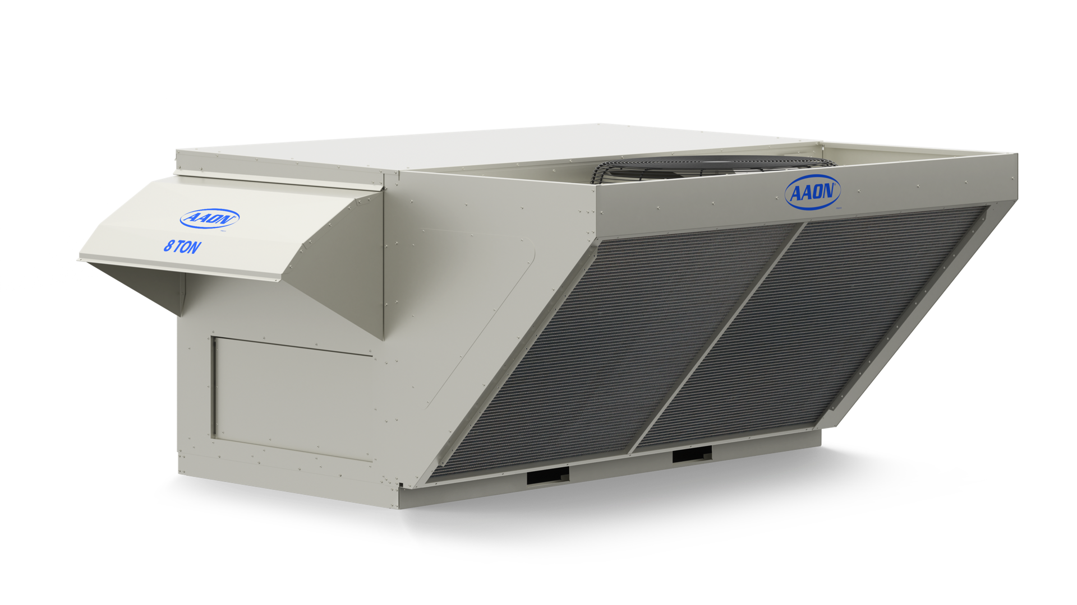
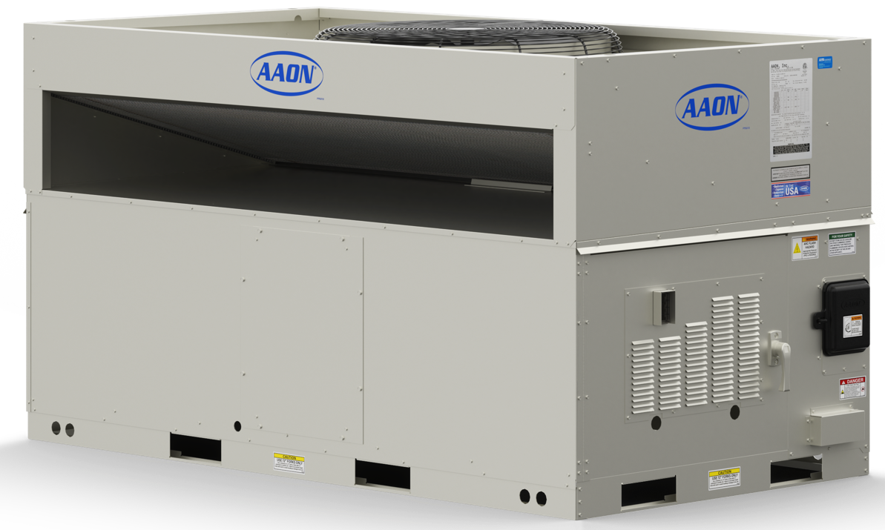
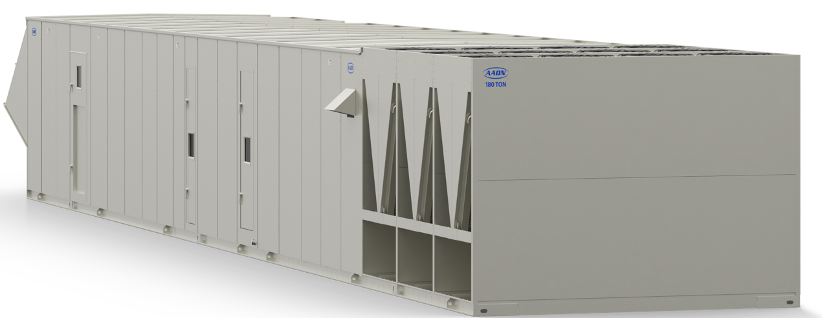
Aaon Corporate Overview (Public)
Company Size: $1.047 Billion
Number of Employees: ~2900
Factory Locations: Tulsa, OK (1.51 million sq.ft), Longview, TX (263,000 sq.ft),
Parkville, MO (48,500 sq.ft)
 | RQ | RN | RZ | H3 | V3 | M2
Description | Packaged Rooftop Unit | Packaged Rooftop Unit | Packaged Rooftop Unit | Horizontal Indoor AHU | Vertical Indoor AHU | Modular AHU
Construction | 2" double wall foam R13 | 2" double wall foam R13 | 2" double wall foam R13 | 2" double wall foam R13 | 2" double wall foam R13 | 2" double wall foam R13
Airflow | 400-3,600 cfm | 1,800 - 42,000 cfm | 7,500 - 80,000 cfm | 450-10,000 cfm | 450-10,000 cfm | 1,000 - 21,600 cfm
Energy Recovery | Wheel or Plate Optional | Wheel or Plate Optional | Wheel or Plate Optional | Wheel | Optional | Wheel
Available Wheels | TE or Sensible | TE or Sensible | TE or Sensible | TE or Sensible | TE or Sensible | TE or Sensible
Cooling Options | Chilled water, Packaged DX | Chilled water, Packaged DX, Heat Pump | Chilled water, Packaged DX, Heat Pump | Chilled water, split DX, Heat Pump | Chilled water, split DX, Heat Pump | Chilled water, split DX, Heat Pump
Heating Options | Electric, Hot Water, Gas Burner, Steam | Electric, Hot Water, Gas Burner, Steam, Heat Pump | Electric, Hot Water, Gas Burner, Steam, Heat Pump | Electric, Hot Water, Gas Burner, Steam, Heat Pump | Electric, Hot Water, Gas Burner, Steam, Heat Pump | Electric, Hot Water, Gas Burner, Steam, Heat Pump
V3
RQ
RN
RZ
M2

Slide 21
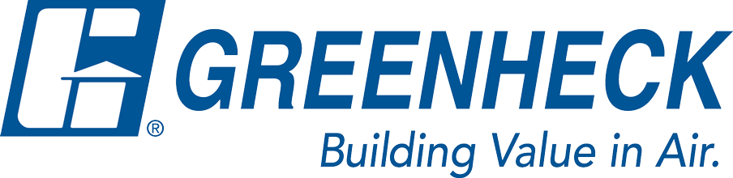
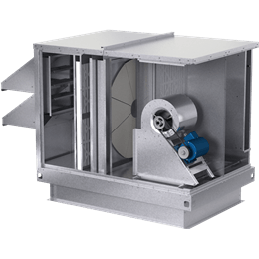
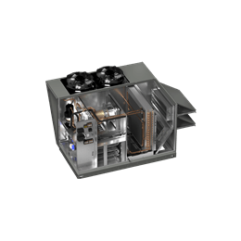
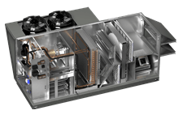
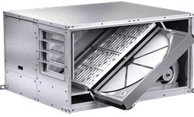
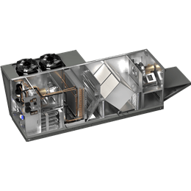
Greenheck Corporate Overview (Public)
Company Size: $1.0 Billion
Number of Employees: ~6,800
Factory Locations: Schofield, WI (300,000 sq. ft ),
Kings Mountain, NC ( 100,000 sq. ft)
 | Minivent | MiniCore | ERV | ERVe | ECV | RV | RVC | RVE
Description | Pre-conditioner | Pre-conditioner | Pre-conditioner | Pre-conditioner | Pre-conditioner | Air Handler no Energy Recovery | Energy Recovery and Conditioning | Energy Recovery and Conditioning
Construction | 1/2” Single wall Fiberglass | 1/2” Single wall Fiberglass | 1” Single or double wall Fiberglass | 1” double wall Fiberglass | 1” Single or double wall Fiberglass | 2” double wall foam R13 | 2” double wall foam R13 | 2” double wall foam R13
Airflow | 150-850 cfm | 150-1,000 cfm | 300-12,000 | 1,000-6,000 cfm | 500-4,400 cfm (Fiber) 500-5,000 cfm (Polymer) | 500-18,000 cfm | 500-15,000 cfm | 500-18,000 cfm
Energy Recovery | TE Wheel | TE Core | TE Wheel | TE Wheel | TE Core | No | TE Core | TE Wheel
Available Wheels | Polymer w/ silica desiccant | Fiber or Polymer | Polymer w/ silica desiccant | Polymer w/ silica desiccant | Fiber or Polymer | N/A | Fiber or Polymer | Polymer or Aluminum
Cooling Options | N/A | N/A | N/A | N/A | N/A | Chilled water, Packaged DX, Split DX, air-source Heat Pump | Chilled water, Packaged DX, Split DX, air-source Heat Pump | Chilled water, Packaged DX, Split DX, air-source Heat Pump
Heating Options | N/A | N/A | N/A | N/A | N/A | Indirect Gas Burner, Electric, Hot Water, Air-source Heat Pump | Indirect Gas Burner, Electric, Hot Water, Air-source Heat Pump | Indirect Gas Burner, Electric, Hot Water, Air-source Heat Pump
ERV
ERVe
RV
RVC
RVE

Slide 22

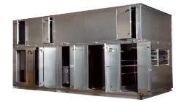
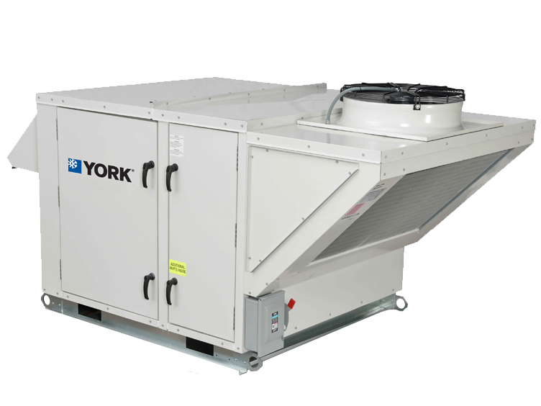
Johnson Controls Corporate Overview (Public)
Company Size: $42.1 Billion
Number of Employees: ~100,000 across 150 countries
Factory Locations: York, PA (285,000 sq.ft),
Wichita, KS (1.3 Million sq.ft), Norman, OK (900,000 sq.ft)
 | JR | Solution
Description | DOAS | AHU
Construction | 2" double wall R-13 | 2" double wall R-13
Airflow | 3,000 - 22,000 | 2,000 - 120,000
Energy Recovery | TE Wheel | Option
Available Wheels | Airxchange, Novel Aire, Thermotech, or innergy Tech | Airxchange, Novel Aire, Thermotech, or innergy Tech
Cooling Options | Packaged DX | CW, DX
Heating Options | HW, Gas or Electric | HW, Gas, Electric, Steam
Solution
JR

Slide 23
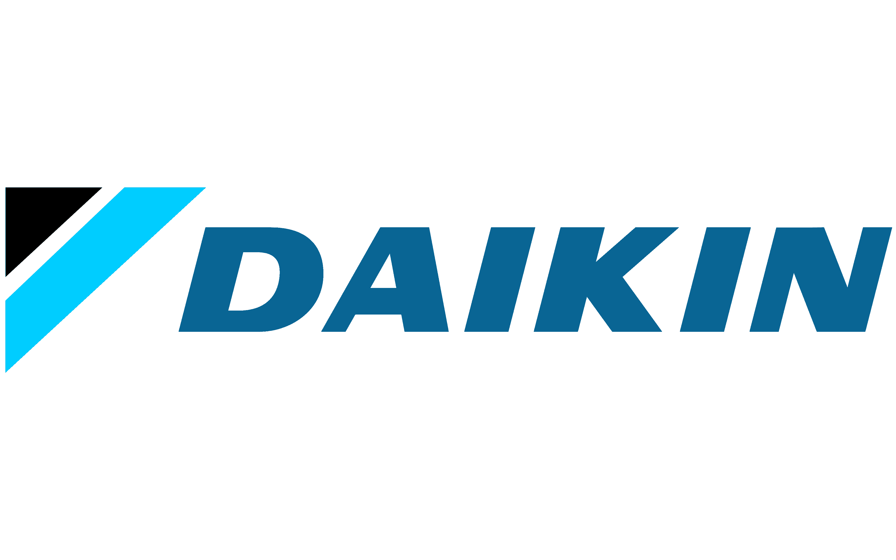
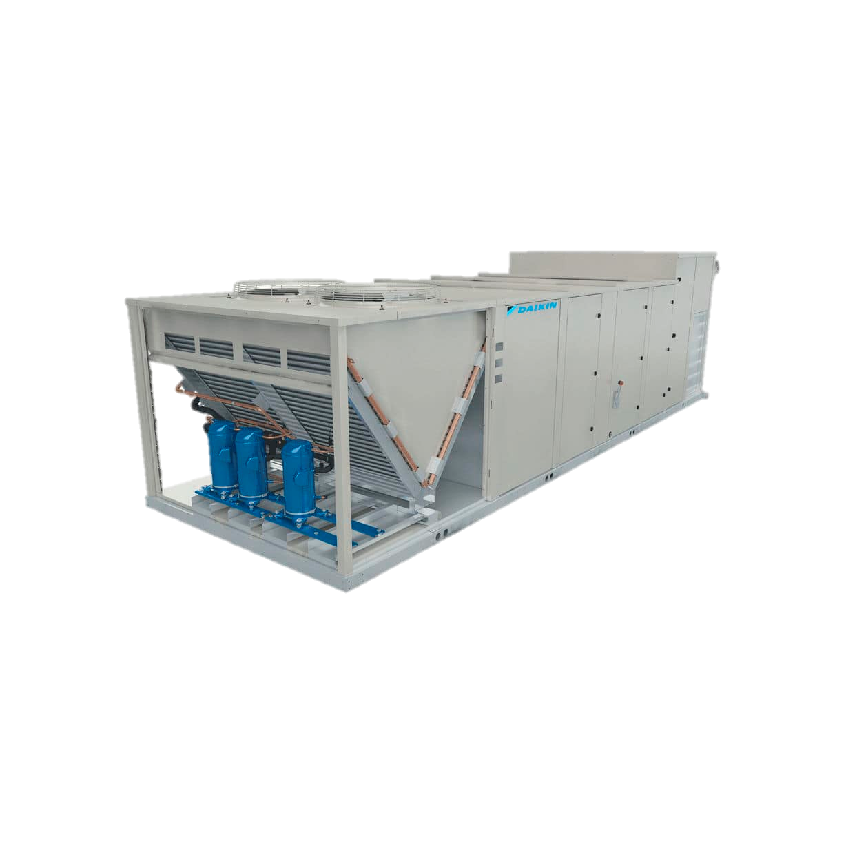
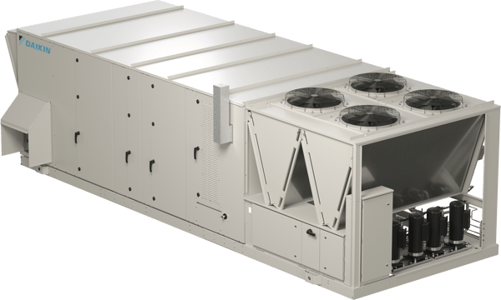
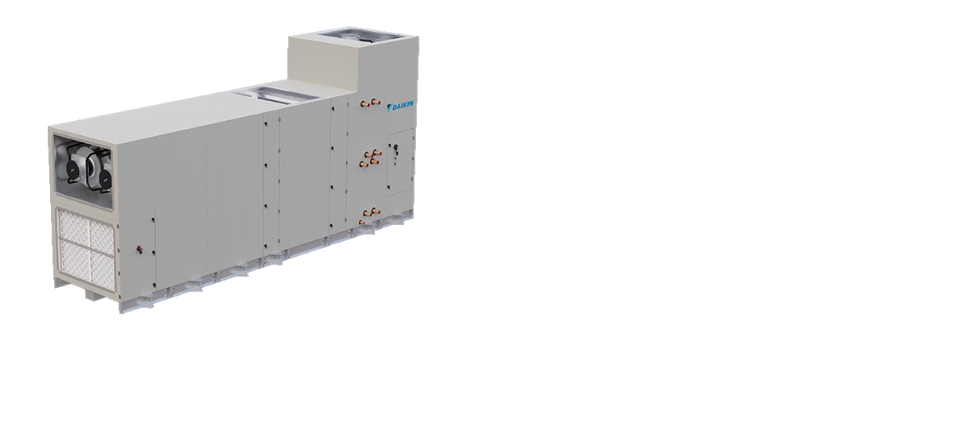
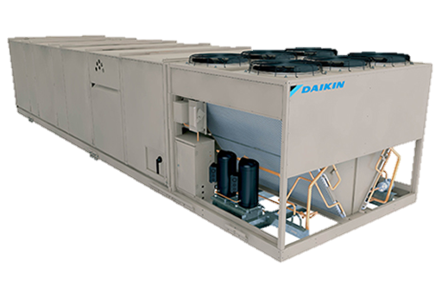
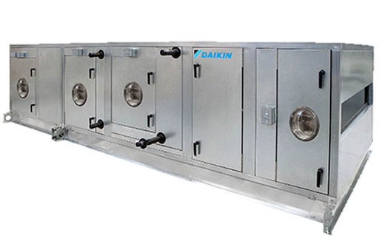
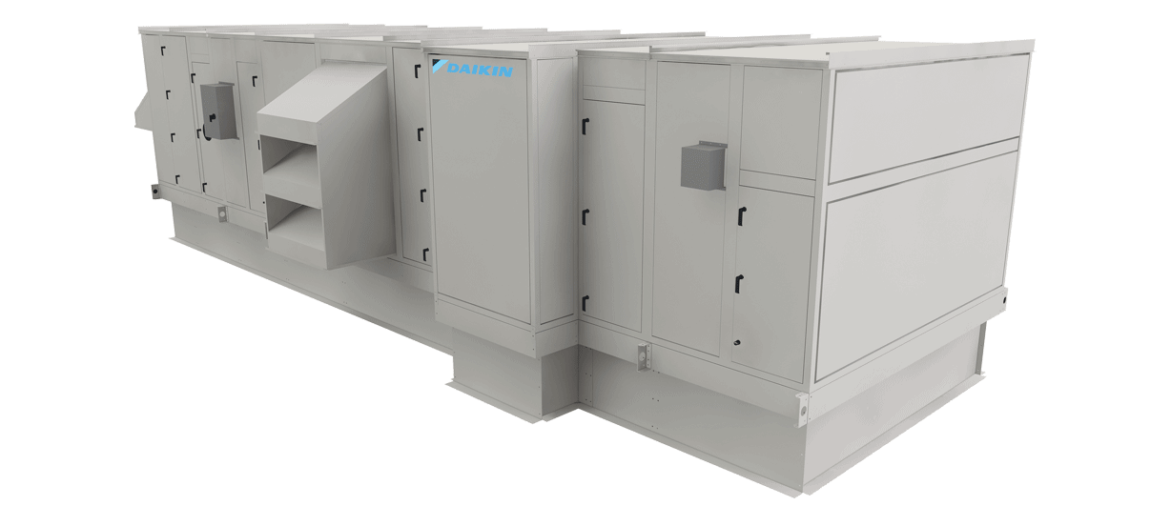
Daikin Corporate Overview (Public)
Company Size: $28.36 Billion
Number of Employees: ~88,000 in over 170 countries
Factory Locations: Plymouth, MN( 300,000 sq. ft), Waller, TX (4.2 Million sq.ft ),
Rebel Applied
Maverick 2
Roofpak
Preciseline
Skyline
Vision
 | Rebel Applied | Maverick 2 | Roofpak | Preciseline | Skyline | Vision
Description | RTU - Packaged | RTU - Commercial | RTU - Applied | AHU | AHU | AHU
Construction | 2" double wall R-13 | 2" double wall R-13 | 2" double wall R-13 | 1" double wall R-6.5 | 2" double wall R-13 | 2" double wall R-13
Airflow | 8,000 - 20,000 | 6,000 - 30,000 | 18,000 - 60,000 | 600 - 10,000 | 900 - 51,000 | 900 - 84,500
Energy Recovery | Yes | Yes | Yes | No | Yes | Yes
AHU Option | Yes | No | Yes | Yes | Yes | Yes
Available Wheels | TE Wheel or Core | TE Wheel or Core | TE Wheel or Core | No | TE Wheel or Core | TE Wheel or Core
Cooling Options | Packaged DX, CW | Packaged DX | Packaged DX, CW | CW, VRF | CW | CW
Heating Options | HW, Steam,Gas or Electric | HW, Gas, Electric | HW, Steam,Gas or Electric | HW, Electric, VRF | HW, Steam,Gas or Electric | HW, Steam,Gas or Electric

Slide 24

Thank you for your attention!

