Slide 1
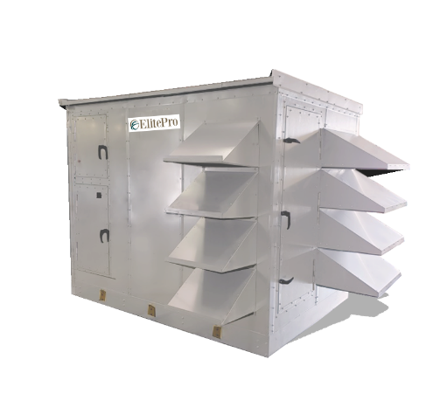



Slide 2

Corporate Overview

Slide 3
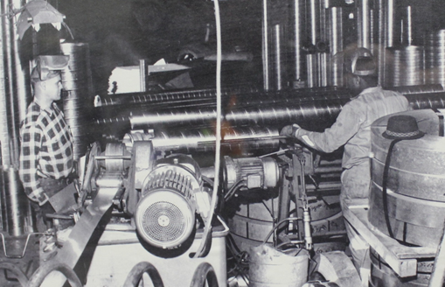
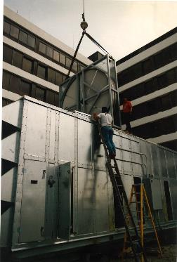
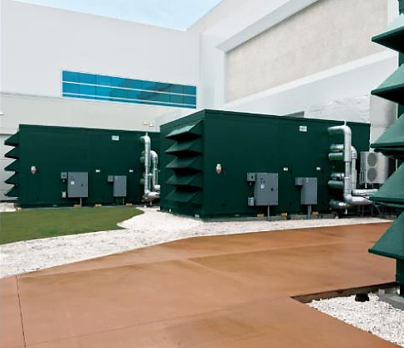










Who we are & what we do
Energy
& Environmental
Focus
Patented &
Certified
Products
U.S & Global
Footprint
Engineered
Air Quality &
Data Center
Solutions
Engineered
Air Distribution
& Sound
Solutions
OEM,
Key Account &
Sales Rep
Route To Market
Service
& Support
Award Winning
& Industry
Recognized
Notes:
In 1963 Salisbury Engineering and Manufacturing Company (SEMCO) was born in Salisbury, MO.
Began as SEMCO -- small sheet metal fabricator specializing in duct.
In the 59 years, evolved into a multi-million dollar company with a large product offering.
Headquartered in Columbia, MO, with 275,000 sq ft of manufacturing space in 3 plants in Arkansas and Virginia
We are a business unit of FläktGroup, and we are owned and backed by Triton Partners—which is a $17 billion annual revenue investment firm.
Innovation is core at FläktGroup SEMCO.
Certified by AHRI, SEMCO was won numerous awards – including multiple AHRI Innovation, Green Building, Dealer Design, School/College Planning & Management Awards
Hold numerous patents and trade secrets for our industry leading energy recovery wheels and systems.

Slide 4
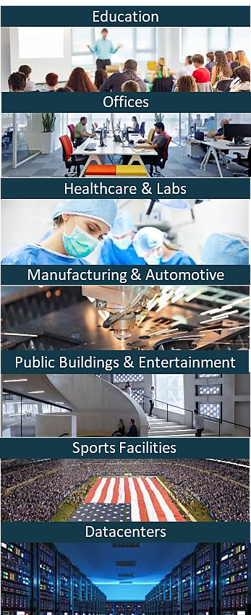

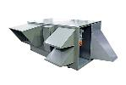
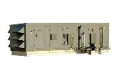


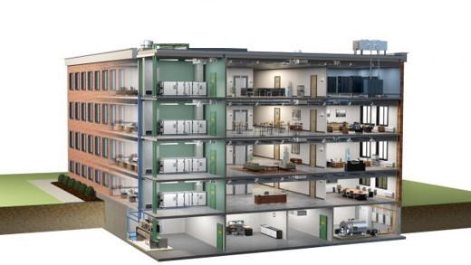






FläktGroup SEMCO Products For Commercial Applications
Energy Recovery Wheel
Unitary Energy Recovery Unit
Applied Energy Recovery Unit
NEUTON Pump
Ductwork
Chilled Beams
Fire-Rated Panels
Sound Attenuation Panels
Notes:
FläktGroup SEMCO provides solutions for a wide variety of applications including casinos, offices, laboratories, hotels, education, healthcare, retail, data centers, stadiums, manufacturing, agriculture & indoor farming, airports, and recreational facilities.
FläktGroup SEMCO products could be utilized in conjunction with one another, to provide the best possible air quality.
We offer energy recovery units & wheels which are engineered to be low maintenance, environmentally friendly, energy efficient & saves money over time as well as protects occupants from harmful contaminants.
We also offer chilled beams, pump modules, data centers, air handlers, duct and panels.
Leverage below if desired:
FläktGroup SEMCO products are designed to be utilized in conjunction with one another, to provide the best possible air quality. We show here:
Ductwork is laid within the walls and ceiling of the building, so supply air may be brought into the building and return air may be exhausted from the building.
Outdoor air is brought into the FV and pre-conditioned
Once the air is pre-conditioned with the FV it is filtered through the Pinnacle energy recovery unit, which will remove contaminants and dehumidify the incoming airstream with its True 3A wheel. Return air will also flow through the Pinnacle on its way out.
The chilled beams and the Neuton will work together with the supply air they receive from the Pinnacle to maintain a comfortable room temperature without condensation. (Together the Pinnacle, Neuton, and chilled beams make up 3fficiency).
During the construction of the building fire panels will be installed around an equipment room or elevator.
Sound attenuation panels are also installed during construction around noisy equipment or places where noise may be a concern

Slide 5
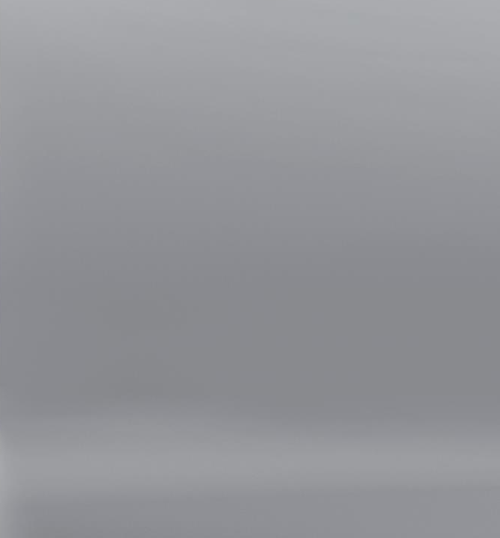

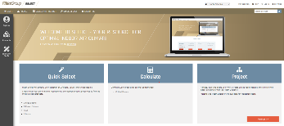

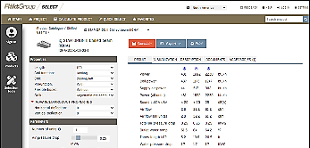
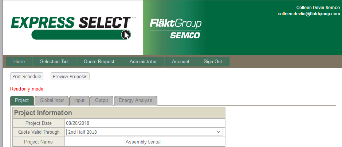

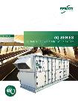
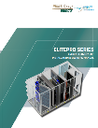

FläktGroup SEMCO Superior Sales Support & Service
Notes:
FläktGroup SEMCO prides ourselves on supplying exceptional sales support and service.
Accessible web-based literature and tools
Our experienced sales team are a phone call away and will help guide you through our selection programs to meet or exceed project specifications.
While all FläktGroup SEMCO products are relatively maintenance free throughout their lifecycle--we have a knowledgeable and dedicated service team available should you require it.

Slide 6
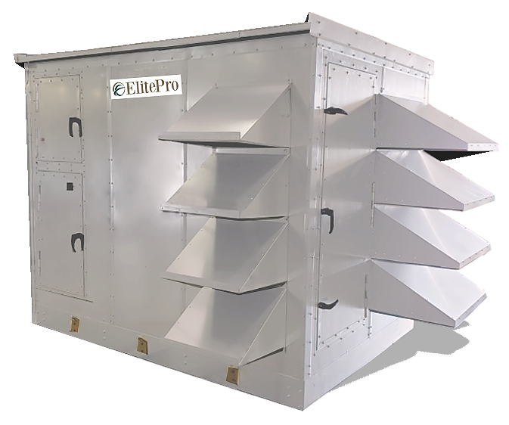
ElitePro Series
CHALLENGE:
Provides a compact, configurable energy-efficient, healthy air solution for applications.
For projects requiring 3,000-20,000 CFM--like schools, shops, and office buildings applications—at a value.
SOLUTION:
The ElitePro Series:
Can be an integrated system that provides total space temperature and humidity control.
  Or it can be a preconditioner to traditional HVAC equipment.
An energy recovery solution that saves energy & money.
  Equal latent and sensible heat transfer
Provides large amounts of healthy outdoor air into the space.
  Offers the industry’s top performing energy recovery wheel which reduces contaminants.
Notes:
Read from the slide

Slide 7
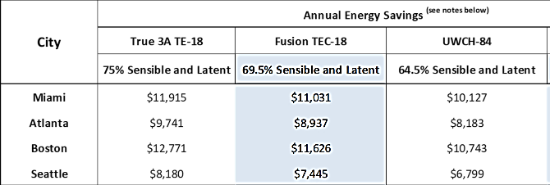
Energy Savings Modeled Results
ELT- 150 Heating & Cooling Model
FläktGroup SEMCO energy recovery units (ERU) often pay for themselves within the first few years of operation
Save up to 55% of annual cost of operation
Energy recovery system operated at 15,000 CFM for 16 hours, 5 days a week
ASHRAE weather data used for each city, electrical cost at $.1/KWH and gas cost at $5 per million BTU
Assumes return air conditions of 75º F/30% heating
Assumes the use of DX refrigeration and indirect gas fired heating, Dri steam humidifier
Notes:
An energy recover unit is designed to save the owner money.
This is a simplified model with the three-wheel options that are offered in the ElitePro.
Each one saves considerable money and often pay for themselves within the first few years of operation.
Also, it can save up to 55% of annual cost of operation.
The three wheels are the True3A TE wheel, the Fusion TEC, and the Unitary Wheel Cassette wheel

Slide 8
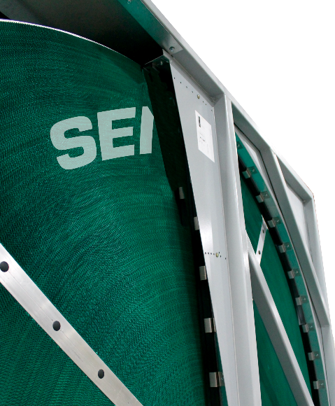
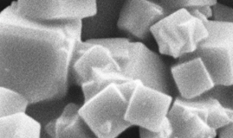
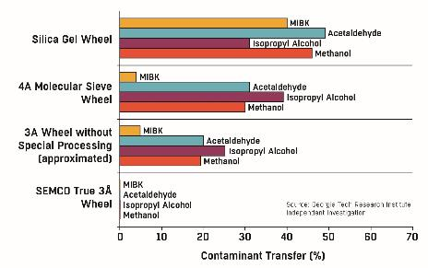
Contaminants Results
CHALLENGE:
Clean the air of contaminants.
SOLUTION:
The Elite Series virtually eliminates contaminants.
Brings in large amounts of fresh, clean air into your building.
Optional True 3Å energy recovery wheel the industry’s highest performing wheel on the market
  3 Ångstrom desiccant molecular-sieve that limits contaminant carry-over to less than .045%. It is.
Electron microscopic image of a 3Å molecular sieve
Notes:
The wheels save you money, but different applications and air cleanliness may lead you to different wheel selections.
The ElitePro offers, the industry’s highest performing wheel the Tru3A Energy recovery wheel as one of those options.
This wheel has a molecular-sieve 3 Ångstrom desiccant. It limits contaminant carry-over to less than .045%.
A FG SEMCO pioneered application that improves indoor air quality in buildings by not transferring exhausted VOCs (Volatile Organic Compounds) back into the fresh outdoor air.
The graph shows a research study conducted by Georgia Tech Research Institute. It compares the True 3A wheel to other competitive technologies for contaminant transfer. The FG SEMCO technology is far superior at limiting contaminant transfer.
In addition to the 3A molecular sieve, the wheel includes an
Acid resistant face coating for critical applications and seaside environments.
Anti-stick face coating that limits the buildup of particulate and simplifies cleaning.
And anti-microbial face coating and media properties
This wheel is featured in installations such as John Hopkins Cancer Center. We recently replaced the wheel there, and after 20 years, it was still performing exceptionally.

Slide 9



High Quality–Without the Wait
CHALLENGE:
Getting the options desired and meeting the tight engineering & construction schedule.
SOLUTION:
FläktGroup SEMCO offers the configurable ElitePro with high-quality components without the wait.
AHRI certified performance, high latent capacity
ASHRAE 62.1 Compliant
Cost effective, tested and approved total energy recovery unit
High quality components:
  Dual-wall R-13 foam panel structure
  Equipped with world-class performance high-efficiency EC fans
  BACnet compatible integrated controls are standard
Designed for quick manufacturing turnaround.
Notes:
Read the slide.

Slide 10
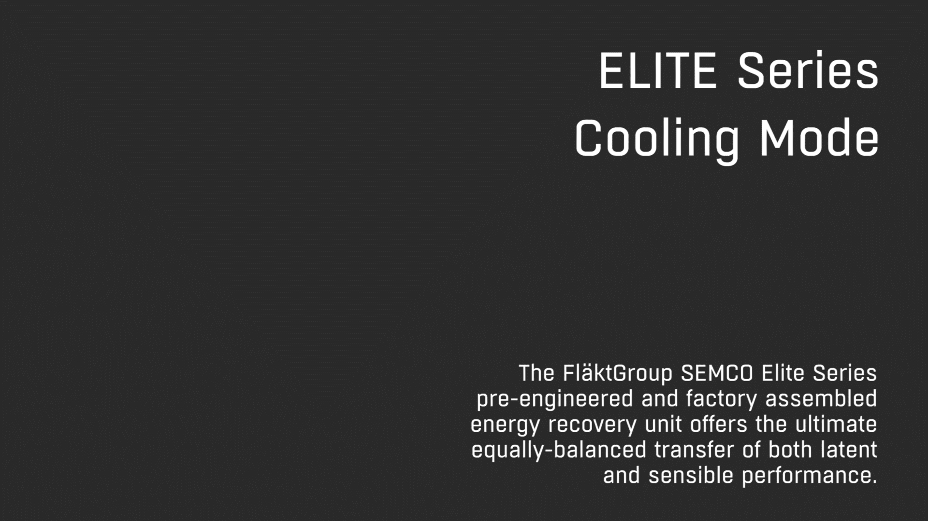
How It Works
Notes:
Play the video.
NOTE: This is designed to walk the customer/engineer through how the units work, and specifically how the temperature is modified.

Slide 11
Airflow Ranges in CFM
ElitePro Series Pre-Conditioner
ElitePro Series with Coils
16,000 – 20,000
14,000 – 17,500
11,000 – 15,000
10,000 – 13,000
7,000 – 12,000
9,000 – 11,000
7,000 – 9,000
The ElitePro Series serves the largest market segment
5,500 – 7,500
4,000 – 8,500
3,000 – 5,300
4,000 – 6,000
Notes:
These are the air flow ranges that are available by unit size.

Slide 12
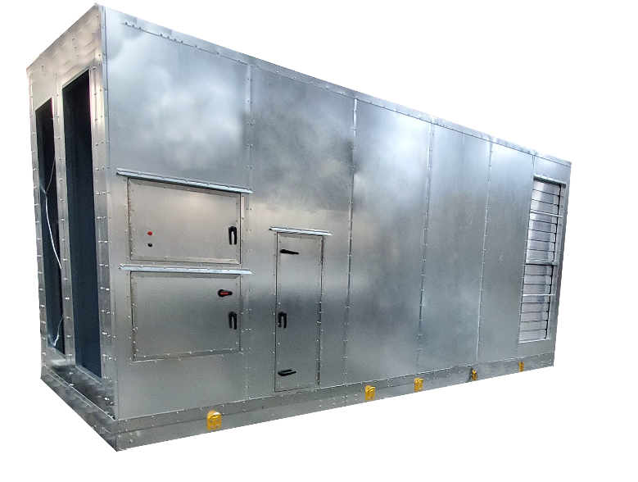
Single-Piece Enclosure
Single piece construction
Light-weight design
Galvanized steel cabinet with
optional painted finish
Standard dual wall R-13 foam
panel construction
Standard service doors
Built-in lifting lugs
Notes:
Eliminates field construction.
Allows for one crane-operator pick to a roof.
Light weight design.
Rust-resistant galvanized with optional painted finish
Standard dual wall R-13 foam-injected panel construction
Standard service doors
Built-in lifting lugs

Slide 13
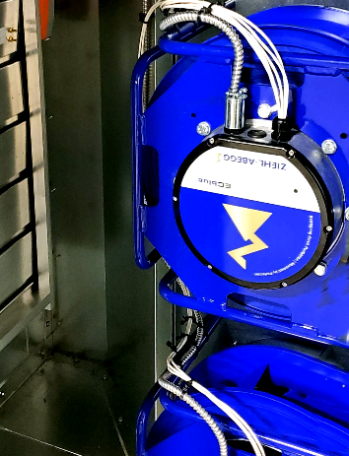
EC Fans- Standard
Supply and exhaust EC fans sized for quiet and efficient operation.
EC fans are built to include air-flow measuring.
No variable frequency drives (VFD) are required to control speed.
Requires minimal maintenance - effectively operating with low efficiency filters without impacting long term performance.
Notes:
Electro commutated fans which is the industries preferred fan is the standard
Built in air flow measurement
No VFDs required
Minimizes fan maintenance

Slide 14

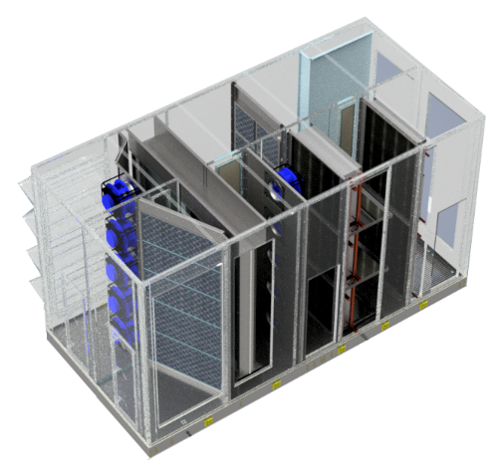
Conditioning Options
Heating Options
Hot water — 1 or 2 rows
Indirect Gas Burner
Electric Pre-Heat
Cooling Options
Chilled water — 4, 6, or 8 rows
DX Coil — 4, 6 or 8 rows
  Evaporator coil only, controls by others
  All refrigeration specialties by others
Coils will be piped externally, no pipe chase through
the floor
Vestibule/doghouse to be provided by others
Notes:
Read the slide.

Slide 15
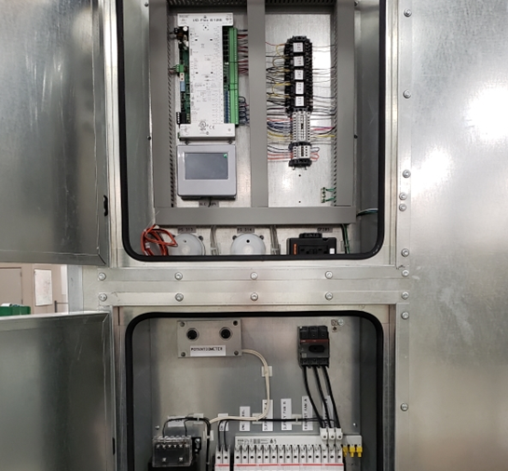
Electrical & Controls Packages
Electrical Package
Integrated electrical and controls panels
Internal disconnect
460/3/60 input power
Controls Packages
Supply temperature control
Communication to BAS via BACnet MS/TP
Standard full-control by FläktGroup SEMCO
Optional controls by others
Variable speed fans
Wheel control
  Variable speed
  Wheel frost protection
  Rotation detector sensor
Notes:
Read the slide.
208V and 575V electrical are handled by a transformer provided by others.

Slide 16


Applications
School classrooms
Offices
Dormitories, apartments
Retail stores
Places of Worship
Day care facilities
Jails and prisons
Smoking areas
Casinos
Restaurant dining areas
Movie theaters
Bowling centers
Light manufacturing areas
Notes:
31
26
26
Read the slide

Slide 17

Thank you for your attention!

