Slide 1
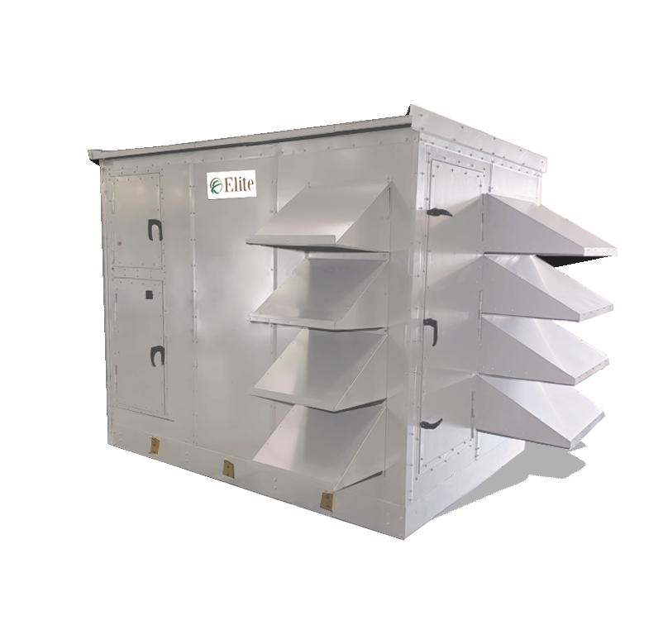



Slide 2


Pre-Conditioner & Conditioned Units Product Overview
Can serve as a pre-conditioner to a conventional air handling system or as part of an integrated system.
Cost effective, tested and approved total energy recovery unit
Certified performance, high latent capacity
Dual-wall R-13 foam panel structure
Equipped with world-class performance
high-efficiency EC fans
BACnet compatible integrated controls are standard
Airflow capacity ranges from 3,000 CFM - 20,000 CFM
The function of an Energy Recovery Ventilator (ERV) is to continuously provide the code required quantity of outdoor air during occupancy, with uncompromised quality and in an energy efficient manner.

Slide 3
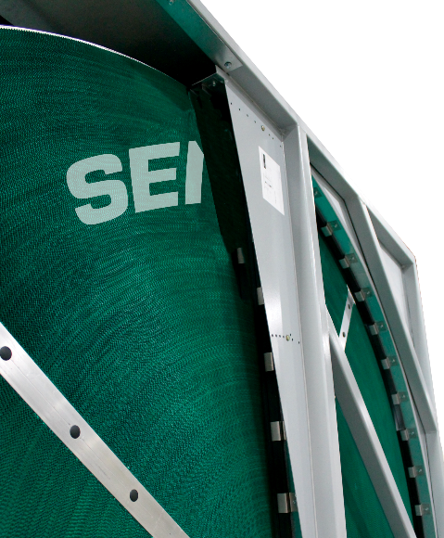
ElitePro Series Energy Recovery Wheels
Comes with the industry leading FläktGroup SEMCO Unitary Wheel Cassette (UWC).
Option to upgrade wheels for a higher performance to the:
  UWCH
  Fusion
  Fusion 3Å
  True 3Å- Industry leading performance
Upgrading to a True 3Å, Fusion or Fusion 3Å will give you the highest recovery performance (AHRI Certified) and recovery efficiency ratios (RER)
The True 3Å has a molecular-sieve 3 Ångstrom desiccant that limits contaminant carry-over to less than .045% while transferring water vapor.

Slide 4

Why Energy Recovery?
Choosing an HVAC unit with an energy recovery wheel, like the ElitePro, will save money on heating and cooling costs, as well as, providing a great return on investment.
FläktGroup SEMCO energy recovery units (ERU) often pay for themselves within the first couple of years of operation
Energy recovery wheels pre-condition incoming outdoor air with return air, while at the same time removing any contaminants.
The ElitePro can recover up to 83% of the total energy expended by a building.

Slide 5
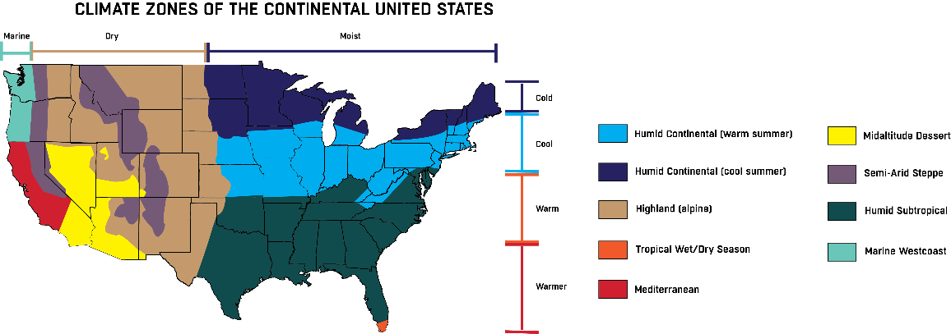
USA Climate Zones
Notes:
ElitePro can work in all climate zones.
Humidity control is critical for comfort. Higher performing wheels to utilize less tonnage.
Provide humidity control for desert applications and very humid applications such as in Miami.

Slide 6

Humidity Control
The ElitePro provides total space conditioning and
humidity control — humidity control that
competitors fail to deliver.
The ELT-CH is especially affective at humidity
control because it dries humid, outdoor
air with its cooling coil and reheats the air
back to a comfortable temperature.
Certified total energy recovery performance — sensible and latent — up to 83% effectiveness*
*Most common selections utilizing moderate face velocities would provide 75% efficiency

Slide 7
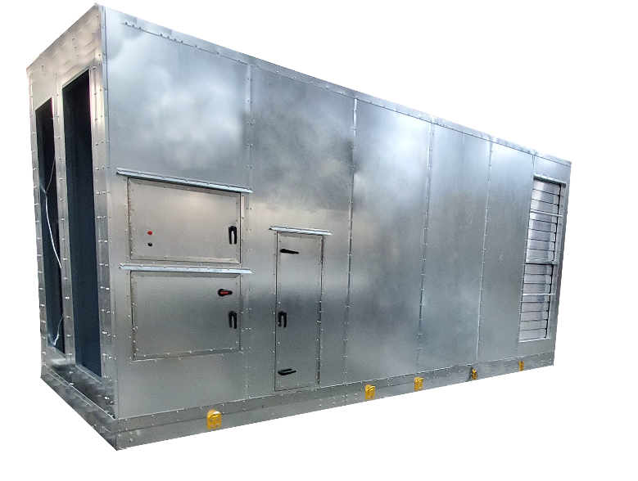

Enclosure
Single piece construction
Light-weight design
Galvanized steel cabinet with
optional painted finish
Standard dual wall R-13 foam
panel construction
Standard service doors
Built-in lifting lugs

Slide 8
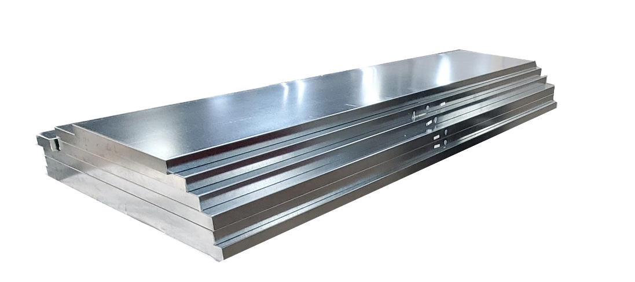
Dual Wall R-13 Foam Panels
Light weight dual wall foam panels are used to construct all ElitePro models
These panels require less steel — making them lighter for roof
Gives the unit a stronger, more rigid structure.
Expanded foam minimizes insulation gaps decreasing air leakage.

Slide 9
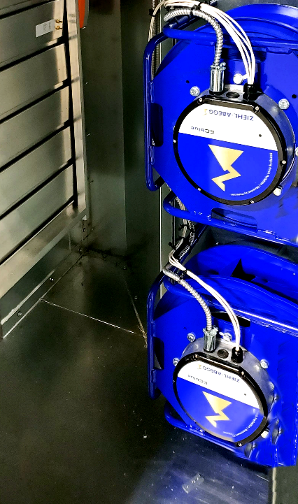
EC Fans & Filters
Supply and exhaust EC fans sized for quiet and efficient operation.
EC fans are built to include air-flow measuring.
No variable frequency drives (VFD) are required to control speed.
Requires minimal maintenance - effectively operating with low efficiency filters without impacting long term performance.
Filtration for both the outdoor air (OA) and return air (RA) – 2” pleated filters MERV 8 or MERV 13.
Outdoor units feature 1-inch-thick aluminum, washable filters.

Slide 10
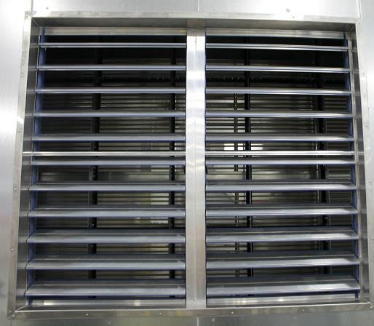
Hoods & Dampers
Intake hood has a cleanable filter to limit rain and snow introduction on outdoor units.
Outdoor units feature 1-inch-thick aluminum, washable filters.
Exhaust hood provided with bird screen on outdoor units.
Features two-position low-leakage motorized ventilation and exhaust air dampers.

Slide 11
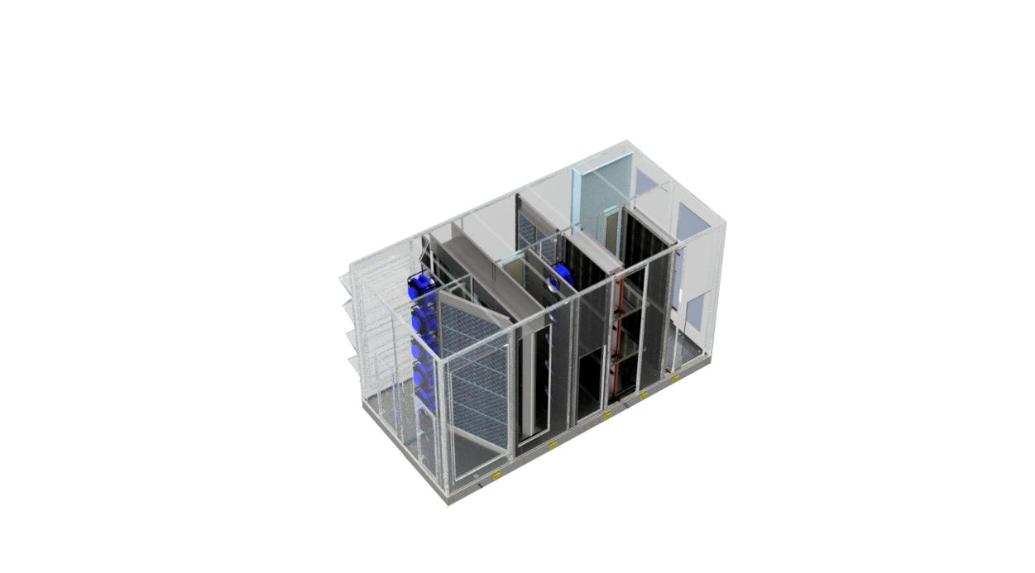

Conditioning Options
Integrated Coils
Hot water — 1 or 2 rows
Chilled water — 4, 6, or 8 rows
DX Coil — 4, 6 or 8 rows
  Evaporator coil only, controls by others
  All refrigeration specialties by others
Coils will be piped externally, no pipe chase
through the floor
Vestibule/doghouse to be provided by others

Slide 12
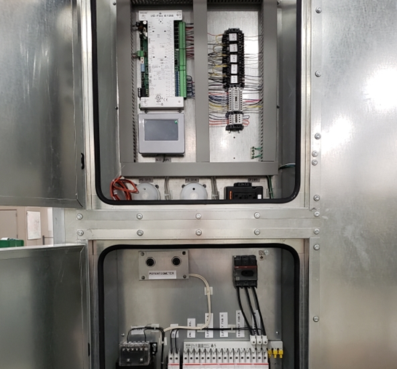
Electrical & Controls Packages
Electrical Package
Integrated electrical and controls panels
Internal disconnect
460/3/60 input power
Controls Packages
Supply temperature control
Communication to BAS via BACnet MS/TP
Standard full-control by FläktGroup SEMCO
Optional controls by others
Variable speed fans
Wheel control
  Variable speed
  Wheel frost protection
  Rotation detector sensor

Slide 13
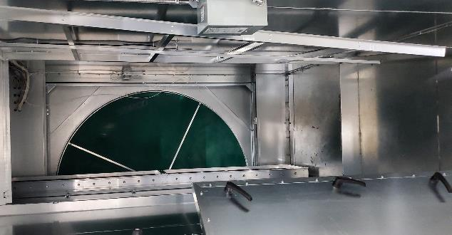

UWC/UWCH Wheel: Key Product Performance Features
Anti-corrosion, anti-stick & anti-microbial face coat
Very low static pressure loss with higher latent efficiencies
Reduced contaminant carry-over vs. competition
NFPA – 90A flame rating of <25 and 50
Low leakage across seals – Outdoor air correction factor
Maximum operating temperature – 180 F
Variable speed wheel capability - standard
True fluted media with laminar flow
Lower filtration requirements
Standard gear motor vs. industry standard of simple electric motor
FläktGroup SEMCO brand & reputation
Purge section, self-cleaning media assures no re-entrainment
Non-plugging aluminum honeycomb transfer wheel media
*Only applies to energy recovery units

Slide 14

Fusion & Fusion 3Å Wheel: Key Product Performance Features
Sensible & latent energy transfer
Substantially reduces the initial cost of the newly installed energy recovery system and its reliance on the cooling & heating plant.
High latent transfer efficiencies allow for full recovery even in low outdoor temperatures without frosting . (i.e. -10°F with return air humidity at 20% relative humidity)
Recovers temperature and humidity during both heating and cooling seasons.
Saves up to 80% of the heating & cooling loads associated with outside air.
Expected life greater than 20 years.
*Only applies to energy recovery units

Slide 15
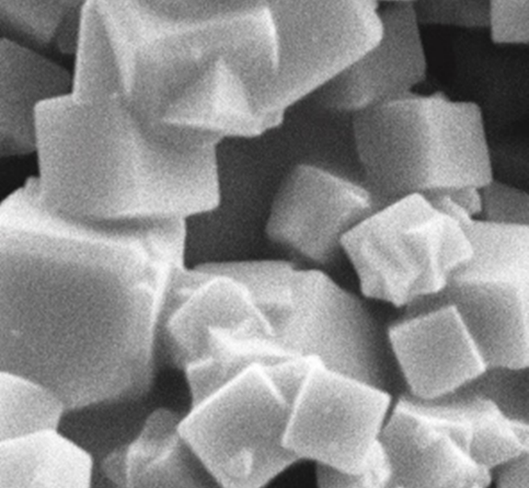
Fusion 3Å & True 3Å: Surface & Coating
Solid adsorbent layer allows for equal
transfer of latent and sensible energy.
3Å / composite desiccant surface limits
the transfer of contaminants.
Acid resistant face coating for critical
applications and seaside environments.
Anti-stick face coating limits the buildup
of particulate, simplifies cleaning.
Anti-microbial face coating and media
properties.
Electron microscopic image of a 3Å molecular sieve

Slide 16

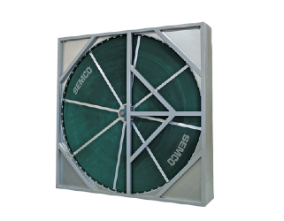

True 3Å Wheel: Key Product Performance Features
Sensible & latent energy transfer
Reduced initial cost by reducing mechanical conditioning.
Operates at lower temperatures without frosting.
Expected life greater than 20 years.
Recovers exhausted winter-time temperature and humidity.
Saves ≈ 50% of the loads associated with outside air.

Slide 17
Airflow Ranges in CFM
ElitePro Series Pre-Conditioner
ElitePro Series with Coils
16,000 – 20,000
14,000 – 17,500
11,000 – 15,000
10,000 – 13,000
7,000 – 12,000
9,000 – 11,000
7,000 – 9,000
The ElitePro Series serves the largest market segment
5,500 – 7,500
4,000 – 8,500
3,000 – 5,300
4,000 – 6,000

Slide 18
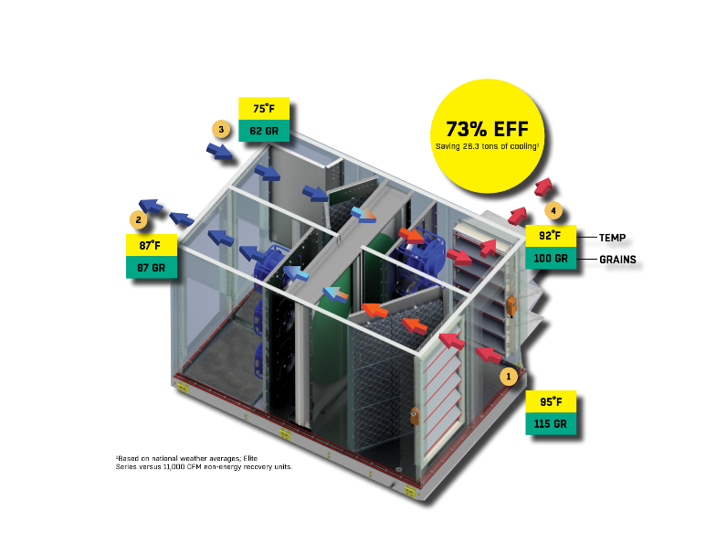
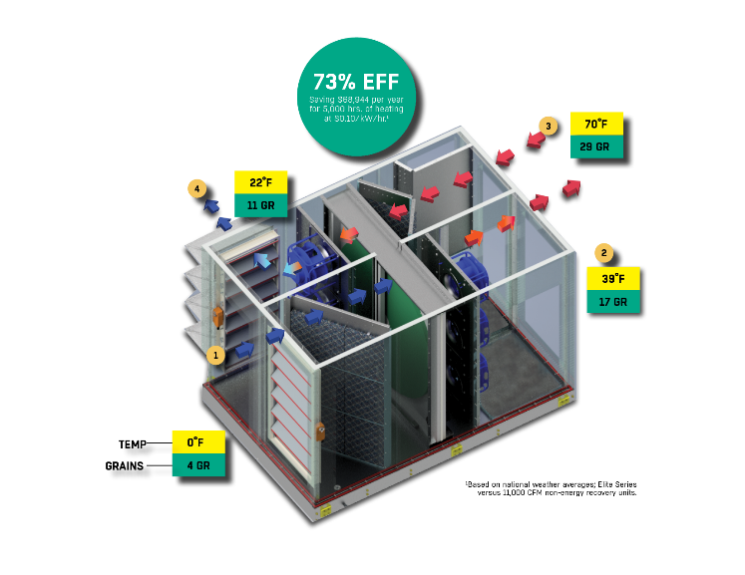
Pre-Conditioner Units: Typical Performance
COOLING SEASON
HEATING SEASON

Slide 19
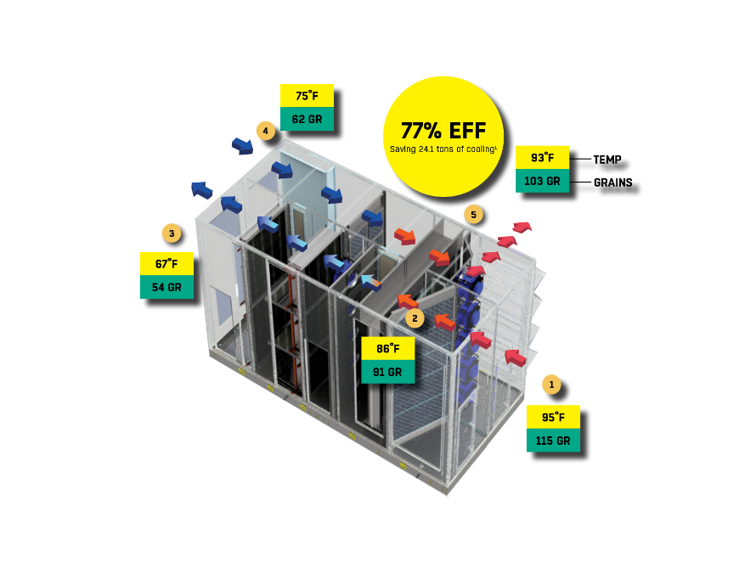
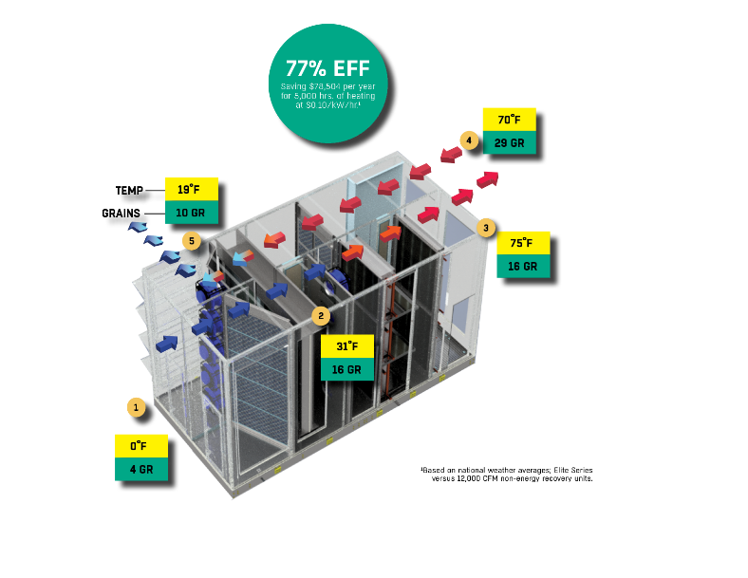
Conditioned Units: Typical Performance
COOLING SEASON
HEATING SEASON

Slide 20

ElitePro Series Air Handling Units: Overview
For applications where energy
recovery is not appropriate.
Should be considered for
applications where a lower first
time cost is weighted more heavily
than future energy savings.
Adding an ElitePro AHU to an
existing HVAC system can augment
incoming outdoor air levels to help
flush out more contaminants allowing
systems achieve ASHRAE 62.1.
Same superior air quality, humidity
control and construction as an ElitePro
energy recovery unit, without an
energy recovery wheel and the added
benefit of energy recovery and savings.

Slide 21
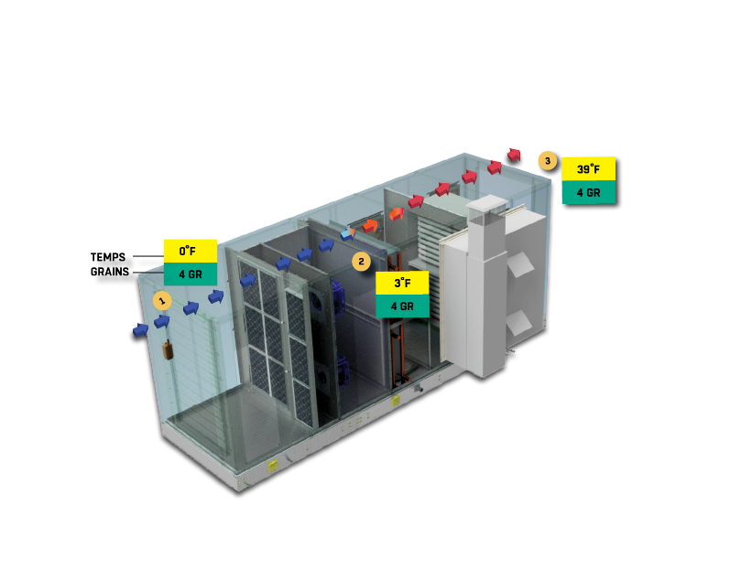
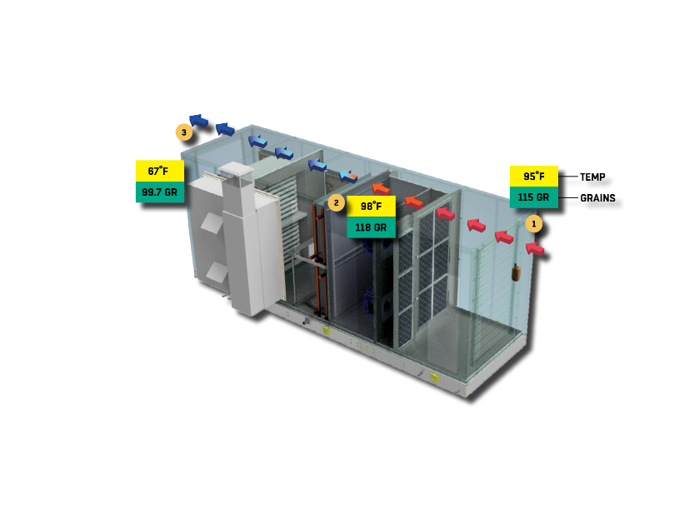
Air Handling Units: Typical Performance
COOLING SEASON
HEATING SEASON

Slide 22


Applications
School classrooms
Offices
Dormitories, apartments
Retail stores
Places of Worship
Day care facilities
Jails and prisons
Smoking areas
Casinos
Restaurant dining areas
Movie theaters
Bowling centers
Light manufacturing areas
Notes:
31
26
26

Slide 23

Thank you for your attention!

Slide 24
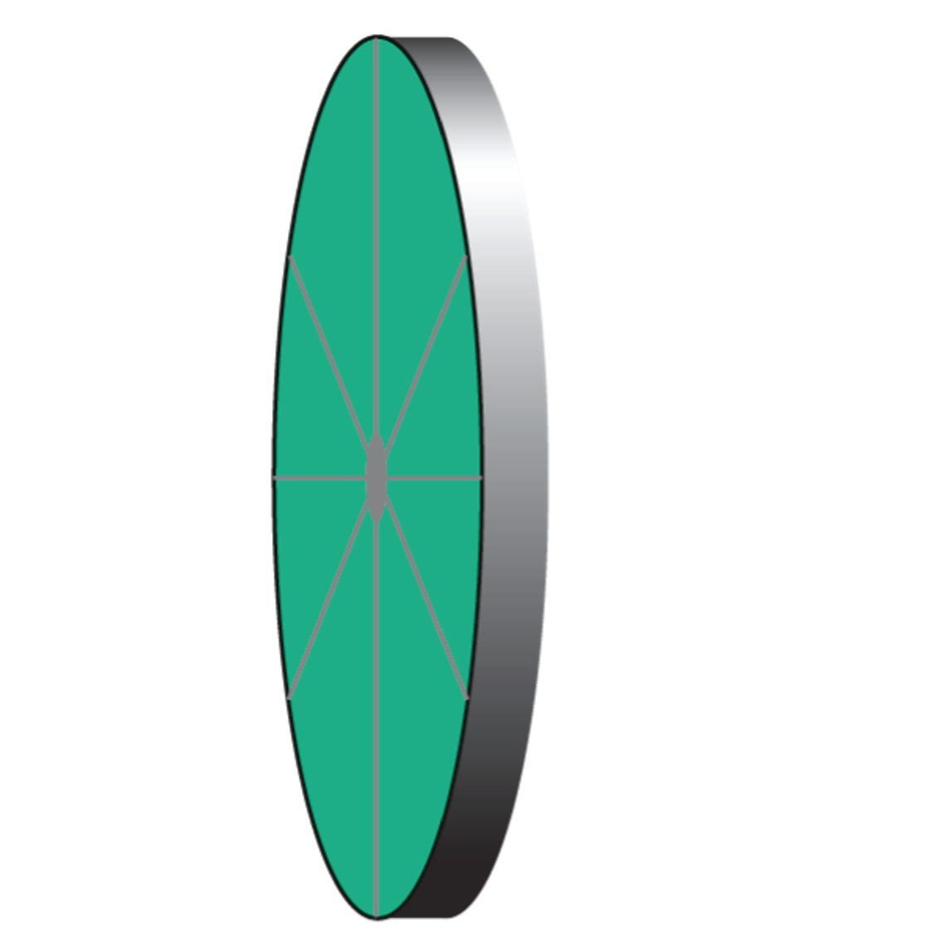

Energy Recovery Units: Typical Performance
EXHAUST AIR
EXHAUST AIR
RETURN AIR
RETURN AIR
91 DEG.
96 GR.
26 DEG.
12 GR.
72 DEG.
62 GR.
70 DEG.
29 GR.
5750 CFM
5750 CFM
95 DEG.
115 GR.
84 DEG.
83 GR.
6000 CFM
0 DEG.
3.7 GR.
48 DEG.
19 GR.
6000 CFM
OUTDOOR AIR
SUPPLY AIR
OUTDOOR AIR
SUPPLY AIR
COOLING MODE
HEATING MODE

