Slide 1
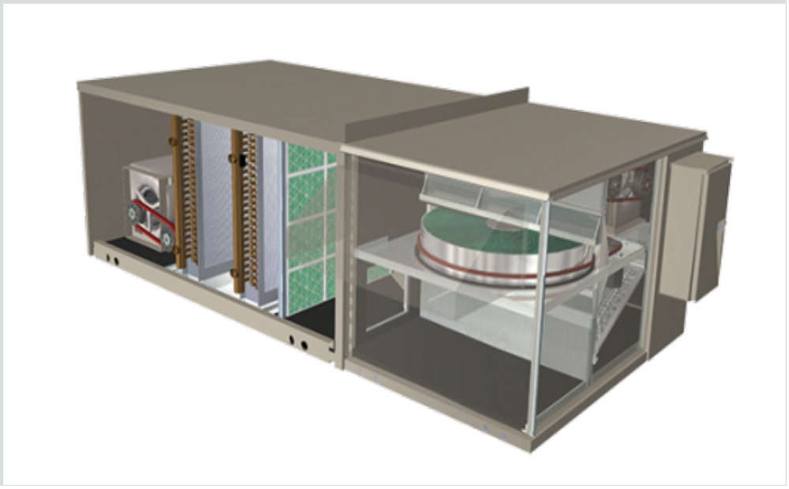
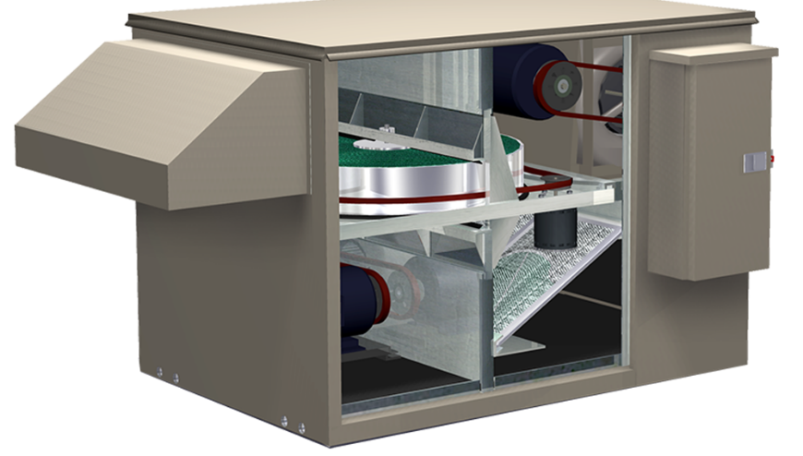

FV and FV Coil Module

Slide 2
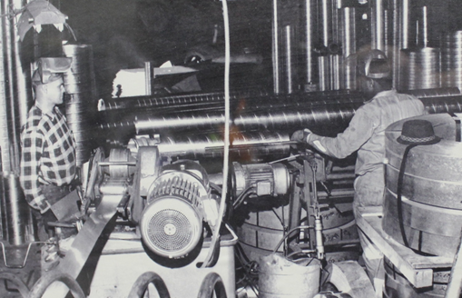
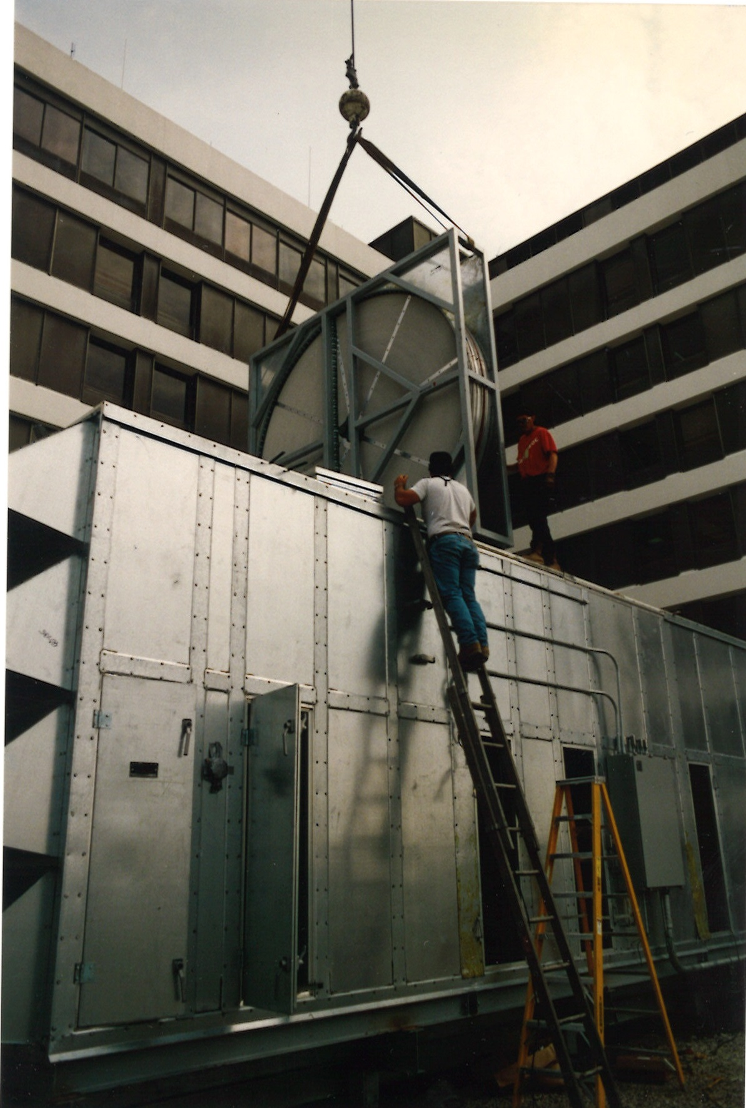
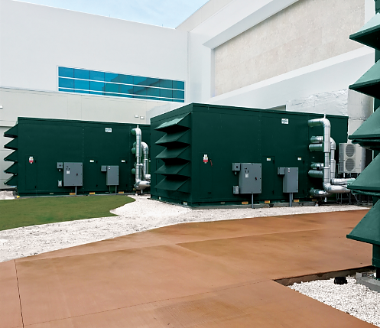






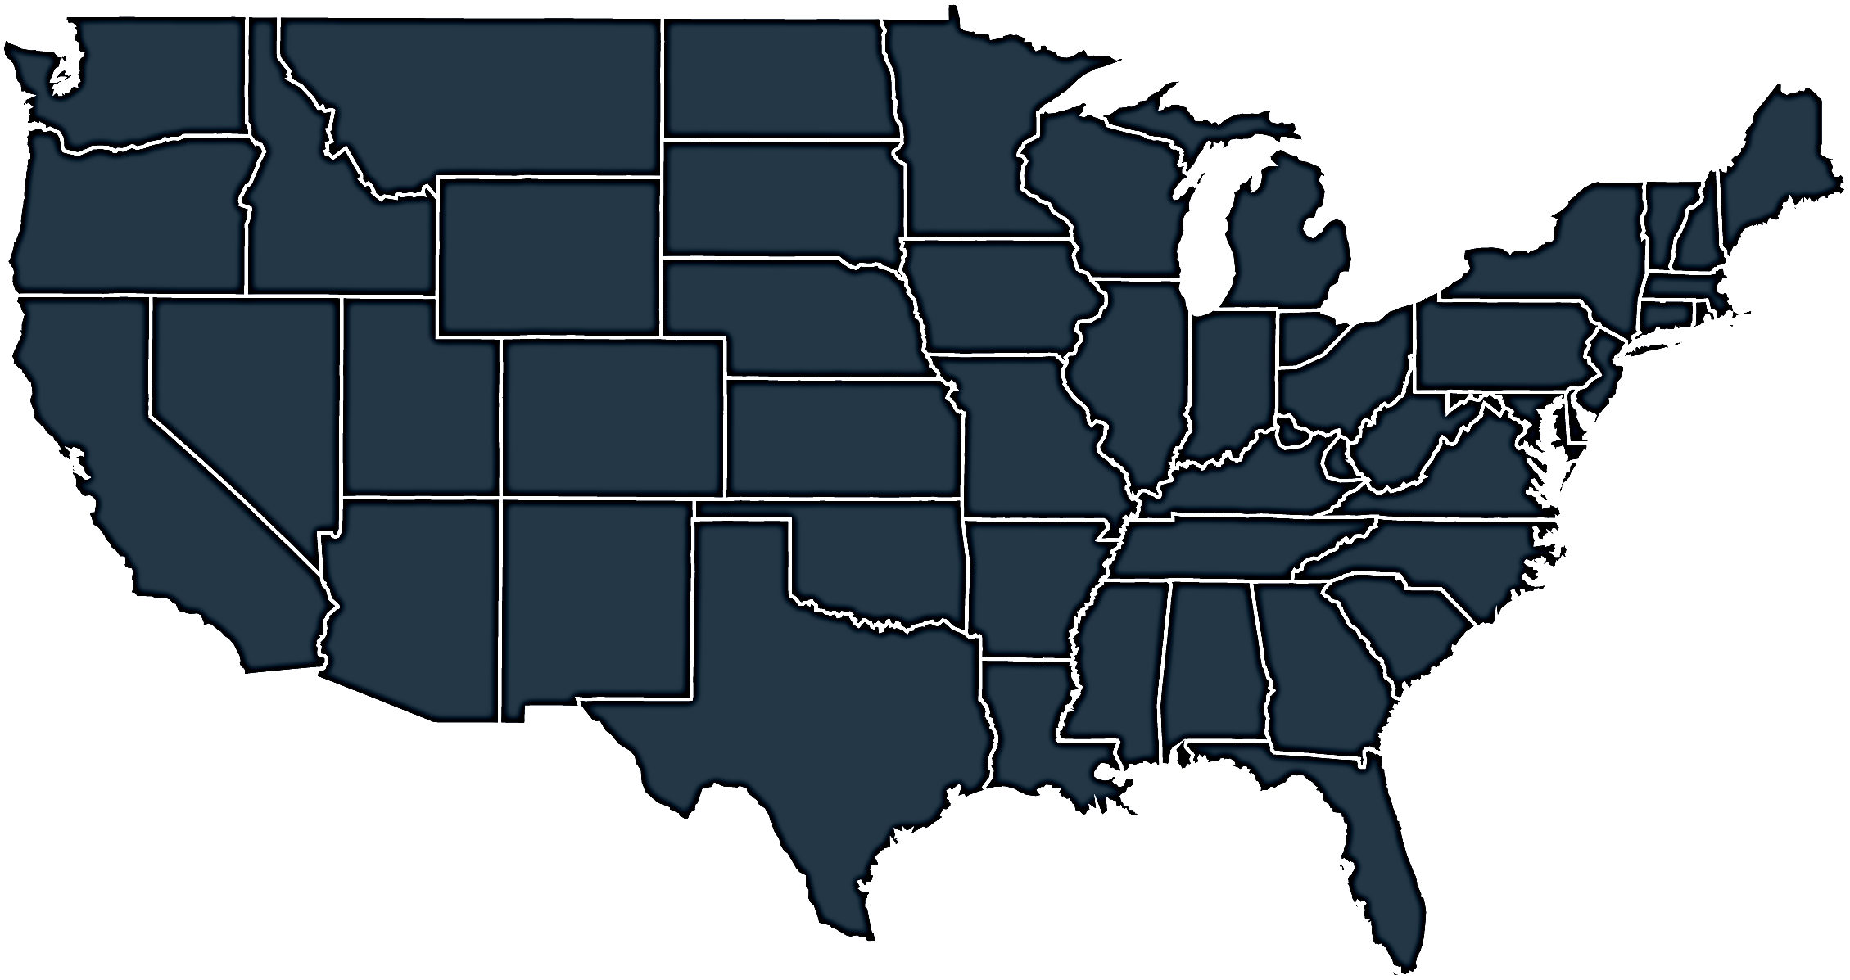



Who we are & what we do
Energy
& Environmental
Focus
Patented &
Certified
Products
U.S & Global
Footprint
Engineered
Air Quality &
Data Center
Solutions
Engineered
Air Distribution
& Sound
Solutions
OEM,
Key Account &
Sales Rep
Route To Market
Service
& Support
Award Winning
& Industry
Recognized
Notes:
In 1963 Salisbury Engineering and Manufacturing Company (SEMCO) was born in Salisbury, MO.
Began as SEMCO -- small sheet metal fabricator specializing in duct.
In the 59 years, evolved into a multi-million dollar company with a large product offering.
Headquartered in Columbia, MO, with 275,000 sq ft of manufacturing space in 3 plants in Arkansas and Virginia
We are a business unit of FläktGroup, and we are owned and backed by Triton Partners—which is a $17 billion annual revenue investment firm.
Innovation is core at FläktGroup SEMCO.
Certified by AHRI, SEMCO was won numerous awards – including multiple AHRI Innovation, Green Building, Dealer Design, School/College Planning & Management Awards
Hold numerous patents and trade secrets for our industry leading energy recovery wheels and systems.

Slide 3

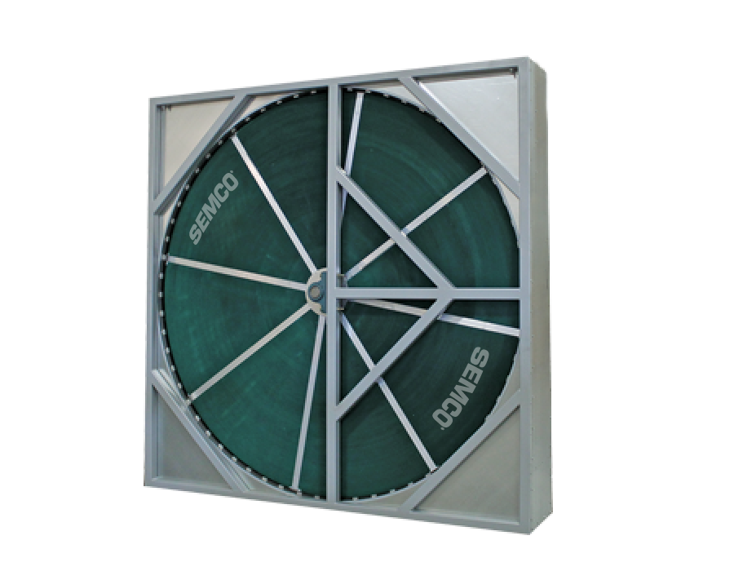
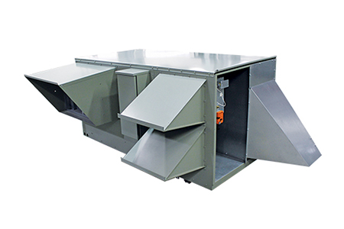
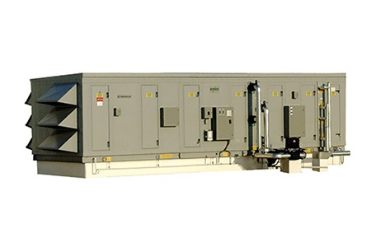

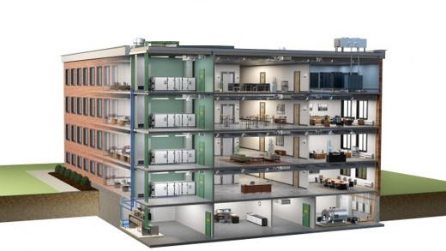
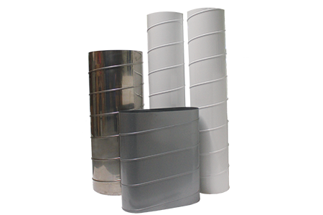
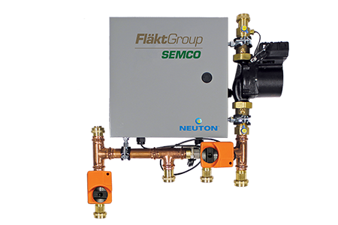
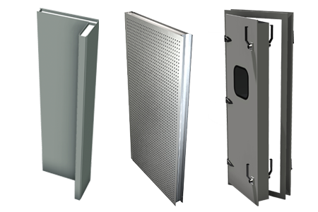
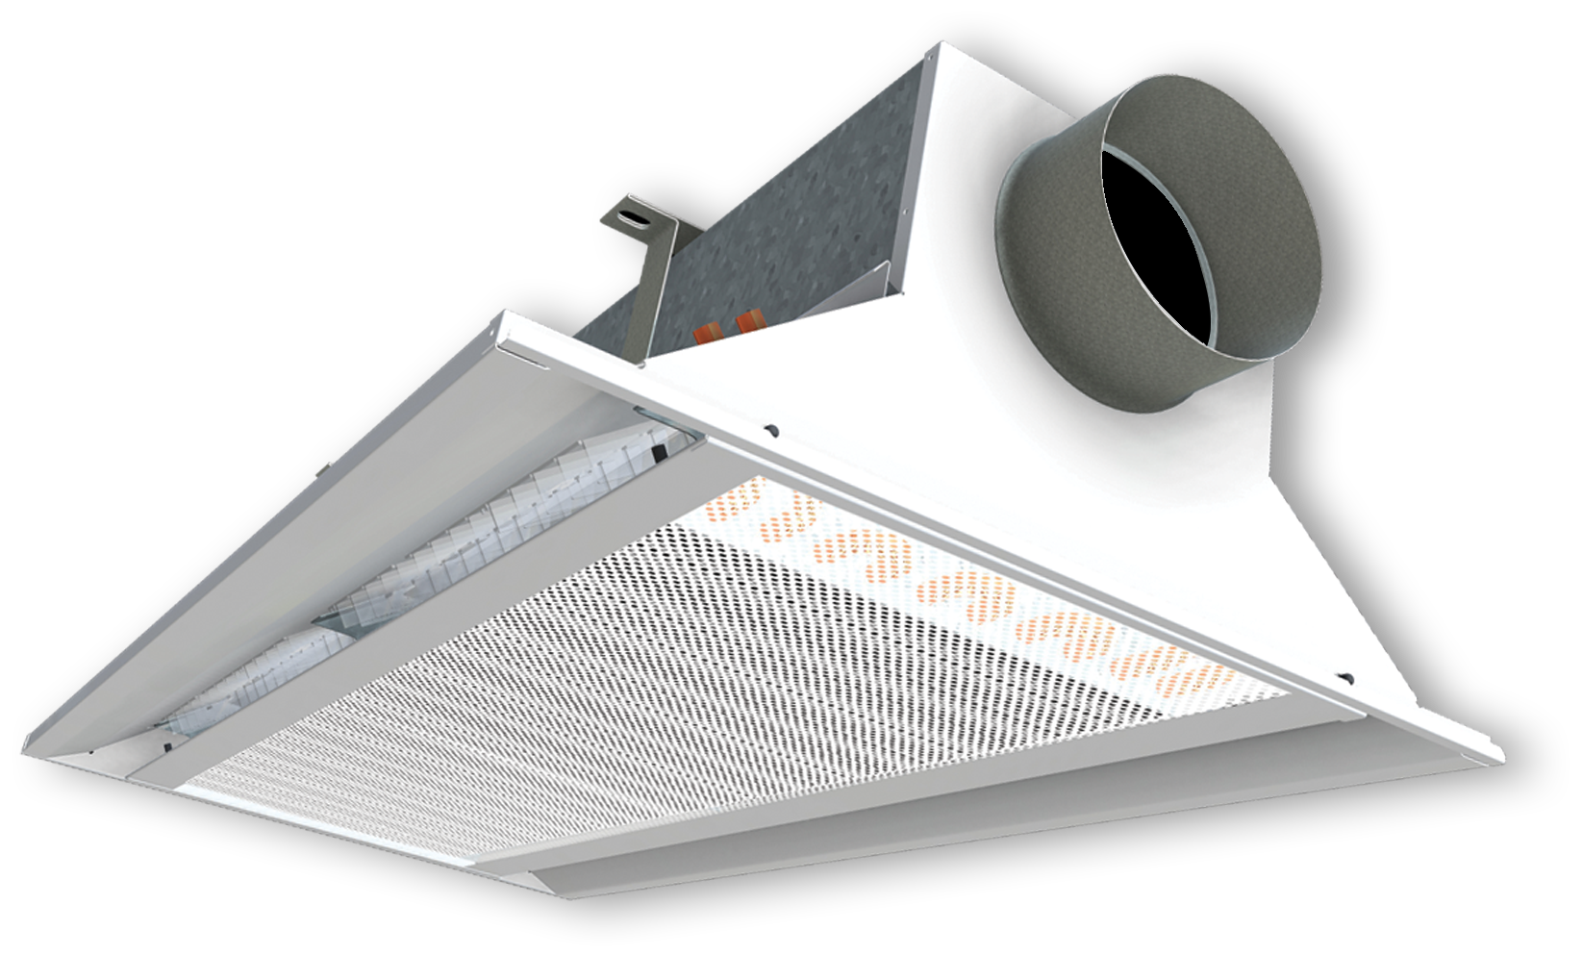
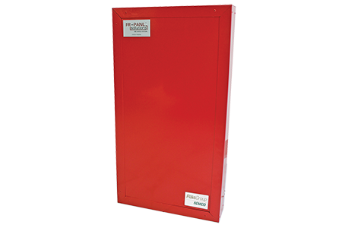
FläktGroup SEMCO Products For Commercial Applications
Energy Recovery Wheel
Unitary Energy Recovery Unit
Applied Energy Recovery Unit
NEUTON Pump
Ductwork
Chilled Beams
Fire-Rated Panels
Sound Attenuation Panels
Notes:
FläktGroup SEMCO provides solutions for a wide variety of applications including casinos, offices, laboratories, hotels, education, healthcare, retail, data centers, stadiums, manufacturing, agriculture & indoor farming, airports, and recreational facilities.
FläktGroup SEMCO products could be utilized in conjunction with one another, to provide the best possible air quality.
We offer energy recovery units & wheels which are engineered to be low maintenance, environmentally friendly, energy efficient & saves money over time as well as protects occupants from harmful contaminants.
We also offer chilled beams, pump modules, data centers, air handlers, duct and panels.
Leverage below if desired:
FläktGroup SEMCO products are designed to be utilized in conjunction with one another, to provide the best possible air quality. We show here:
Ductwork is laid within the walls and ceiling of the building, so supply air may be brought into the building and return air may be exhausted from the building.
Outdoor air is brought into the FV and pre-conditioned
Once the air is pre-conditioned with the FV it is filtered through the Pinnacle energy recovery unit, which will remove contaminants and dehumidify the incoming airstream with its True 3A wheel. Return air will also flow through the Pinnacle on its way out.
The chilled beams and the Neuton will work together with the supply air they receive from the Pinnacle to maintain a comfortable room temperature without condensation. (Together the Pinnacle, Neuton, and chilled beams make up 3fficiency).
During the construction of the building fire panels will be installed around an equipment room or elevator.
Sound attenuation panels are also installed during construction around noisy equipment or places where noise may be a concern

Slide 4


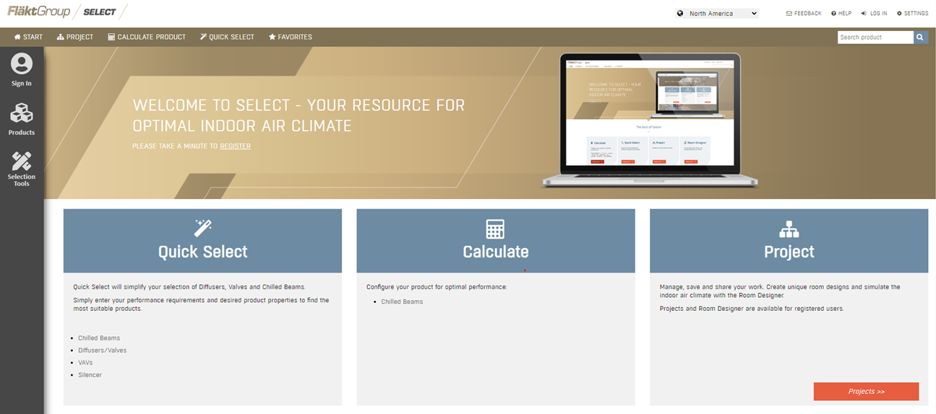
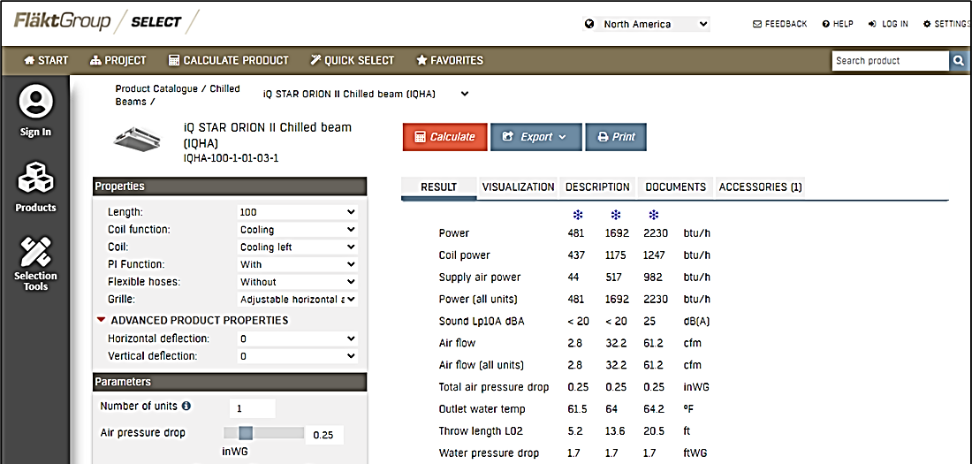

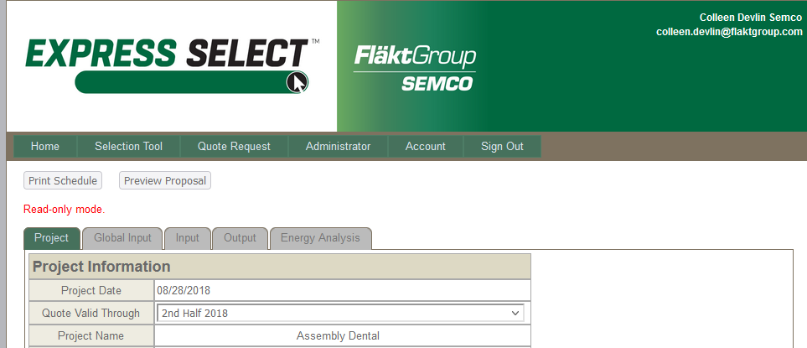
FläktGroup SEMCO Superior Sales Support & Service
Notes:
FläktGroup SEMCO prides ourselves on supplying exceptional sales support and service.
Our experienced sales team are a phone call away and will help guide you through our selection programs to meet or exceed project specifications.
While all FläktGroup SEMCO products are relatively maintenance free throughout their lifecycle--we have a knowledgeable and dedicated service team available should you require it.

Slide 5
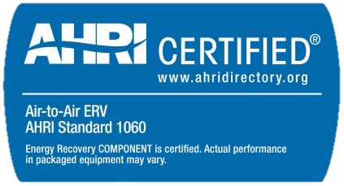
SEMCO FV: Product Overview
The function of an Energy Recovery Ventilator (ERV) is to continuously provide the code required quantity of outdoor air during occupancy, with uncompromised quality and in an energy efficient manner.
Cost effective, tested and approved total energy recovery module
Certified performance, high latent capacity
Non-plugging aluminum honeycomb transfer media
Patented molecular-sieve desiccant limits the transfer of exhaust air pollutants
Purge section, self-cleaning media assures no re-entrainment

Slide 6
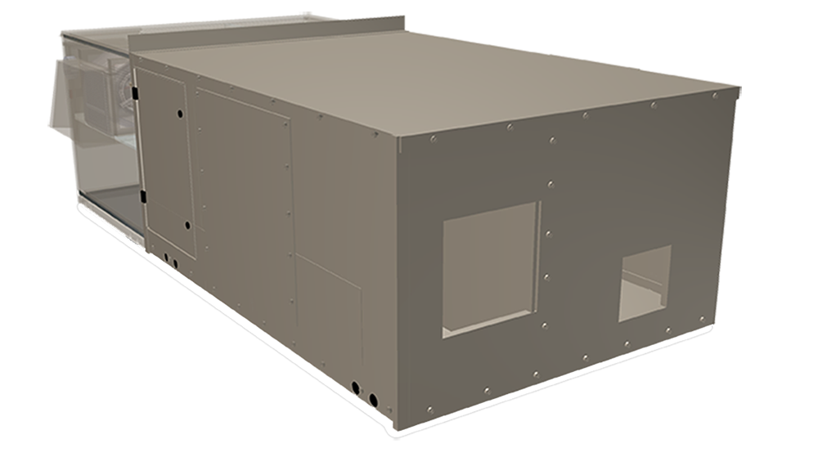
SEMCO FV: Coil Module
Provides an increase in the outdoor air quantity (5 to 20 cfm/person) without significantly increasing operating costs.
Effective solution to ASHRAE Standard 62
Airflow capacity from 800 cfm to 9,000 cfm
Indoor and outdoor installation capable
Horizontal and down flow configurations
Numerous coil material construction types available
Insulated to minimize energy loss
LEED compliant filters
Low profile design

Slide 7
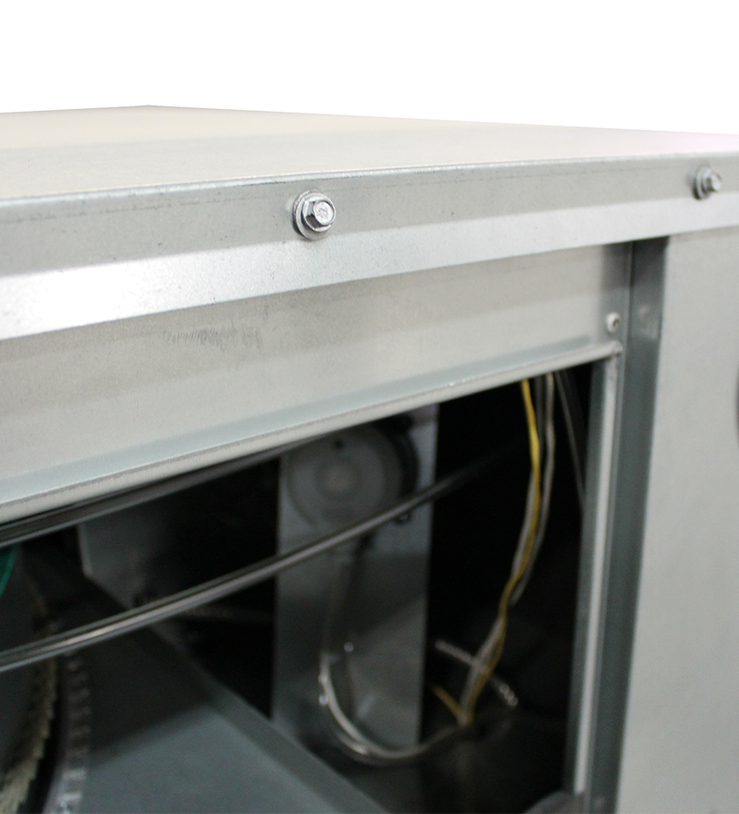
SEMCO FV: Casing
1 piece Construction
Light weight design
Long life finish
½” Closed cell elastomeric anti-microbial wipe down insulation
Optional dual wall construction
G90 painted or unpainted finish
Large access doors
FV Coil Module
Galvanized steel cabinet, with optional enamel finish

Slide 8
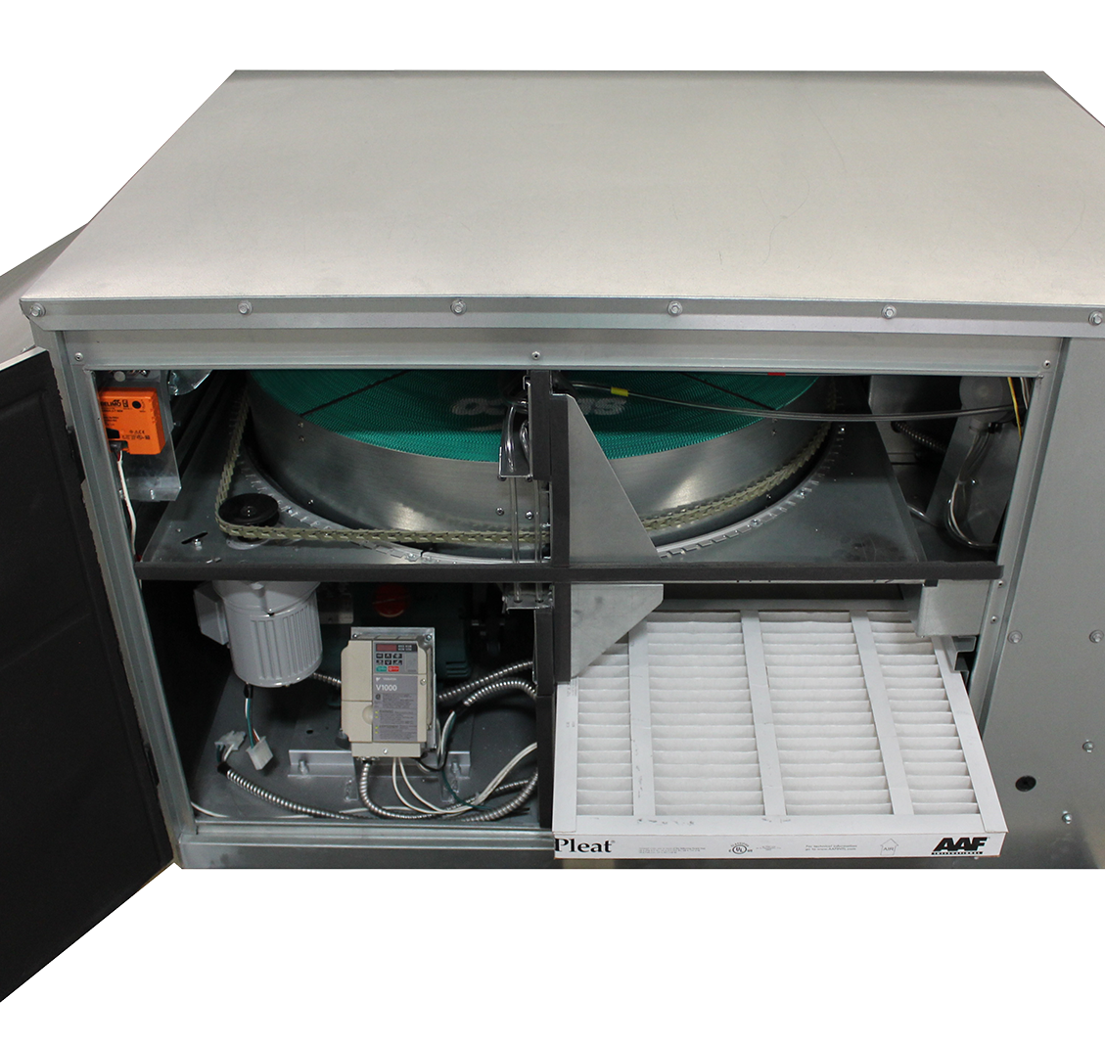
SEMCO FV: Fans & Filters
Supply and exhaust fans sized for quiet and efficient operation
Multiple motor/sheave combination to match design requirements
Optional upgraded controls include VFD control of fans.
Optional premium controls also include VFD control of the wheel
Requires minimal maintenance - effectively operating with low efficiency filters without impacting long term performance
Filtration for both the OA and RA – MERV 8 or MERV 13
Standard 1-inch thick aluminum, washable filters
Standard 2” thick pleated type filters

Slide 9
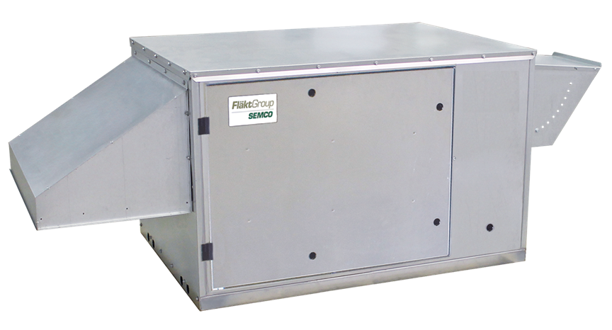
SEMCO FV: Hoods & Dampers
Intake hood with a cleanable filter to limit rain and snow introduction on outdoor units
Exhaust air back draft damper on outdoor units only
Optional motorized exhaust damper
Outdoor air manually adjustable damper
Optional motorized outdoor air damper
Recirculation is available as part of optional separate FV Coil Module

Slide 10
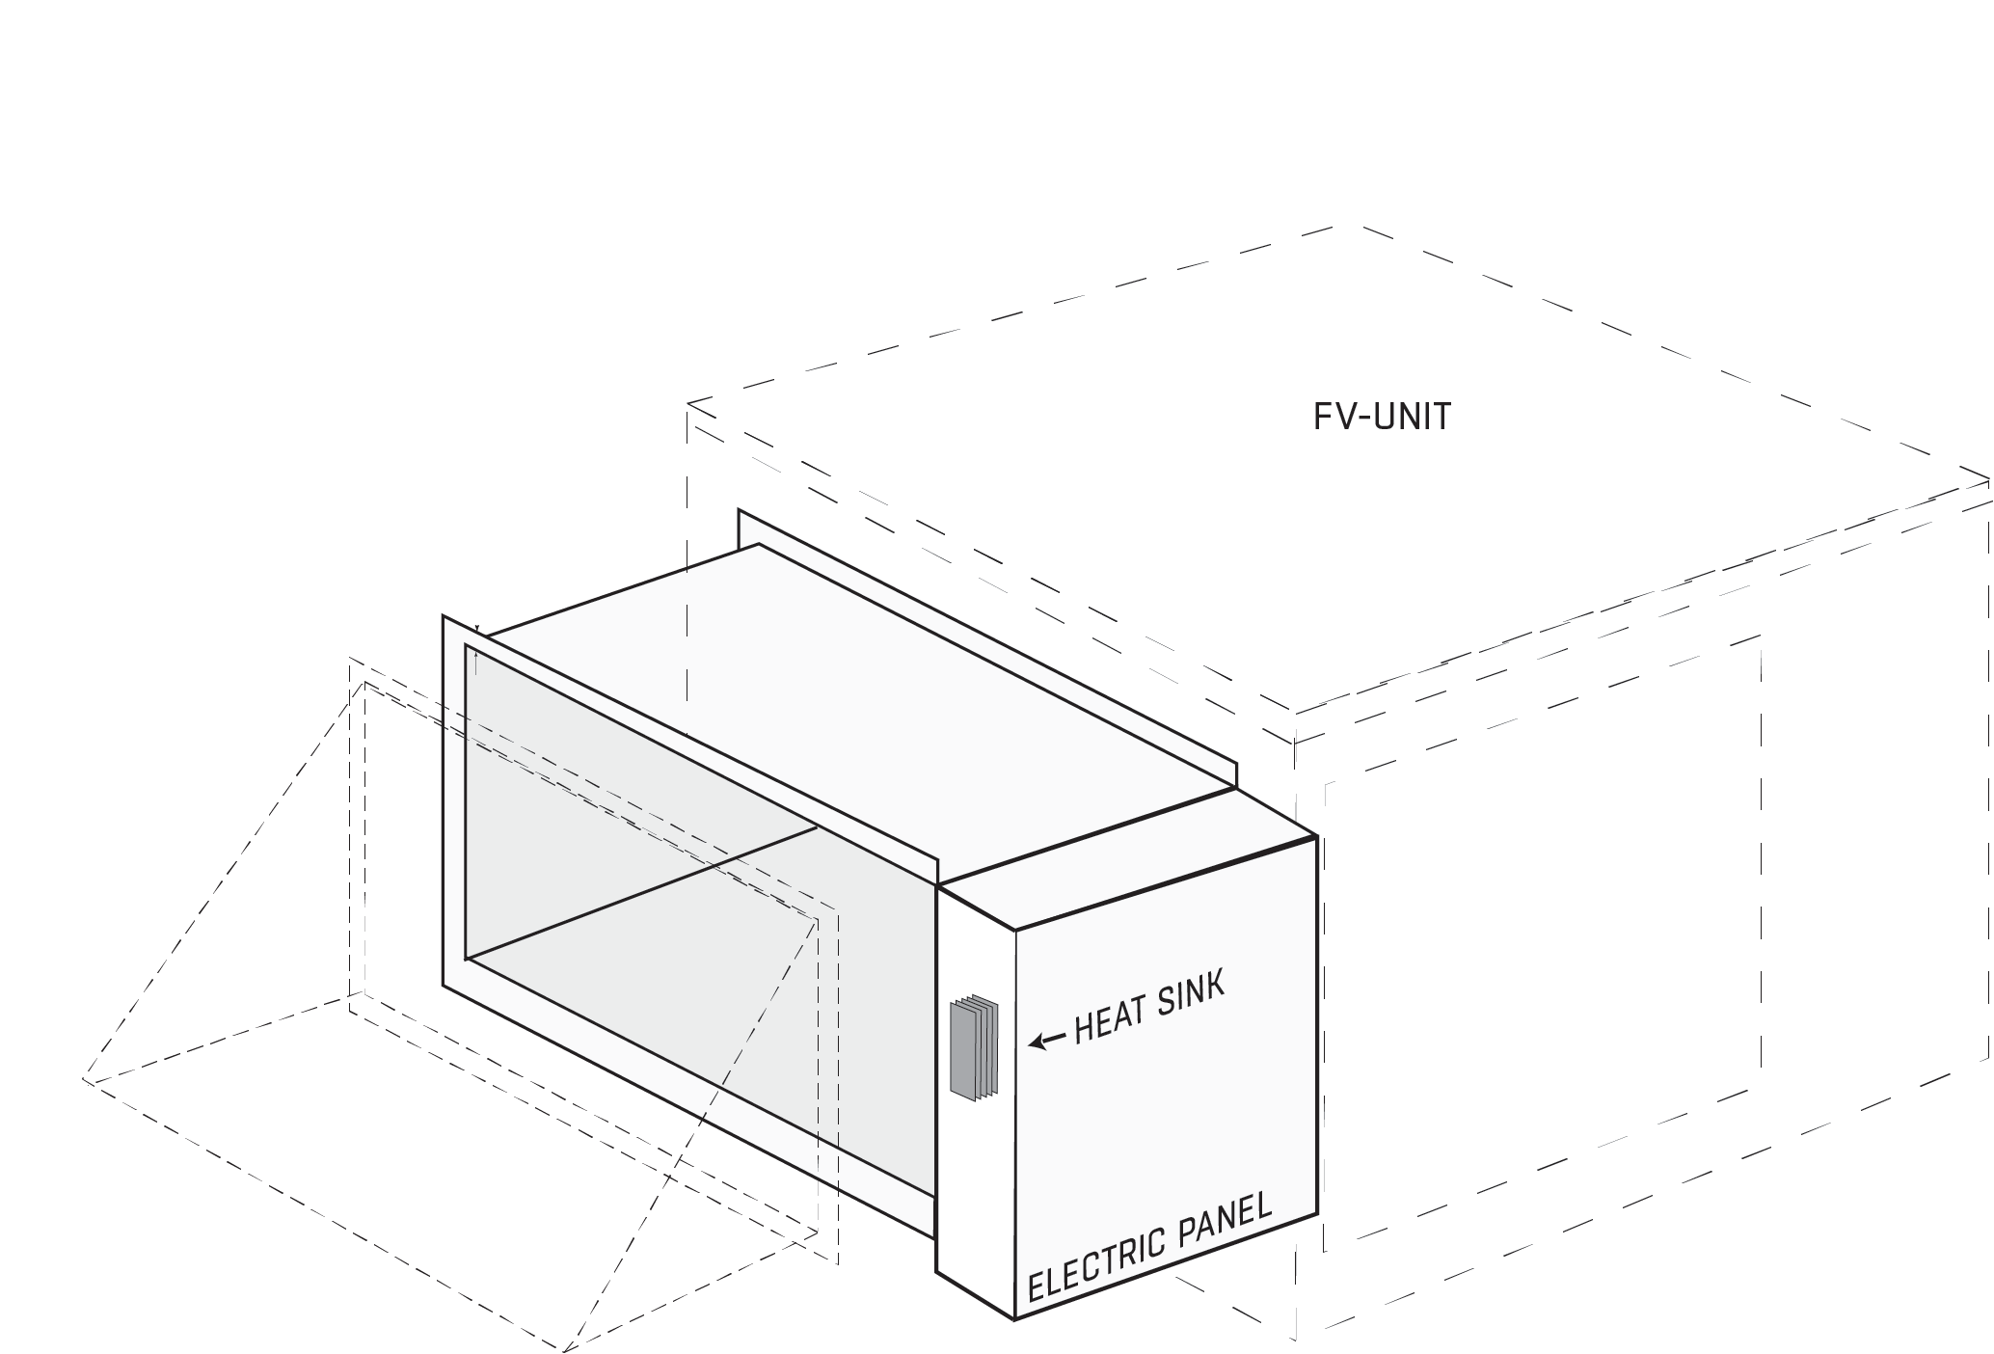
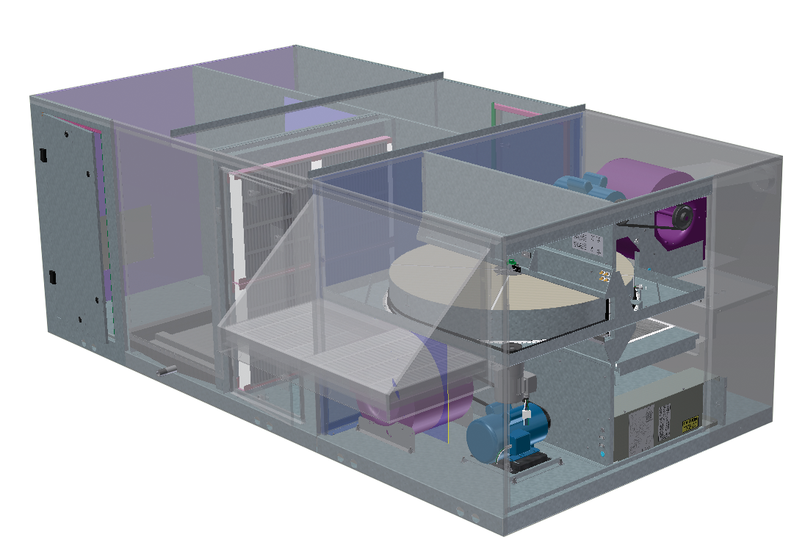
SEMCO FV: Heating and Cooling Configurations
FV Integrated coils
Electric Preheat is optional
Coil Module Options:
Electric – Staged standard, SCR with premium controls
Hydronic Heating and/or Cooling
DX Cooling

Slide 11
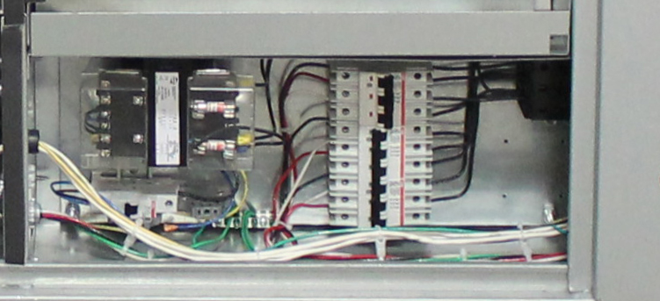
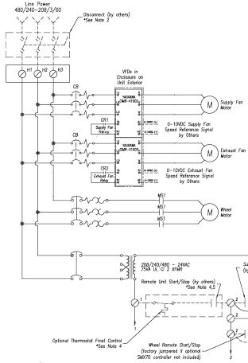
SEMCO FV: Electrical Package
All motors wired to starters
Optional variable frequency drive (VFD) for supply and exhaust fans
Optional VFD for wheel with premium controls
Accepts contact inputs for supply fan, wheel, and unit start/stop
Multiple options on input voltage to units

Slide 12
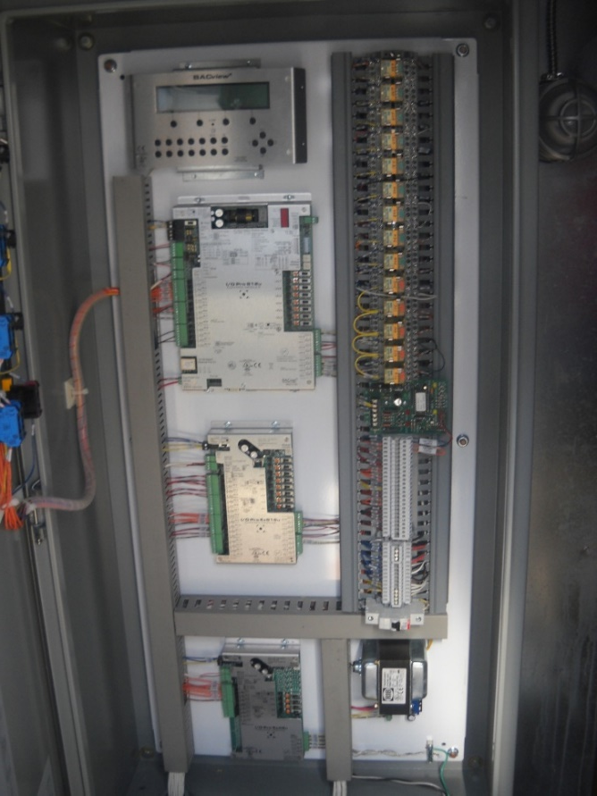
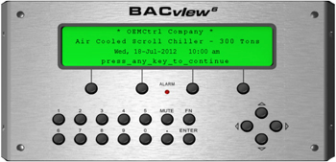
SEMCO FV: Control System
Coil Control
Web Access
Communication to BAS
Wheel Control
  Stop/Jog Economizer - allows wheel to be stopped automatically during mild outdoor temperatures with periodic brief rotation to maintain the self-cleaning feature of the heat exchanger
  Wheel Frost Protection - allows wheel only to be stopped by the stop/jog economizer at a predetermined outdoor temperature in applications where preheat coil or thermostat shut-off is not desired
  Rotation Detector Sensor - can provide an alarm signal indicating wheel rotation failure

Slide 13
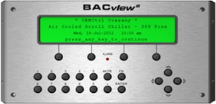
SEMCO FV: Control Options
Basic Options
Control Ready Package
Full Controls
Stop/Jog Economizer
Wheel VFD
Enthalpy Economizer
Rotation Detector
Rotation Detector
CFM Fan Control Opt
Frost T-Stat
Filter Pressure Switches
HOA switch w/ Alarm Light
Duct P Fan Control Opt
CO2 Monitoring Opt
Cooling/Heating Control
Large Keypad
BAS Connection

Slide 14

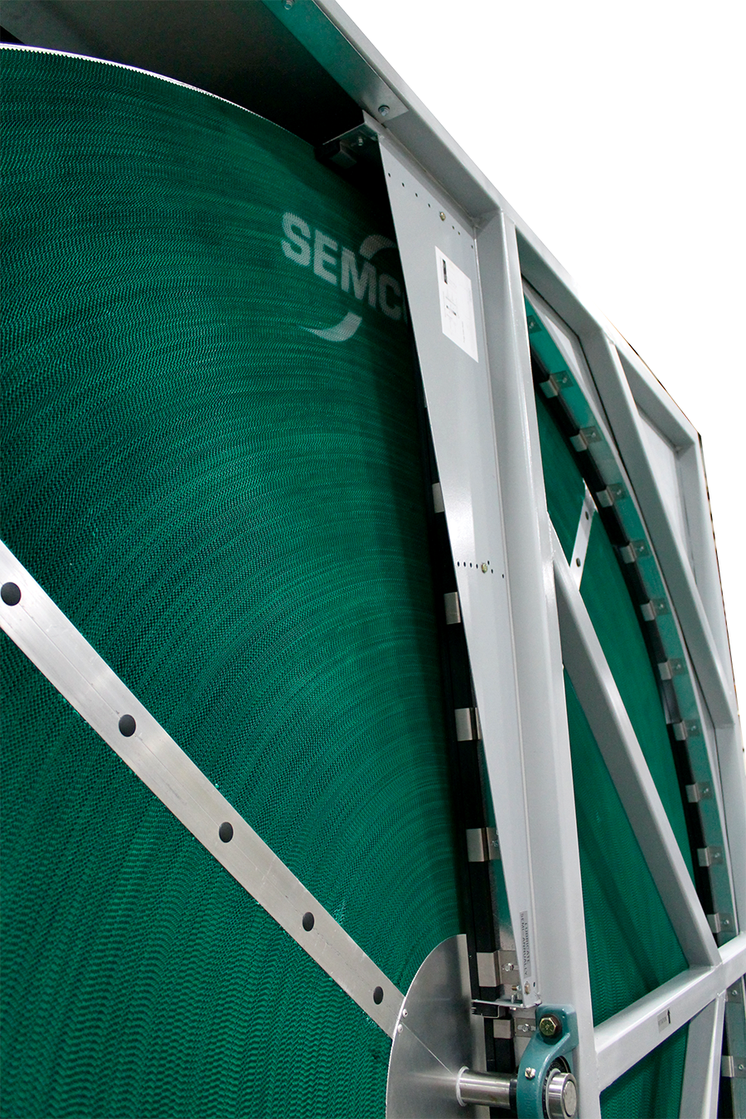
SEMCO FV: True 3Å Wheel
Patented 3Å molecular sieve-desiccant coating for independently certified cross-contamination < 0.04%
Optimizes the parasitic pressure loss across the energy wheel media
Designed with an aluminum substrate built to meet smoke and flame ratings
Independently certified wheel performance in accordance with ASHRAE Standard 84-91 and ARI Standard 1060 with regard to:
  latent transfer efficiency
  sensible transfer efficiency
  pressure loss across wheel

Slide 15
SEMCO FV: Airflow ranges
FV - 9000
6,000
10,000
FV - 7500
4,500
9,000
FV - 5000
2,600
6,200
FV - 4000
2,600
4,000
FV - 3000
1,800
3,000
FV - 2000
800
2,000
FV - 1000
415
1,245
FV - 600
525
775
Adding a SEMCO Coil Module will provide a significant increase in the outdoor air quantity
(5 to 20 cfm/person) without increasing operating costs

Slide 16
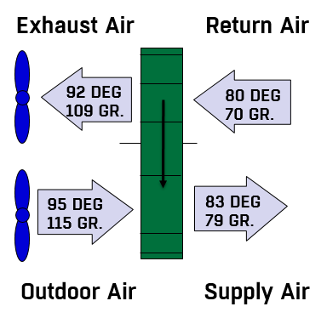
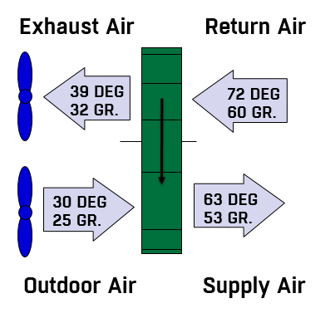
SEMCO FV: Typical Performance
LIVE TYPE UNDERNEATH GRAPHIC
Exhaust Air
Return Air
Exhaust Air
Return Air
92 DEG
80 DEG
39 DEG
72 DEG
109 GR.
70 GR.
32 GR.
60 GR.
95 DEG
83 DEG
30 DEG
63 DEG
115 GR.
79 GR.
25 GR.
53 GR.
Outdoor Air
Supply Air
Outdoor Air
Supply Air
Cooling Mode
Heating Mode
Notes:
8
5
5
LIVE TYPE UNDERNEATH GRAPHIC

Slide 17
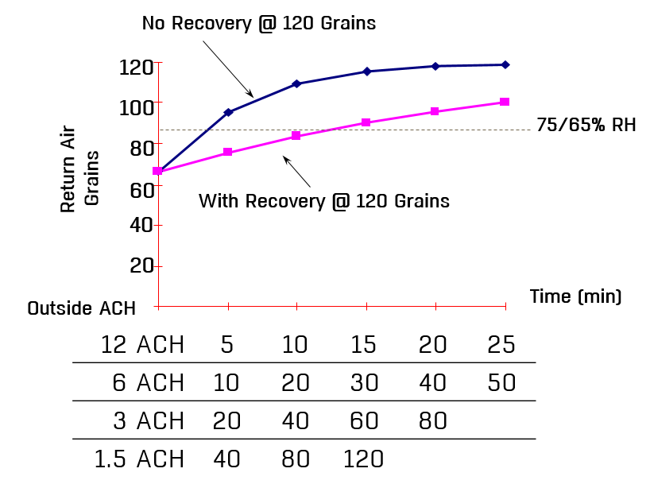
SEMCO FV: Compressors off - Continuous Ventilation
No Recovery @ 120 Grains
120
LIVE TYPE UNDERNEATH GRAPHIC
100
75/65% RH
80
Return Air
Grains
60
With Recovery @ 120 Grains
40
20
Time (min)
  Outside ACH
12 ACH | 5 | 10 | 15 | 20 | 25
6 ACH | 10 | 20 | 30 | 40 | 50
3 ACH | 20 | 40 | 60 | 80
1.5 ACH | 40 | 80 | 120
Notes:
14
LIVE TYPE UNDERNEATH GRAPHIC

Slide 18
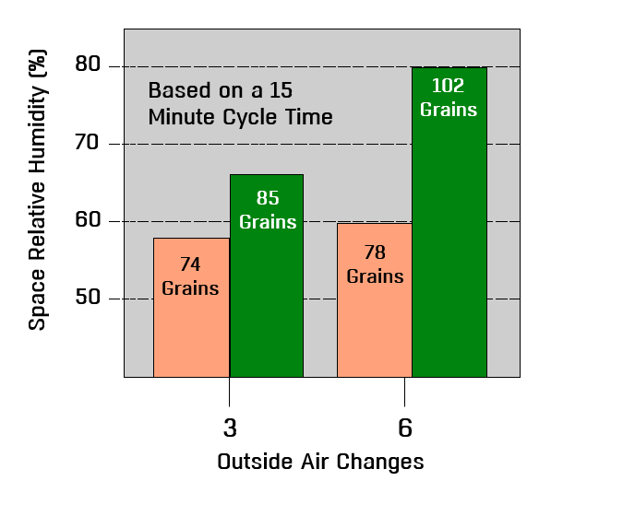
SEMCO FV: Space Humidity at Part Load Conditions
80
Based on 15 minute
compressor cycle time
102
Grains
Based on a 15
Minute Cycle Time
LIVE TYPE UNDERNEATH GRAPHIC
70
Space Relative Humidity (%)
85
Grains
60
74
Grains
78
Grains
50
3
6
Outside Air Changes
Notes:
15
10
10

Slide 19
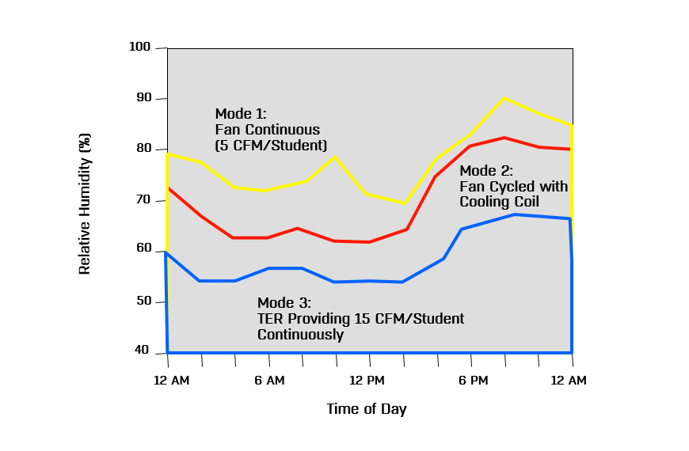
SEMCO FV: Space RH Measured at Different Operating Modes (Cooling)
100
90
LIVE TYPE UNDERNEATH GRAPHIC
Mode 1:
Fan Continuous
80
(5 CFM/Student)
Mode 2:
Fan Cycled with
70
Cooling Coil
Relative Humidity (%)
60
50
Mode 3:
TER Providing 15 CFM/Student
Continuously
40
12 AM
6 AM
12 PM
6 PM
12 AM
Time of Day
Notes:
37
30
30

Slide 20
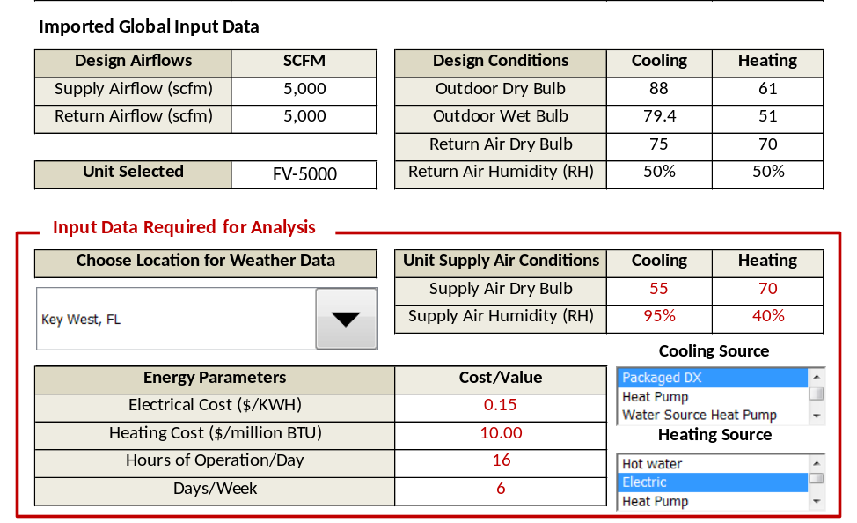
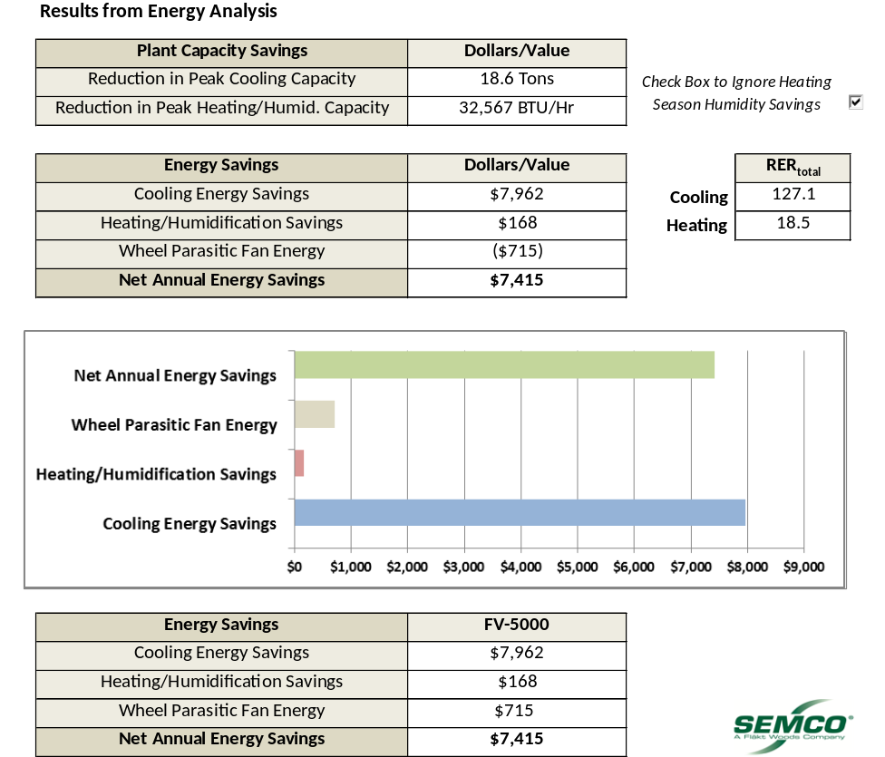
Low Cost Power: Cost Savings Example
Electric Costs $0.15/KWH
Net Savings: $7,415

Slide 21

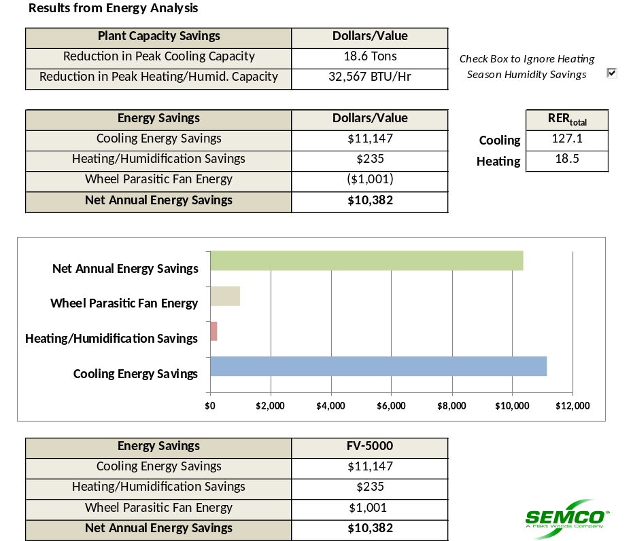
Brazil High Cost Power: Cost Savings Example
Electric Costs $0.21/KWH
Net Savings: $10,382

Slide 22

SEMCO FV: School Classroom Example
Design for 15 cfm/student of outdoor air provided continuously
Maintain space at 75 degrees at or below 60% RH when occupied
Design for 29 students and a teacher
Space sensible load at 1.2 tons, space latent load at .70 tons (SHR at .65)
Design condition 85 degrees and 110 grains (humidity control design point during spring season)
Notes:
16
11
11

Slide 23
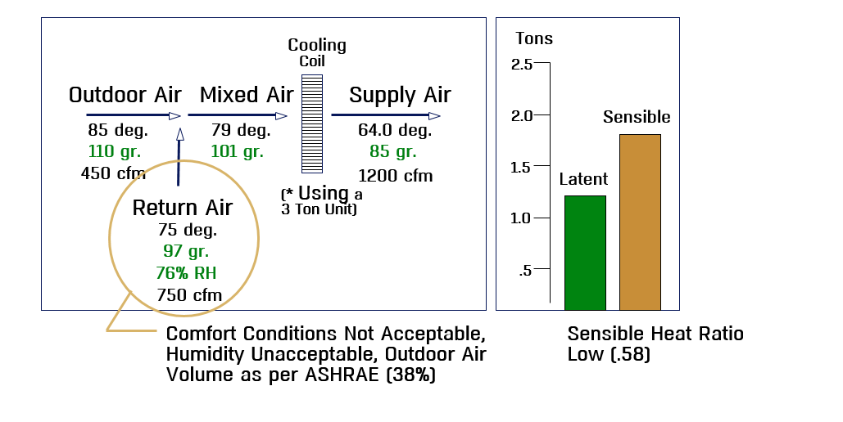
Classroom Example: Common Approach
3 ton unit, 38% outdoor air
• Space humidity control is lost
• High latent to sensible heat ratios on packaged AC unit
LIVE TYPE UNDERNEATH GRAPHIC
Cooling
Tons
Coil
2.5
Outdoor Air
Mixed Air
Supply Air
2.0
Sensible
85 deg.
79 deg.
64.0 deg.
110 gr.
101 gr.
85 gr.
450 cfm
1200 cfm
1.5
Latent
(* Using a
Return Air
3 Ton Unit)
75 deg.
1.0
97 gr.
76% RH
.5
750 cfm
Comfort Conditions Not Acceptable,
Humidity Unacceptable, Outdoor Air
Volume as per ASHRAE (38%)
Sensible Heat Ratio
Low (.58)
Notes:
17
12
12

Slide 24
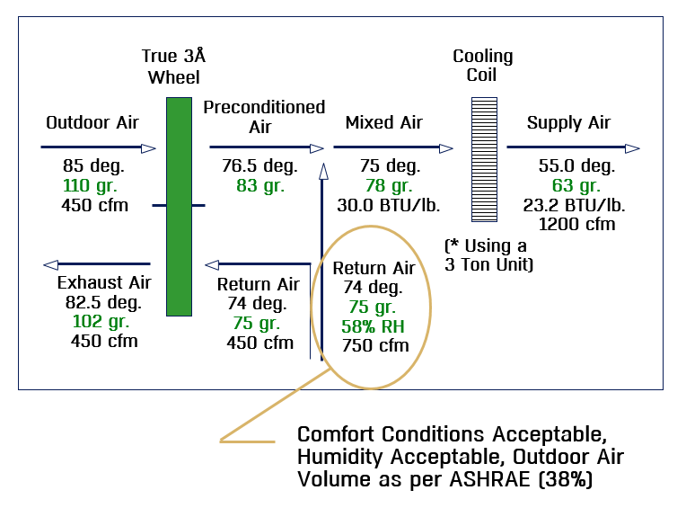
Classroom Example: FV Approach
FV allows packaged equipment to accommodate ASHRAE 62 in classroom
LIVE TYPE UNDERNEATH GRAPHIC
True 3Å
Wheel
Cooling
Coil
Preconditioned
Outdoor Air
Air
Mixed Air
Supply Air
85 deg.
76.5 deg.
75 deg.
55.0 deg.
110 gr.
83 gr.
78 gr.
63 gr.
450 cfm
30.0 BTU/lb.
23.2 BTU/lb.
1200 cfm
(* Using a
Return Air
3 Ton Unit)
Exhaust Air
Return Air
74 deg.
82.5 deg.
74 deg.
75 gr.
102 gr.
75 gr.
58% RH
450 cfm
450 cfm
750 cfm
Comfort Conditions Acceptable,
Humidity Acceptable, Outdoor Air
Volume as per ASHRAE (38%)

Slide 25
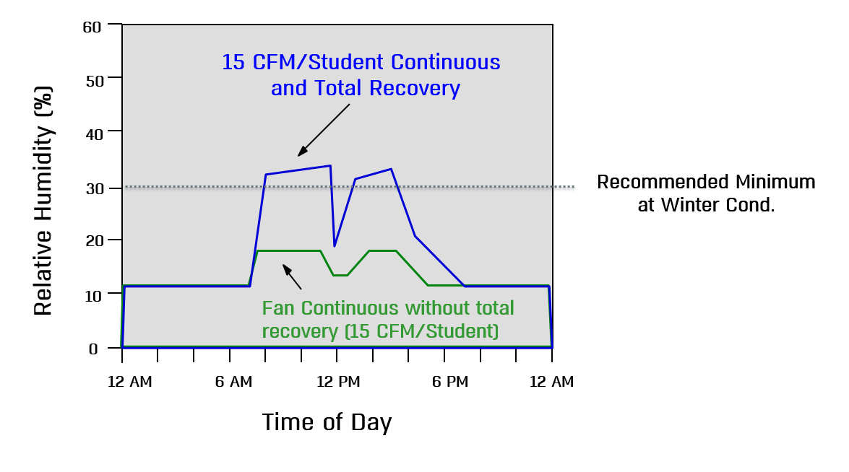
Classroom Example: Relative Humidity Typical with TERS (Heating Mode)
Space Relative Humidity Typical of a Classroom with TERS (Heating Mode)
LIVE TYPE UNDERNEATH GRAPHIC
60
15 CFM/Student Continuous
and Total Recovery
50
40
30
Recommended Minimum at Winter Cond.
Relative Humidity (%)
20
10
Mode 3:
Fan Continuous without total
recovery (15 CFM/Student)
TER Providing 15 CFM/Student
Continuously
0
12 AM
6 AM
12 PM
6 PM
12 AM
Time of Day
Notes:
21
16
16

Slide 26
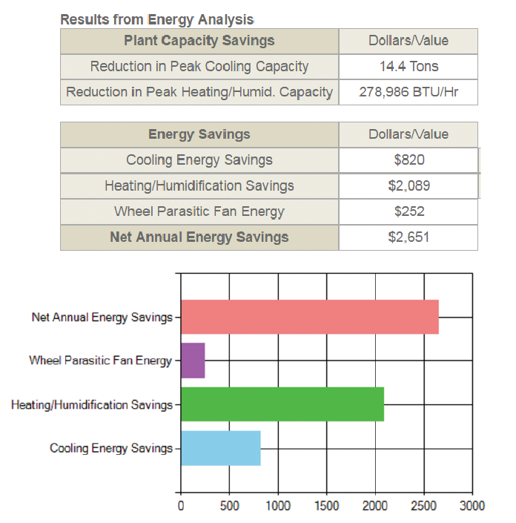
SEMCO FV: Energy Savings
Specifically designed to reduce the energy required to heat or cool outdoor air by up to 80%
Captures moisture generated within the space to provide free humidification during the heating season
Preconditioning the incoming air to the packaged equipment, may reduce required refrigeration capacity by as much as 50%
Selection software allows quick calculation your Net Annual Energy Savings

Slide 27

SEMCO FV: Applications
School Classrooms
Offices
Dormitories, Apartments
Retail Stores
Nursing Homes
Day Care Facilities
Smoking Areas
Casinos
Restaurant Dining Areas
Movie Theaters
Bowling Centers
Churches
Light Manufacturing Areas
Hospital Patient Care Areas
Jails and Prisons
Technology proven on 1000+ installations ranging from research facilities to school classrooms
Notes:
31
26
26

Slide 28

Contact Information & Thank You
ElitePro: elite.semco@flaktgroup.com
Chilled Beams: chilledbeams.semco@flaktgroup.com
Unitary: unitary.semco@flaktgroup.com
Applied Products (Pinnacle, Ascendant, EnergyPackage, Custom): applied.semco@flaktgroup.com
Duct: duct.semco@flaktgroup.com
Panels: panels.semco@flaktgroup.com
Refresh Wheels & Components: refresh.semco@flaktgroup.com
OEM Energy Wheel: oem.semco@flaktgroup.com
Datacenters: datacenters.semco@flaktgroup.com
Parts/Service Contact Information: service.semco2@flaktgroup.com
Warranty/Quality Claims: https://info.semcohvac.com/claim-form
Service Request: https://info.semcohvac.com/service-request
Parts Request: https://info.semcohvac.com/parts-request
Thank you for your attention!

