Slide 1
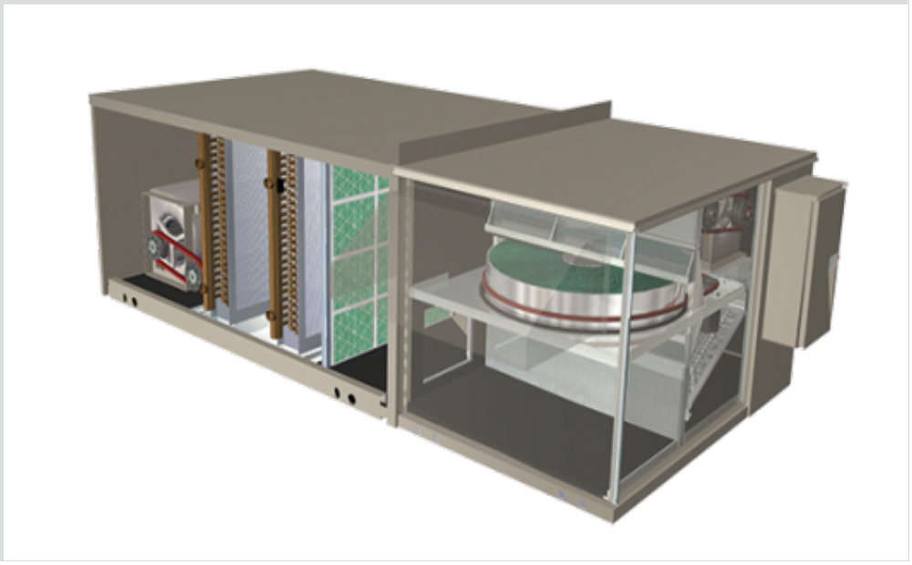
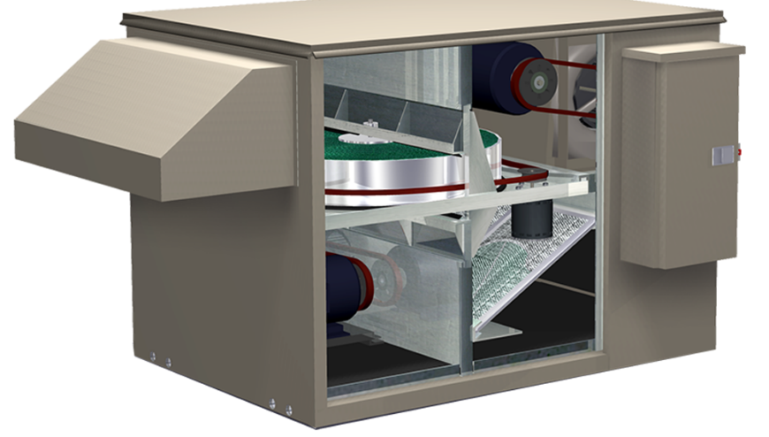

FV and FV Coil Module

Slide 2
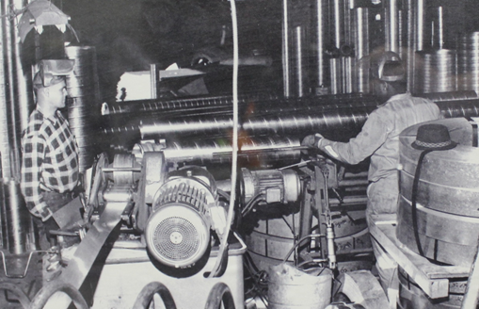
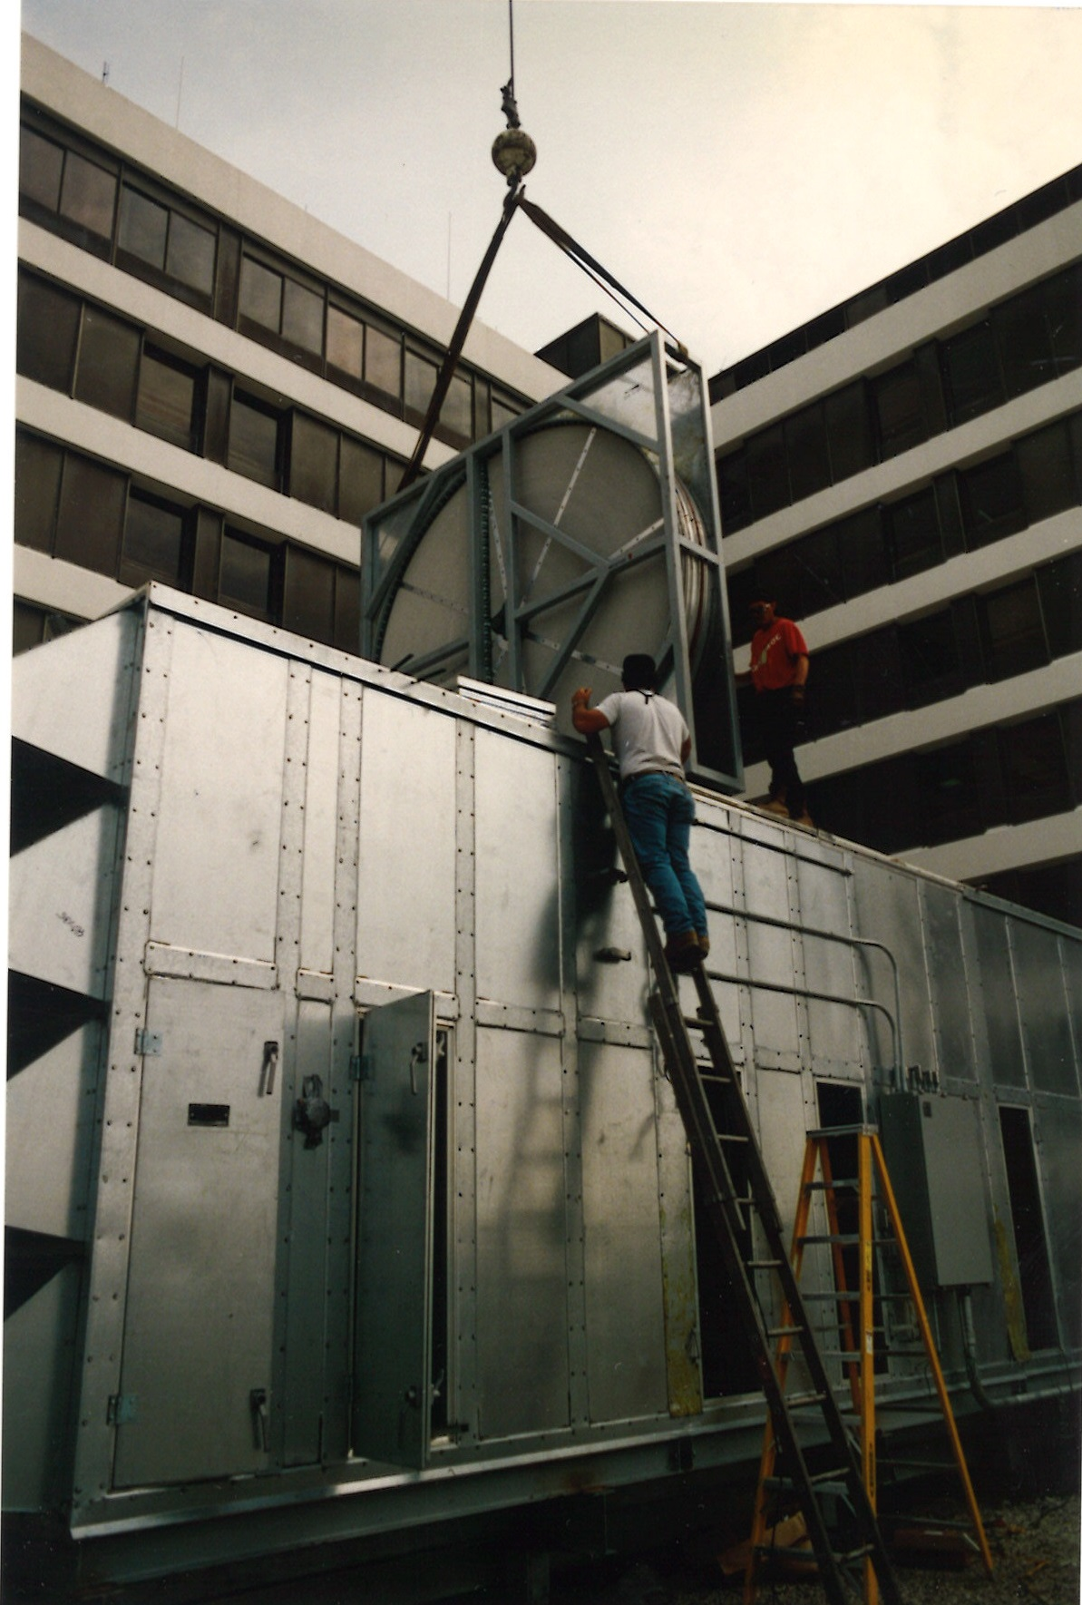
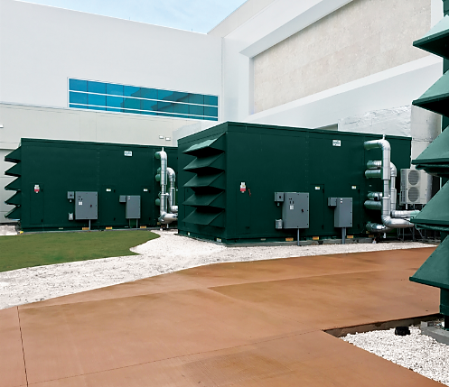






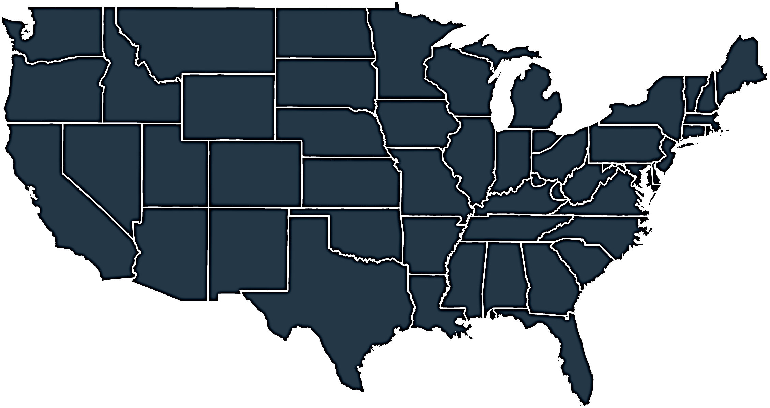



Who we are & what we do
Energy
& Environmental
Focus
Patented &
Certified
Products
U.S & Global
Footprint
Engineered
Air Quality &
Data Center
Solutions
Engineered
Air Distribution
& Sound
Solutions
OEM,
Key Account &
Sales Rep
Route To Market
Service
& Support
Award Winning
& Industry
Recognized
Notes:
In 1963 Salisbury Engineering and Manufacturing Company (SEMCO) was born in Salisbury, MO.
Began as SEMCO -- small sheet metal fabricator specializing in duct.
In the 59 years, evolved into a multi-million dollar company with a large product offering.
Headquartered in Columbia, MO, with 275,000 sq ft of manufacturing space in 3 plants in Arkansas and Virginia
We are a business unit of FläktGroup, and we are owned and backed by Triton Partners—which is a $17 billion annual revenue investment firm.
Innovation is core at FläktGroup SEMCO.
Certified by AHRI, SEMCO was won numerous awards – including multiple AHRI Innovation, Green Building, Dealer Design, School/College Planning & Management Awards
Hold numerous patents and trade secrets for our industry leading energy recovery wheels and systems.

Slide 3

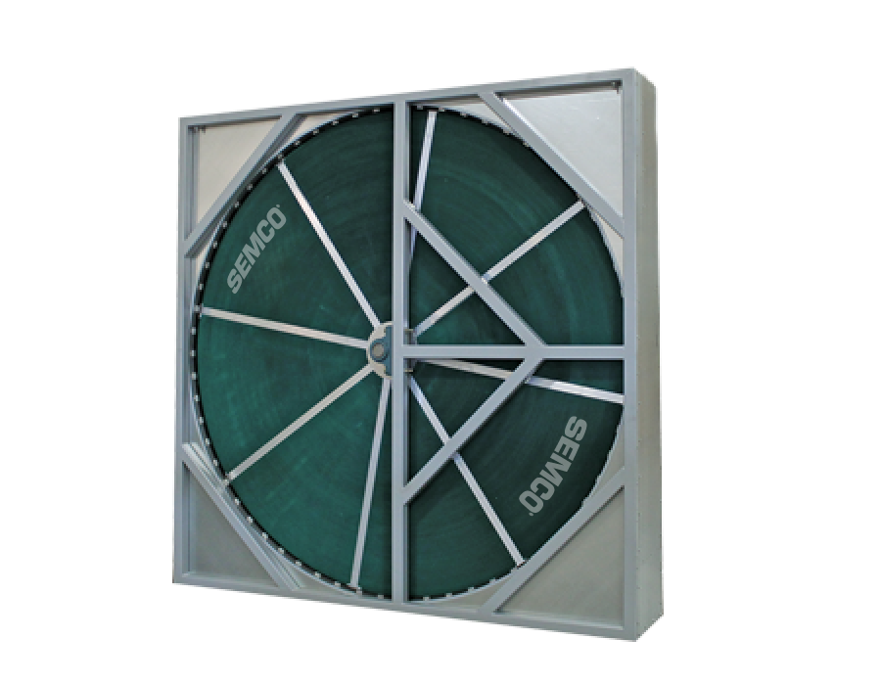
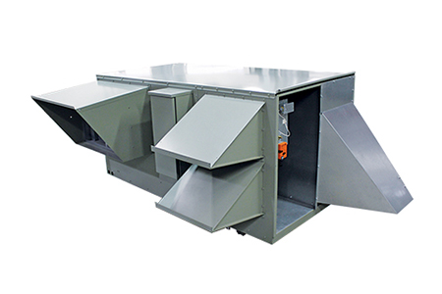
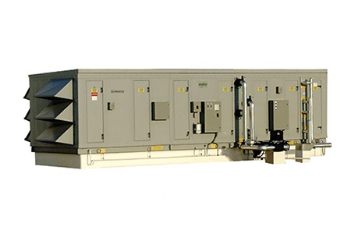

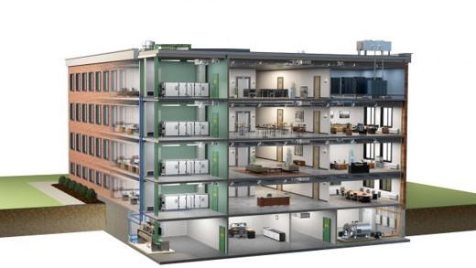
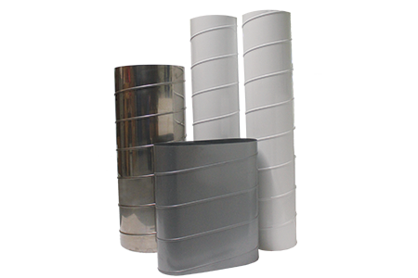
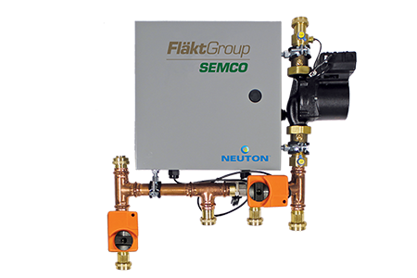
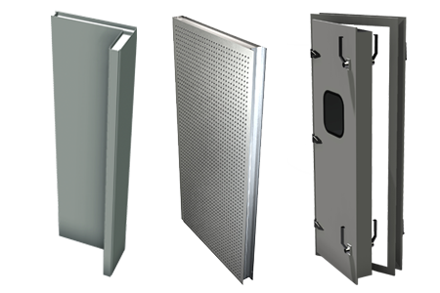
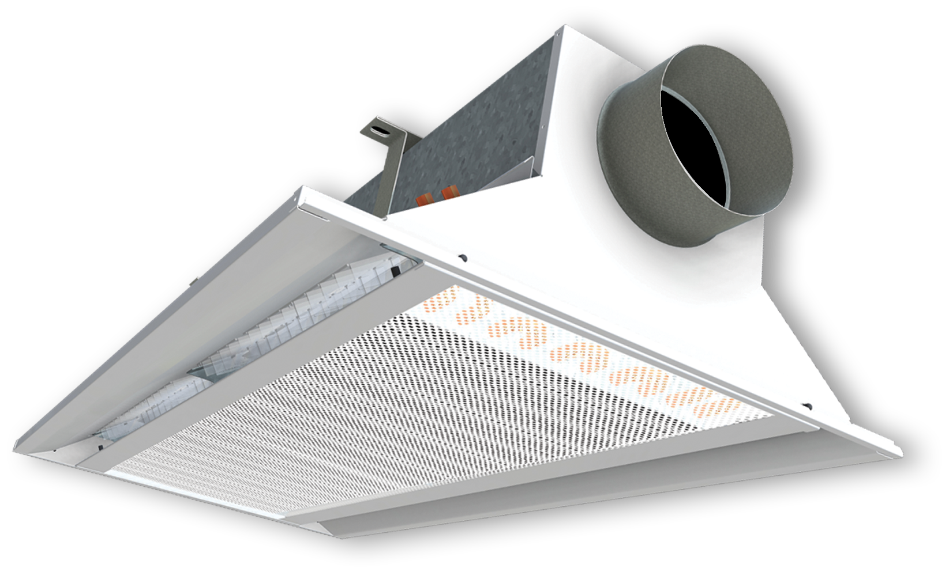
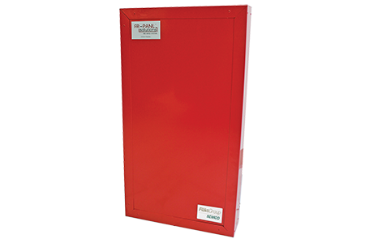
FläktGroup SEMCO Products For Commercial Applications
Energy Recovery Wheel
Unitary Energy Recovery Unit
Applied Energy Recovery Unit
NEUTON Pump
Ductwork
Chilled Beams
Fire-Rated Panels
Sound Attenuation Panels
Notes:
FläktGroup SEMCO provides solutions for a wide variety of applications including casinos, offices, laboratories, hotels, education, healthcare, retail, data centers, stadiums, manufacturing, agriculture & indoor farming, airports, and recreational facilities.
FläktGroup SEMCO products could be utilized in conjunction with one another, to provide the best possible air quality.
We offer energy recovery units & wheels which are engineered to be low maintenance, environmentally friendly, energy efficient & saves money over time as well as protects occupants from harmful contaminants.
We also offer chilled beams, pump modules, data centers, air handlers, duct and panels.
Leverage below if desired:
FläktGroup SEMCO products are designed to be utilized in conjunction with one another, to provide the best possible air quality. We show here:
Ductwork is laid within the walls and ceiling of the building, so supply air may be brought into the building and return air may be exhausted from the building.
Outdoor air is brought into the FV and pre-conditioned
Once the air is pre-conditioned with the FV it is filtered through the Pinnacle energy recovery unit, which will remove contaminants and dehumidify the incoming airstream with its True 3A wheel. Return air will also flow through the Pinnacle on its way out.
The chilled beams and the Neuton will work together with the supply air they receive from the Pinnacle to maintain a comfortable room temperature without condensation. (Together the Pinnacle, Neuton, and chilled beams make up 3fficiency).
During the construction of the building fire panels will be installed around an equipment room or elevator.
Sound attenuation panels are also installed during construction around noisy equipment or places where noise may be a concern

Slide 4


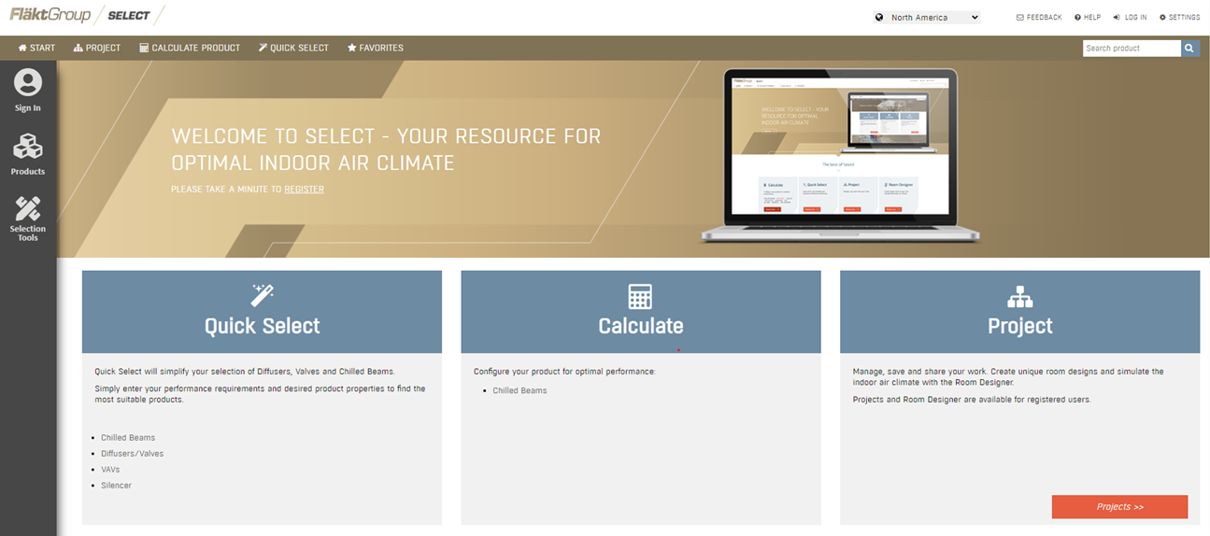
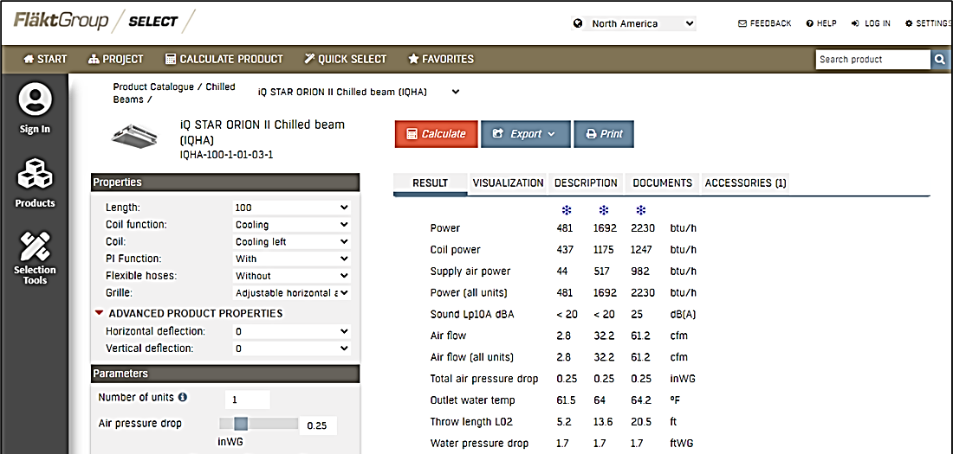

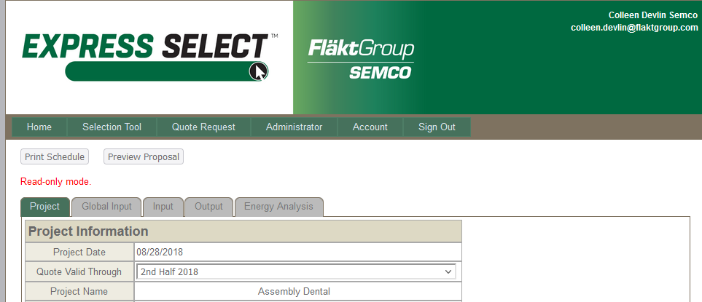
FläktGroup SEMCO Superior Sales Support & Service
Notes:
FläktGroup SEMCO prides ourselves on supplying exceptional sales support and service.
Our experienced sales team are a phone call away and will help guide you through our selection programs to meet or exceed project specifications.
While all FläktGroup SEMCO products are relatively maintenance free throughout their lifecycle--we have a knowledgeable and dedicated service team available should you require it.

Slide 5
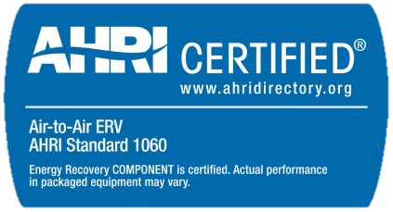
SEMCO FV: Product Overview
The function of an Energy Recovery Ventilator (ERV) is to continuously provide the code required quantity of outdoor air during occupancy, with uncompromised quality and in an energy efficient manner.
Cost effective, tested and approved total energy recovery module
Certified performance, high latent capacity
Non-plugging aluminum honeycomb transfer media
Patented molecular-sieve desiccant limits the transfer of exhaust air pollutants
Purge section, self-cleaning media assures no re-entrainment

Slide 6
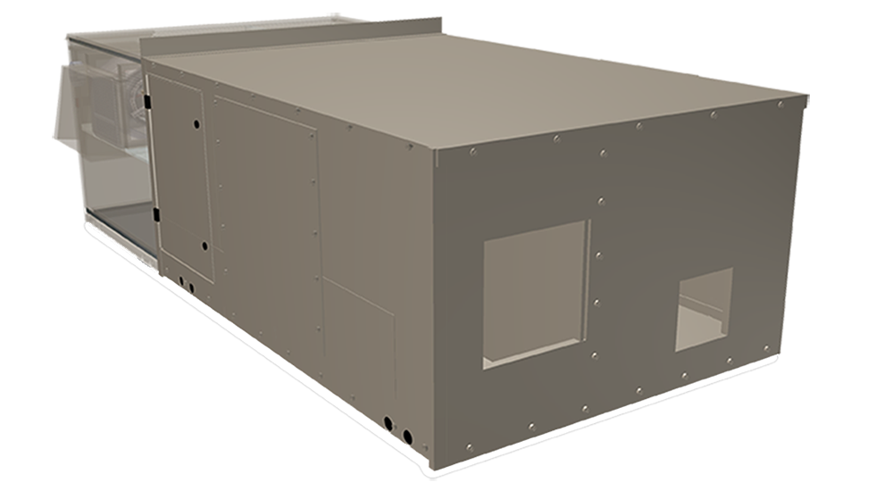
SEMCO FV: Coil Module
Provides an increase in the outdoor air quantity (5 to 20 cfm/person) without significantly increasing operating costs.
Effective solution to ASHRAE Standard 62
Airflow capacity from 800 cfm to 9,000 cfm
Indoor and outdoor installation capable
Horizontal and down flow configurations
Numerous coil material construction types available
Insulated to minimize energy loss
LEED compliant filters
Low profile design

Slide 7
SEMCO FV: Airflow ranges
FV - 9000
6,000
10,000
FV - 7500
4,500
9,000
FV - 5000
2,600
6,200
FV - 4000
2,600
4,000
FV - 3000
1,800
3,000
FV - 2000
800
2,000
FV - 1000
415
1,245
FV - 600
525
775
Adding a SEMCO Coil Module will provide a significant increase in the outdoor air quantity
(5 to 20 cfm/person) without increasing operating costs

Slide 8

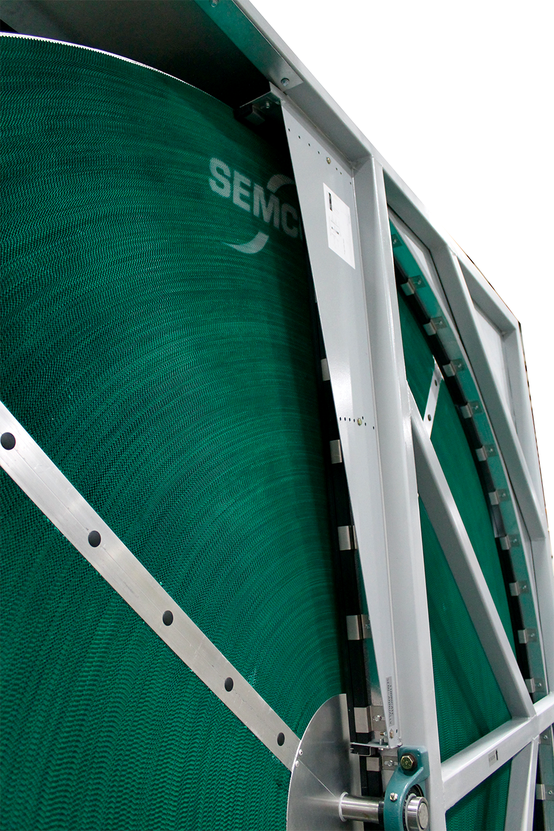
SEMCO FV: True 3Å Wheel
Patented 3Å molecular sieve-desiccant coating for independently certified cross-contamination < 0.04%
Optimizes the parasitic pressure loss across the energy wheel media
Designed with an aluminum substrate built to meet smoke and flame ratings
Independently certified wheel performance in accordance with ASHRAE Standard 84-91 and ARI Standard 1060 with regard to:
  latent transfer efficiency
  sensible transfer efficiency
  pressure loss across wheel

Slide 9
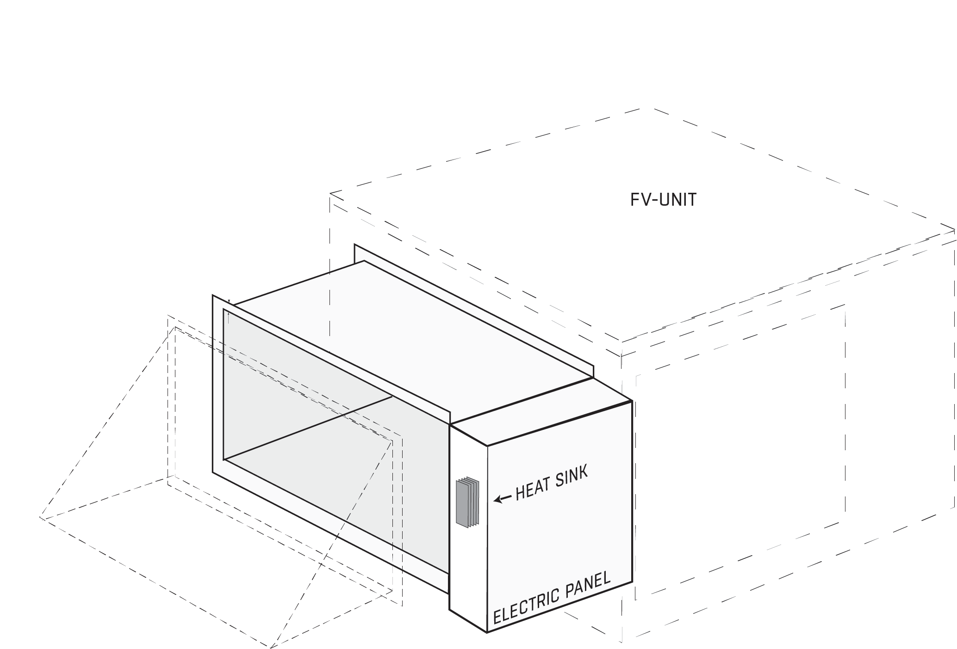
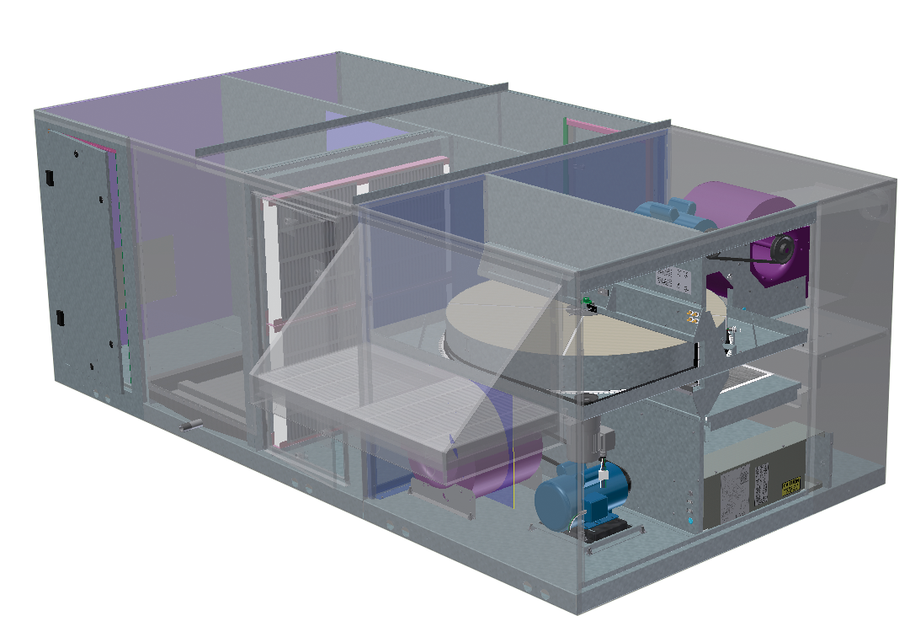
SEMCO FV: Heating and Cooling Configurations
FV Integrated coils
Electric Preheat is optional
Coil Module Options:
Electric – Staged standard, SCR with premium controls
Hydronic Heating and/or Cooling
DX Cooling

Slide 10
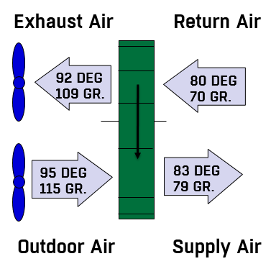
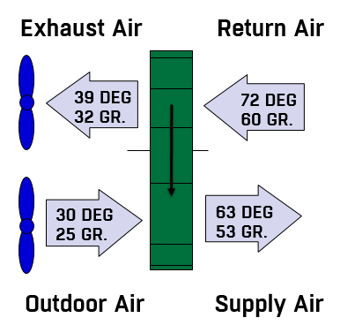
SEMCO FV: Typical Performance
LIVE TYPE UNDERNEATH GRAPHIC
Exhaust Air
Return Air
Exhaust Air
Return Air
92 DEG
80 DEG
39 DEG
72 DEG
109 GR.
70 GR.
32 GR.
60 GR.
95 DEG
83 DEG
30 DEG
63 DEG
115 GR.
79 GR.
25 GR.
53 GR.
Outdoor Air
Supply Air
Outdoor Air
Supply Air
Cooling Mode
Heating Mode
Notes:
8
5
5
LIVE TYPE UNDERNEATH GRAPHIC

Slide 11
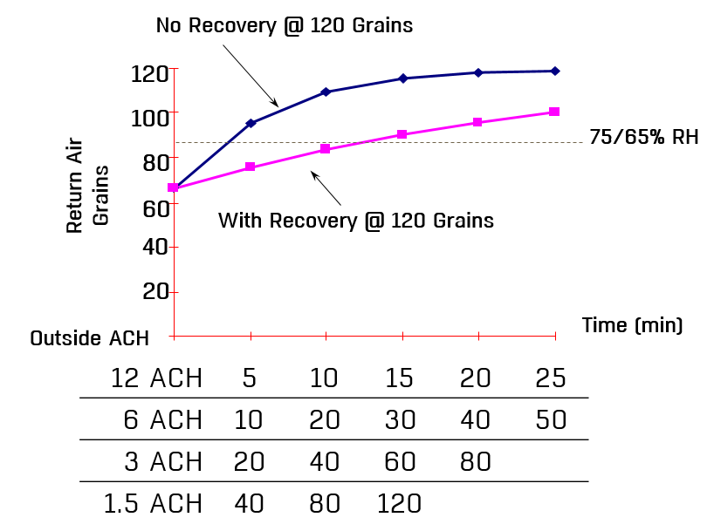
SEMCO FV: Compressors Off - Continuous Ventilation
No Recovery @ 120 Grains
120
LIVE TYPE UNDERNEATH GRAPHIC
100
75/65% RH
80
Return Air
Grains
60
With Recovery @ 120 Grains
40
20
Time (min)
  Outside ACH
12 ACH | 5 | 10 | 15 | 20 | 25
6 ACH | 10 | 20 | 30 | 40 | 50
3 ACH | 20 | 40 | 60 | 80
1.5 ACH | 40 | 80 | 120
Notes:
14
LIVE TYPE UNDERNEATH GRAPHIC

Slide 12
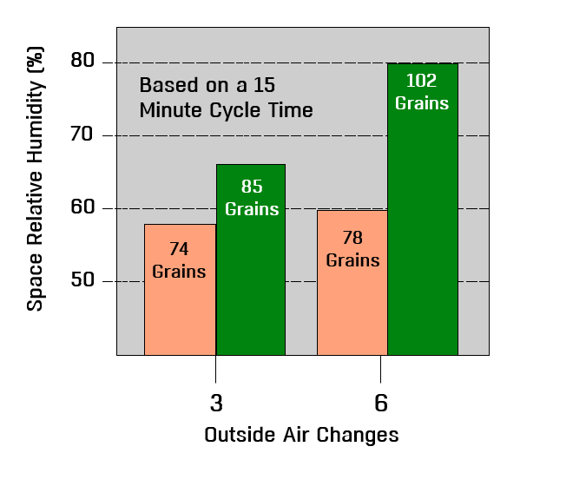
SEMCO FV: Space Humidity at Part Load Conditions
80
Based on 15 minute
compressor cycle time
102
Grains
Based on a 15
Minute Cycle Time
LIVE TYPE UNDERNEATH GRAPHIC
70
Space Relative Humidity (%)
85
Grains
60
74
Grains
78
Grains
50
3
6
Outside Air Changes
Notes:
15
10
10

Slide 13
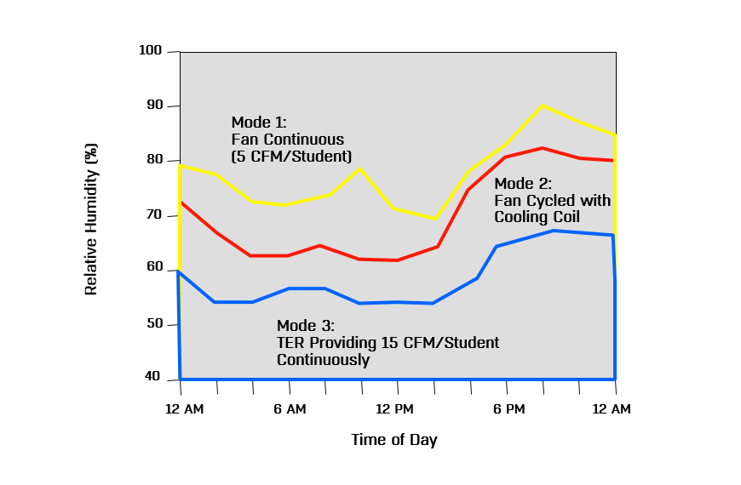
SEMCO FV: Space RH Measured at Different Operating Modes (Cooling)
100
90
LIVE TYPE UNDERNEATH GRAPHIC
Mode 1:
Fan Continuous
80
(5 CFM/Student)
Mode 2:
Fan Cycled with
70
Cooling Coil
Relative Humidity (%)
60
50
Mode 3:
TER Providing 15 CFM/Student
Continuously
40
12 AM
6 AM
12 PM
6 PM
12 AM
Time of Day
Notes:
37
30
30

Slide 14
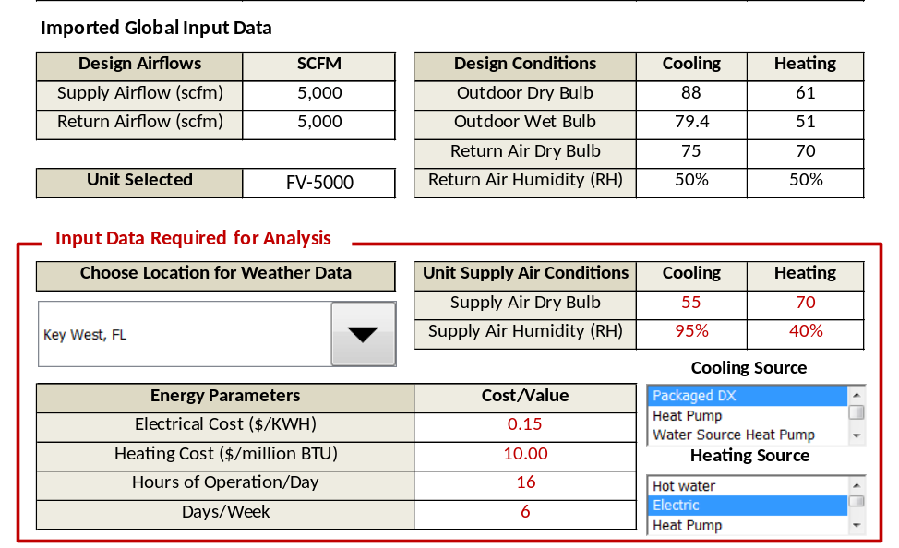
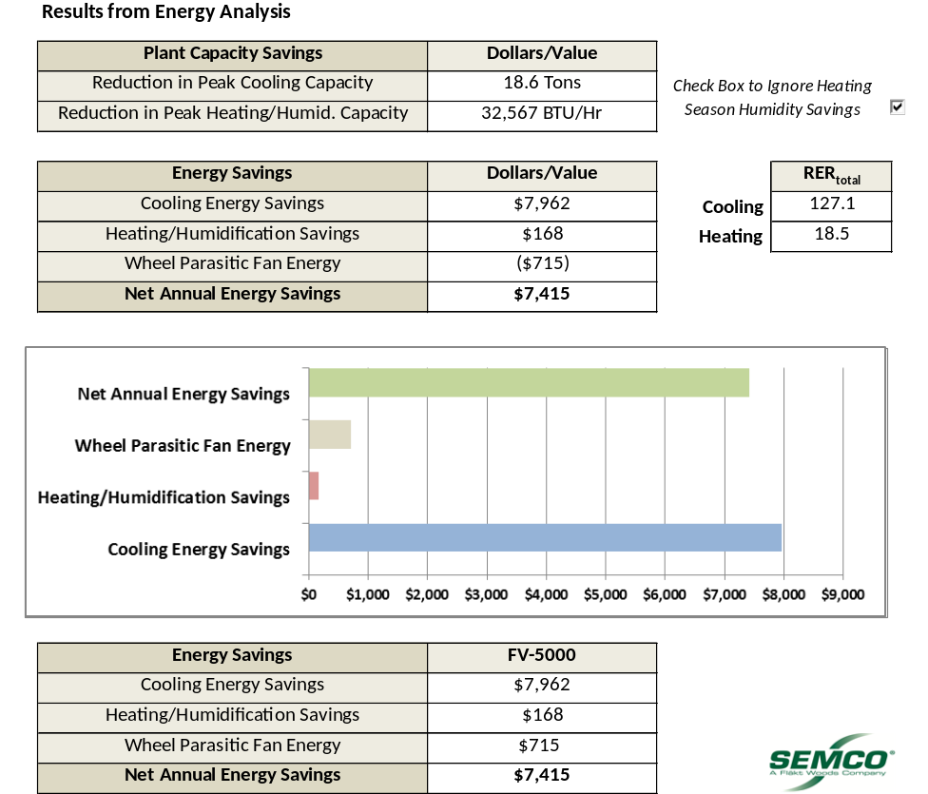
Cost Savings Example
Electric Costs $0.15/KWH
Net Savings: $7,415

Slide 15
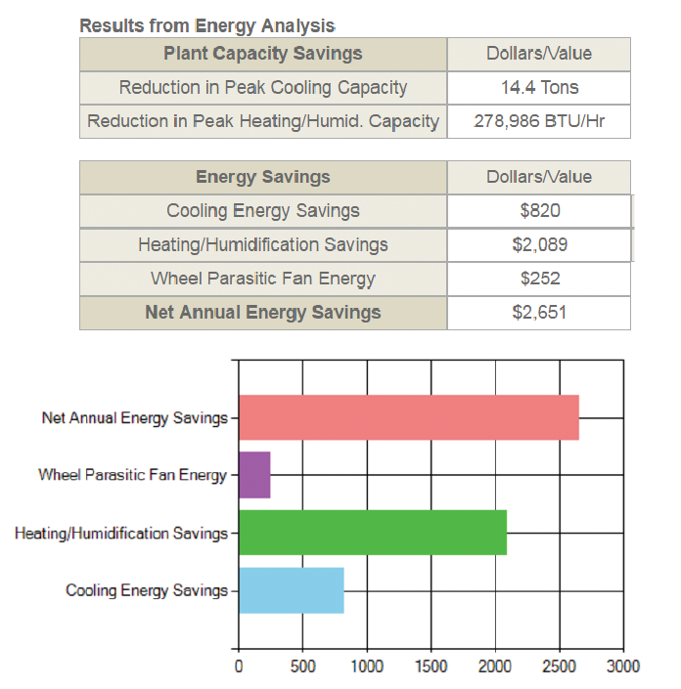
SEMCO FV: Energy Savings
Specifically designed to reduce the energy required to heat or cool outdoor air by up to 80%
Captures moisture generated within the space to provide free humidification during the heating season
Preconditioning the incoming air to the packaged equipment, may reduce required refrigeration capacity by as much as 50%
Selection software allows quick calculation your Net Annual Energy Savings

Slide 16

Contact Information & Thank You
Unitary: unitary.semco@flaktgroup.com
Chilled Beams: chilledbeams.semco@flaktgroup.com
Unitary: unitary.semco@flaktgroup.com
ElitePro: elite.semco@flaktgroup.com
Applied Products (Pinnacle, Ascendant, EnergyPackage, Custom): applied.semco@flaktgroup.com
Duct: duct.semco@flaktgroup.com
Panels: panels.semco@flaktgroup.com
Refresh Wheels & Components: refresh.semco@flaktgroup.com
OEM Energy Wheel: oem.semco@flaktgroup.com
Datacenters: datacenters.semco@flaktgroup.com
Parts/Service Contact Information: service.semco2@flaktgroup.com
Warranty/Quality Claims: https://info.semcohvac.com/claim-form
Service Request: https://info.semcohvac.com/service-request
Parts Request: https://info.semcohvac.com/parts-request
Thank you for your attention!

