Slide 1

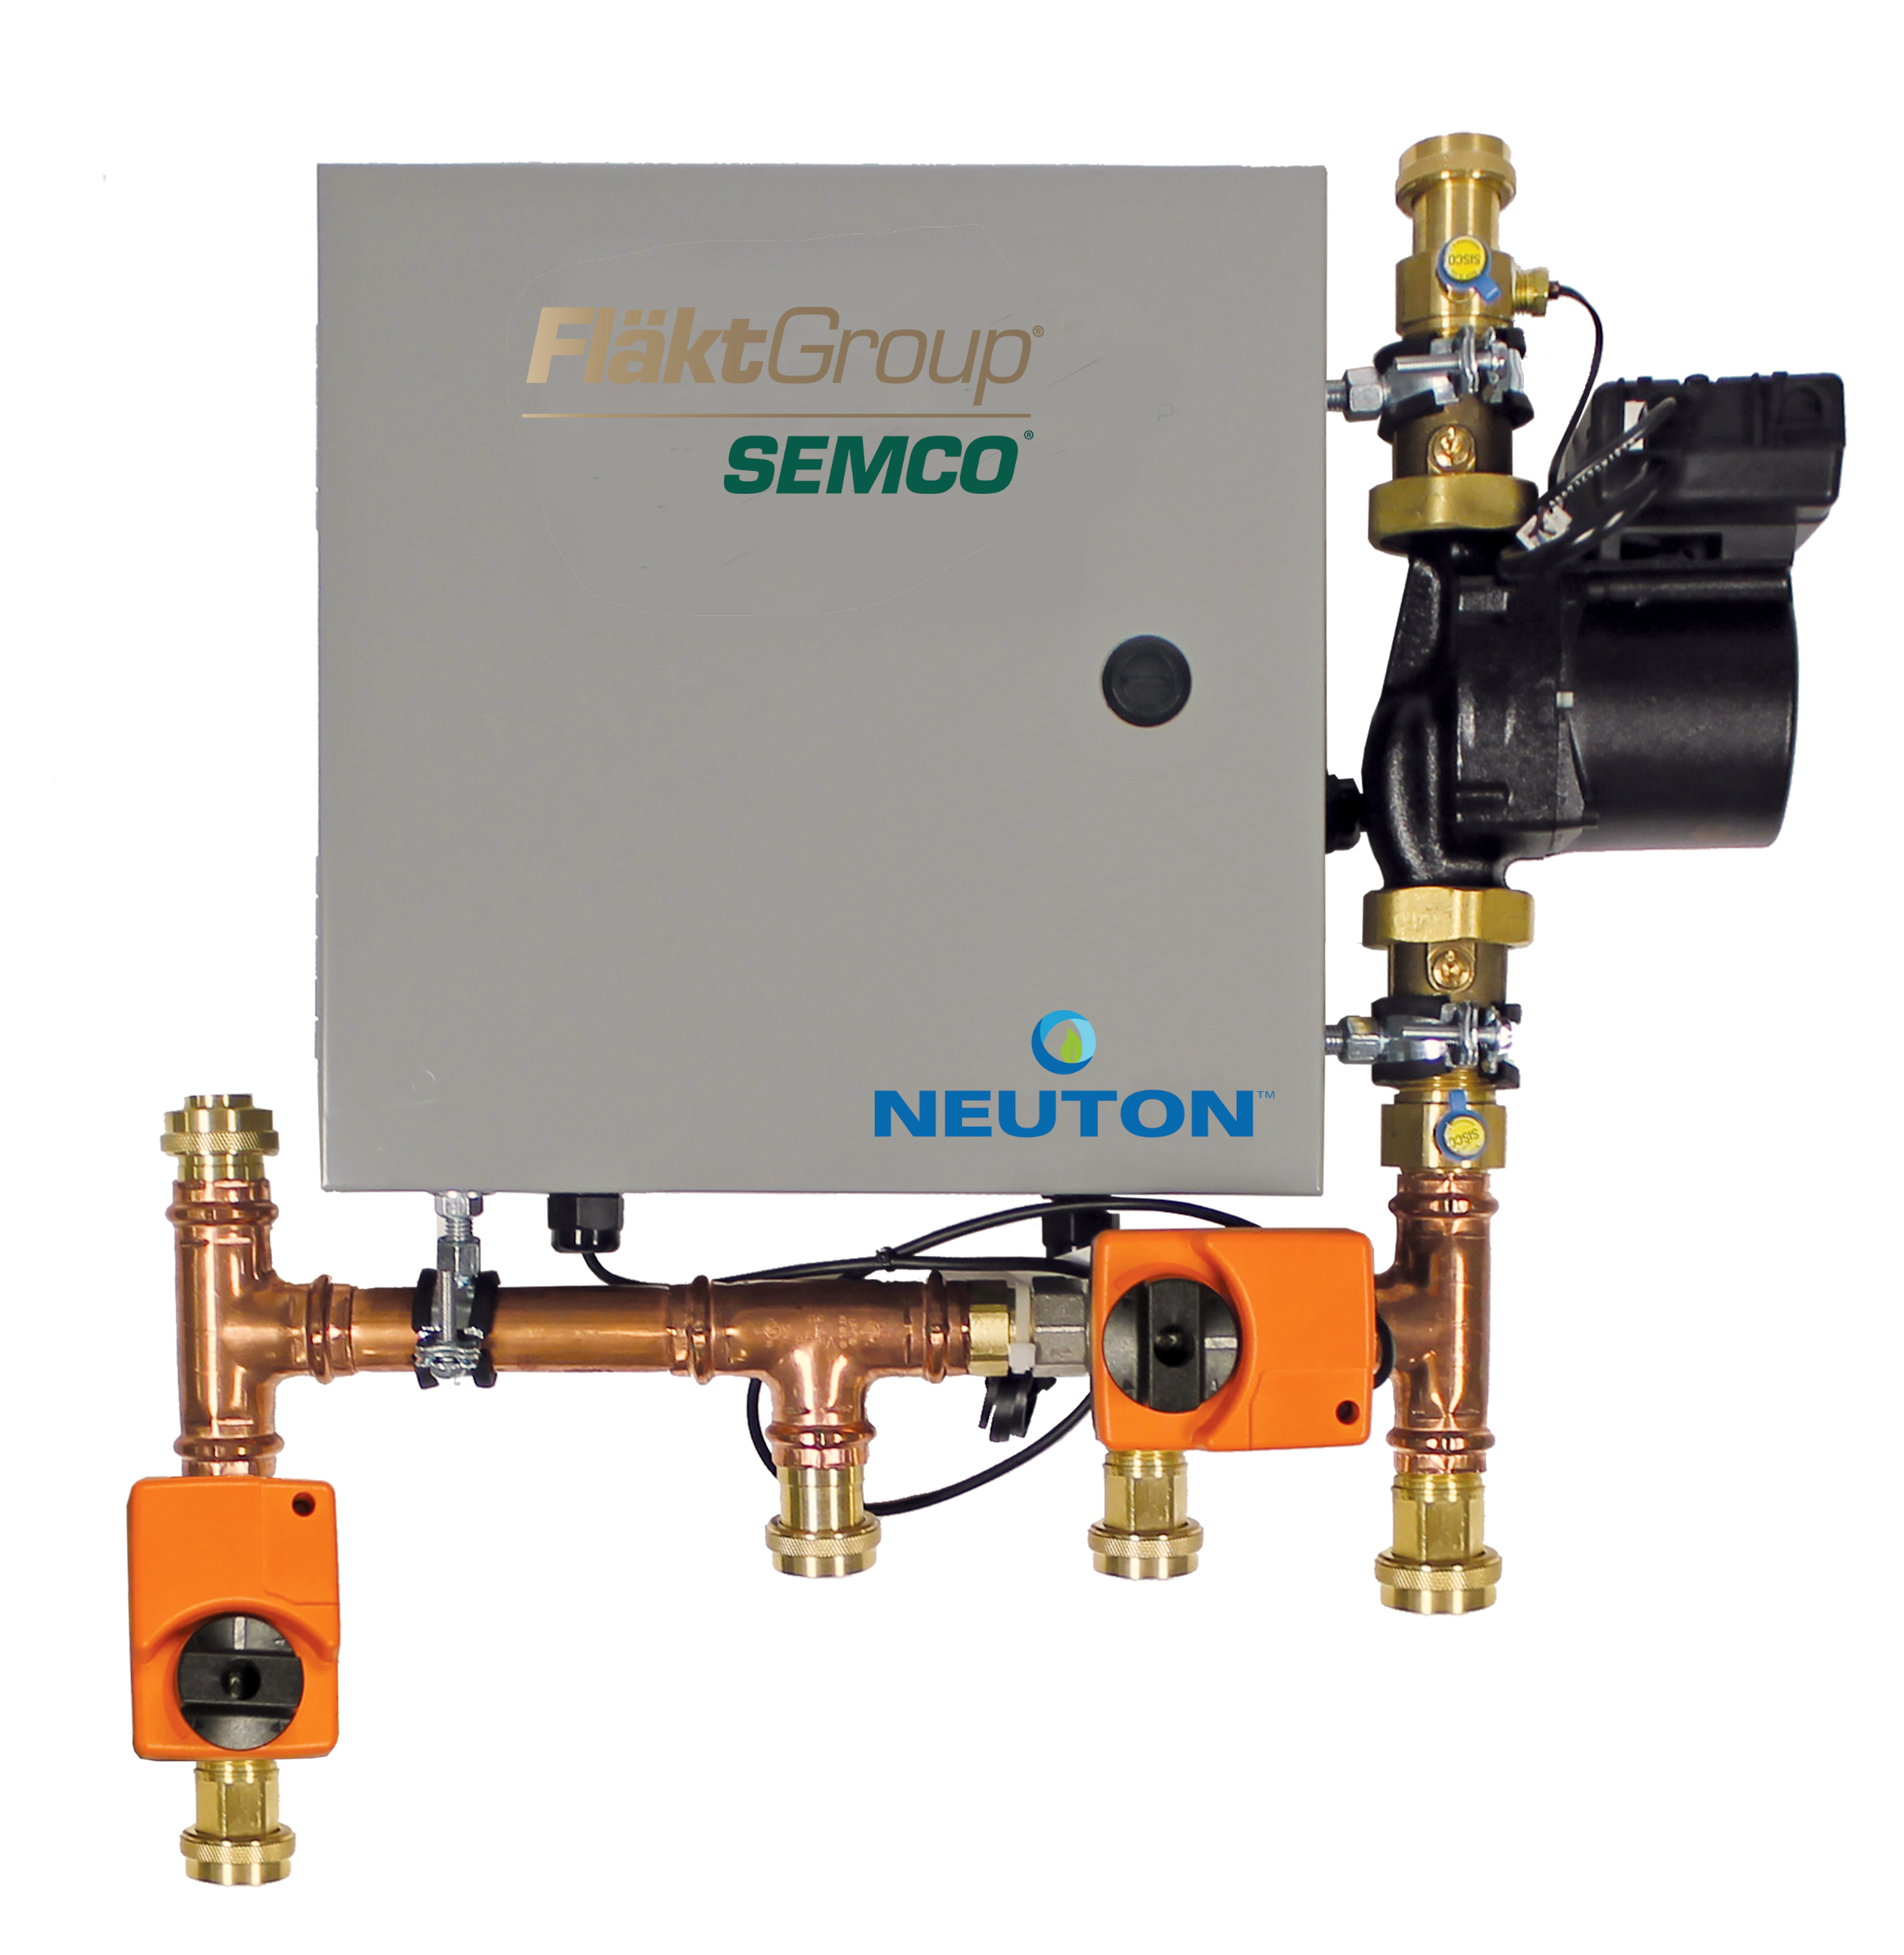
NEUTON®
Controlled Chilled
Beam Pump Module

Slide 2


FläktGroup’s Purpose
Our Purpose:
We care for your air while protecting
the environment.

Slide 3

FläktGroup’s Vision
Our Vision:
We are the leaders in air technology, delivering best-in-class,
innovative and energy-efficient solutions
to ensure comfort, safety and performance
for our customers, while reducing
their carbon footprint.

Slide 4


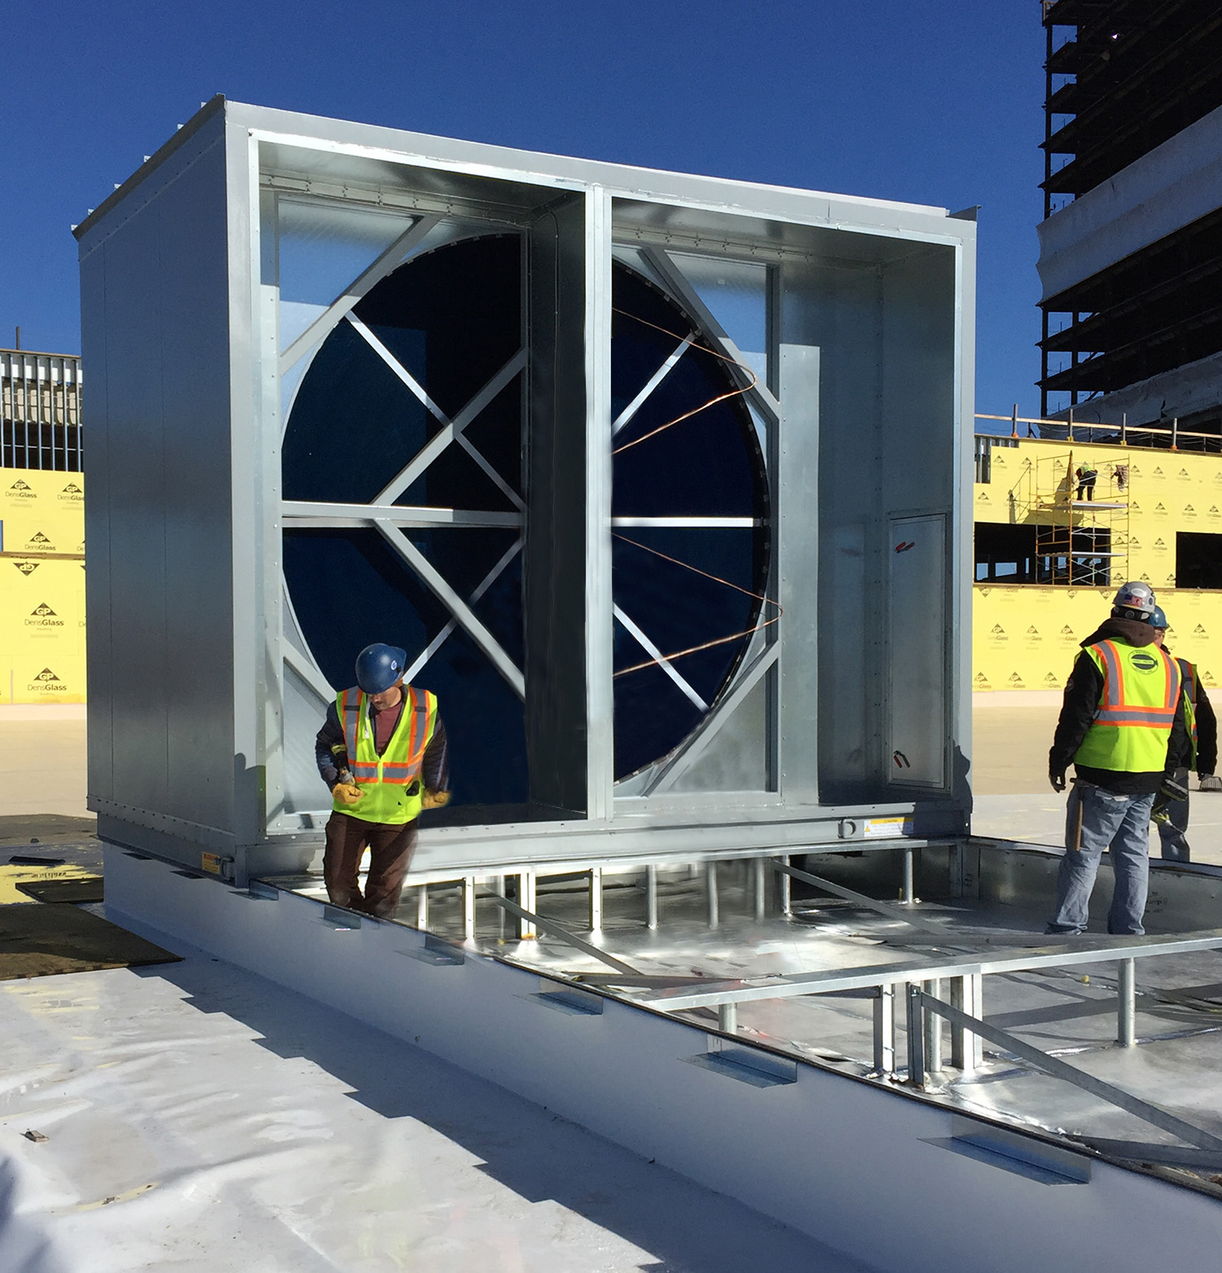






Who We Are and
What We Do
Award winning and
industry recognized
Energy efficiency and environmental focus
Engineered air distribution
and sound solutions
Engineered air quality and
data center solutions
Global footprint
OEM, key account and sales rep route to market
Patented and certified products
Service and support
Notes:
In 1963 Salisbury Engineering and Manufacturing Company (SEMCO) was born in Salisbury, MO.
Began as SEMCO -- small sheet metal fabricator specializing in duct.
In the 63 years, evolved into a multi-million dollar company with a large product offering.
Headquartered in Columbia, MO, with 275,000 sq ft of manufacturing space in 3 plants in Arkansas and Virginia
We are a business unit of FläktGroup, and we are owned by Samsung
Innovation is core at FläktGroup SEMCO.
Certified by AHRI, SEMCO was won numerous awards – including multiple AHRI Innovation, Green Building, Dealer Design, School/College Planning & Management Awards
Hold numerous patents and trade secrets for our industry leading energy recovery wheels and systems.

Slide 5

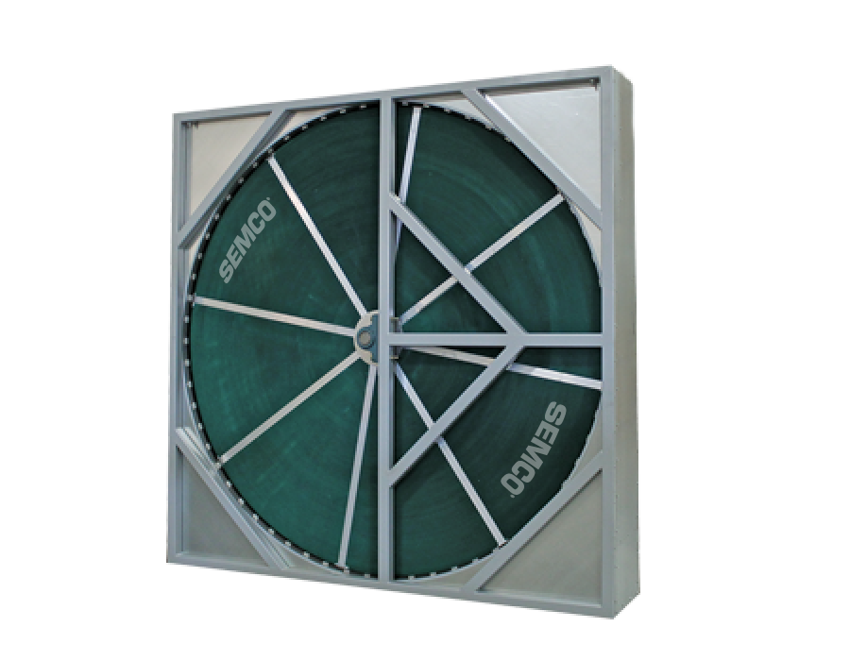
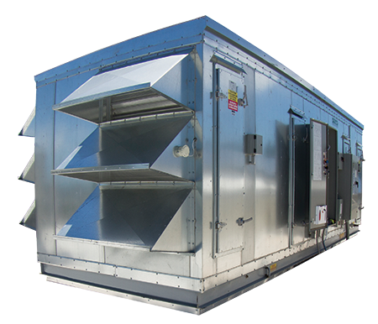
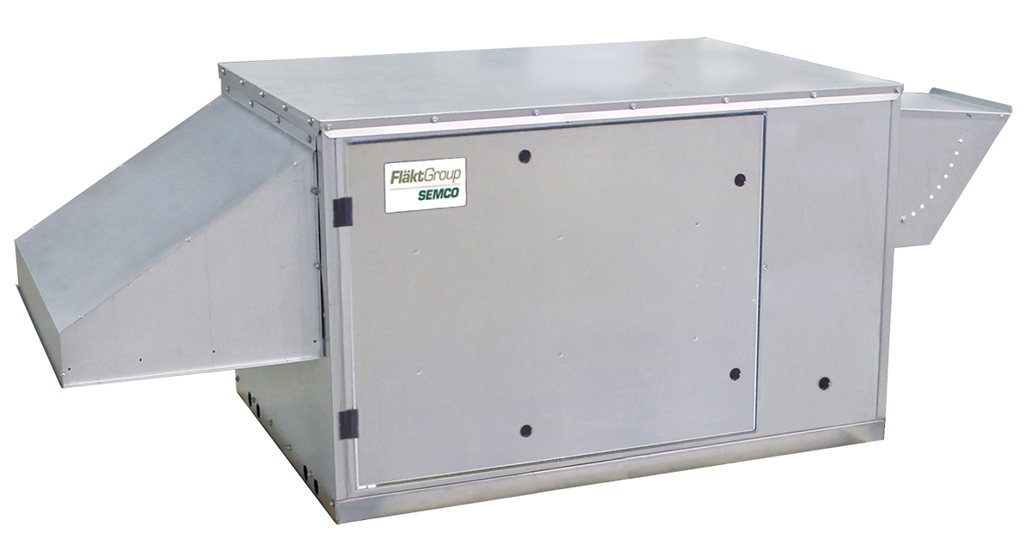
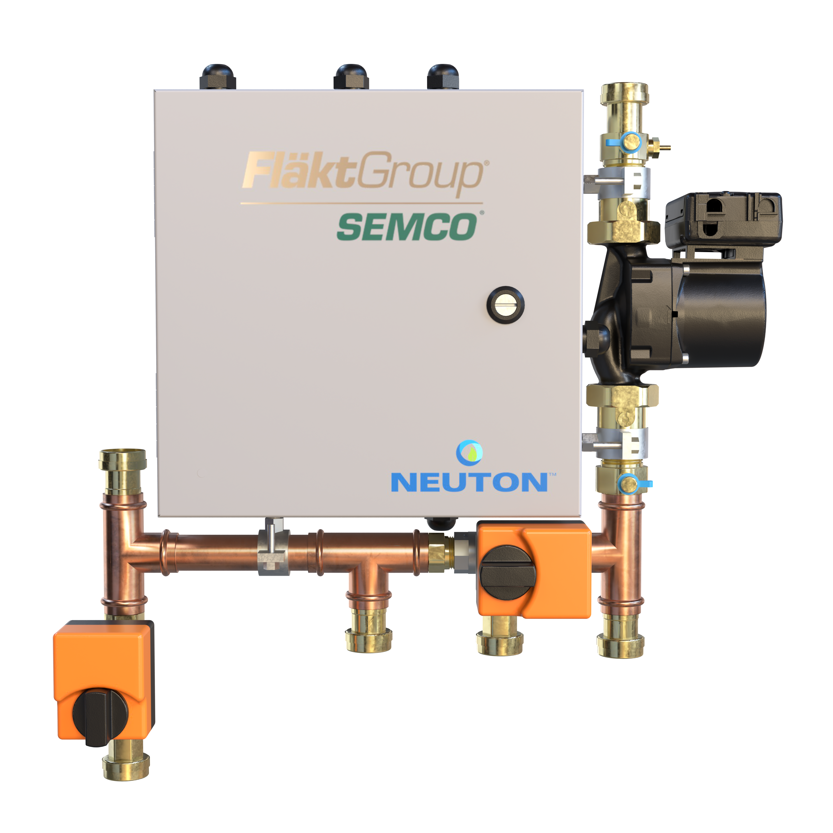
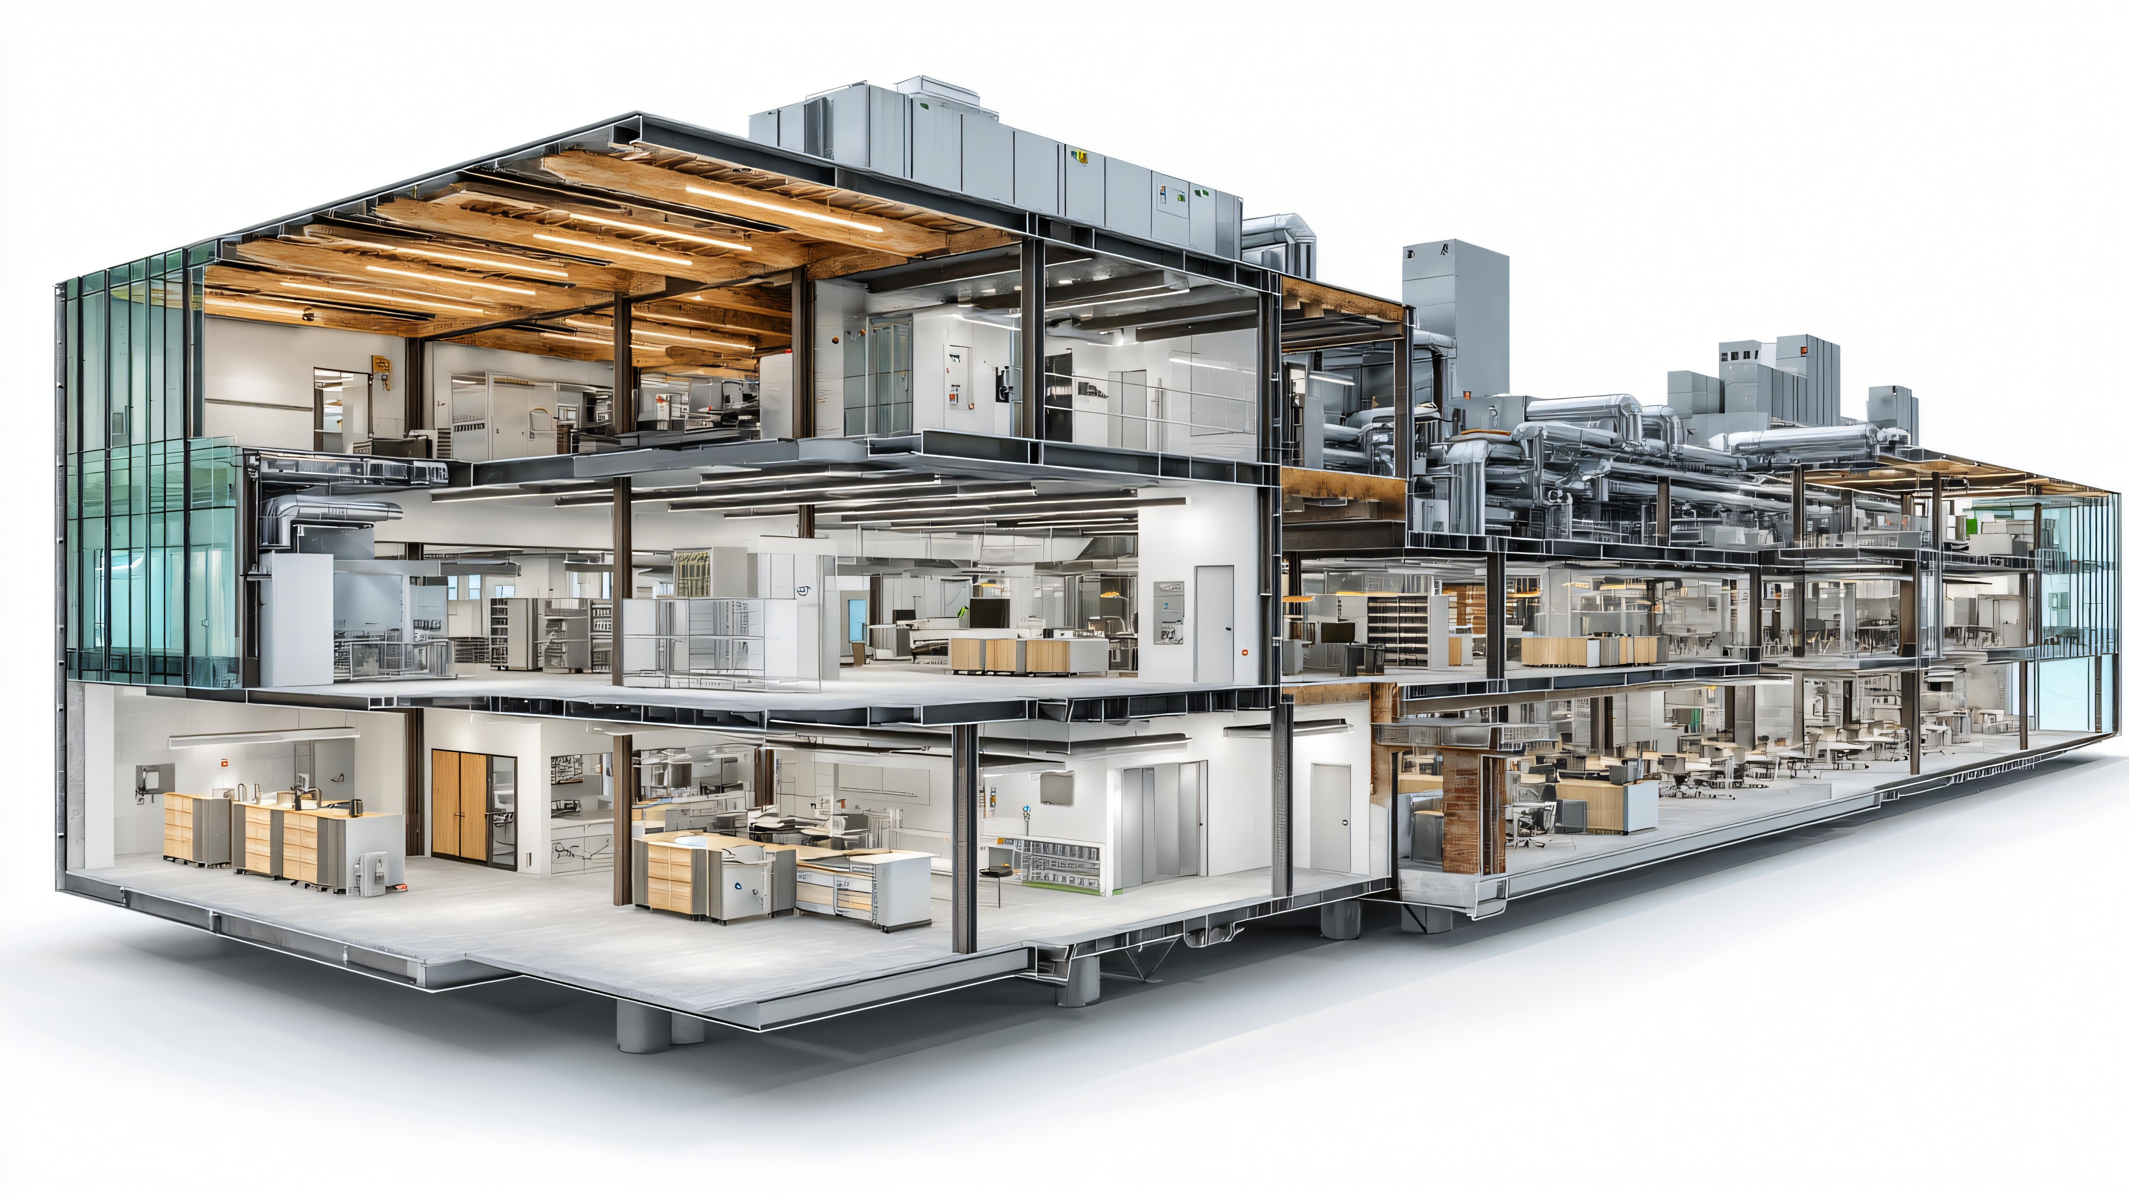
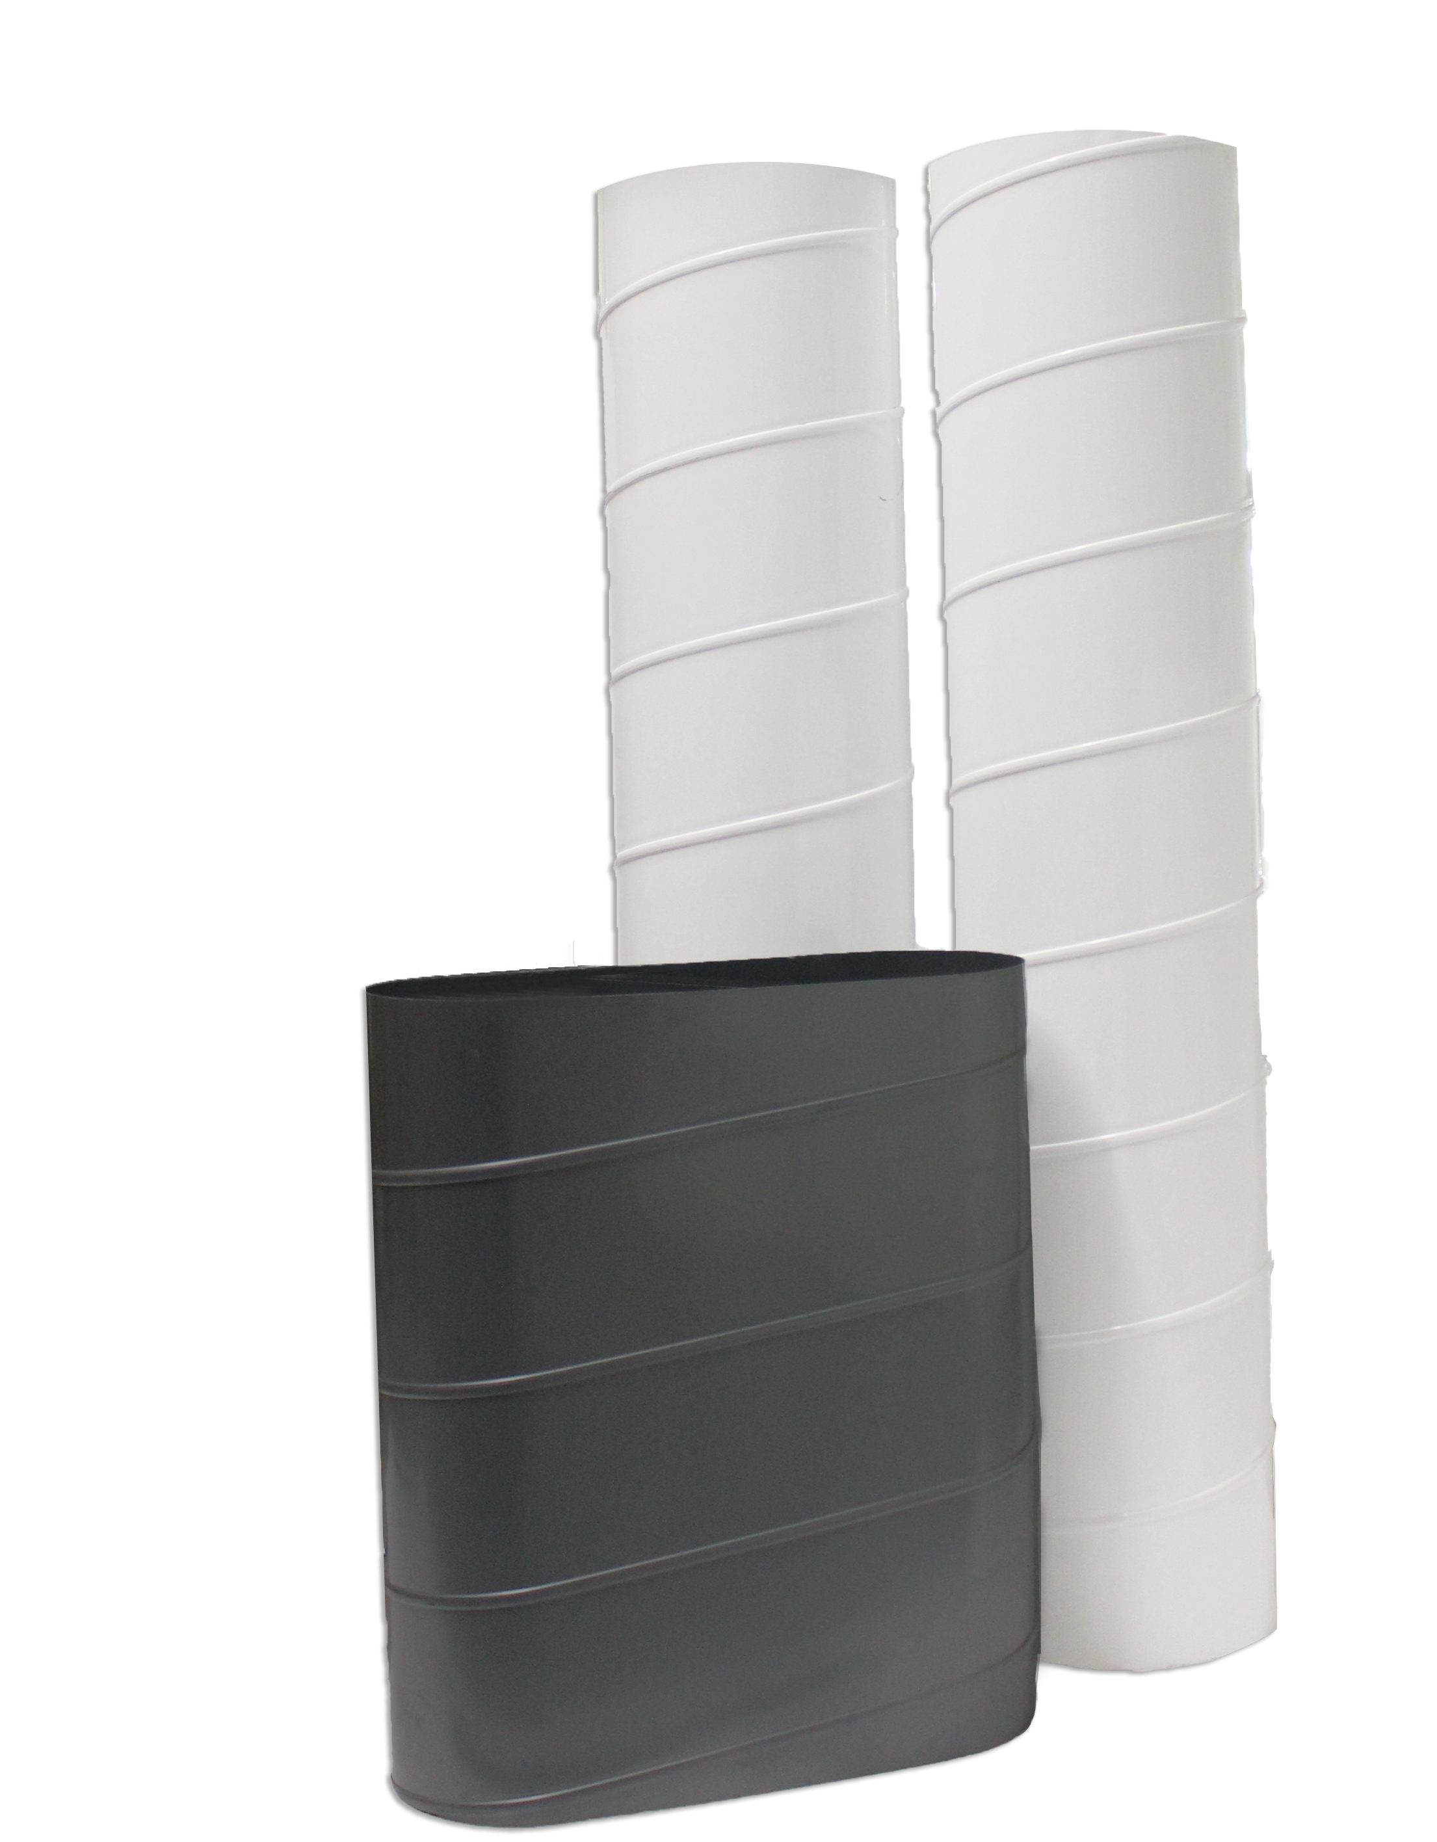
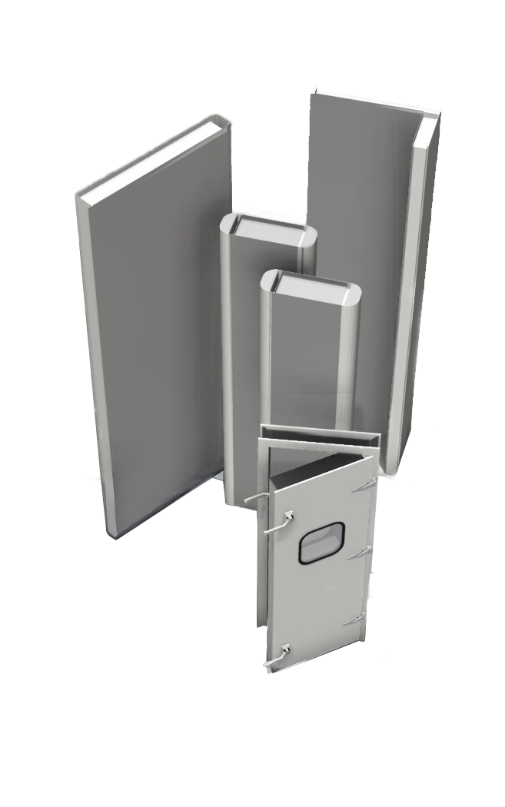
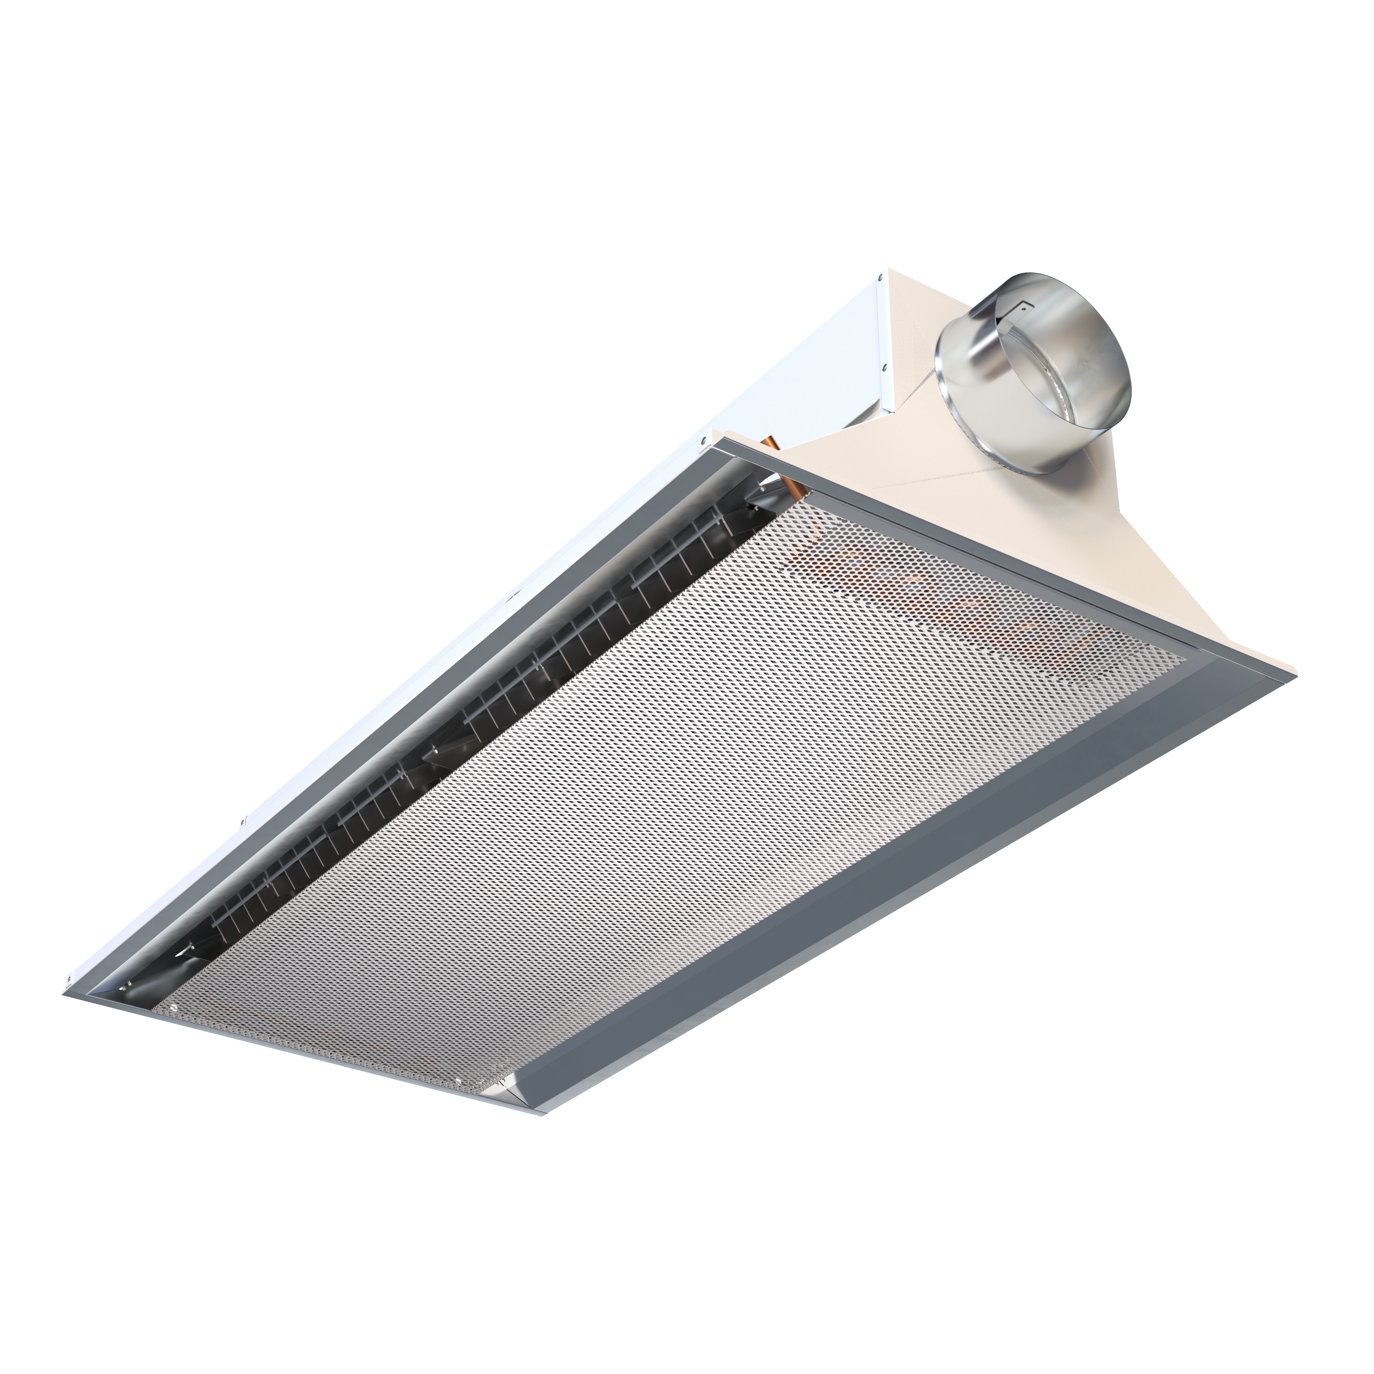
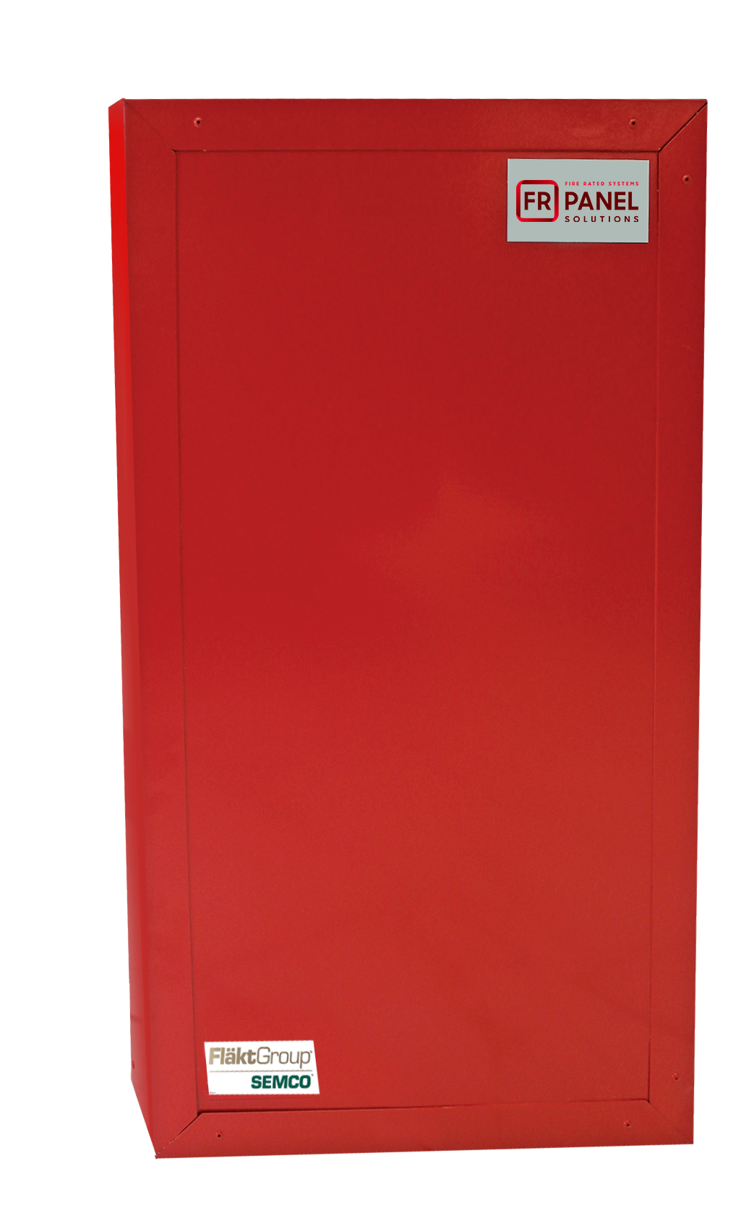
HVAC Products for a Range of Commercial Applications
Unitary Energy Recovery Unit
Applied Energy
Recovery Unit
Energy Recovery Wheel
NEUTON Pump
Ductwork
zz
Sound Attenuation Panels
Chilled Beams
Fire-Rated Panels
Notes:
FläktGroup SEMCO provides solutions for a wide variety of applications including casinos, offices, laboratories, hotels, education, healthcare, retail, data centers, stadiums, manufacturing, agriculture & indoor farming, airports, and recreational facilities.
FläktGroup SEMCO products could be utilized in conjunction with one another, to provide the best possible air quality.
We offer energy recovery units & wheels which are engineered to be low maintenance, environmentally friendly, energy efficient & saves money over time as well as protects occupants from harmful contaminants.
We also offer chilled beams, pump modules, data centers, air handlers, duct and panels.
Leverage below if desired:
FläktGroup SEMCO products are designed to be utilized in conjunction with one another, to provide the best possible air quality. We show here:
Ductwork is laid within the walls and ceiling of the building, so supply air may be brought into the building and return air may be exhausted from the building.
Outdoor air is brought into the FV and pre-conditioned
Once the air is pre-conditioned with the FV it is filtered through the Pinnacle energy recovery unit, which will remove contaminants and dehumidify the incoming airstream with its True 3A wheel. Return air will also flow through the Pinnacle on its way out.
The chilled beams and the Neuton will work together with the supply air they receive from the Pinnacle to maintain a comfortable room temperature without condensation. (Together the Pinnacle, Neuton, and chilled beams make up 3fficiency).
During the construction of the building fire panels will be installed around an equipment room or elevator.
Sound attenuation panels are also installed during construction around noisy equipment or places where noise may be a concern

Slide 6
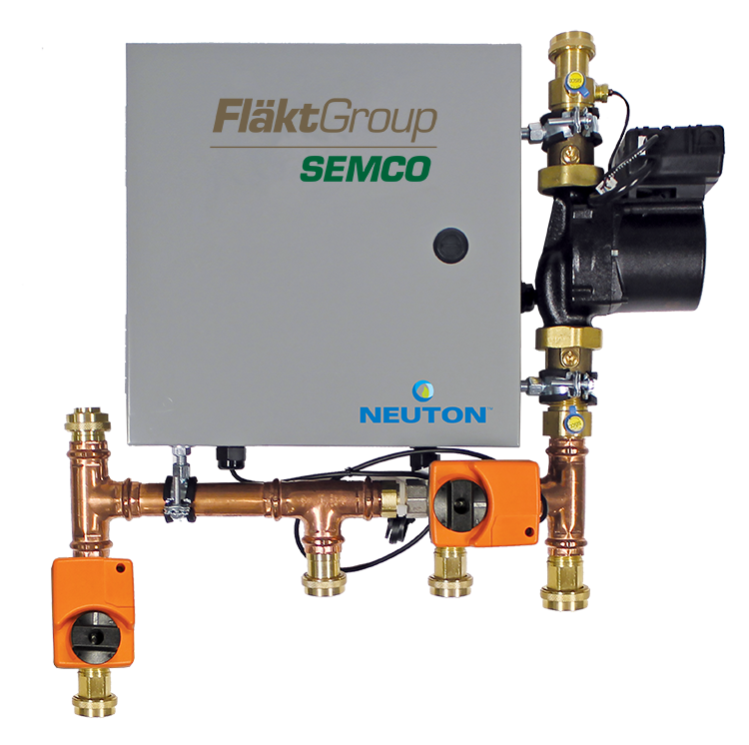
What is the NEUTON?
Controlled Chilled Beam Pump Module that provides:
State-of-the art active condensation control system effectively eliminates chilled beam condensation
High efficiency, variable speed pump uses a fraction of the energy used by traditional pump loops
Plug-and-play control system optimizes water temperature for each zone
Notes:
What is NEUTON?
Neuton is a controlled chilled beam pump module that allows the user to have active condensation controls in a plug and play control system.
Neuton combines high efficiency with effective condensation control at a fraction of the energy used by traditional chilled beam pump loops.

Slide 7
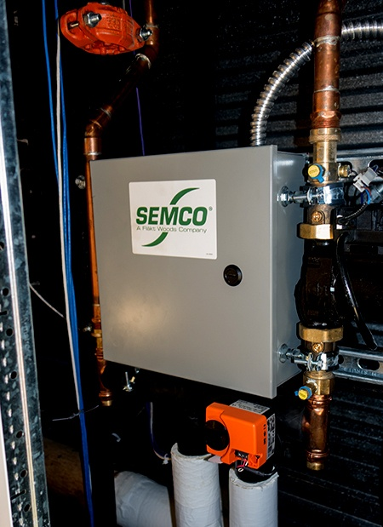
NEUTON: Efficient Design
Allows beam zones to be served with conventional chilled/hot water temperatures – no need for secondary loops for chilled beams
Simplifies installation, controls and commissioning of a beam system – eliminates frustration and cost of customized controls development and installation
Increases beam cooling and heating output –all coil passes used for both cooling and heating
Incredible response to occupied, unoccupied and low load conditions – novel control sequences vary water flow and/or temperature to the beams, as needed, to accommodate changes in zone load conditions
Notes:
Biggest benefits of using:
Lower install costs because you can use smaller pipes and less pipes.
Reduce zone piping as well.
Can use conventional water supply, doesn’t have to be from separate systems to support just the beams.
Condensation controls probably the biggest. Don’t want it to rain at the customers locations.
Probably the second is the energy savings of the pump. Savings are based on case by case, but the 90% is based on typical pump to pump savings.

Slide 8
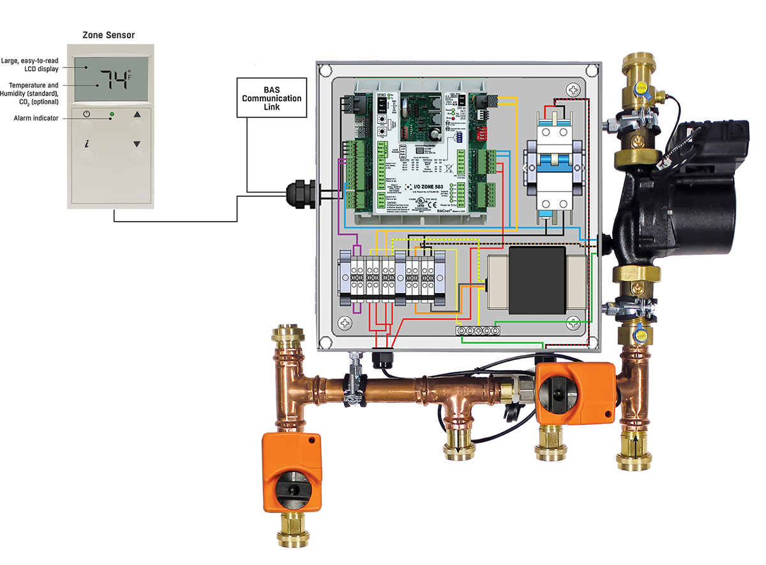
Greatly Simplify Design and Installation Process
Factory wired/tested
Zone Pump
Water temp sensor
Control Valve
Electrical/controls
Electrical Field connections required
Smart sensor
Main power (208/230 – 1 Ph)
BAS (if applicable)
Water connections
6 pipe connections
Swivel half-union adapters
Designed for std 1” male fitting

Slide 9
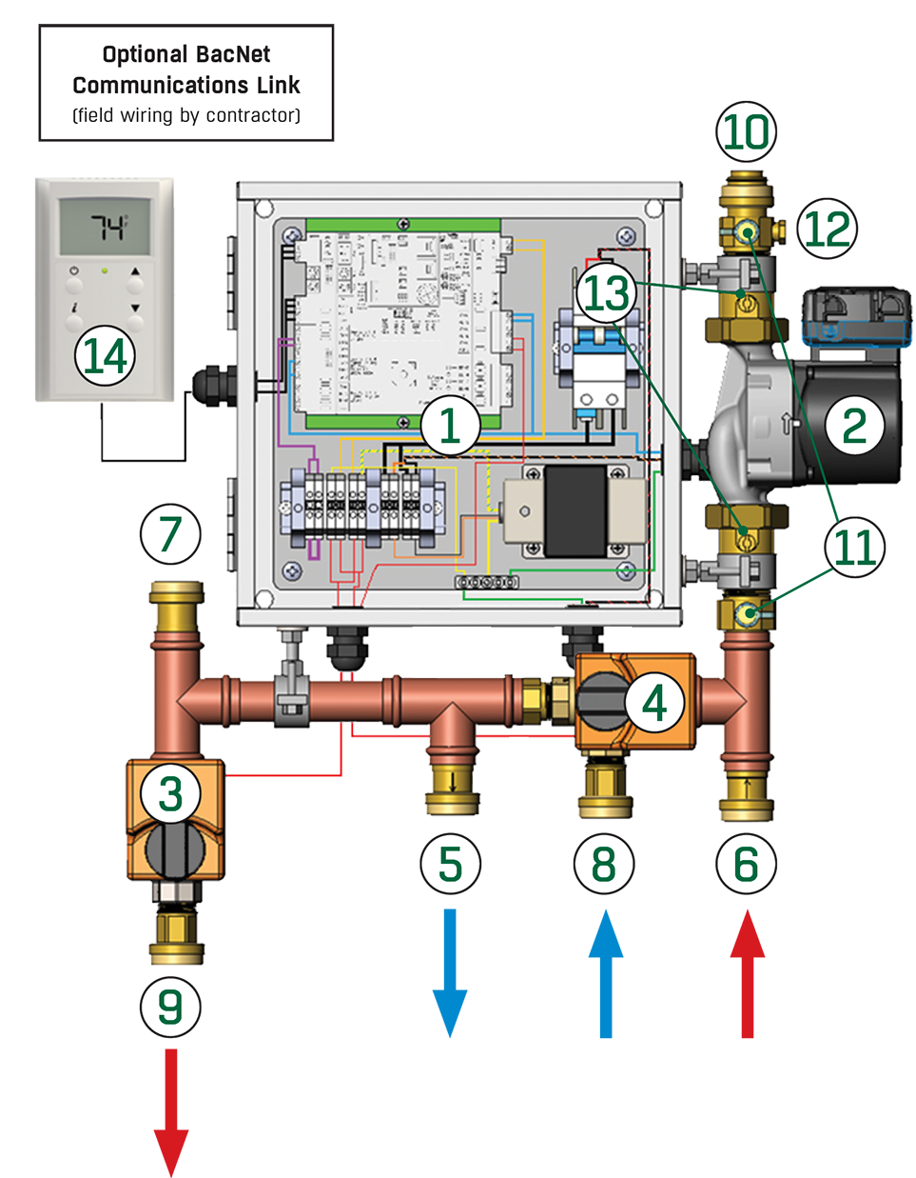
NEUTON: Component Parts
Integrated electrical, DDC controls panel
Electronically Commutated Motor (ECM) high efficiency,
variable speed pump
Hot water control valve
Chilled water control valve
Chilled water return
Hot water supply
Zone loop return connection
Chilled water supply
Hot water return
Zone supply water connection
Pete’s plugs for pressure and flow measurement
Zone supply water thermistor
Pump Isolation Valves
ZS Pro Sensor Zone Controller

Slide 10
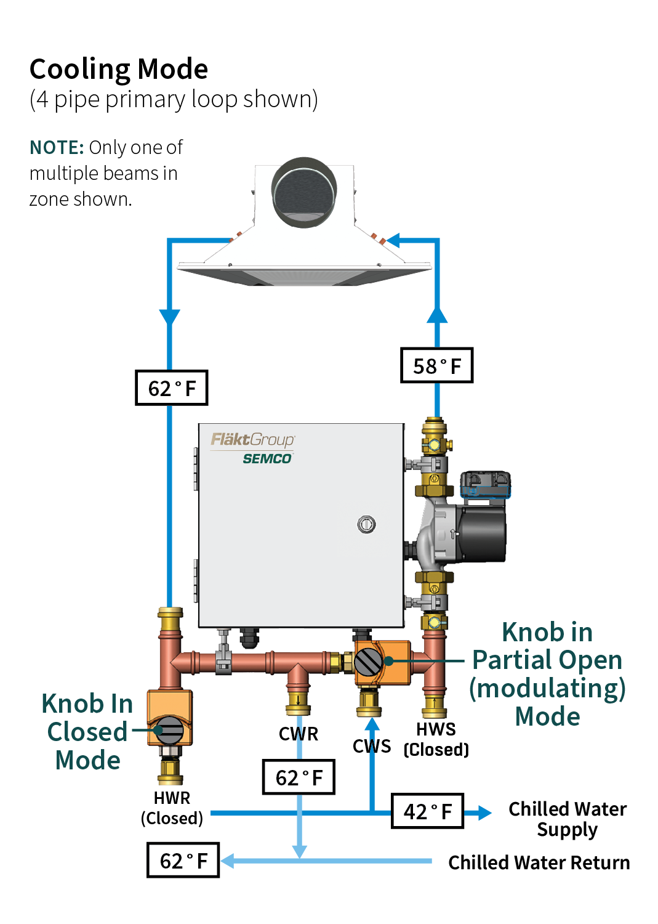
How NEUTON Works: Cooling Mode
Chilled water control valve slowly injects chilled water from the primary loop as recirculated secondary beam loop water is discharged through the check-valve into primary chilled water return loop
Hot water control valve is in the full bypass position and the corresponding check valve is closed
Conventional 42°F chilled water can be utilized within a single primary loop to serve both the chilled beam zones and the dedicated outdoor air system
Notes:
How does the Neuton work:
The system slowly injects water from the primary chilled water supply, mixing the chilled water with the recircuilated water from the beams to achieve the correct temperature set for the beams.
The system is set to a few degrees above the dew point measured in the room by the thermostat and humidity control shipped with the unit.
3. SO in the cooling mode, the water coming into the system is from chilled water.

Slide 11
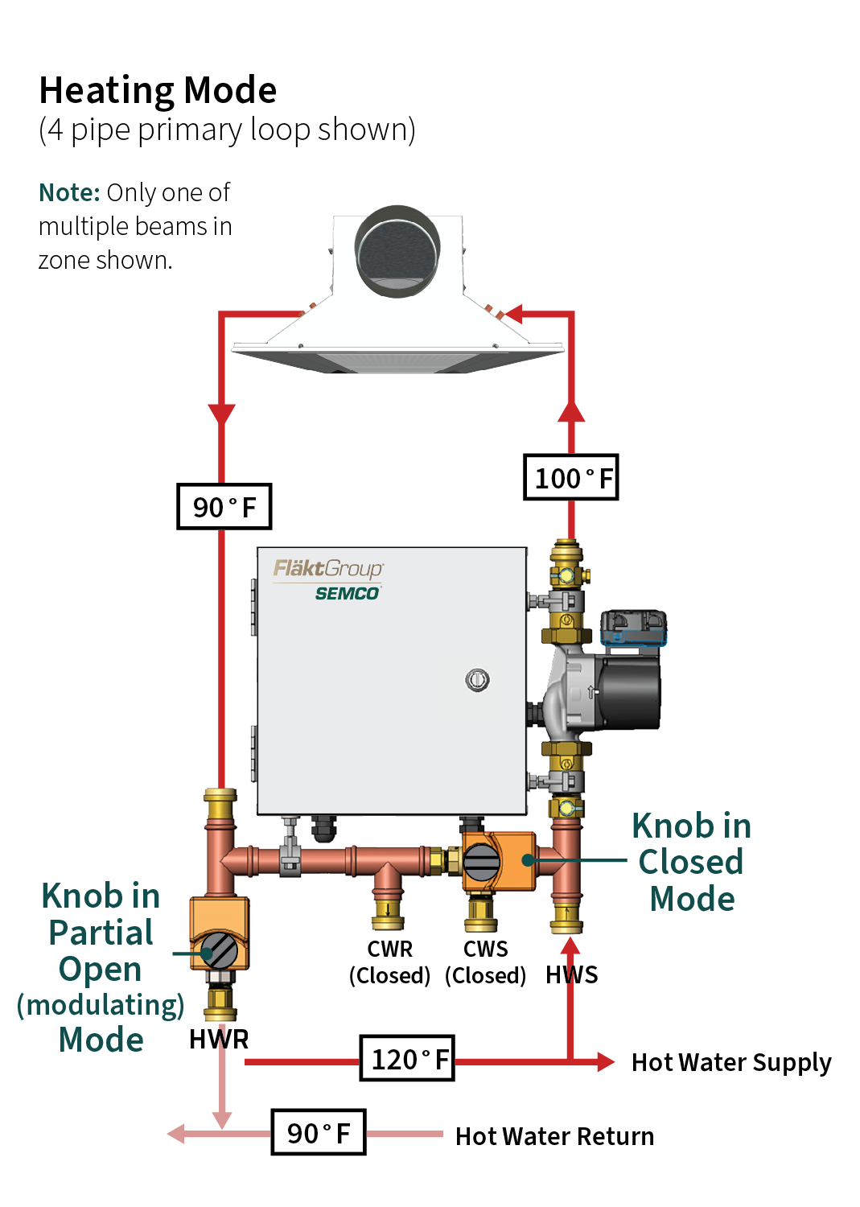
How NEUTON Works: Heating Mode
Hot water control valve slowly ejects a metered amount of recirculated secondary beam loop water while corresponding check-valve allows for injection of water from hot water supply loop
Chilled water control valve is in full bypass position and corresponding check valve is closed
Conventional 120°F hot water can be utilized within a single primary loop to serve both the chilled beam zones and the DOAS
Notes:
How does the Neuton work:
The system slowly injects water from the primary chilled water supply, mixing the hot water with the recircuilated water from the beams to achieve the correct temperature set for the beams.
The system is set to a few degrees above the dew point measured in the room by the thermostat and humidity control shipped with the unit.
3. SO in the heating mode, the water coming into the system is from chilled water.

Slide 12

NEUTON: Active Condensation Control
In both heating and cooling modes NEUTON monitors:
  the zone pump
  beam water temperature sensor
  control valves
  associated electrical and controls
NEUTON keeps the beam pipe temperature a few degrees above the measured dew point in the room via the supplied wall sensor
All this is done via factory installed software and tested with sensors
With NEUTON, you won’t worry about rain coming from your chilled beams.
Notes:
So how does it provide condensation control.
The system is set to a few degrees above the dew point measured in the room by the thermostat and humidity control shipped with the unit.
Additionally, the system is always monitoring the water temperatures of the recirc and the supply water to mix the water to meet the correct temp.
Concept is simple, but not easy to achieve, which is why we design the system to be plug and play so the control scheme is already created.

Slide 13

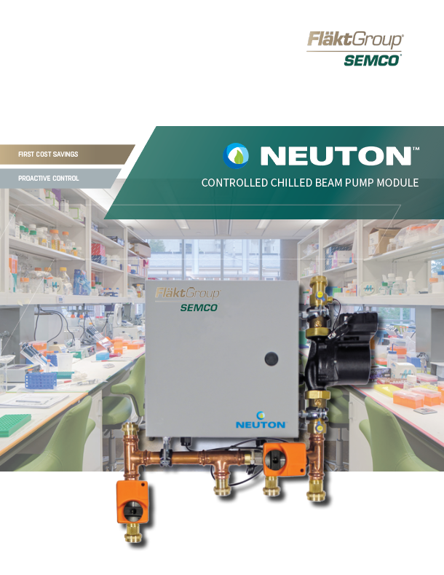

NEUTON: Resources Available to you
Product Brochure
Features & Benefits Leaflet
Technical Guide
Multizone Application note – Multiple Rooms, similar loads
Owner’s Manual
PowerPoint Presentations
How to sell guide
Technical support from Product and Sales Management

Slide 14
Traditional Chilled Beam Design

Slide 15
Challenges with Traditional Chilled Beam Designs without NEUTON
Despite the many obvious advantages offered by chilled beams, their acceptance has been limited due to several design challenges:
High cost of the primary and secondary piping makes the use of the technology somewhat more expensive than conventional systems
Inability to use traditional chilled/hot water main loop temperatures without costly secondary loops or separate boiler/chillers for the chilled beam network
The concern for condensation on the surfaces of the coils
Designing and implementing controls
Notes:
Chilled/hot water main loop temperatures (i.e. 42° and 120-180°)
Controls used to operate chilled beam network, optimize system performance, including communication with the DOAS – “plug-and-play” solutions

Slide 16
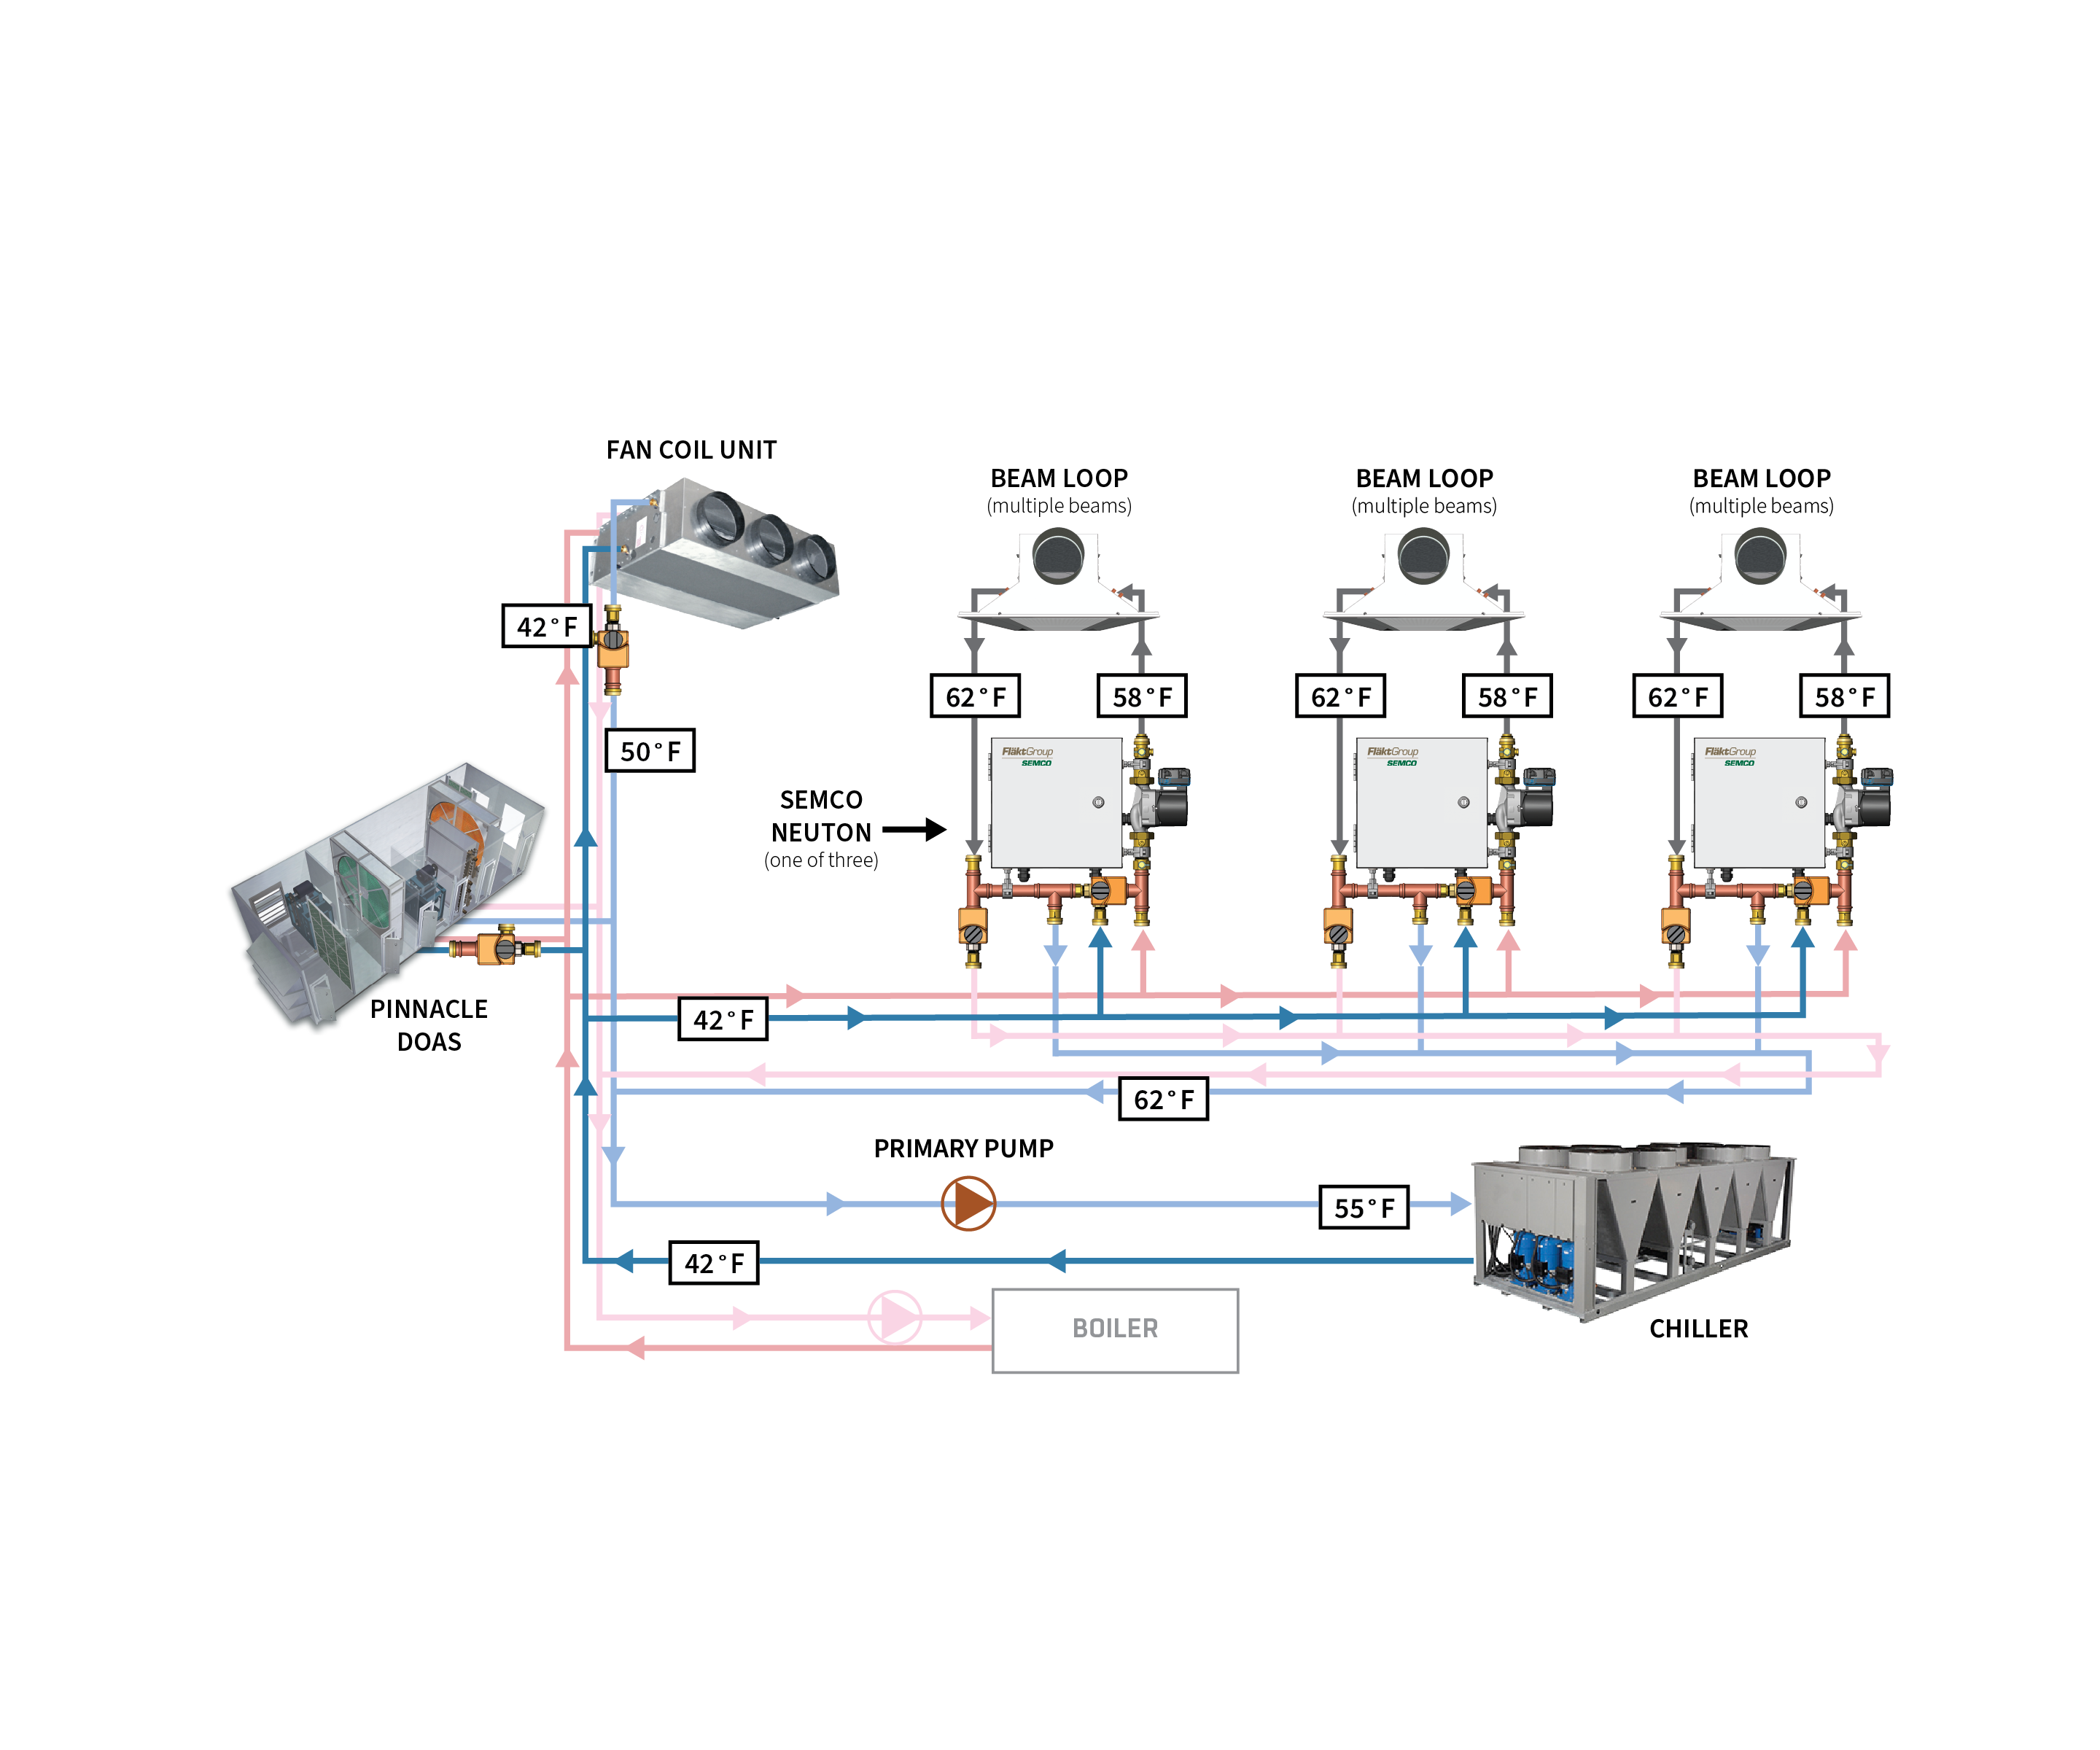
Traditional Chilled Beam Piping Layout: Cooling
Primary/secondary cooling loops required or second chiller
Increased pipe size ($$$) needed to accommodate the more moderate temperature water required (58°F)
Notes:
Two primary loops required for both cooling and heating to accommodate the DOAS and beams, requiring second chiller and boiler, plate frame heat exchangers or other modifications
Increased pipe size required for beam loop due to moderate chilled and hot water temperatures required by the beams

Slide 17
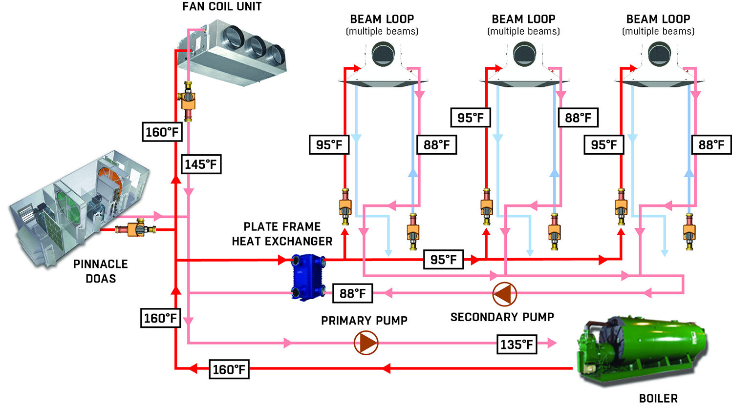
Traditional Chilled Beam Piping Layout: Heating
Primary/secondary heating loops required or second boiler
Increased pipe size (substantial cost) needed to accommodate the more moderate temperature water required (95°F)

Slide 18
Additional Chilled Beam Design Requirements without NEUTON
Four pipe beam coils, with some coil passes allocated for cooling and others for heating
Piping at each zone needs to accommodate four piping runs – heating and cooling supply and return lines, valves and couplings
In each zone contractor needs to install two control valves, condensation sensors, run power to all devices then communicate with space thermostat or BAS signals
Design engineer needs to develop a custom control algorithm then communicate this to the BAS subcontractor then debug
NEUTON addresses all of these design challenges.

Slide 19
NEUTON® Chilled Beam Design

Slide 20
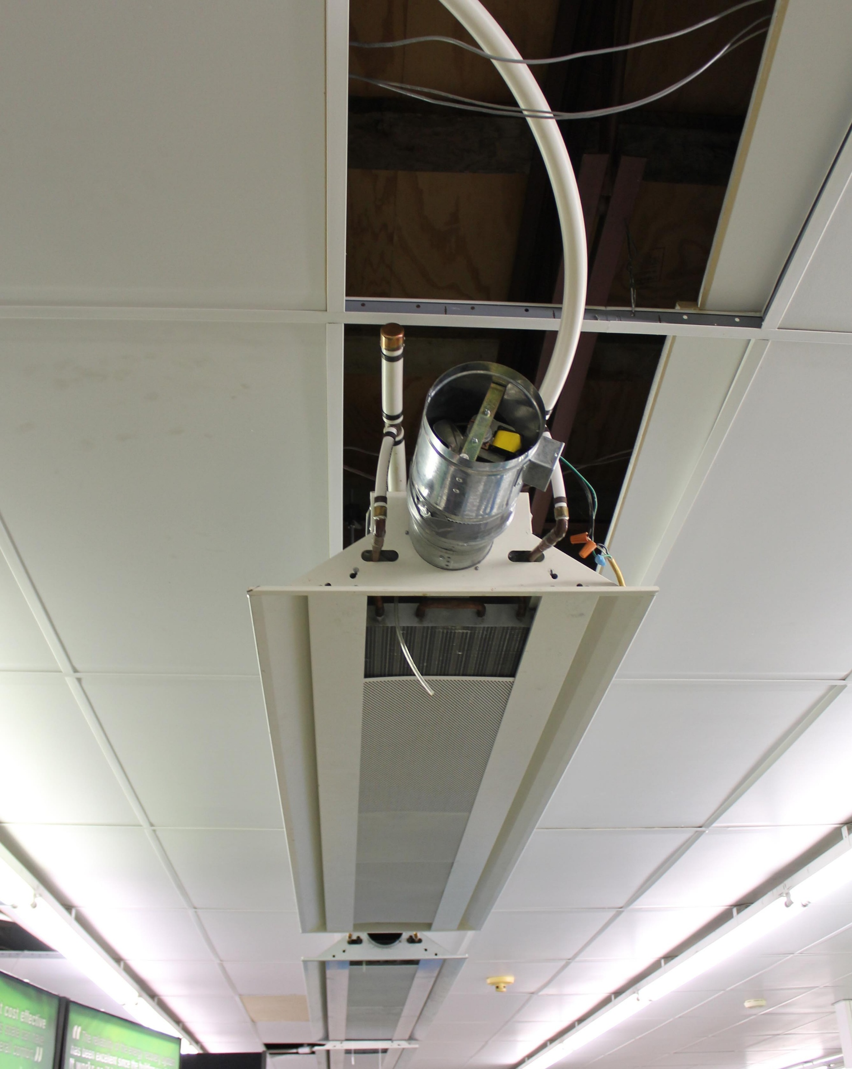
NEUTON Design Requirements: 4 Pipe Approach
Single primary loop with all devices served by the same traditional chilled and hot water temperatures (beam water temperature set by NEUTON)
Primary pipe size (cost) remains small since no change to the chilled or hot water temperatures required (same temperature to beams as DOAS)
Two pipe beam coils, with all passes allocated for cooling and heating
Only a single supply and return piping run in each zone since two pipe coils are used (half that required by conventional approach)

Slide 21
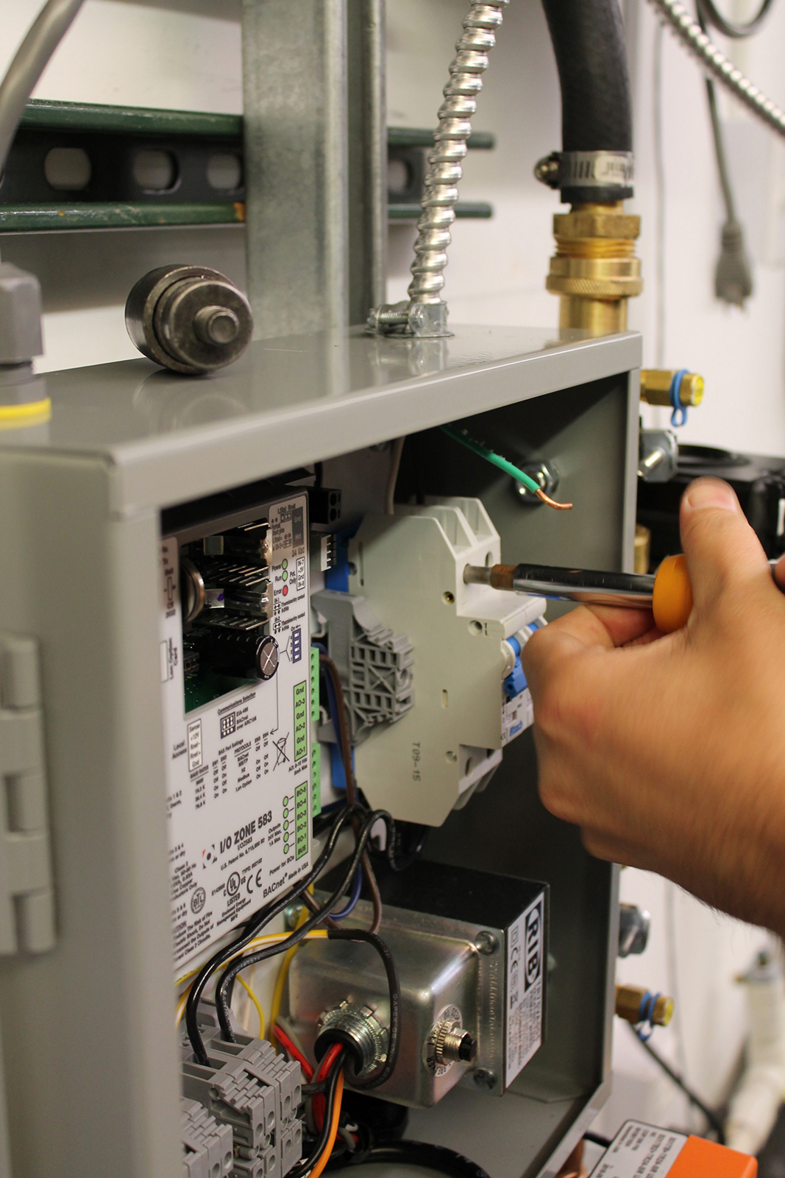
NEUTON Design Requirements: 4 Pipe Approach
Contractor only needs to install the NEUTON and install/connect the smart sensor and power to the unit - all valves, DDC controller, electrical and software are factory installed and tested.
No controls programming since the optimized algorithms complete with BACnet communications capabilities are standard with each NEUTON.
Approximately 75% of the installed first cost associated with traditional chilled beam systems (see cost analysis section) plus substantial energy saving

Slide 22
Chilled Beam Pipe Layout with NEUTON: 4 pipe Approach

Slide 23
NEUTON Design Requirements: 2 Pipe Approach
All of the advantages associated with the NEUTON 4 pipe approach plus:
Primary distribution pipe lengths that are approximately half of the traditional approach since the chilled/hot water is pulled from then injected back into the same distribution pipe (the variable chilled/hot water temperatures that result can be accommodated by the NEUTON)
Approximately 65% of the installed cost associated with traditional chilled beam systems (see cost analysis section) while providing advanced controls and substantial energy savings

Slide 24
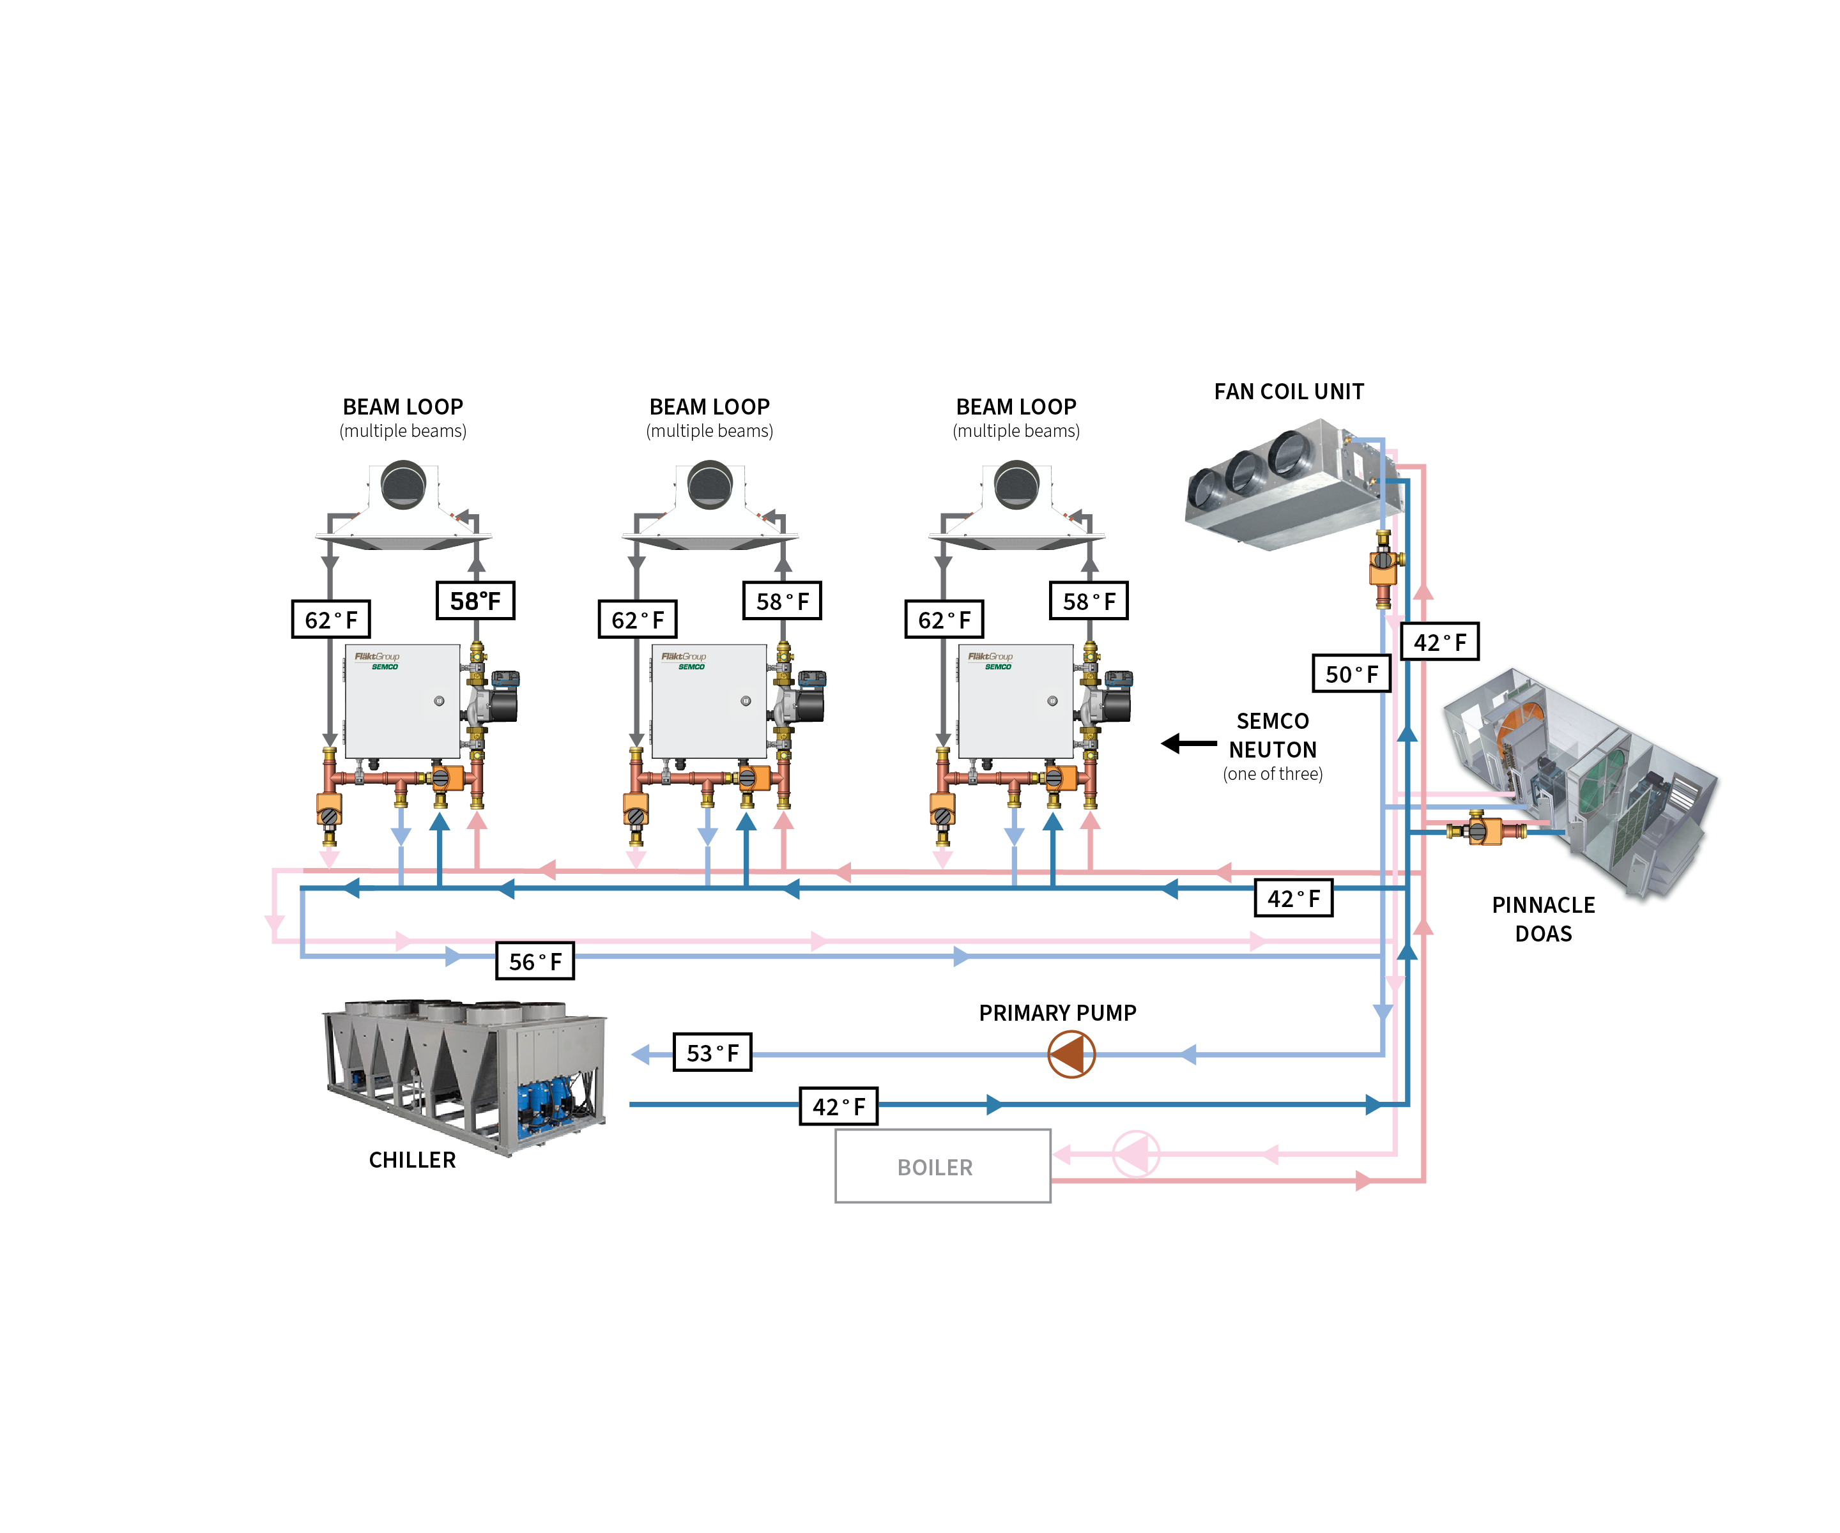
Chilled Beam Pipe Layout with NEUTON: 2 pipe Approach

Slide 25
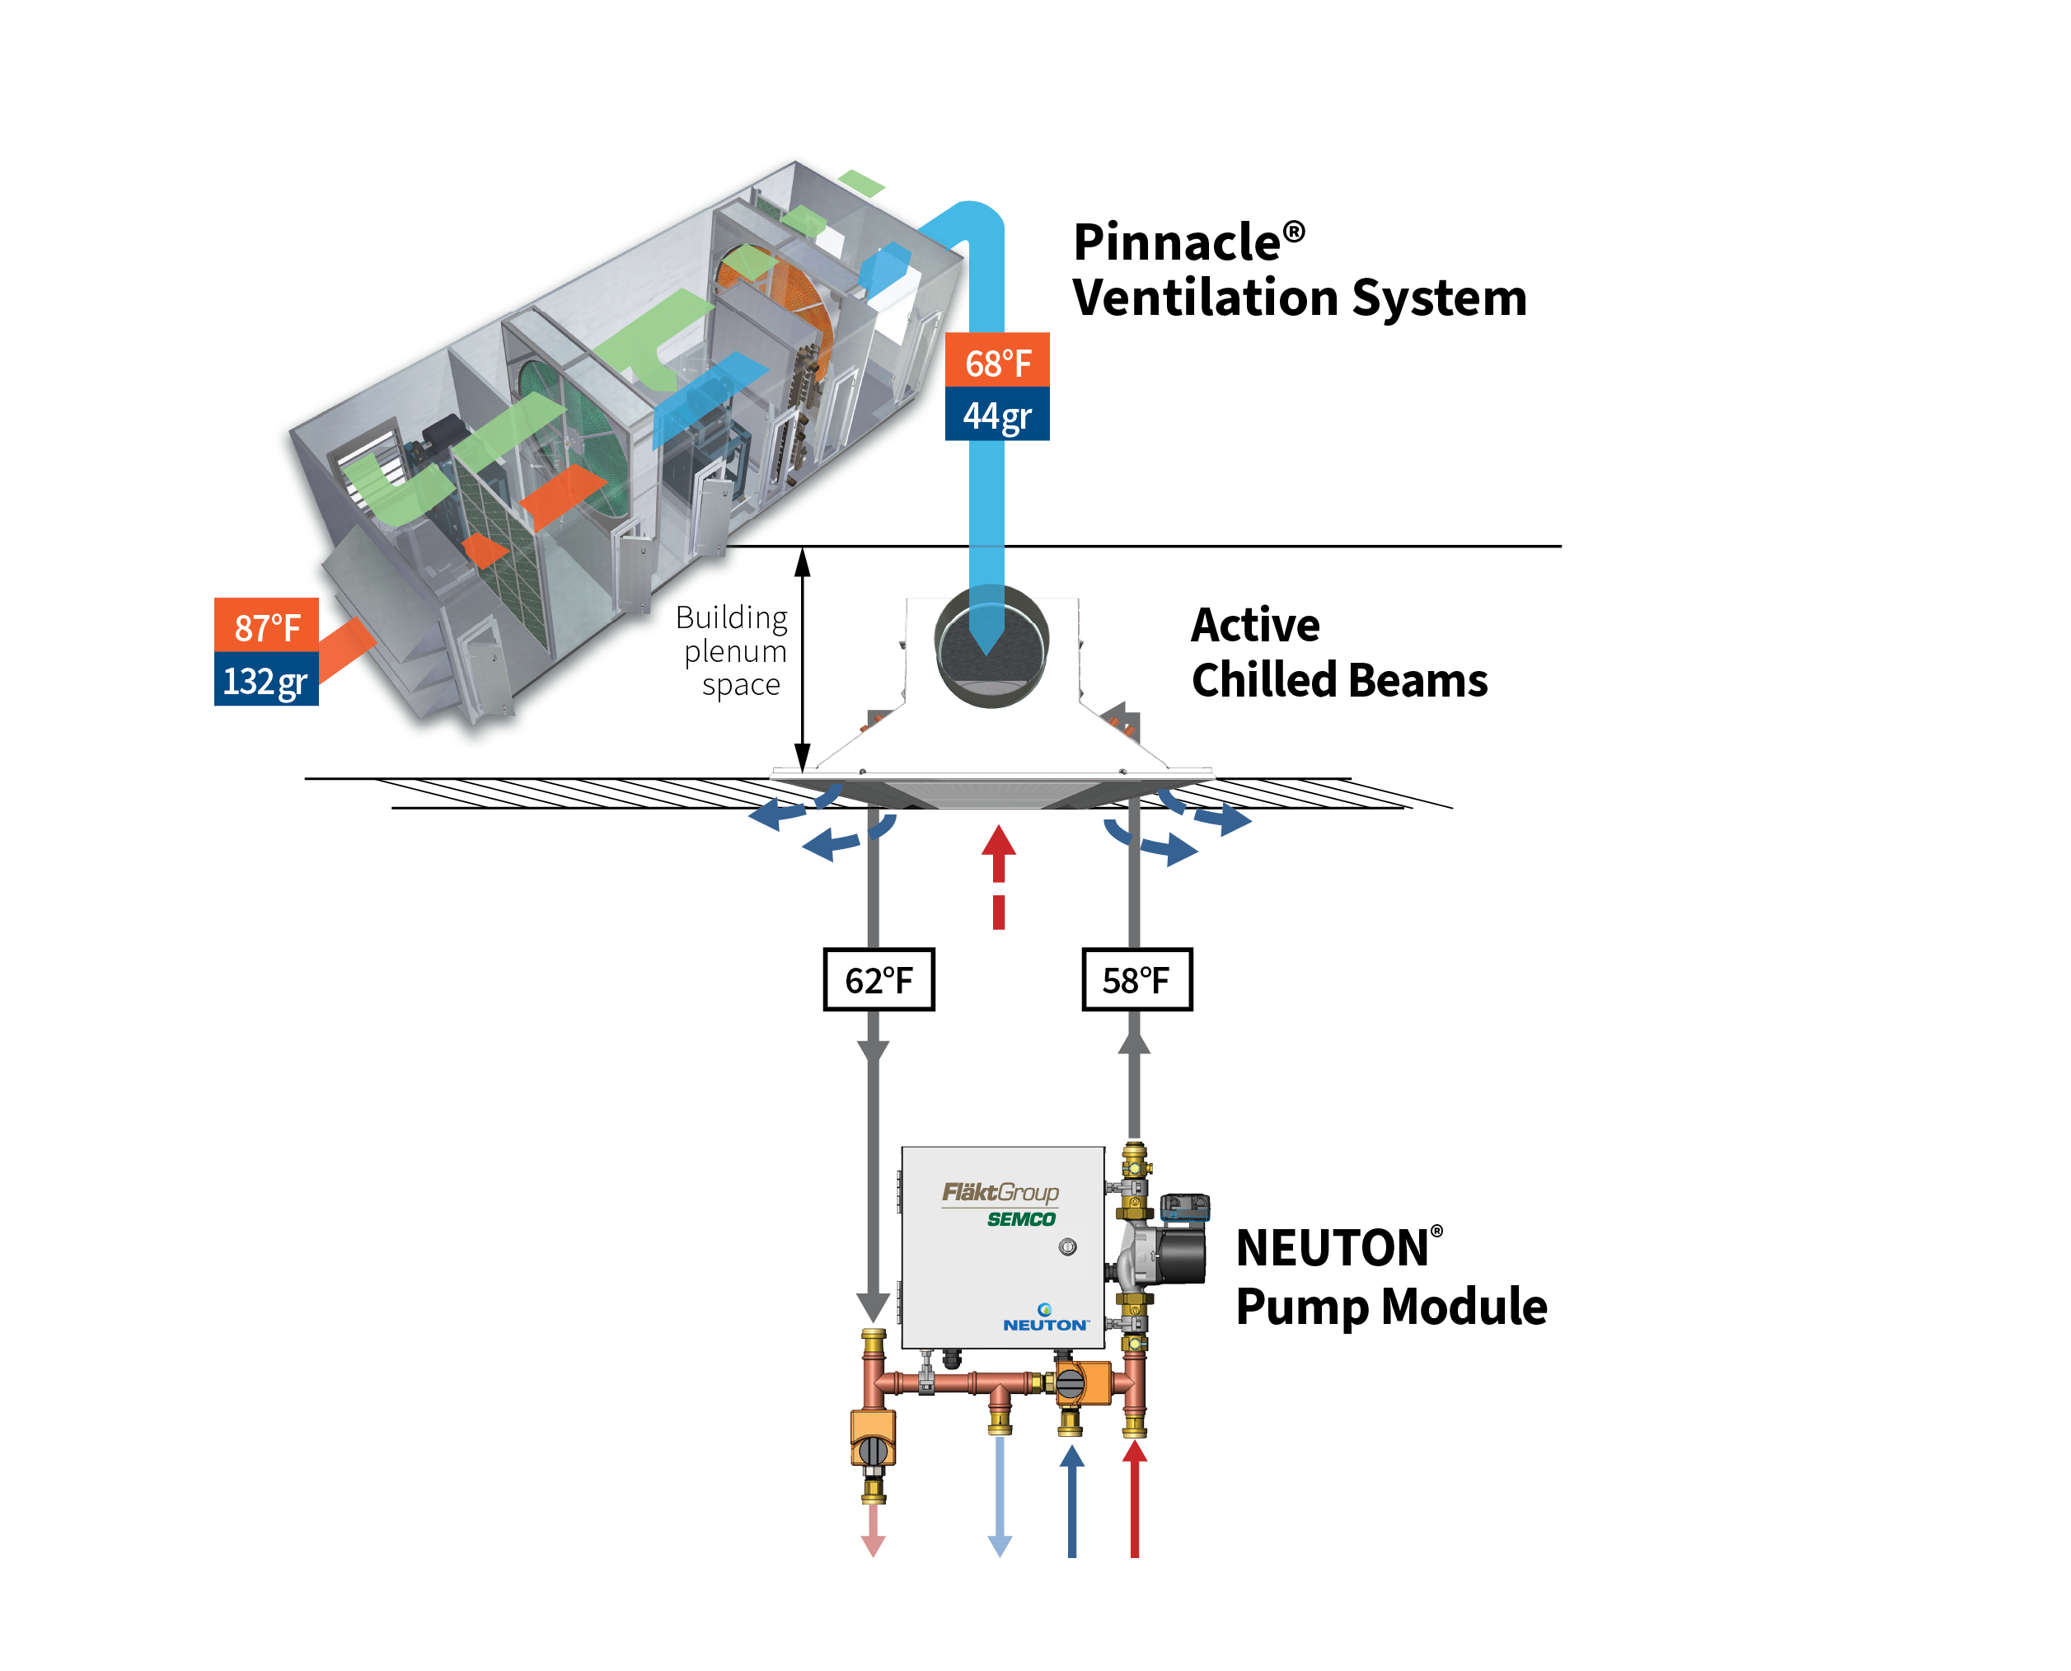
NEUTON: 3fficiency
3fficiency combines NEUTON® with the Pinnacle® DOAS and active chilled beams for an efficient hydronic system. Design advantages include:
Very high energy efficiency
Very low primary airflow requirements
Low noise levels
Reduced filter maintenance – central location not room by room
Ideal air distribution
Improved indoor air quality – excellent outdoor air delivery
Ideal humidity control
Eliminates condensate management problems
Notes:
Listed here are key features and benefits of the system. These will be touched on as we go through the next few slides, and can be further discussed in the advanced training session of the NEUTON which will be offered later.

Slide 26
NEUTON® Multiple Zone

Slide 27
NEUTON Multiple Zone: Individual Offices
One NEUTON can be utilized to serve multiple individual offices with similar load profiles
One NEUTON is used to create a separate zone loop to feed multiple small zones (offices)
Smart zone sensor installed in office with greatest latent load or, if all zones are equal, the return air plenum
Each zone contains a thermostat and conventional 2-way valve (on/off)

Slide 28
NEUTON Multiple Zone: Piping Example
Best to locate smart sensor in one representative zone since setpoints can be modified using the sensor LED keypad or local access port
Other zone sensors and control valves shown in this example are by others

Slide 29
Installation, Controls, Communications, & Sizing

Slide 30
Compatible Room Smart Sensor
Room thermostat compatible with Automated Logic controller (4 conductor connection)
Full digital display
If desired, any BAS room sensor can be used with signal and set points being provided to the Pump Module over a BACnet communications network
Wall sensor includes
  Temperature
  Relative humidity
  CO₂ (occupancy) Optional
ZS Pro Sensor Zone Controller

Slide 31
Integrated Control Functionality
Specifically designed for optimum chilled beam system operation
  Accommodates occupied and unoccupied set points
  Provides “Active Condensation Control” for beams in cooling mode
  Optimizes pump energy during cooling and heating modes
  Provides “boost” mode for high occupancy or morning startup
  Calculates dewpoint in each zone which can be “poled” to BAS system to reset primary air dewpoint
  Can provide numerous alarms (i.e. potential condensation condition, space temperature not met, etc.)
  Can use compatible space temperature/RH/CO₂ sensor to automatically determine occupied/unoccupied modes

Slide 32
NEUTON with BACnet: Typical Points List

Slide 33
Installation: Vertical or Horizontal Mounting Accommodated
Notes:
NEUTON can be mounted in several positions as long as the pump shaft remains horizontal (as shown above)
Adequate space must be allocated of opening the hinged panel door and accessing the DDC control board and other components

Slide 34
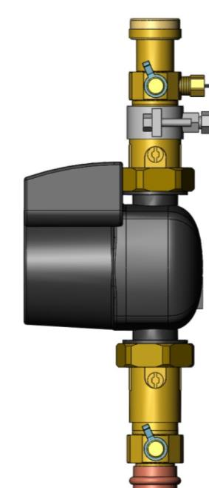
High Efficiency Variable Speed Pump: Performance and Service
High Efficiency ECM Pump with permanent magnet motor, uses up to 90% less energy then conventional on/off pumping designs
Pump designed for condensing environments. Controller separated from motor and motor protected by coatings
Pump easily removed if needed using standard isolation valves
Pump head designed to be easily removed without removing pump housing or piping connections
Pump Isolation and shutoff valves standard

Slide 35
Product Family
NEUTON⁴, Dual Valve
NEUTON², Single Valve
Utilized as dynamic zone operation with simultaneous heating and cooling demand
2 pipe primary system – return water from pump module is returned to same loop downstream from supply, on both cooling and heating loops.
4 pipe primary system – return water is piped to dedicated return line, one for cold water and one for hot water.
Requires only one Neuton⁴ for both cooling and heating.
Utilized as only cooling or only heating
2 pipe primary system (supply/return) - requires primary system to have a summer/winter switch over
4 pipe primary system (cold supply/ cold return, hot supply/ hot return) - requires one Neuton² per circuit (one for cooling, one for heating)

Slide 36
Water Flow Capacity & Feet of Head Pressure

Slide 37
NEUTON
Capacities
  11 GPM
  20 GPM
  30 GPM
Notes:
The building doesn’t know if it is summer or winter outside due to the “spring” like conditions the Pinnacle delivers.

Slide 38
Product Family
Model | Voltage | Device FLA | Pump Data |  | Rated Fbw (GPM) | Head Pressure | Dimensions
 |  |  | Max Energy Use | Max Amps
NEUTON CCBPM-11 | 230/1/60 | 1.2 amps | 87 watts | 0.71 amps | 11 | 12 ft. | 21.4"X21.3"X9"
NEUTON CCBPM-20 | 230/1/60 | 2.5 amps | 450 watts | 2.00 amps | 20 | 30 ft. | 26"X25"X10"
NEUTON CCBPM-30 | 230/1/60 | 3.0 amps | 607 watts | 2.68 amps | 30 | 40 ft. | 26"X25"X10"
Three models each available for NEUTON² and NEUTON⁴ – selection based on flow and external pressure
  NEUTON-CCBPM-11: up to 11 GPM at 12 feet of external head pressure
  NEUTON-CCBPM-20: up to 20 GPM at 30 feet of external head pressure
  NEUTON-CCBPM-30: up to 30 GPM at 40 feet of external head pressure
Voltages available –230/1/60
Controlled via optional smart sensor or BACnet signal via BAS
  Smart sensor with digital display recommended
Optional keypad (one per project) to make second level setpoint adjustments if desired

Slide 39
Selecting and Sizing Easily Done: Cooling Example
Simple Example: Using highlighted zone from IQHC Selection Software
Step 1: Zone flow 5 GPM total (4 x 1.25 GPM), Pressure loss 6.2 feet
Step 2: Assume zone piping losses at 9.8 feet
Step 3: NEUTON sized for 5 GPM at 15 feet of external pressure (cooling)
Step 4: From NEUTON–11 pump curve, the cooling mode pump start setting is easily determined to be 7.9 volts
Step 5: Repeat for heating mode setting

Slide 40
NEUTON Capacity Pump Curve
NEUTON CCBPM-11 Capacity Curves at Multiple Pump Speeds
NEUTON CCBPM-30 Capacity Curves at Multiple Pump Speeds
10 Volts
9 Volts
8 Volts
7 Volts
External Pressure Capability (feet of head pressure)
External Pressure Capability (feet of head pressure)
6 Volts
5 Volts
NEUTON Water Flow – Gallons Per Minute(GPM)
NEUTON Water Flow – Gallons Per Minute(GPM)

Slide 41
Cost Saving With NEUTON

Slide 42
NEUTON: Cost Savings
Reduce installation cost by 30% + with smaller pipe diameters, fittings and feet of pipe
Contractor only needs to install NEUTON, connecting the smart sensor and power. All valves, DDC controller, electrical and software factory installed and tested.
Cuts beam loop pump energy by up to 90% - high efficiency, variable speed pump uses a fraction of the energy used by traditional pump loops

Slide 43
High Cost of Chilled Beam Piping without NEUTON
Piping and installation percentage of Non-AHU Costs= 28%
Note: Average of actual project costs Pinnacle/CB Design Guide

Slide 44
NEUTON: Installation Savings
Installation is a fraction of the cost associated with traditional chilled beam systems while providing advanced controls and substantial energy savings.

Slide 45
Installed Cost Analysis: Traditional Approach vs. NEUTON
Example Details: Classroom wing with 14 typical classrooms
  Each classroom has a 2 ton cooling load and 10,000 btu/hr heating load to be handled by beam coils
  State-of-the-art (SOA) system uses 58°F (cooling) and 105°F (heating) water temperatures with 6 and 9 degree delta T respectively
  NEUTON 4 pipe approaches use 45°F (cooling) and 140°F (heating) water temperatures with 19 and 44 degree delta T respectively
  NEUTON 2 pipe approaches use the same 45°F (cooling) and 140°F (heating) water but with 10° and 20° delta T respectively
  SOA system needs 4 pipe coils to accommodate cooling and heating, NEUTON uses 2 pipe coils (all passes for cooling and heating)
  Findings: 4 Pipe NEUTON reduced the installation cost compared to the SOA approach by 24%, 2 Pipe NEUTON resulted in a 34% reduction

Slide 46
Reduced First Cost Comparison
Estimated Installed Cost | SOA 4 Pipe Coils | NEUTON 4 Pipe Coils | NEUTON 2 Pipe Coils
Primary Loop | $65,000 | $23,840 | $10,450
Zone Loops, Beams, Controls, NEUTON | $68,230 | $77,300 | $77,300
Total Installed Cost (1) | $133,230 | $101,140 | $87,750
Reduction from SOA Baseline (percentage) | 0% | 24% | 34%
Reduction from SOA Baseline ($/sq.ft.) | $0 / sq.ft. | $2.10 / sq.ft. | $3.00 / sq.ft.
Note 1: Includes all installed components except ductwork and Pinnacle DOAS equipment and installation

Slide 47
Primary Loop Installation Cost Analysis: NEUTON 4-Pipe vs. SOA
Summary of Performance/Cost Analysis for 4 Pipe Approach: Current State of the Art vs. NEUTON
 |  | SOA 4 Pipe | NEUTON 4 Pipe | Percent Reduction with NEUTON
Flow Required | Cooling Loop | 112 GPM | 35 GPM | 69%
 | Heating Loop | 31 GPM | 6.5 GPM | 79%
Pump Power | Cooling Loop | 1.1 HP | .2 HP | 81%
 | Heating Loop | .2 HP | .04 HP | 80%
Pipe Diameter | Cooling Loop | 3" | 2" | 33%
 | Heating Loop | 2" | 1" | 50%
Estimated Installation Cost | Cooling Loop | $30,400 | $16,600 | 45%
 | Heating Loop | $16,600 | $7,240 | 56%
 | Secondary Loop ⁽¹⁾ Hot and Cold | $18,000 | $0 | 100%
 | Total Installation Cost | $65,000 | $23,840 | $41,160 savings (63% Reduction)
Note 1: Estimated cost associated with creating a separate secondary water loop to serve the chilled beams (cooling and heating). This would include plate frame heat exchanger, piping, valves and installation.

Slide 48
Primary Loop Installation Cost Analysis: NEUTON 2-Pipe vs. SOA
Summary of Primary Loop Performance/Cost Analysis: Current State of the Art 4-pipe Approach vs.
NEUTON 2-pipe Approach
 |  | SOA 4 Pipe | NEUTON 2 Pipe | Percent Reduction with 2 pipe NEUTON
Flow Required | Cooling Loop | 112 GPM | 67 GPM | 40%
 | Heating Loop | 31 GPM | 14 GPM | 55%
Pump Power | Cooling Loop | 1.1 HP | .6 HP | 45%
 | Heating Loop | .2 HP | .06 HP | 70%
Pipe Diameter | Cooling Loop | 3" | 2" | 33%
 | Heating Loop | 2" | 1.25" | 38%
Estimated Installation Cost | Cooling Loop | $30,400 | $8,300 | 73%
 | Heating Loop | $16,600 | $2,150 | 87%
 | Secondary Loop ⁽¹⁾ Hot and Cold | $18,000 | $0 | 100%
 | Total Installation Cost | $65,000 | $10,450 | $54,550 savings (84% Reduction)
Note 1: Estimated cost associated with creating a separate secondary water loop to serve the chilled beams (cooling and heating). This would include plate frame heat exchanger, piping, valves and installation.

Slide 49
Zone Internal Loop Cost Analysis: NEUTON vs. SOA
Summary of Zone Internal Loop Performance/Cost Analysis: Current State of the Art 4 Pipe Approach vs. NEUTON
and 2 Pipe Approach
 |  | SOA 4 Pipe Coils | NEUTON 2 Pipe Coils | Percent Reduction with 2 NEUTON pump modules
Flow Required | Cooling Loop Heating Loop | 112 GPM 31 GPM | 84 GPM 21 GPM | 25% 32%
Pump Power | Cooling Loop Heating Loop | .75 HP .08 HP | 1.4 - .4 HP ⁽¹⁾ .11 - .03 HP ⁽¹⁾ | 47% ⁽²⁾ 63% ⁽²⁾
Chilled Beam Cost ⁽³⁾ | 4 Pipe - 8' beam 2 Pipe - 8' beam | $49,890 | $43,890 | 12%
Estimated ⁽⁴⁾ Installation Cost | Piping Cost Valves, controllers, flow measurement, electrical, etc. NEUTON Pump Modules | $8,400 $9,940 | $4,200 $3,220 $25,900 | 50% -161%
 | Total Installation Cost | $68,230 | $77,300 | ($9,070)
Note 1: Reflects the difference between a low efficiency and high efficiency ECM pump
Note 2: Comparison with the preferred high efficiency pump used for NEUTON
Note 3: Reflects cost difference between a two pipe and 4 pipe coil in the chilled beams (required by SOA approach)
Note 4: Pipe cost and component installation cost estimates from R.S. Means (2009)

Slide 50
Energy Saving With NEUTON

Slide 51
Energy Use Comparison
This chart shows energy modeling completed for a 200,000 sq.ft. high school. NEUTON pump modules combined with chilled beams result in the most energy efficient system available.

Slide 52
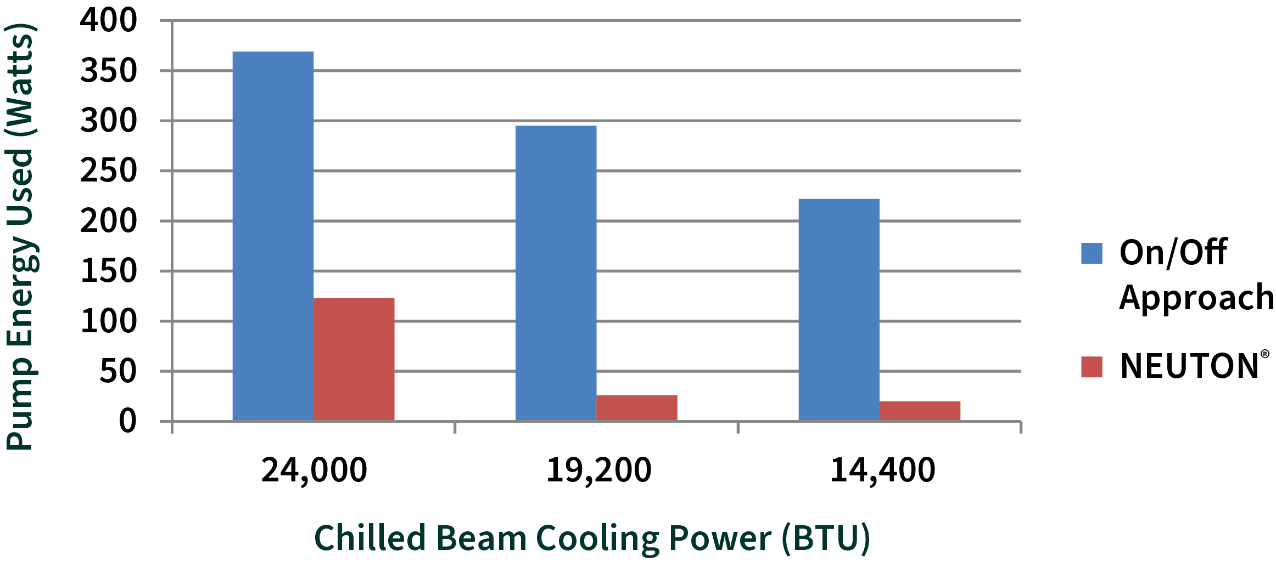
Substantial Pump Energy Savings Example
Graphic representation of energy use comparison between the baseline cycled constant speed zone pump and the high efficiency variable speed zone pump used in NEUTON.
Results: NEUTON uses an average of 80% less pump energy to achieve the same beam cooling output

Slide 53
Substantial Pump Energy Savings Example
High efficiency ECM motor combined with substantial power reduction offered by variable flow pump results in significant energy savings over a traditional, constant flow – on/off design approach
Three cooling conditions analyzed: peak coil cooling power (24,000 BTUs), 80% of peak (19,200 BTUs) and 60% of peak (14,400 BTUs).
Constant speed pump operated to deliver a constant flow of 6 GPM at a 13 foot pressure head – cycled on and off during part load
ECM variable flow pump runs continuously, but varies the flow from 6 GPM down to 3 GPM
Results: In this example, NEUTON uses an average of 80% less pump energy to achieve the same beam cooling output

Slide 54
Applicatons

Slide 55

Projects by Application Type*: Key selling points
LEED Chilled Beam Projects where highest energy efficiency is desired
Schools, offices, laboratories, etc. –reduce first costs of the system and provide long term energy savings
Renovations –allows existing distribution piping accommodating traditional hot and cold-water temperatures to be reused
Projects where installing active chilled beams at the lowest cost is desired
(*a partial list)
Notes:
Where / Who would use the NEUTON
Basically the same applications and customers that would use Chilled beams. The system can be part of original install or retrofit/rehabs.
When designed in conjunction with the entire system from the HVAC unit, fans, etc, the overall design can be optimized to create substantial savings.
With the potential energy savings of Beams/Pump/Pinnacle, it is a great total sales package.

Slide 56
NEUTON: Case Study Example
Campbell Junior High School
Winchester, Kentucky
3fficiency - (2) 5000-cfm Pinnacle DOAS units, (212) IQHC Active Chilled Beams, and (46) NEUTON Pump Modules
Combined chilled beam pinpoint indoor air comfort temperature and humidity control with energy efficiency
Saved $147,000 labor/installation vs. a VRF System
$33,000 annual energy savings over the school's former system
Increased attendance at the school attributed to the quiet system and superior indoor air quality

