Slide 1

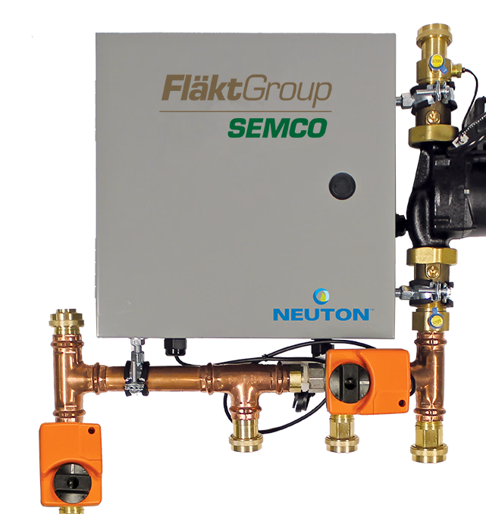

Neuton
Controlled Chilled
Beam Pump Module

Slide 2
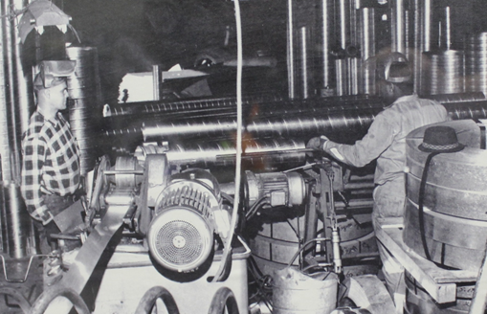
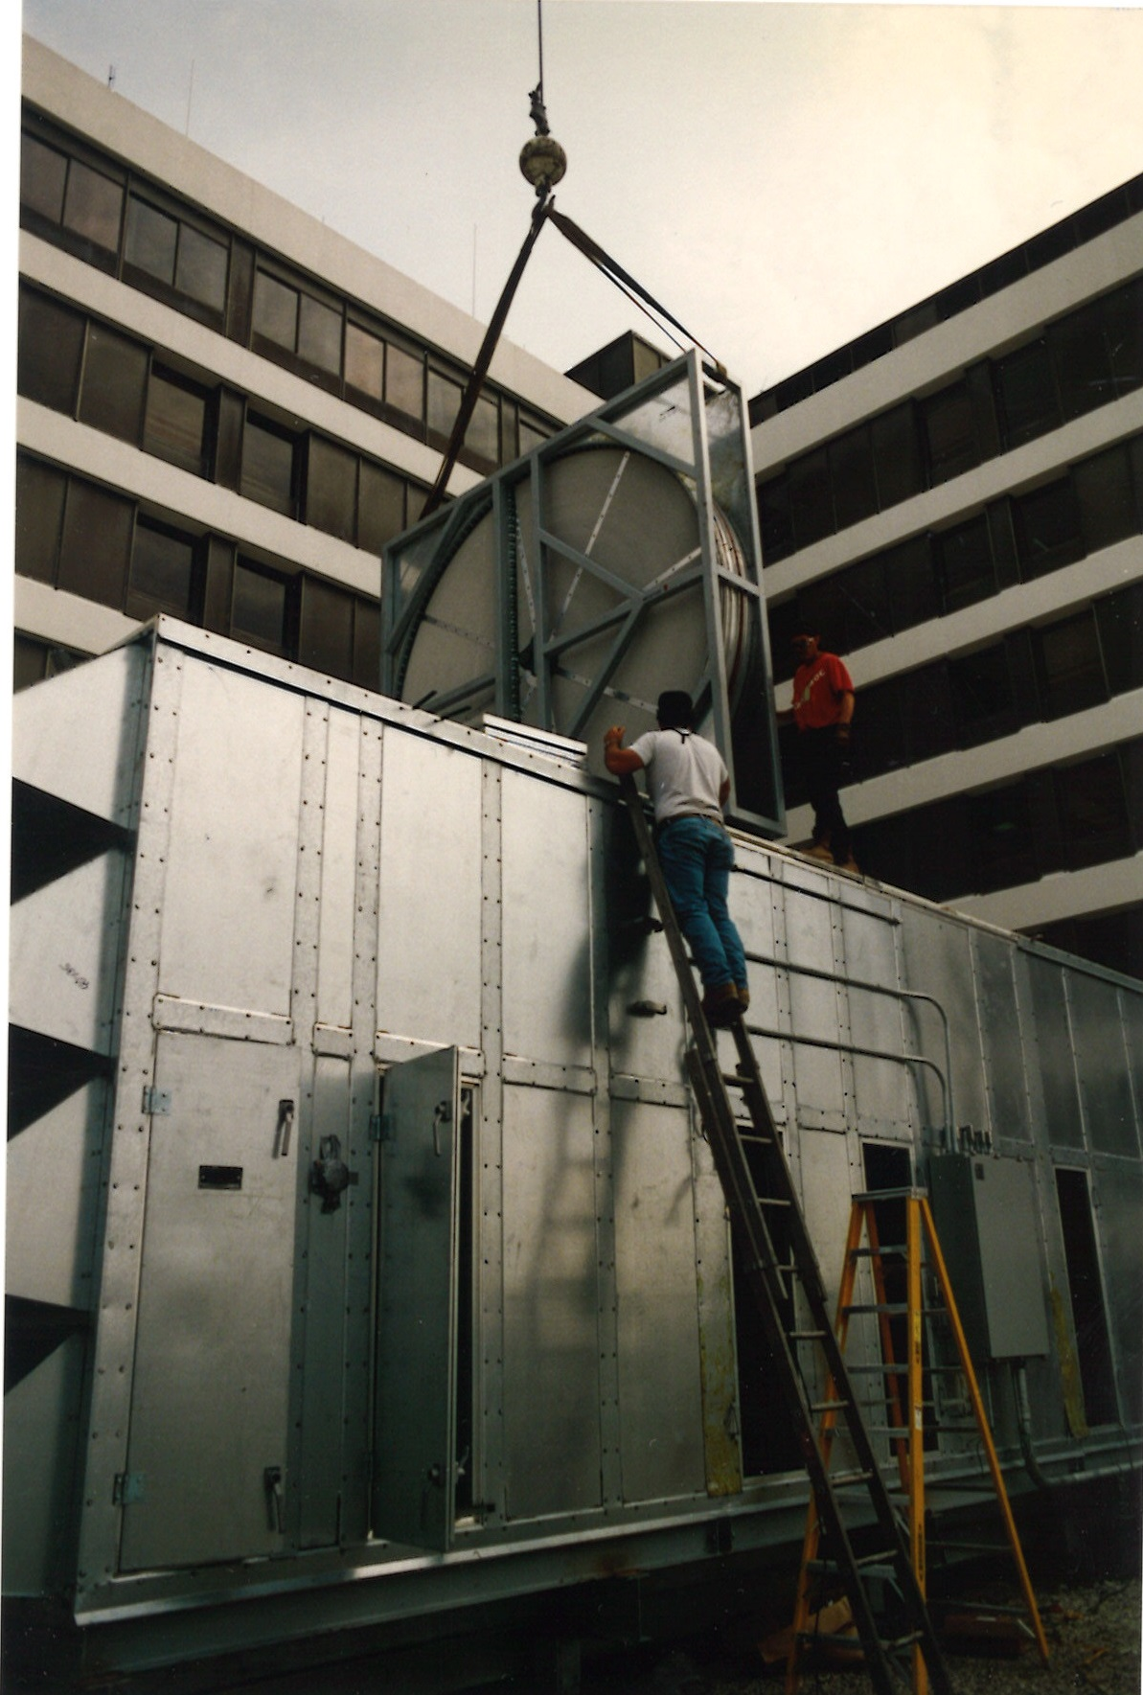
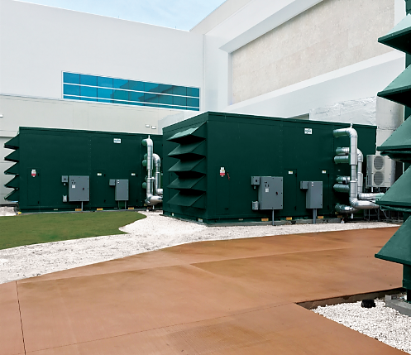






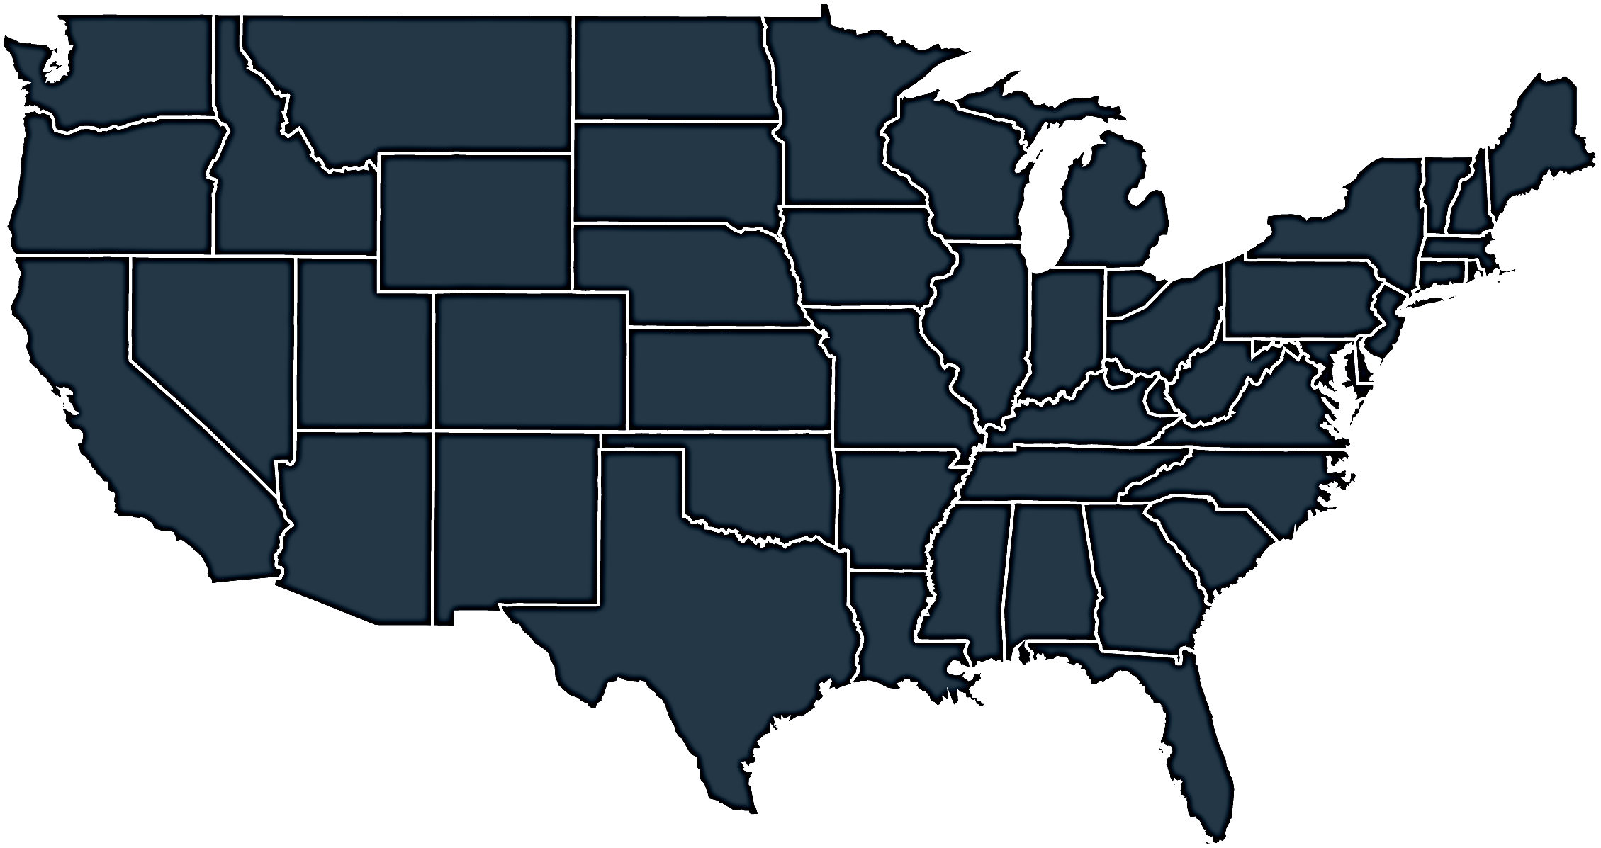



Who we are & what we do
Energy
& Environmental
Focus
Patented &
Certified
Products
U.S & Global
Footprint
Engineered
Air Quality &
Data Center
Solutions
Engineered
Air Distribution
& Sound
Solutions
OEM,
Key Account &
Sales Rep
Route To Market
Service
& Support
Award Winning
& Industry
Recognized
Notes:
In 1963 Salisbury Engineering and Manufacturing Company (SEMCO) was born in Salisbury, MO.
Began as SEMCO -- small sheet metal fabricator specializing in duct.
In the 59 years, evolved into a multi-million dollar company with a large product offering.
Headquartered in Columbia, MO, with 275,000 sq ft of manufacturing space in 3 plants in Arkansas and Virginia
We are a business unit of FläktGroup, and we are owned and backed by Triton Partners—which is a $17 billion annual revenue investment firm.
Innovation is core at FläktGroup SEMCO.
Certified by AHRI, SEMCO was won numerous awards – including multiple AHRI Innovation, Green Building, Dealer Design, School/College Planning & Management Awards
Hold numerous patents and trade secrets for our industry leading energy recovery wheels and systems.

Slide 3

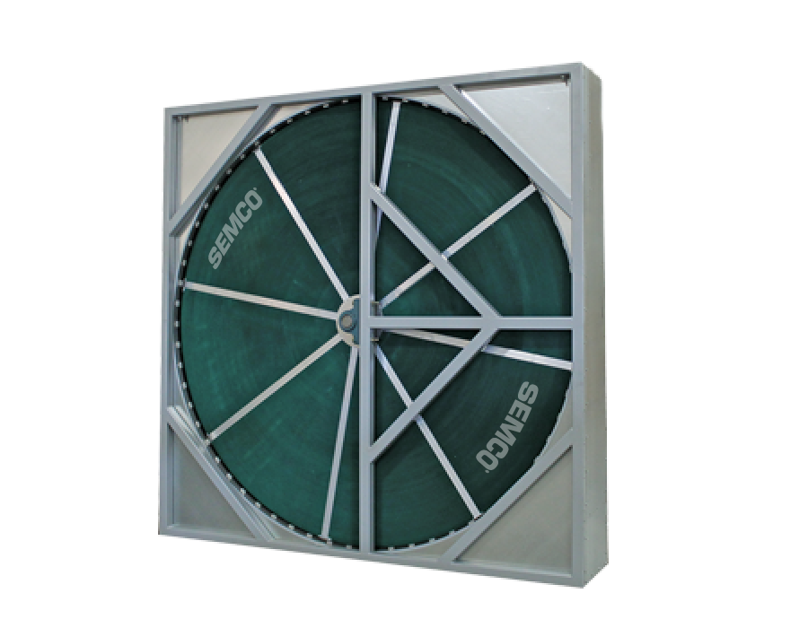
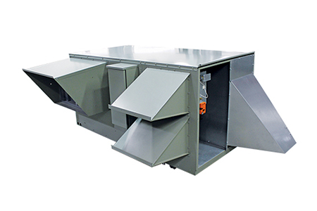
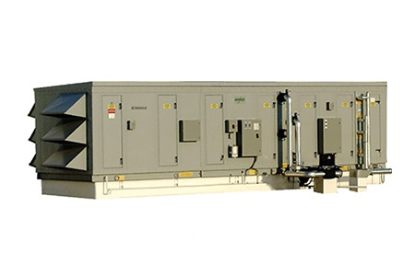

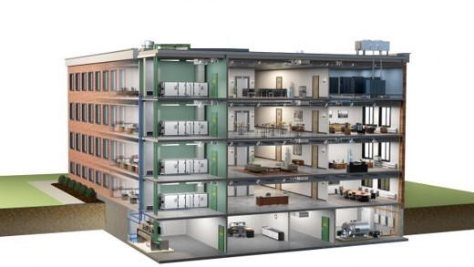
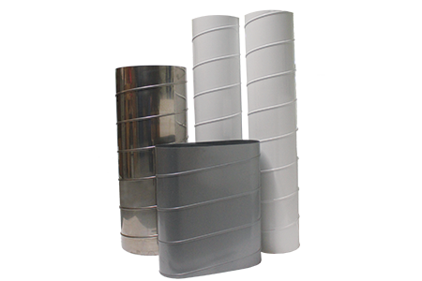
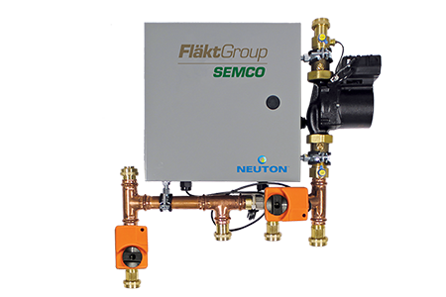
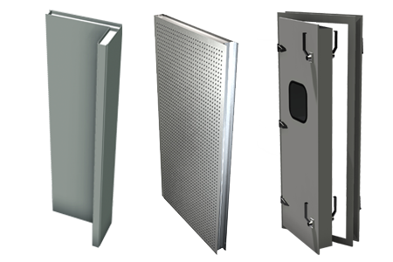
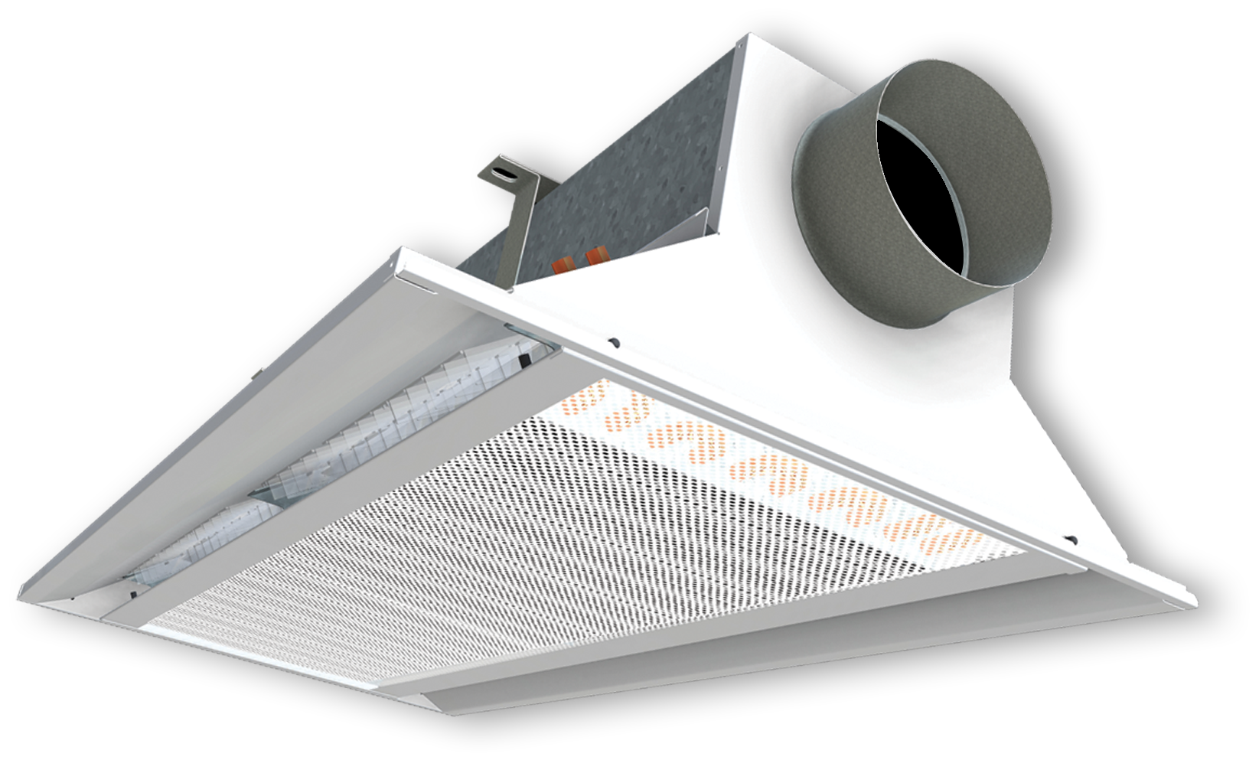
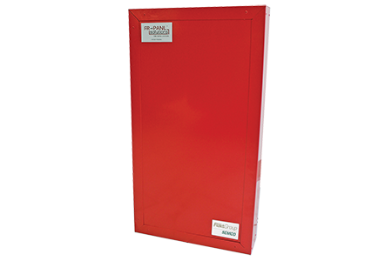
FläktGroup SEMCO Products For Commercial Applications
Energy Recovery Wheel
Unitary Energy Recovery Unit
Applied Energy Recovery Unit
NEUTON Pump
Ductwork
Chilled Beams
Fire-Rated Panels
Sound Attenuation Panels
Notes:
FläktGroup SEMCO provides solutions for a wide variety of applications including casinos, offices, laboratories, hotels, education, healthcare, retail, data centers, stadiums, manufacturing, agriculture & indoor farming, airports, and recreational facilities.
FläktGroup SEMCO products could be utilized in conjunction with one another, to provide the best possible air quality.
We offer energy recovery units & wheels which are engineered to be low maintenance, environmentally friendly, energy efficient & saves money over time as well as protects occupants from harmful contaminants.
We also offer chilled beams, pump modules, data centers, air handlers, duct and panels.
Leverage below if desired:
FläktGroup SEMCO products are designed to be utilized in conjunction with one another, to provide the best possible air quality. We show here:
Ductwork is laid within the walls and ceiling of the building, so supply air may be brought into the building and return air may be exhausted from the building.
Outdoor air is brought into the FV and pre-conditioned
Once the air is pre-conditioned with the FV it is filtered through the Pinnacle energy recovery unit, which will remove contaminants and dehumidify the incoming airstream with its True 3A wheel. Return air will also flow through the Pinnacle on its way out.
The chilled beams and the Neuton will work together with the supply air they receive from the Pinnacle to maintain a comfortable room temperature without condensation. (Together the Pinnacle, Neuton, and chilled beams make up 3fficiency).
During the construction of the building fire panels will be installed around an equipment room or elevator.
Sound attenuation panels are also installed during construction around noisy equipment or places where noise may be a concern

Slide 4


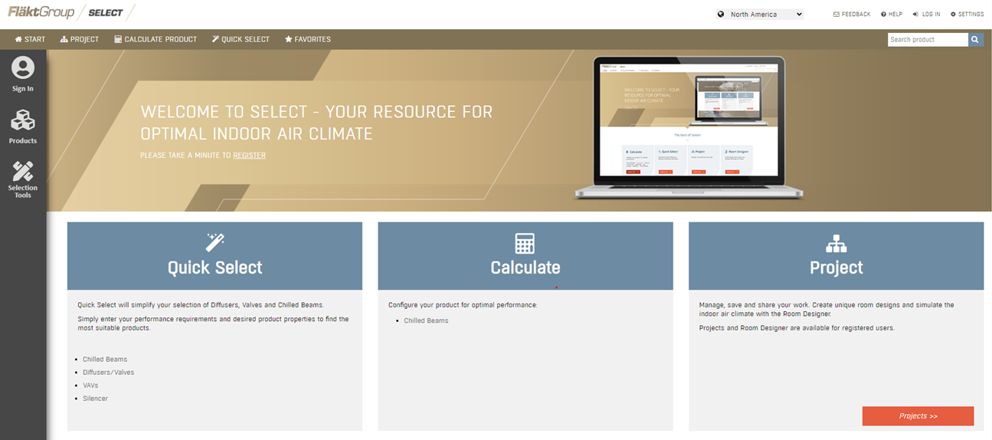
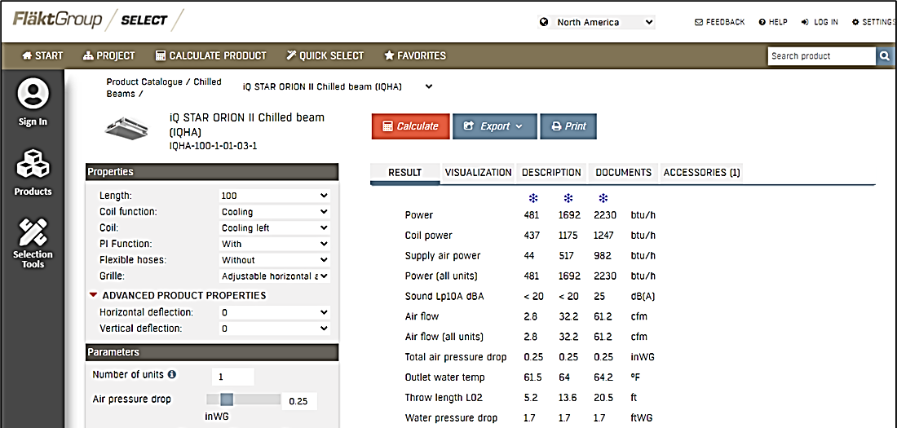

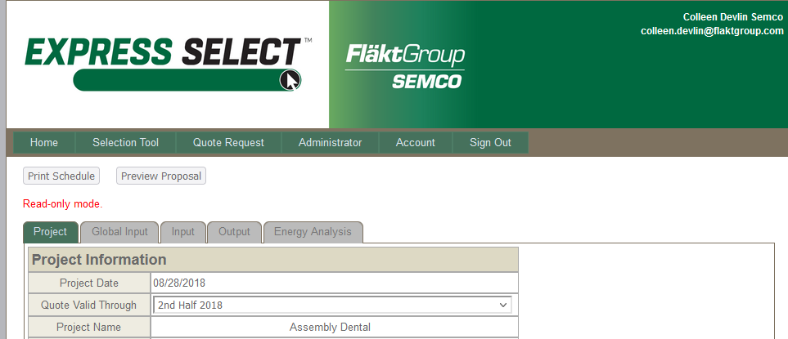
FläktGroup SEMCO Superior Sales Support & Service
Notes:
FläktGroup SEMCO prides ourselves on supplying exceptional sales support and service.
Our experienced sales team are a phone call away and will help guide you through our selection programs to meet or exceed project specifications.
While all FläktGroup SEMCO products are relatively maintenance free throughout their lifecycle--we have a knowledgeable and dedicated service team available should you require it.

Slide 5
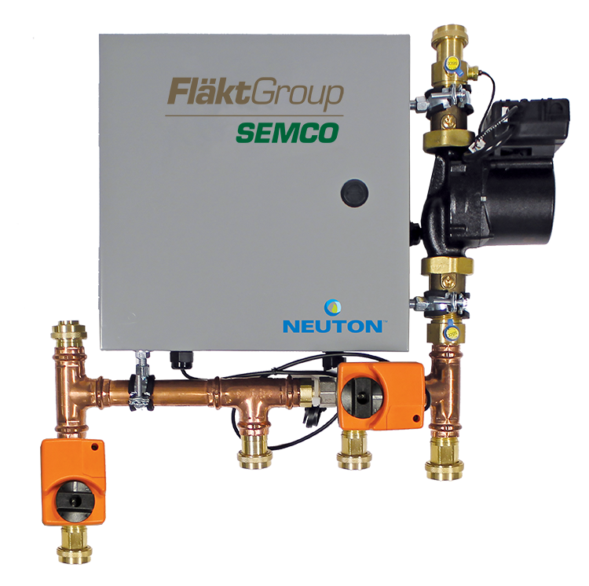




What is NEUTON?
Controlled Chilled Beam Pump Module that provides:
State-of-the art active condensation control system effectively eliminates chilled beam condensation
High efficiency, variable speed pump uses a fraction of the energy used by traditional pump loops
Plug-and-play control system optimizes water temperature for each zone
Notes:
What is NEUTON?
Neuton is a controlled chilled beam pump module that allows the user to have active condensation controls in a plug and play control system.
Neuton combines high efficiency with effective condensation control at a fraction of the energy used by traditional chilled beam pump loops.

Slide 6
Challenges with Traditional Chilled Beam Designs Without the NEUTON
Despite the many obvious advantages offered by chilled beams, their acceptance has been limited due to several design challenges:
High cost of the primary and secondary piping makes the use of the technology somewhat more expensive than conventional systems
Inability to use traditional chilled/hot water main loop temperatures without costly secondary loops or separate boiler/chillers for the chilled beam network
The concern for condensation on the surfaces of the coils
Designing and implementing controls
Notes:
Chilled/hot water main loop temperatures (i.e. 42° and 120-180°)
Controls used to operate chilled beam network, optimize system performance, including communication with the DOAS – “plug-and-play” solutions

Slide 7
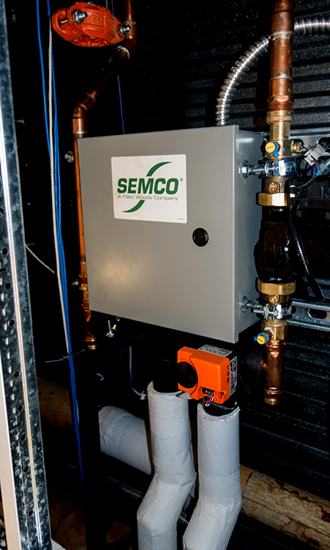
SEMCO NEUTON: Efficient Design
Allows beam zones to be served with conventional chilled/hot water temperatures – no need for secondary loops for chilled beams
Simplifies installation, controls and commissioning of a beam system – eliminates frustration and cost of customized controls development and installation
Increases beam cooling and heating output –all coil passes used for both cooling and heating
Incredible response to occupied, unoccupied and low load conditions – novel control sequences vary water flow and/or temperature to the beams, as needed, to accommodate changes in zone load conditions
Notes:
Biggest benefits of using:
Lower install costs because you can use smaller pipes and less pipes.
Reduce zone piping as well.
Can use conventional water supply, doesn’t have to be from separate systems to support just the beams.
Condensation controls probably the biggest. Don’t want it to rain at the customers locations.
Probably the second is the energy savings of the pump. Savings are based on case by case, but the 90% is based on typical pump to pump savings.

Slide 8
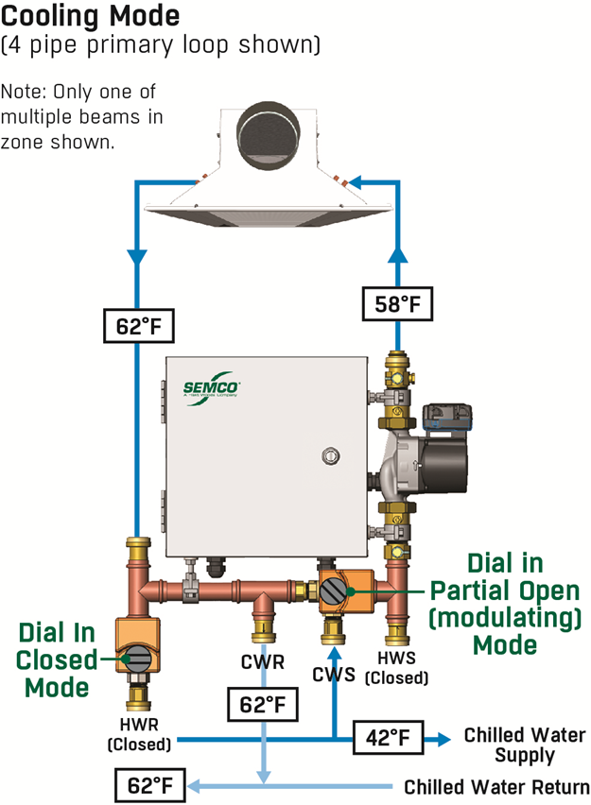
How NEUTON Works: Cooling Mode
Chilled water control valve slowly injects chilled water from the primary loop as recirculated secondary beam loop water is discharged through the check-valve into primary chilled water return loop
Hot water control valve is in the full bypass position and the corresponding check valve is closed
Conventional 42°F chilled water can be utilized within a single primary loop to serve both the chilled beam zones and the dedicated outdoor air system
Notes:
How does the Neuton work:
The system slowly injects water from the primary chilled water supply, mixing the chilled water with the recircuilated water from the beams to achieve the correct temperature set for the beams.
The system is set to a few degrees above the dew point measured in the room by the thermostat and humidity control shipped with the unit.
3. SO in the cooling mode, the water coming into the system is from chilled water.

Slide 9
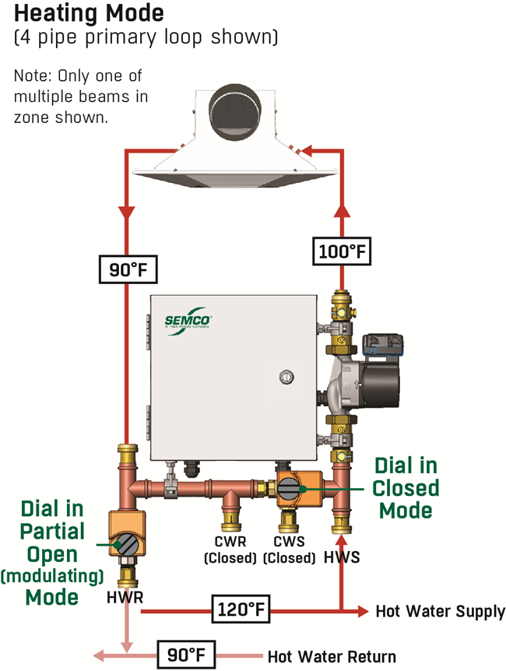
How NEUTON Works: Heating Mode
Hot water control valve slowly ejects a metered amount of recirculated secondary beam loop water while corresponding check-valve allows for injection of water from hot water supply loop
Chilled water control valve is in full bypass position and corresponding check valve is closed
Conventional 120°F hot water can be utilized within a single primary loop to serve both the chilled beam zones and the DOAS
Notes:
How does the Neuton work:
The system slowly injects water from the primary chilled water supply, mixing the hot water with the recircuilated water from the beams to achieve the correct temperature set for the beams.
The system is set to a few degrees above the dew point measured in the room by the thermostat and humidity control shipped with the unit.
3. SO in the heating mode, the water coming into the system is from chilled water.

Slide 10

SEMCO NEUTON: Active Condensation Control
In both heating and cooling modes NEUTON monitors:
  the zone pump
  beam water temperature sensor
  control valves
  associated electrical and controls
NEUTON keeps the beam pipe temperature a few degrees above the measured dew point in the room via the supplied wall sensor
All this is done via factory installed software and tested with sensors
With NEUTON, you won’t worry about rain coming from your chilled beams.
Notes:
So how does it provide condensation control.
The system is set to a few degrees above the dew point measured in the room by the thermostat and humidity control shipped with the unit.
Additionally, the system is always monitoring the water temperatures of the recirc and the supply water to mix the water to meet the correct temp.
Concept is simple, but not easy to achieve, which is why we design the system to be plug and play so the control scheme is already created.

Slide 11
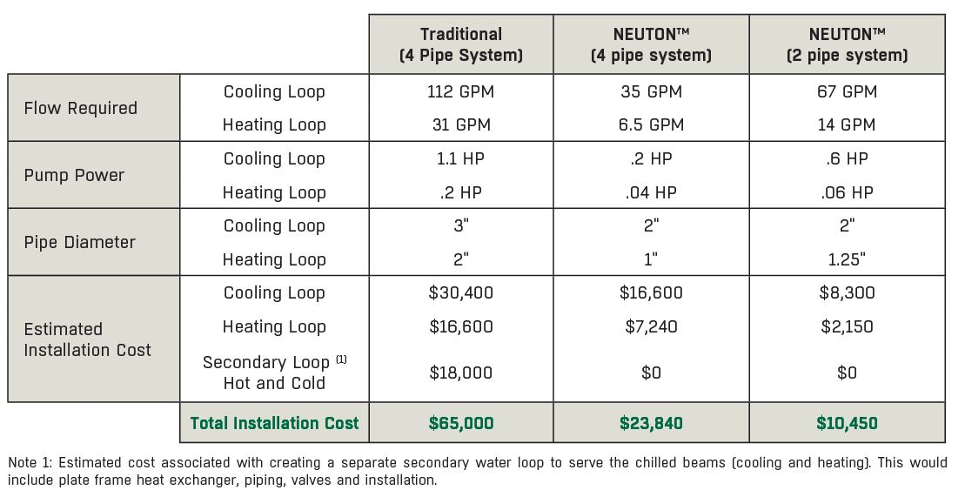
SEMCO NEUTON: Installation Savings
Installation is a fraction of the cost associated with traditional chilled beam systems while providing advanced controls and substantial energy savings.

Slide 12
Reduced First Cost Comparison
Estimated Installed Cost | SOA 4 Pipe Coils | NEUTON 4 Pipe Coils | NEUTON 2 Pipe Coils
Primary Loop | $65,000 | $23,840 | $10,450
Zone Loops, Beams, Controls, NEUTON | $68,230 | $77,300 | $77,300
Total Installed Cost (1) | $133,230 | $101,140 | $87,750
Reduction from SOA Baseline (percentage) | 0% | 24% | 34%
Reduction from SOA Baseline ($/sq.ft.) | $0 / sq.ft. | $2.10 / sq.ft. | $3.00 / sq.ft.
Note 1: Includes all installed components except ductwork and Pinnacle DOAS equipment and installation

Slide 13
Primary Loop Installation Cost Analysis: NEUTON 4-Pipe vs. SOA
Summary of Performance/Cost Analysis for 4 Pipe Approach: Current State of the Art vs. NEUTON
 |  | SOA 4 Pipe | NEUTON 4 Pipe | Percent Reduction with NEUTON
Flow Required | Cooling Loop | 112 GPM | 35 GPM | 69%
 | Heating Loop | 31 GPM | 6.5 GPM | 79%
Pump Power | Cooling Loop | 1.1 HP | .2 HP | 81%
 | Heating Loop | .2 HP | .04 HP | 80%
Pipe Diameter | Cooling Loop | 3" | 2" | 33%
 | Heating Loop | 2" | 1" | 50%
Estimated Installation Cost | Cooling Loop | $30,400 | $16,600 | 45%
 | Heating Loop | $16,600 | $7,240 | 56%
 | Secondary Loop ⁽¹⁾ Hot and Cold | $18,000 | $0 | 100%
 | Total Installation Cost | $65,000 | $23,840 | $41,160 savings (63% Reduction)
Note 1: Estimated cost associated with creating a separate secondary water loop to serve the chilled beams (cooling and heating). This would include plate frame heat exchanger, piping, valves and installation.

Slide 14
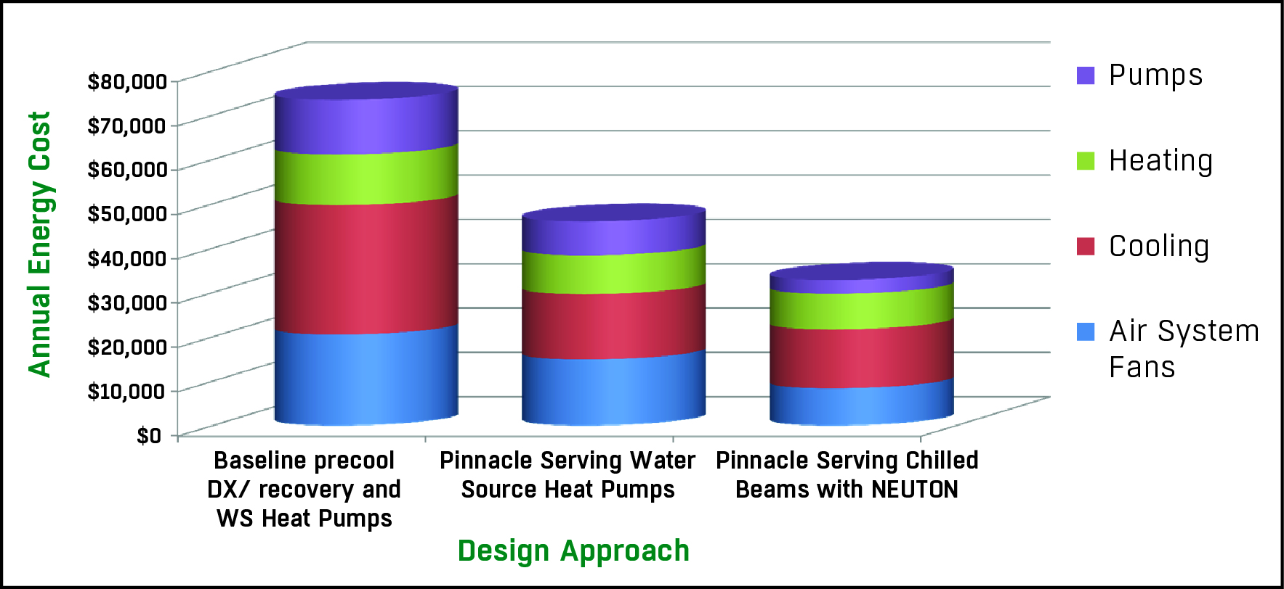

Energy Use Comparison
This chart shows energy modeling completed for a 200,000 sq.ft. high school. NEUTON pump modules combined with chilled beams result in the most energy efficient system available.

Slide 15
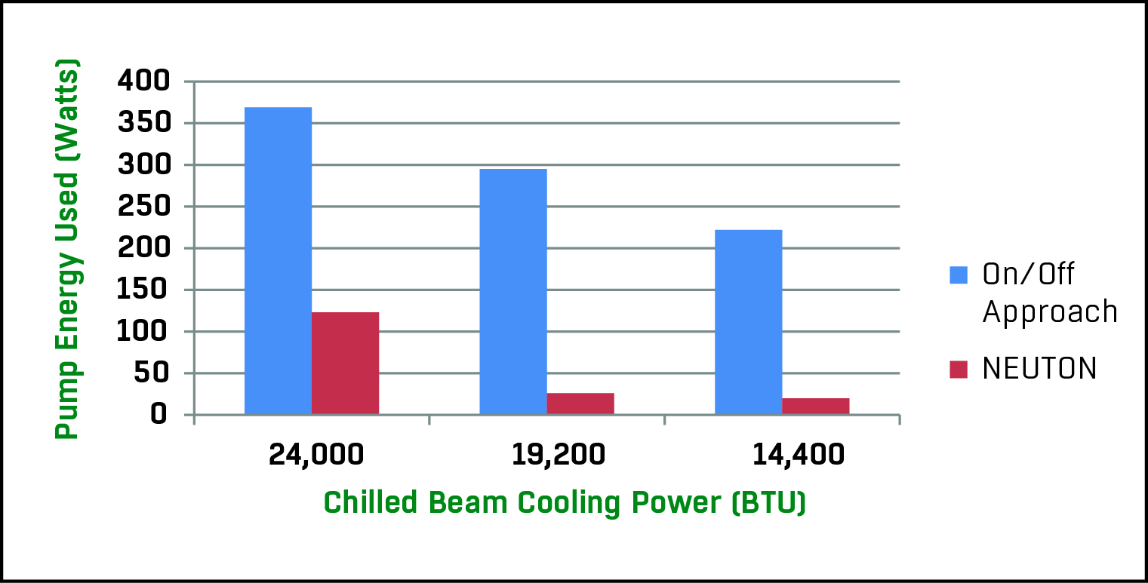
Substantial Pump Energy Savings Example
Graphic representation of energy use comparison between the baseline cycled constant speed zone pump and the high efficiency variable speed zone pump used in NEUTON.
Results: NEUTON uses an average of 80% less pump energy
to achieve the same beam cooling output

Slide 16


Contact Information & Thank You
Applied Products (Pinnacle, Ascendant, EnergyPackage, Custom): applied.semco@flaktgroup.com
Chilled Beams: chilledbeams.semco@flaktgroup.com
Unitary: unitary.semco@flaktgroup.com
ElitePro: elite.semco@flaktgroup.com
Applied Products (Pinnacle, Ascendant, EnergyPackage, Custom): applied.semco@flaktgroup.com
Duct: duct.semco@flaktgroup.com
Panels: panels.semco@flaktgroup.com
Refresh Wheels & Components: refresh.semco@flaktgroup.com
OEM Energy Wheel: oem.semco@flaktgroup.com
Datacenters: datacenters.semco@flaktgroup.com
Parts/Service Contact Information: service.semco2@flaktgroup.com
Warranty/Quality Claims: https://info.semcohvac.com/claim-form
Service Request: https://info.semcohvac.com/service-request
Parts Request: https://info.semcohvac.com/parts-request
Tom Rice
Vice President of Sales
573-823-5282
Thank you for your attention!

