Slide 1
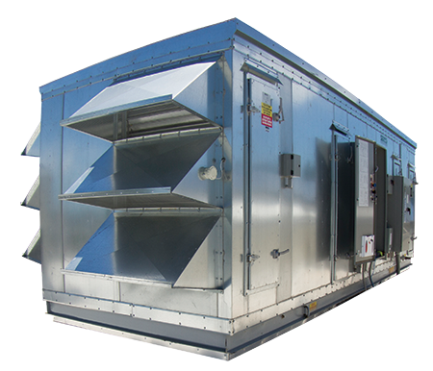

PINNACLE® SERIES

Slide 2

Corporate Overview

Slide 3
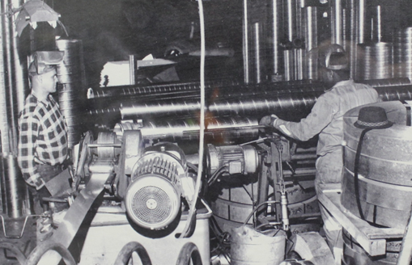
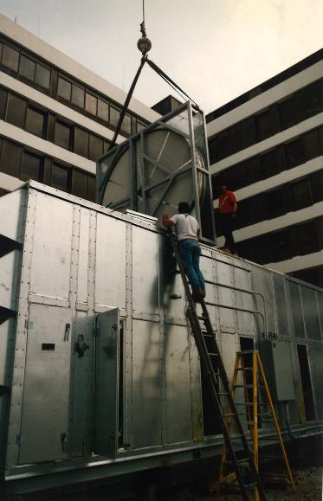
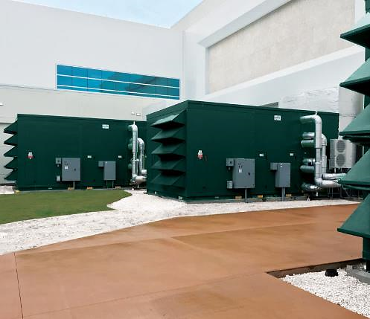









Who we are & what we do
Energy
& Environmental
Focus
Patented &
Certified
Products
U.S & Global
Footprint
Engineered
Air Quality &
Data Center
Solutions
Engineered
Air Distribution
& Sound
Solutions
OEM,
Key Account &
Sales Rep
Route To Market
Service
& Support
Award Winning
& Industry
Recognized
Notes:
In 1963 Salisbury Engineering and Manufacturing Company (SEMCO) was born in Salisbury, MO.
Began as SEMCO -- small sheet metal fabricator specializing in duct.
In the 59 years, evolved into a multi-million dollar company with a large product offering.
Headquartered in Columbia, MO, with 275,000 sq ft of manufacturing space in 3 plants in Arkansas and Virginia
We are a business unit of FläktGroup, and we are owned and backed by Triton Partners—which is a $17 billion annual revenue investment firm.
Innovation is core at FläktGroup SEMCO.
Certified by AHRI, SEMCO was won numerous awards – including multiple AHRI Innovation, Green Building, Dealer Design, School/College Planning & Management Awards
Hold numerous patents and trade secrets for our industry leading energy recovery wheels and systems.

Slide 4

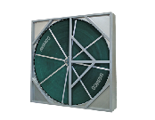
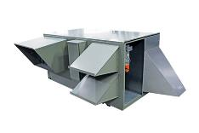
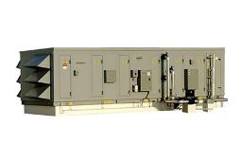


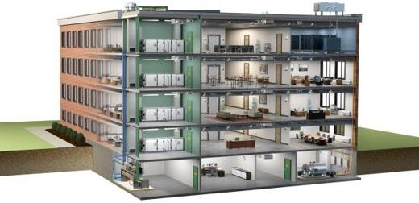
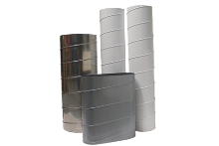
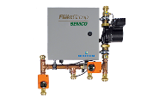
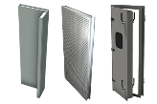

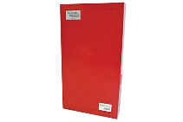
FläktGroup SEMCO Products For Commercial Applications
Energy Recovery Wheel
Unitary Energy Recovery Unit
Applied Energy Recovery Unit
NEUTON Pump
Ductwork
Chilled Beams
Fire-Rated Panels
Sound Attenuation Panels
Notes:
FläktGroup SEMCO provides solutions for a wide variety of applications including casinos, offices, laboratories, hotels, education, healthcare, retail, data centers, stadiums, manufacturing, agriculture & indoor farming, airports, and recreational facilities.
FläktGroup SEMCO products could be utilized in conjunction with one another, to provide the best possible air quality.
We offer energy recovery units & wheels which are engineered to be low maintenance, environmentally friendly, energy efficient & saves money over time as well as protects occupants from harmful contaminants.
We also offer chilled beams, pump modules, data centers, air handlers, duct and panels.
Leverage below if desired:
FläktGroup SEMCO products are designed to be utilized in conjunction with one another, to provide the best possible air quality. We show here:
Ductwork is laid within the walls and ceiling of the building, so supply air may be brought into the building and return air may be exhausted from the building.
Outdoor air is brought into the FV and pre-conditioned
Once the air is pre-conditioned with the FV it is filtered through the Pinnacle energy recovery unit, which will remove contaminants and dehumidify the incoming airstream with its True 3A wheel. Return air will also flow through the Pinnacle on its way out.
The chilled beams and the Neuton will work together with the supply air they receive from the Pinnacle to maintain a comfortable room temperature without condensation. (Together the Pinnacle, Neuton, and chilled beams make up 3fficiency).
During the construction of the building fire panels will be installed around an equipment room or elevator.
Sound attenuation panels are also installed during construction around noisy equipment or places where noise may be a concern

Slide 5
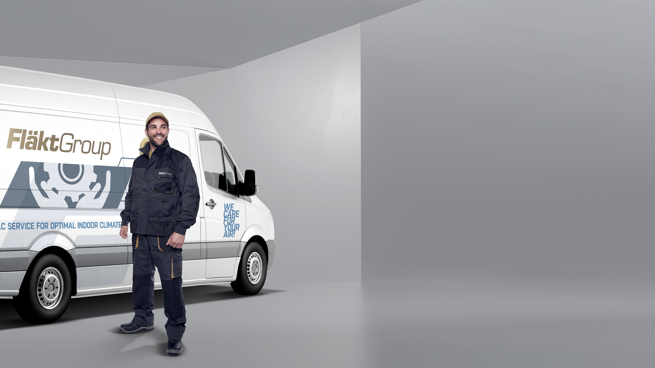

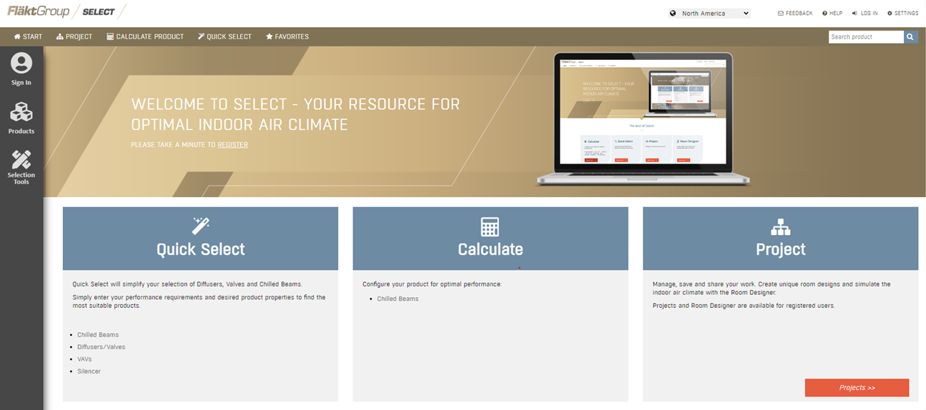
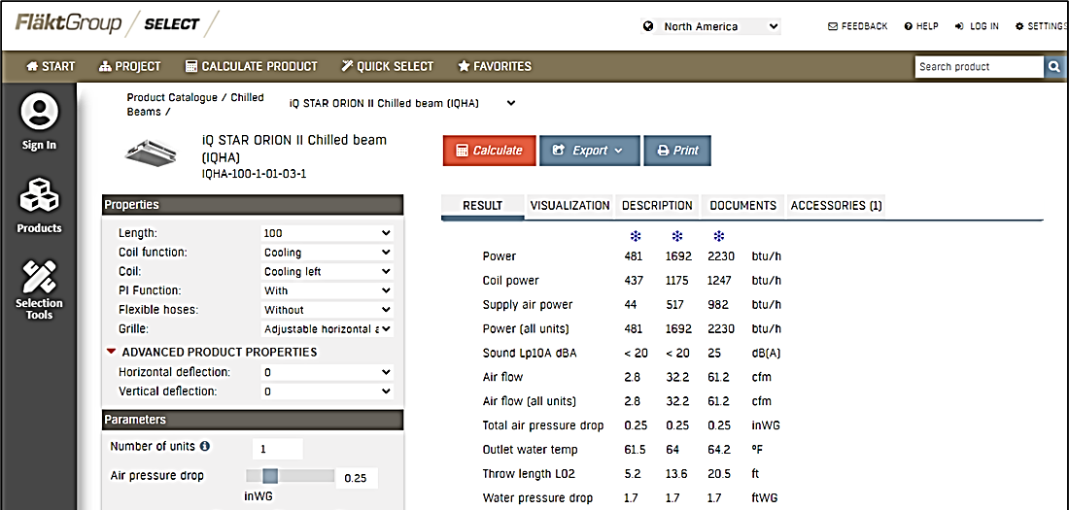
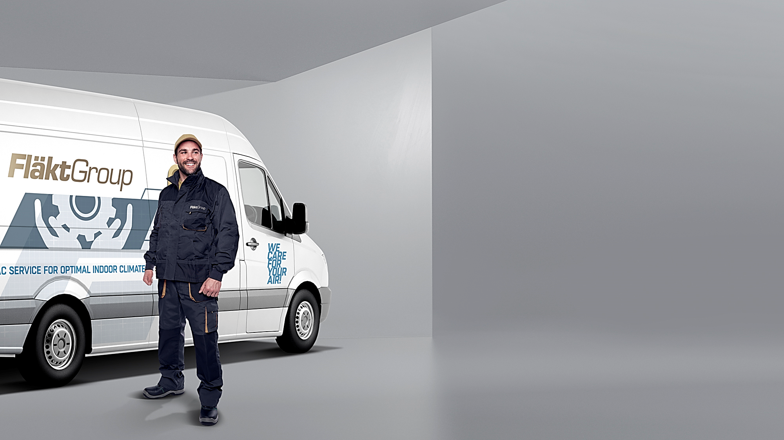
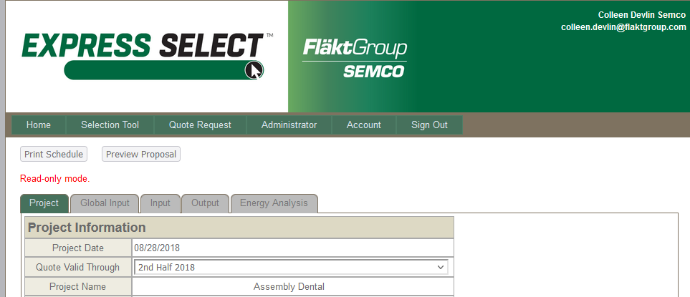
FläktGroup SEMCO Superior Sales Support & Service
Notes:
FläktGroup SEMCO prides ourselves on supplying exceptional sales support and service.
Accessible web-based literature and tools
Our experienced sales team are a phone call away and will help guide you through our selection programs to meet or exceed project specifications.
While all FläktGroup SEMCO products are relatively maintenance free throughout their lifecycle--we have a knowledgeable and dedicated service team available should you require it.

Slide 6
Introduction to the Pinnacle Series

Slide 7
Introduction to the Pinnacle® Series
What is the Pinnacle® Series?
Pinnacle® Series is a dedicated outdoor air system (DOAS) that employs passive dehumidification, to condition and dehumidify outdoor air without regeneration.
In addition to treating and dehumidifying large quantities of outdoor air, the Pinnacle Series is also a highly efficient energy recovery system.

Slide 8

Pinnacle Series – Dehumidification
CHALLENGE:
Needing to bring in more outdoor air to comply with ASHRAE 62.1, without adding excess humidity.
SOLUTION:
The Pinnacle Series will not only bring in large quantities of outdoor air but will also treat and manage 100% of a building’s humidity.
Conventional cooling with a twist – passive dehumidification. Passive wheels team up with cooling coils to remove humidity without relying on a regeneration source or using excessive energy.
The Pinnacle II comes with a digital scroll compressor to dehumidify air to 35 grains — unheard of with a conventional system.
Notes:
Read from the slide

Slide 9

Pinnacle Series – Cost-Efficiency
CHALLENGE:
Is the Pinnacle more cost-efficient than similar units on the market?
SOLUTION:
The True 3Å® wheel pre-heats and pre-cools supply air with energy recovery, while the passive dehumidification wheel removes excess humidity — saving on operating costs and energy expenditure.
Not only can the Pinnacle Series deliver the lowest dew points on the market as low as 42°F, but it also uses the lowest cooling capacity (24 tons), on the market, to achieve these conditions. Saving energy and money.
Comparatively, the Pinnacle has the lowest operating cost and life cycle cost, several hundred thousand dollars less, than other units on the market.
Lower installation costs due to reduced demand for overall heating and cooling capacity
Notes:
ASCENDANT™ achieves a high operating efficiency by utilizing conventional cooling where it is most efficient (cooling air to moderate temperatures) and active desiccant dehumidification where they are most beneficial and operates most efficiently (processing saturated air)

Slide 10
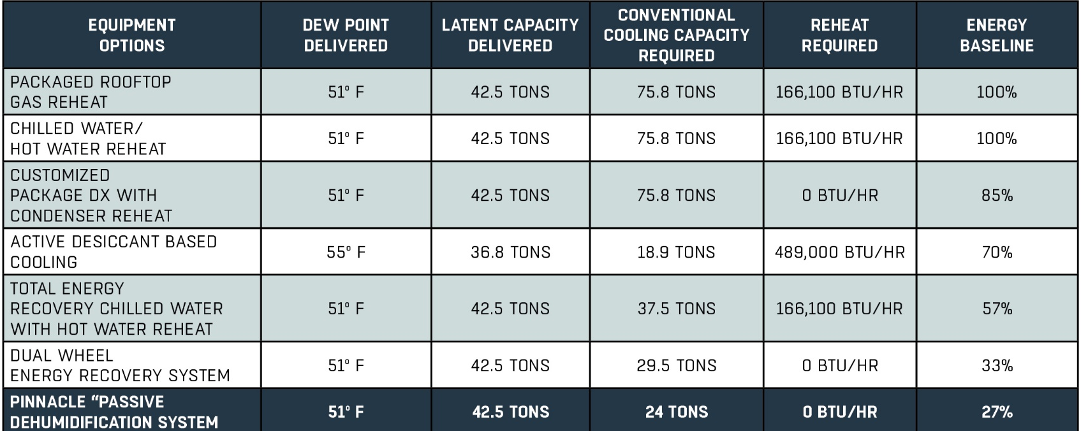
Pinnacle Series – Energy Savings
During the heating season, Pinnacle Series can recover up to 90% of the energy from the building’s exhaust air stream.
Desiccant rejects airborne contaminants while it transfers water vapor, thus providing total energy transfer from the exhaust to the supply airstream.

Slide 11

Pinnacle Series – Healthcare Applications
CHALLENGE:
Finding one unit that can efficiently heat, cool, control humidity, and provide proper ventilation.
SOLUTION:
The Pinnacle Series, manages 100% of a building’s ventilation and indoor humidity load in a single package.
Can respond to varying outdoor conditions on demand.
Cools, heats, or dehumidifies as required.
Provides a steady stream of optimally
pre-conditioned, high quality, comfortable air.
Notes:
Contaminant carry-over is 0.045%

Slide 12
Pinnacle Series Components

Slide 13
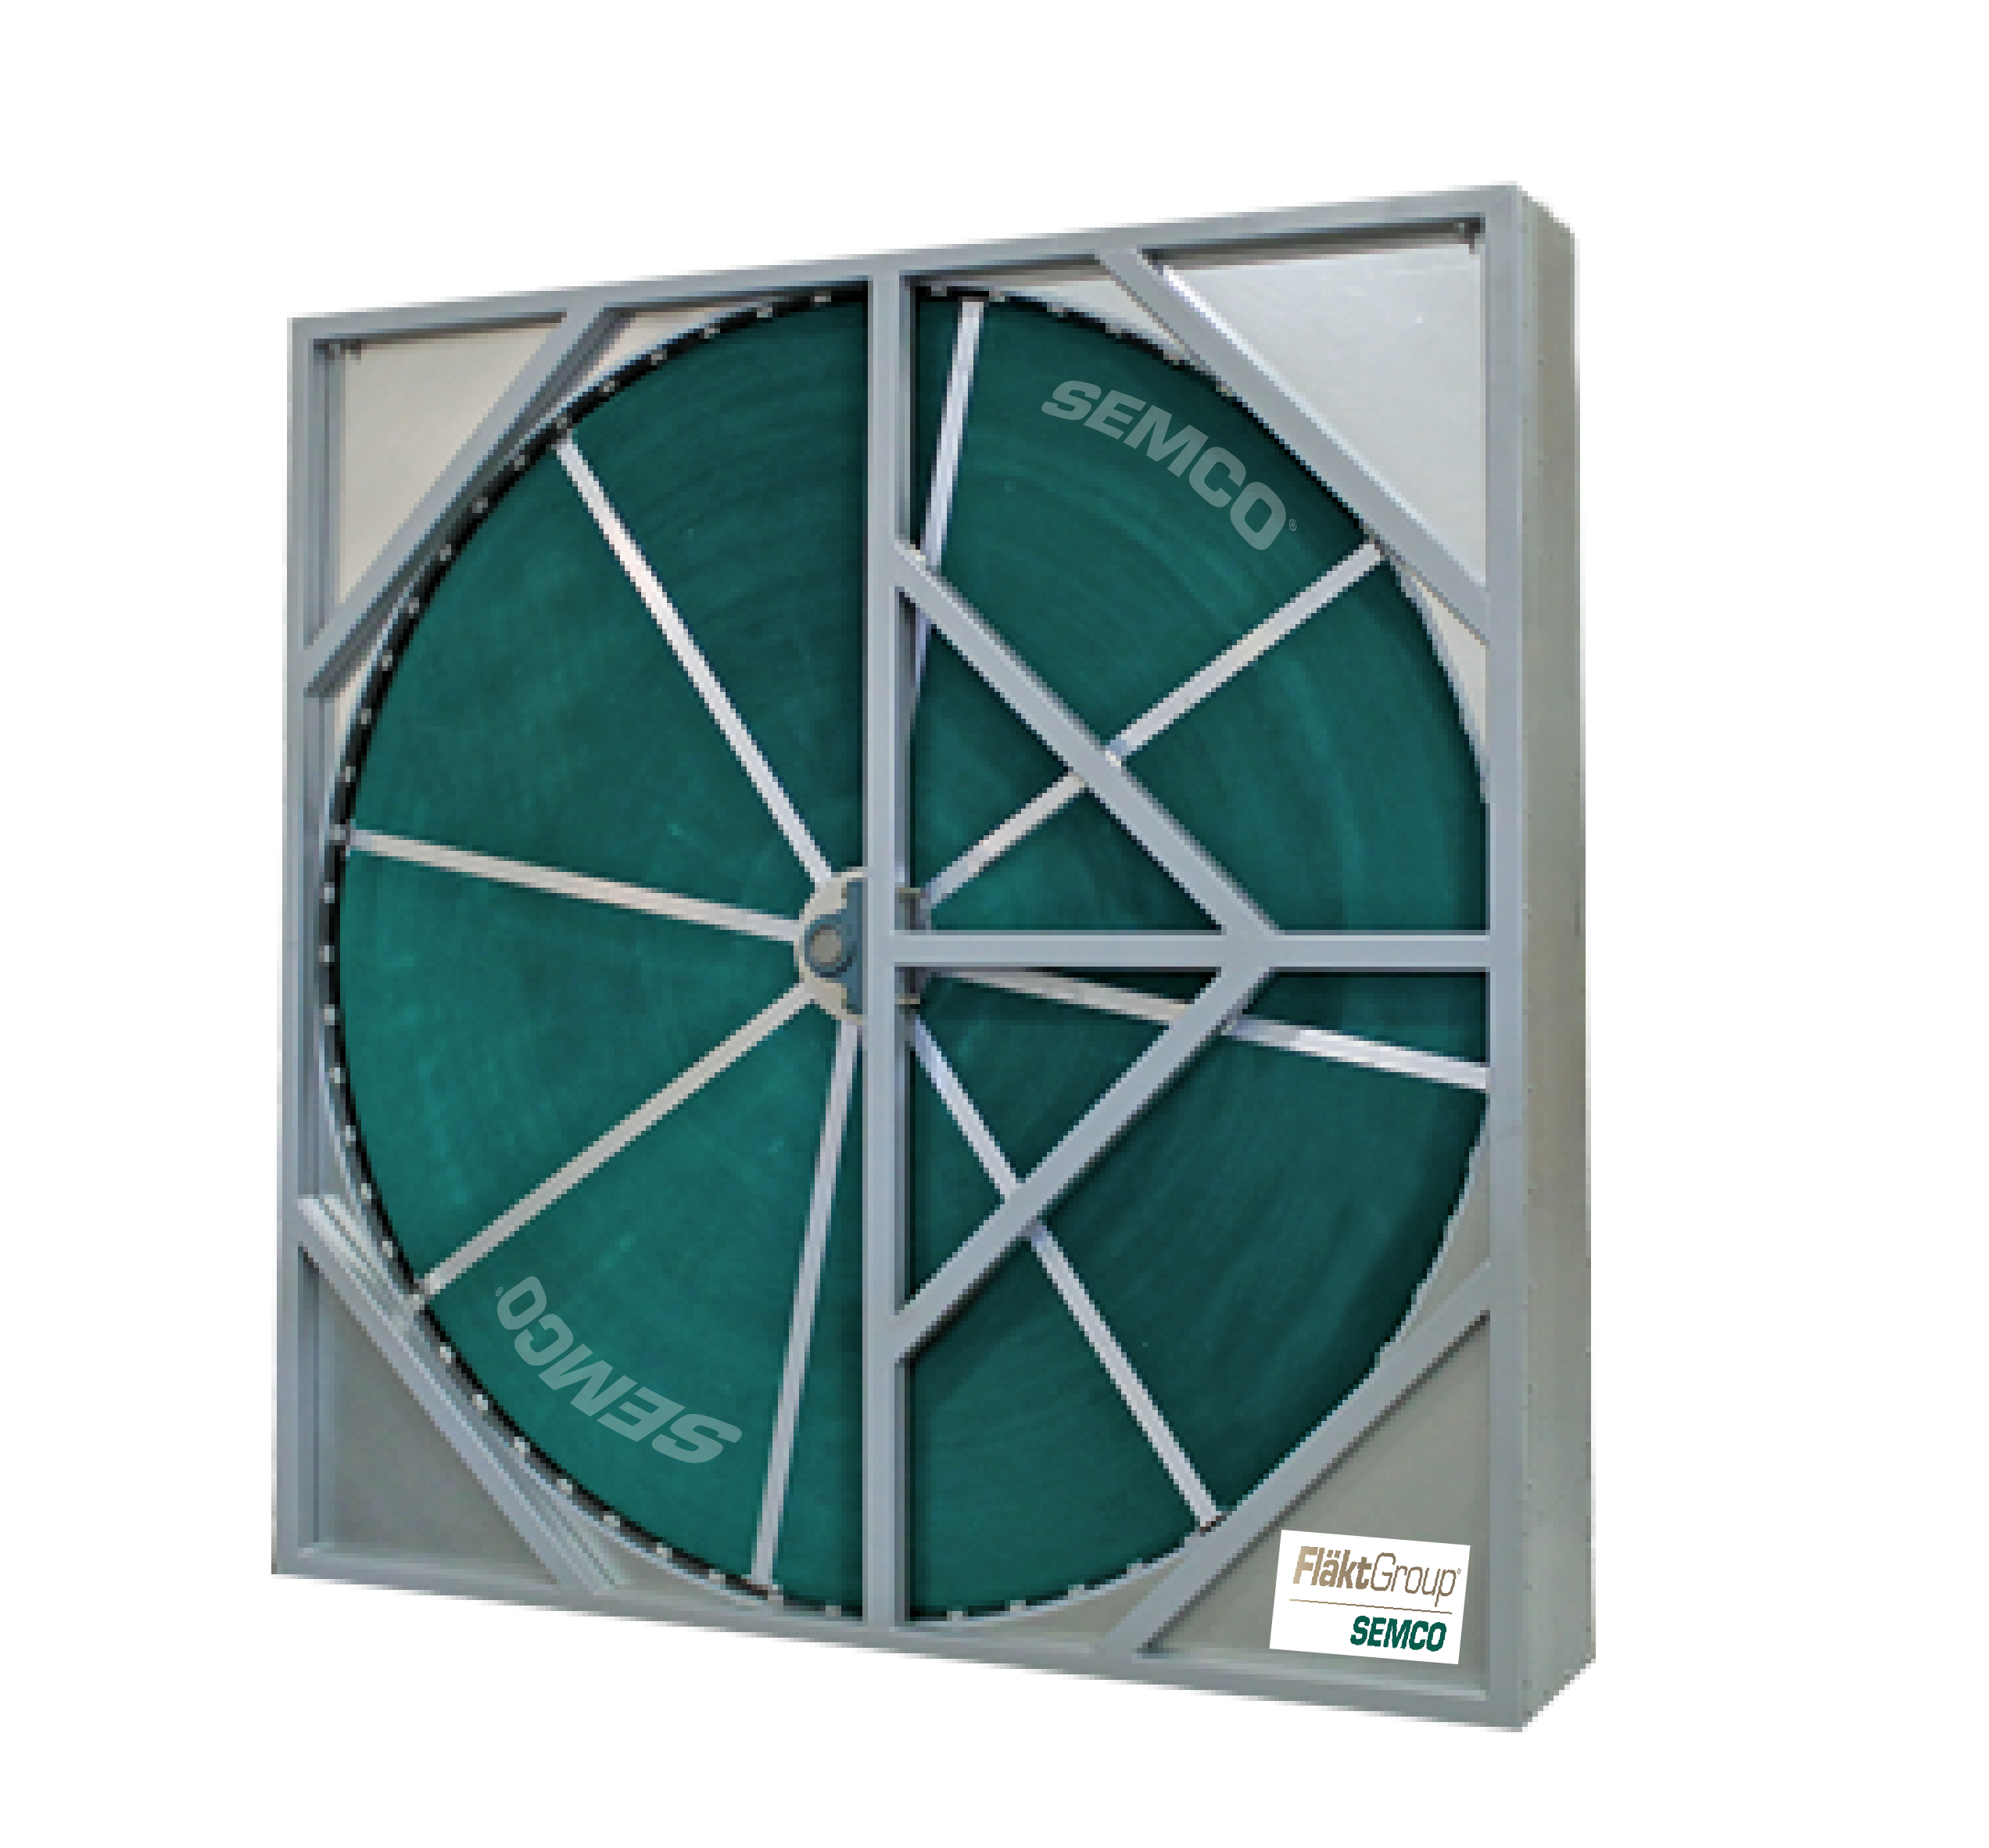
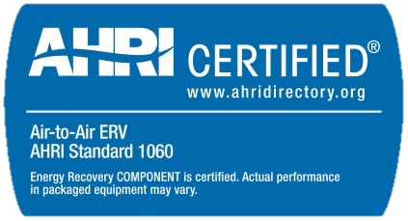
EP Series — Wheels
True 3Å Total Energy Wheel (TE)
Total energy wheel
Patented 3Å molecular sieve-desiccant coating for independently certified cross-contamination less than 0.04%
All aluminum, structural spoke system eliminates mechanical fatigue and allows media replacement (sizes 13+)
Field adjustable purge section
NFPA 90A certified for flame spread and smoke generation based upon ASTM E84 fire test method
Independently certified wheel performance in accordance with ASHRAE Standard 84-91 and ARI Standard 1060 regarding:
  latent transfer efficiency
  sensible transfer efficiency
  pressure loss across wheel

Slide 14
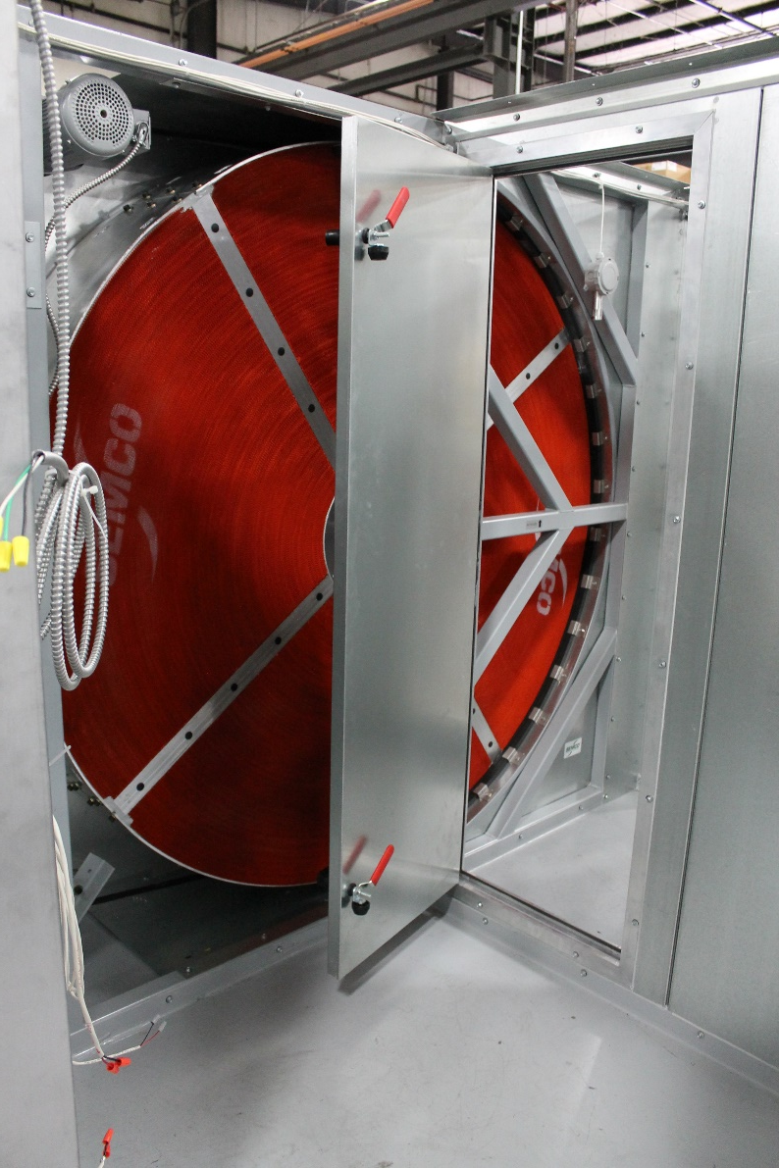
EP Series — Wheels
Passive Dehumidification Wheels (PD)
The passive dehumidification wheel’s performance can be modulated on demand to respond to various conditions of temperature and humidity.
Optimized to remove moisture from a saturated air stream, without an active regeneration source.
Passive dehumidification wheel is polymer coated to avoid oxidation and future transferring of moisture.
Exclusive SEMCO product.

Slide 15
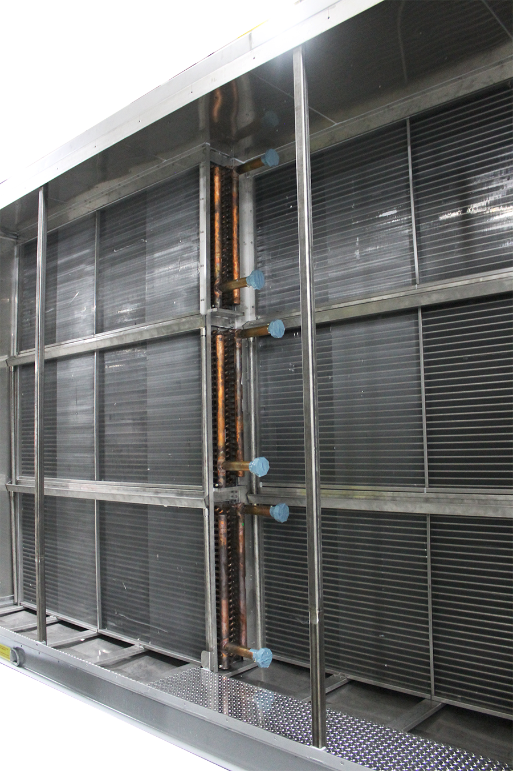
Pinnacle Series - Heating & Cooling Options
Heating Options
  Hot water coil
  Steam coil, non-freeze type
  Electric coil (optional with
  separate electrical connection point — not available on the Pinnacle II)
  Condenser coil in return air path (Pinnacle II only)
Cooling Options
  Chilled water
  Direct expansion (DX) coil

Slide 16
Pinnacle Series - How it Works

Slide 17
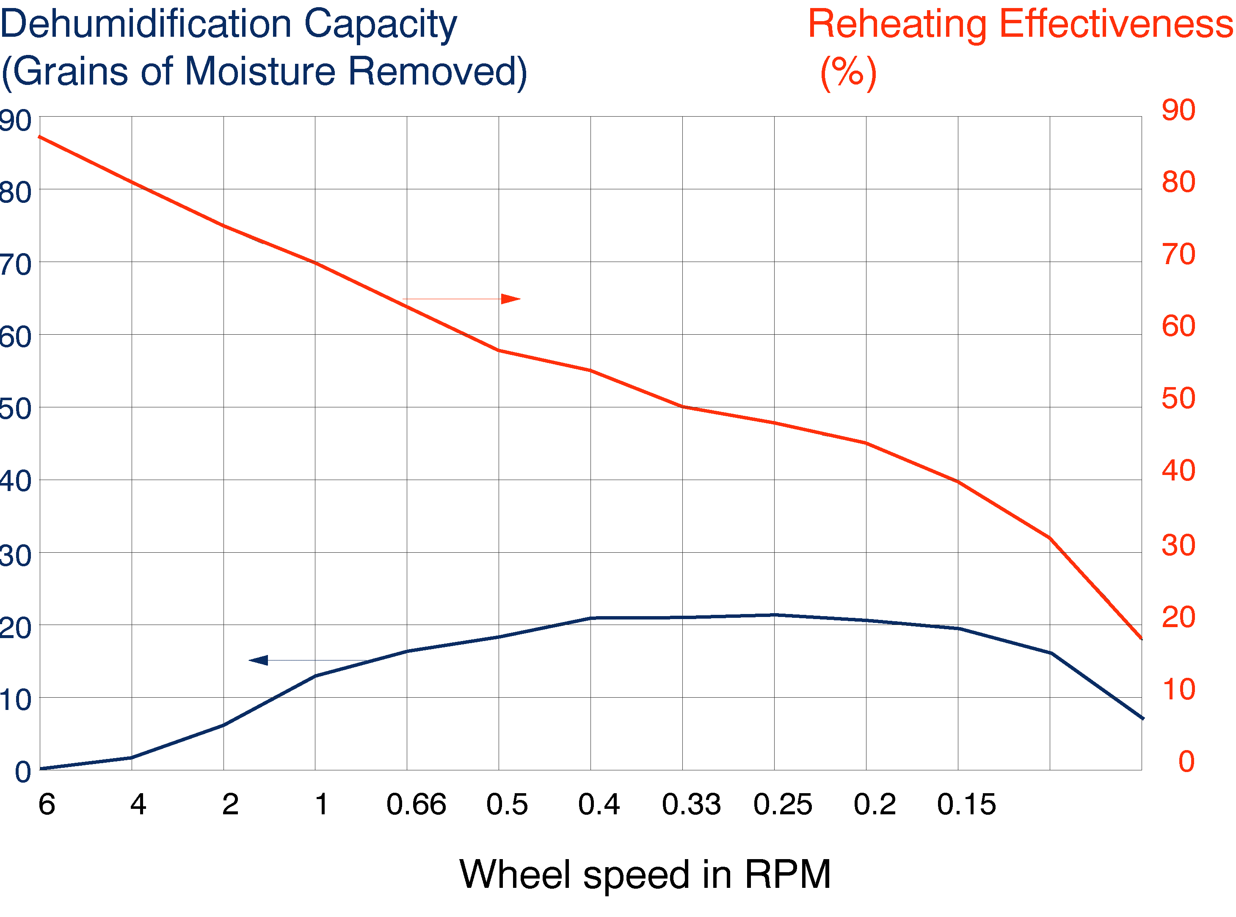
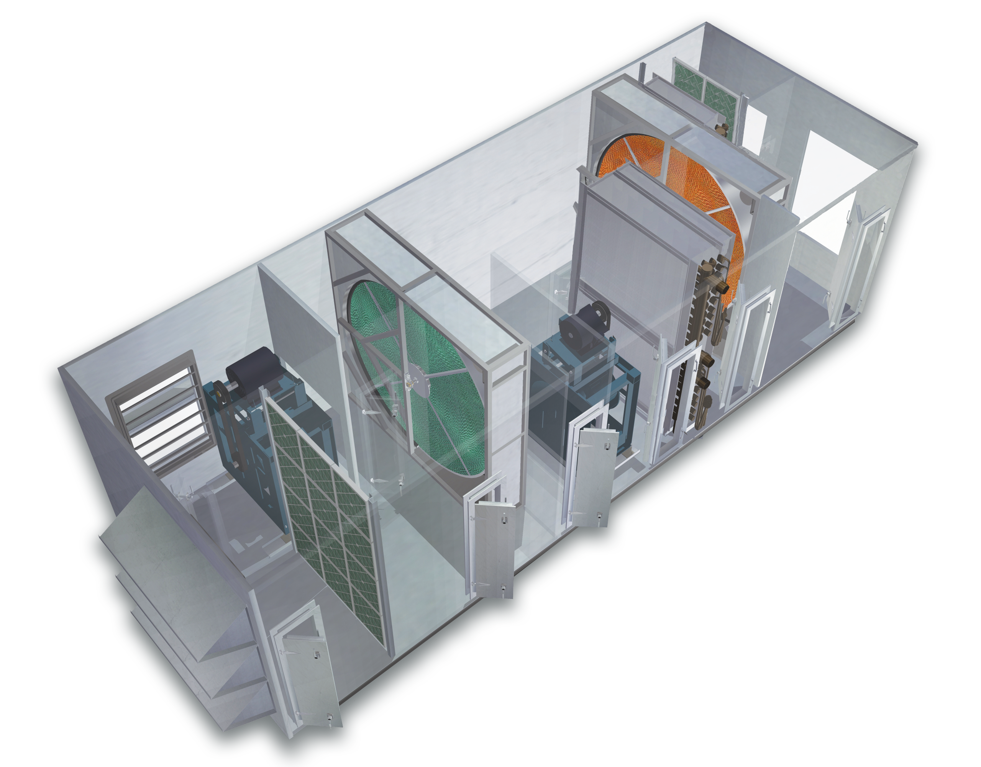
Pinnacle Series - Dual Wheel System
Re-heating effectiveness of PD wheel
The True 3Å® total energy wheel has fluted aluminum, "honeycombed" media coated with a high performance 3Å (angstrom) molecular sieve desiccant
The passive dehumidification (PD) wheel’s
performance can be modulated on demand to respond to various conditions of temperature and humidity.

Slide 18
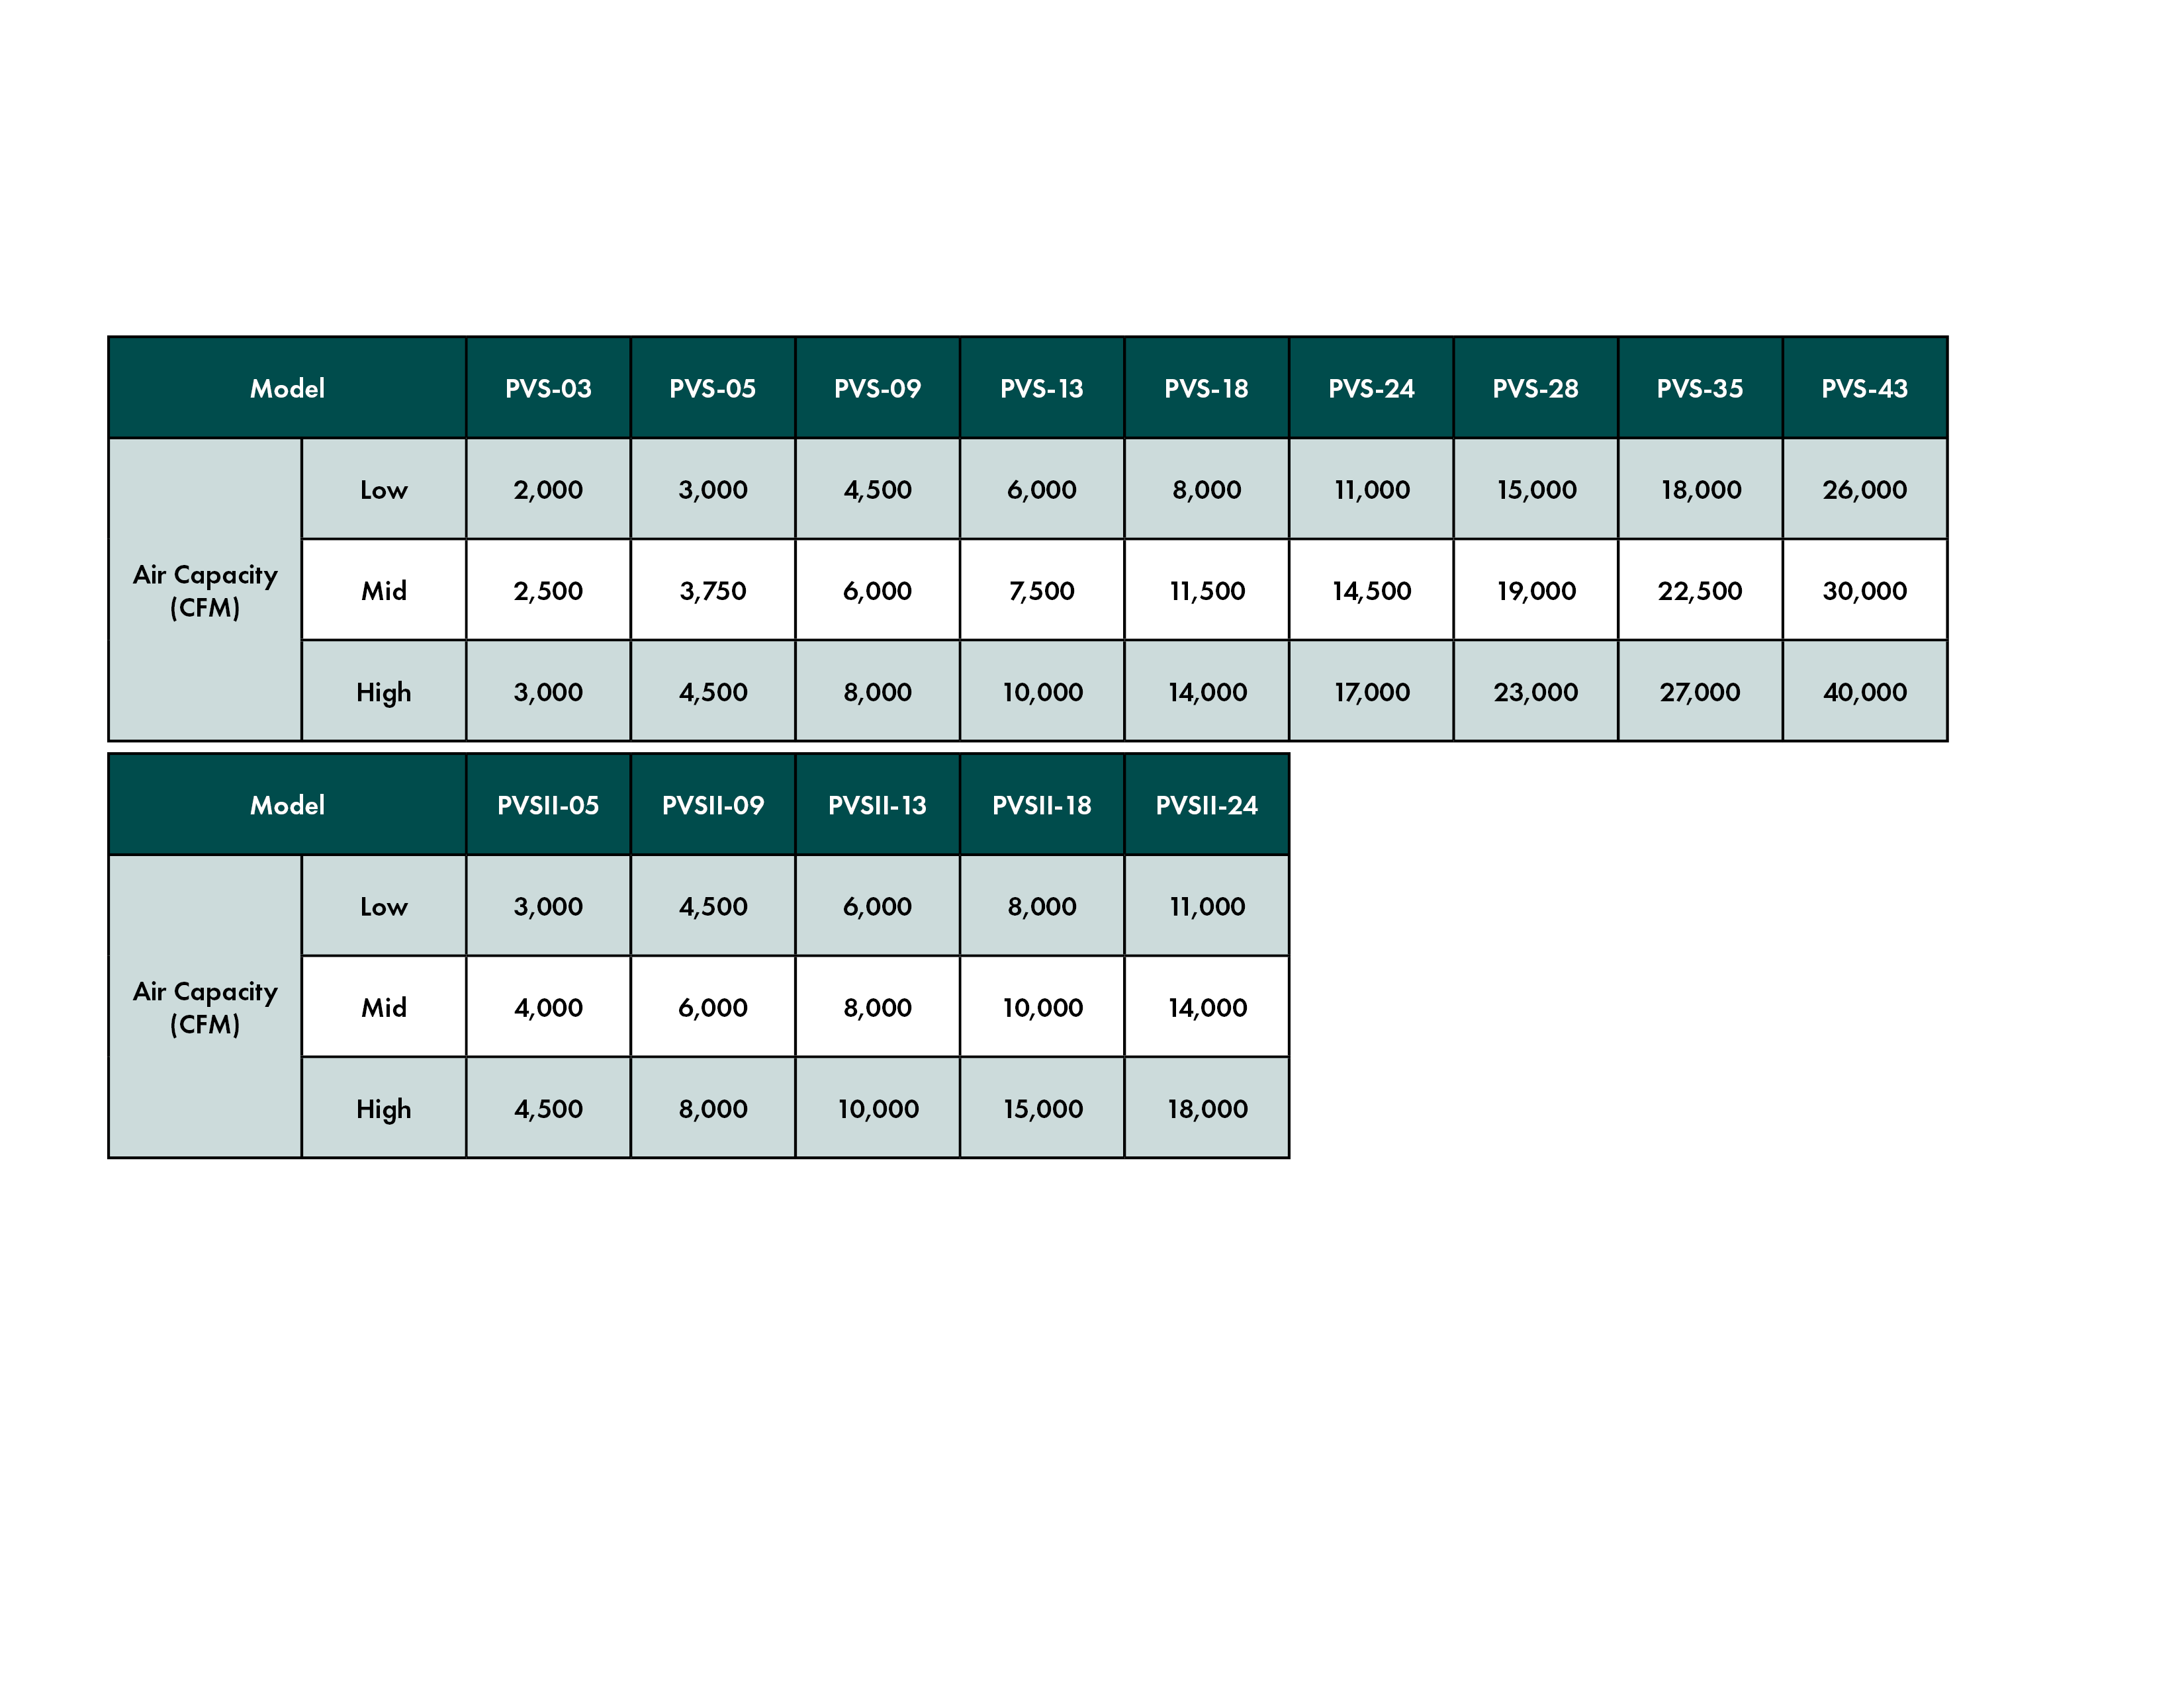
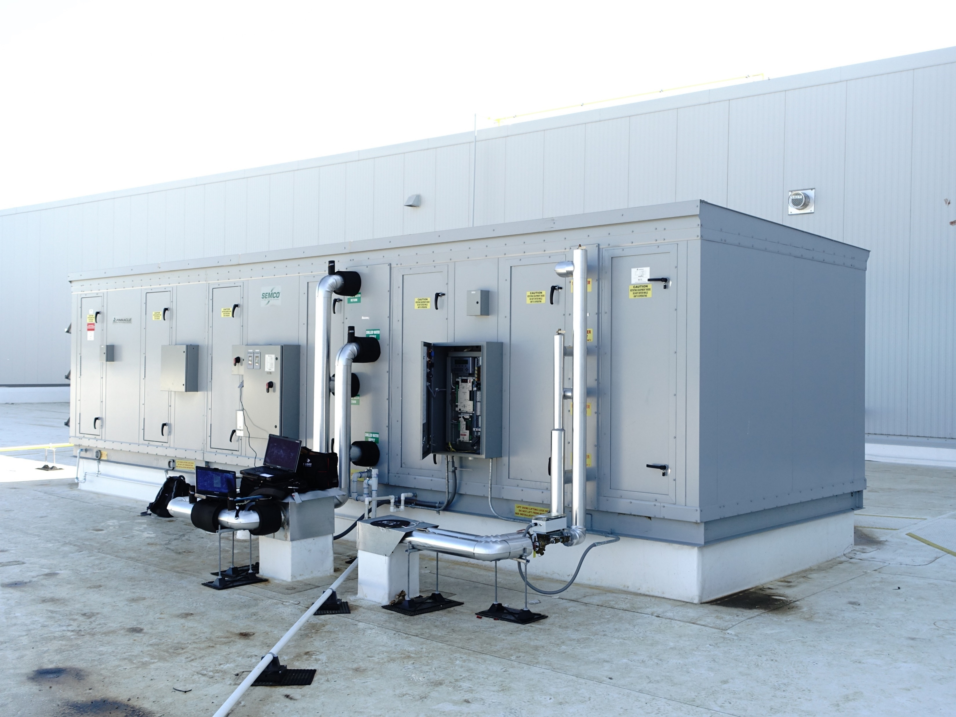
Pinnacle® Series Airflow Capacity
Pinnacle®
Pinnacle® II

Slide 19
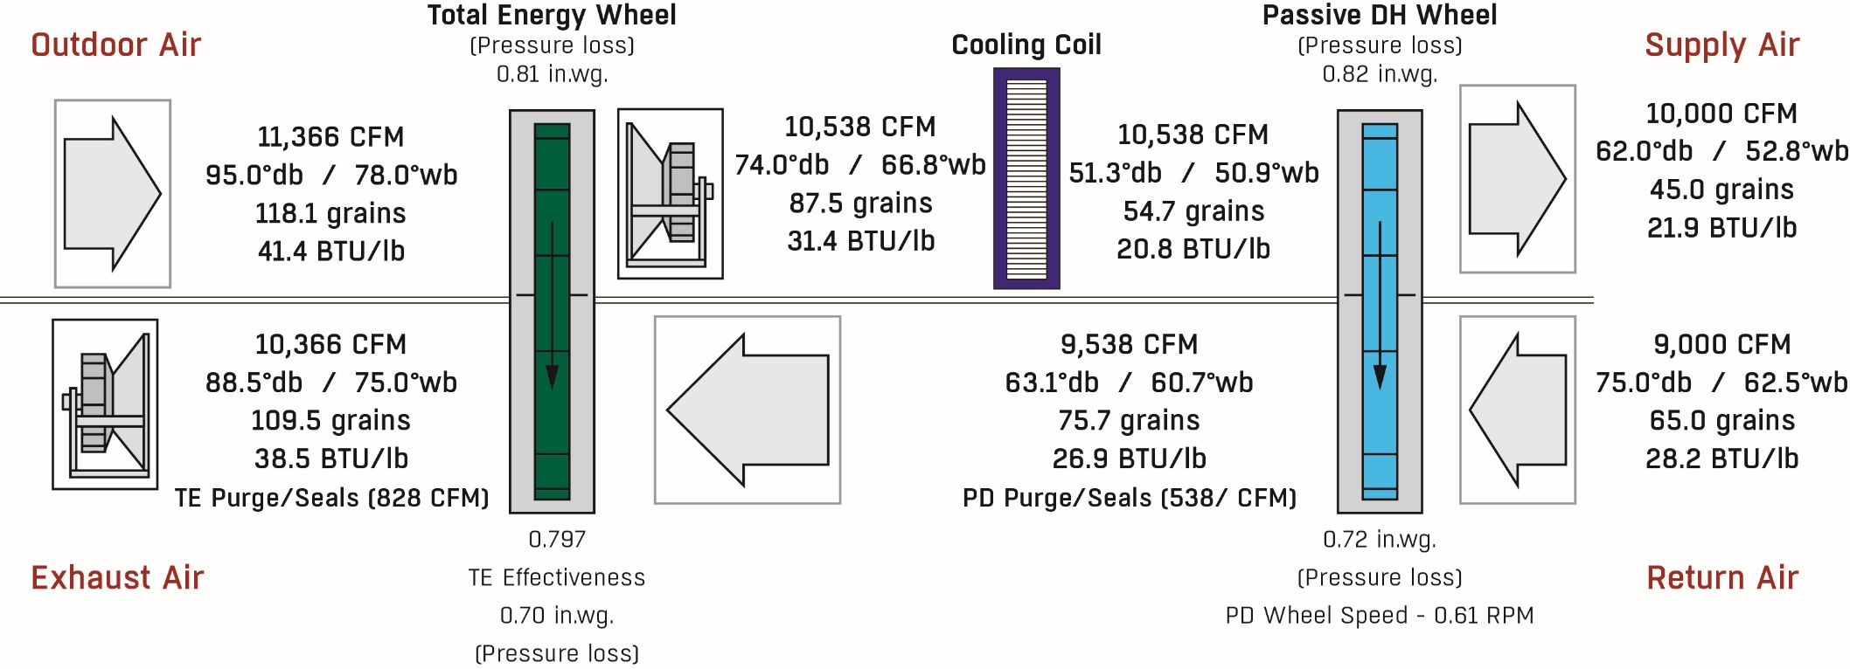
Pinnacle ® Summer Performance
Dehumidification & temperature rise.
Two factors for
temperature rise.
A) Heat of Adsorption
B) Wheel Heat
carry-over
VS
LOAD WITH OUT ENERGY RECOVERY
1,073 MBH
OVER 89 TONS OF COOLING NEEDED
LOAD WITH ENERGY RECOVERY
504.8 MBH
42.1 TONS OF COOLING NEEDED

Slide 20
Pinnacle ® Summer Performance
50%

Slide 21
Pinnacle® Summer Performance
50%
Conditions are outdoor dependent
Conditions are space dependent

Slide 22
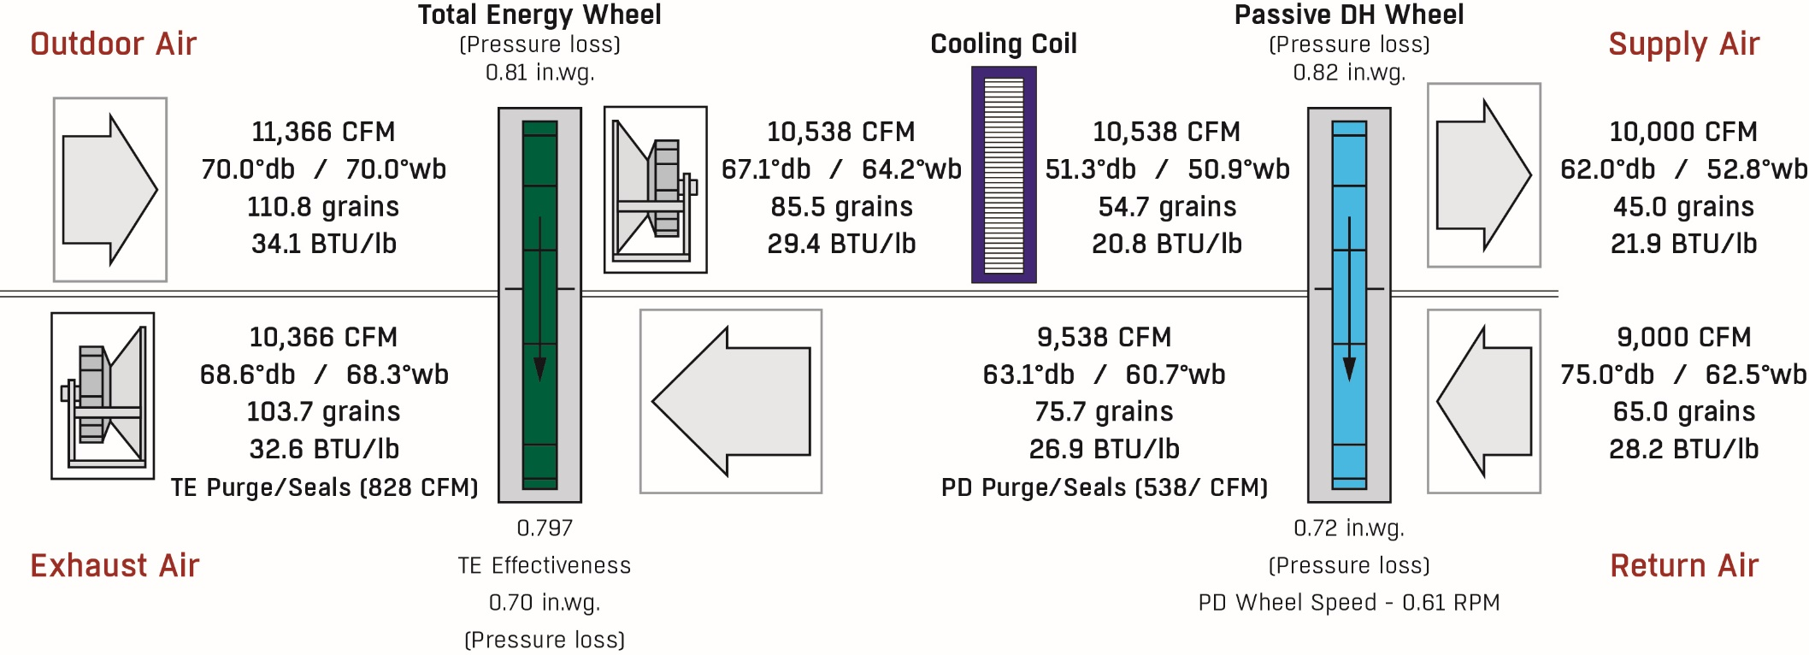
Pinnacle® Partial Load
NO CHANGE ON BUILDING SIDE
50%

Slide 23
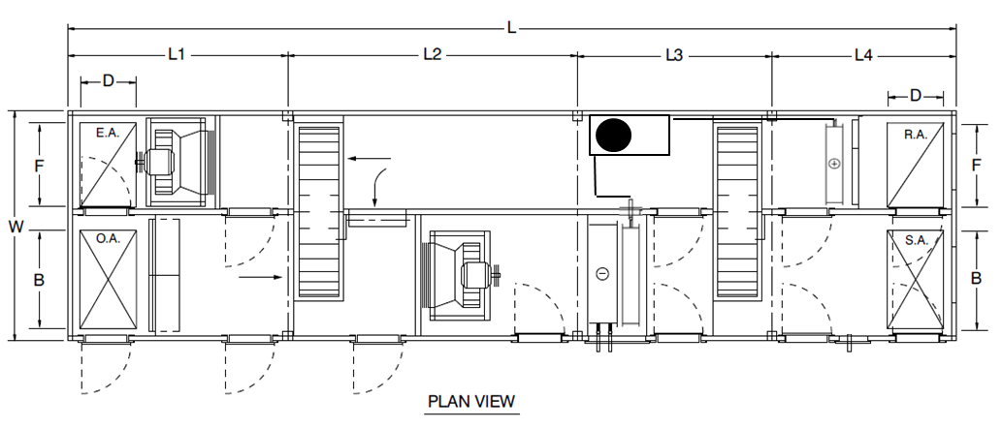
Pinnacle II – General Arrangement (GA) Drawing
Single Compressor and components
Single row Dx condensing coil
Two row Dx evaporator “trim” cooling coil

Slide 24
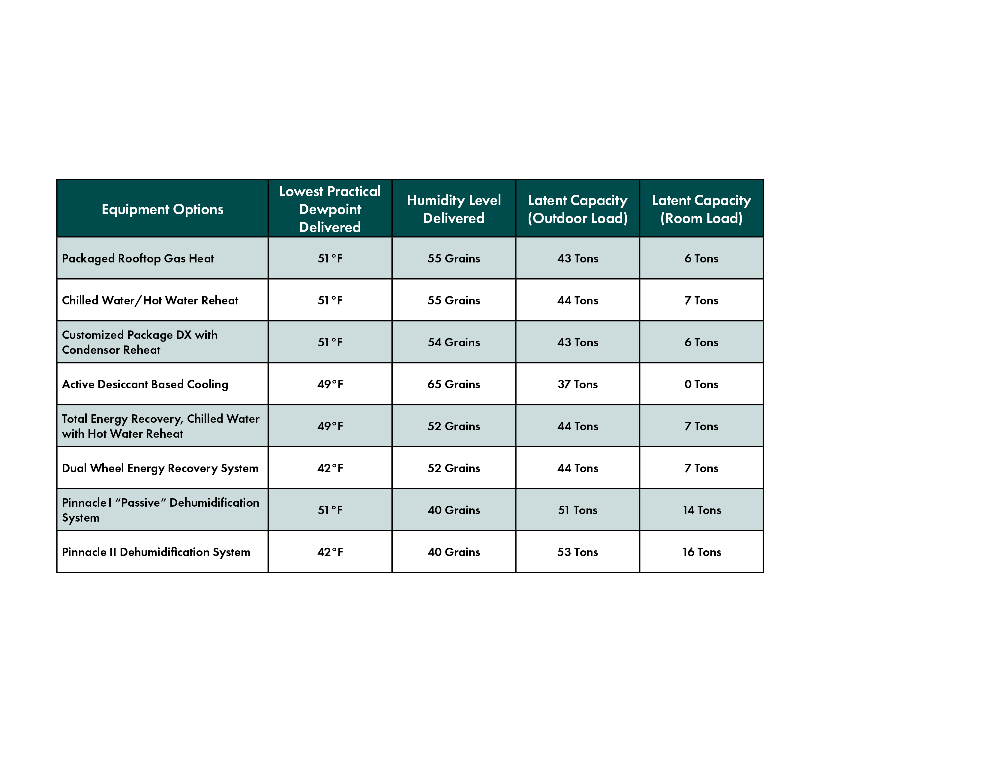
Pinnacle Series: Latent Capacity
Comparing Latent Capacity Provided at Attainable Dewpoints
100% more latent capacity available to handle space loads

Slide 25
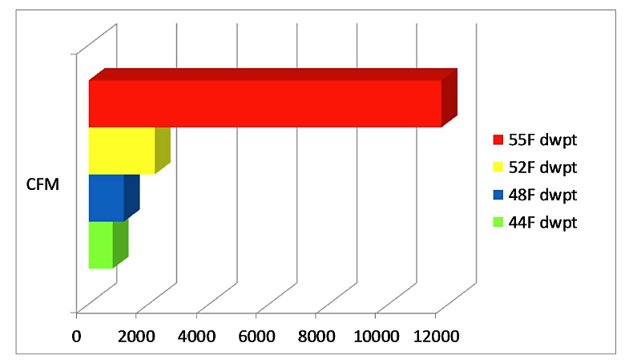
Effect of Lower DP on Primary Airflow
Maintaining space @ 75F db / 50% RH. Based on 3 ton space latent load

Slide 26
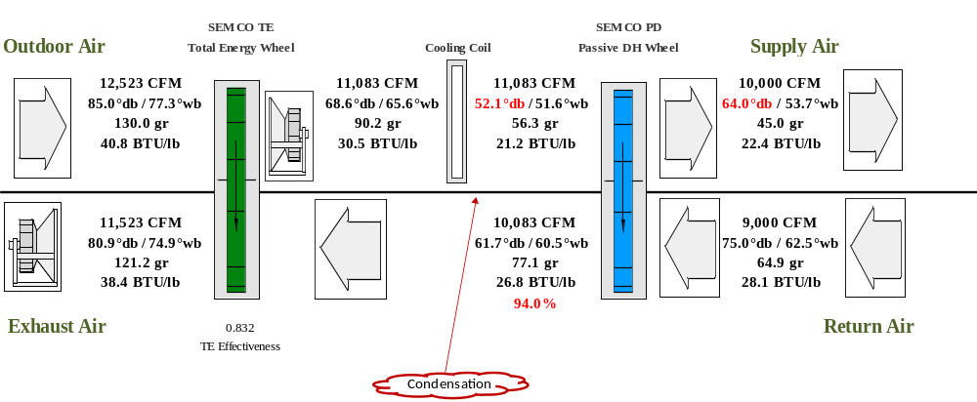
Pinnacle® Lowest Dewpoint With Chilled Water
To deliver 45 grains, a leaving coil temperature of 52ºF is required which is not easily achieved with chilled water. If it is, a very deep coil and chiller operating at low efficiency is required. Drier air cannot be achieved with chilled water.
The RH leaving the PD wheel is very high (94% RH) and condensation on the wall between the cooling coil and PD exhaust is likely

Slide 27
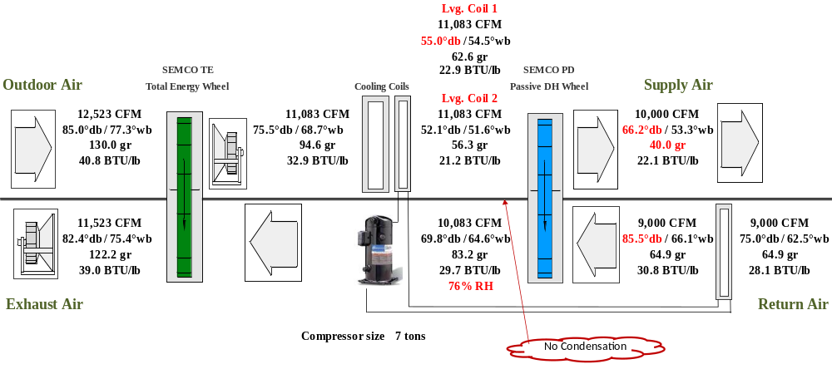
Pinnacle®II Lowest Dewpoint With Chilled Water
With Pinnacle II, much drier air is delivered using the same off coil temperature. Traditional chilled water temperatures and coil rows are used by primary coil increasing system efficiency.
Warmer air, as desired, is supplied from the unit despite the lower supply air dewpoint.
PD leaving conditions are no longer saturated, greatly reducing the risk of condensation and dehumidification performance degradation.

Slide 28
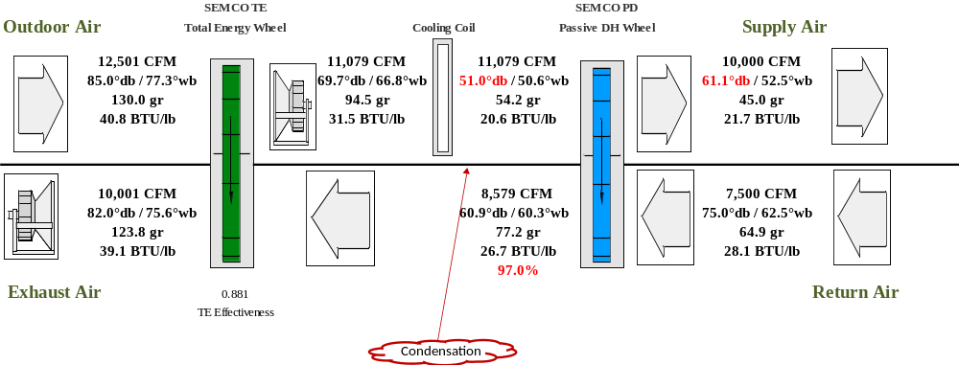
Pinnacle I Example: Impact of Increased Flow Imbalance
To deliver 45 grains, a leaving coil temperature of 51ºF is required which is not achieved with chilled water.
The RH leaving the PD wheel is nearly saturated (97% RH) and condensation on the wall between the cooling coil and PD exhaust certain along with reduced DH performance
Supply air temperature is too low for most applications

Slide 29
Pinnacle II Example: Impact of Increased Flow Imbalance
45 grains is easily delivered with chilled water and modest temperature off the trim coil due to low RH in the return air (fewer cooling tons required).
The RH leaving the PD wheel is only 72% so condensation is not an issue due to higher return air temperature
Supply air temperature is increased as desired even with big flow imbalance

Slide 30
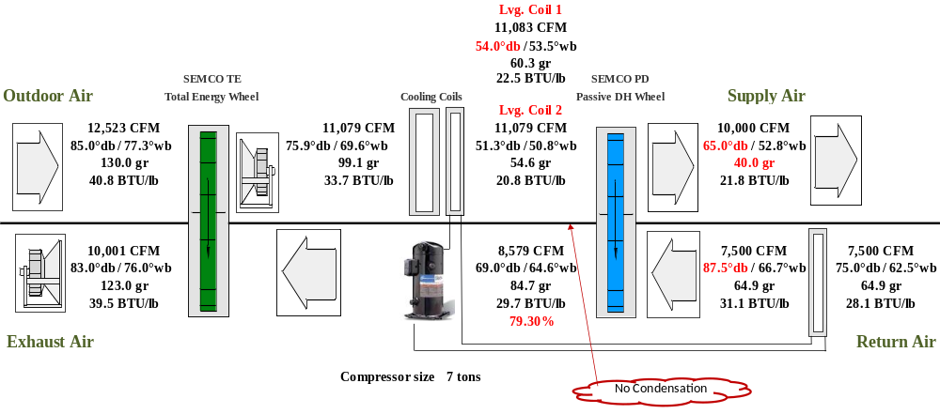
Pinnacle II Example: Impact of Increased Flow Imbalance
40 grains is delivered using the same 51ºF required by current Pinnacle. This is a 25% increase in dehumidification capacity at the same off coil condition
The RH leaving the PD wheel is only 79% so condensation is not an issue due to higher return air temperature
Supply air temperature is increased as desired even with big flow imbalance

Slide 31
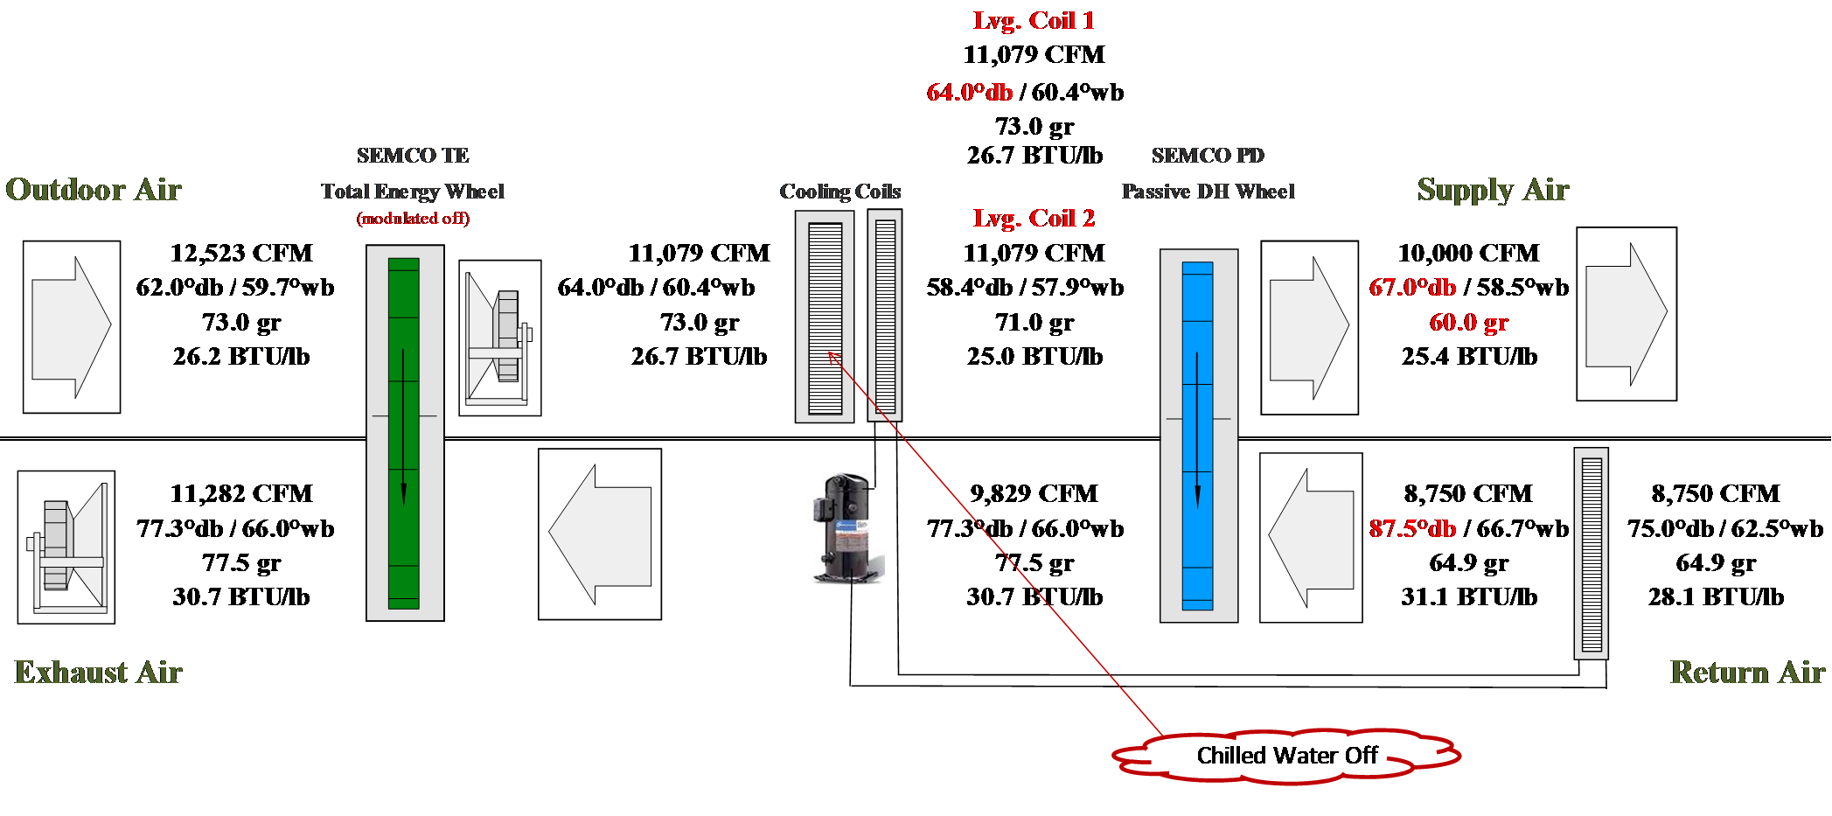
Pinnacle II Example: Partial Load Condition with No Chilled Water
Numerous part load hours exist where the outdoor air temperature is low, but the humidity is higher than the required supply air dewpoint (humidity level) setpoint
Often chillers are locked out during these conditions or, if activated, the load on the chiller is so low that wide fluctuations in the chilled water temperature occurs causing problems
Pinnacle II allows the supply dewpoint to be achieved using only the secondary DX trim coil

Slide 32
Applications

Slide 33

Pinnacle Series: Applications & Target Markets
Hospitals
Laboratories
Nursing Homes
Universities
Classrooms
Dormitories
Hotels
Casinos
Manufacturing
Office Buildings
Retail

Slide 34
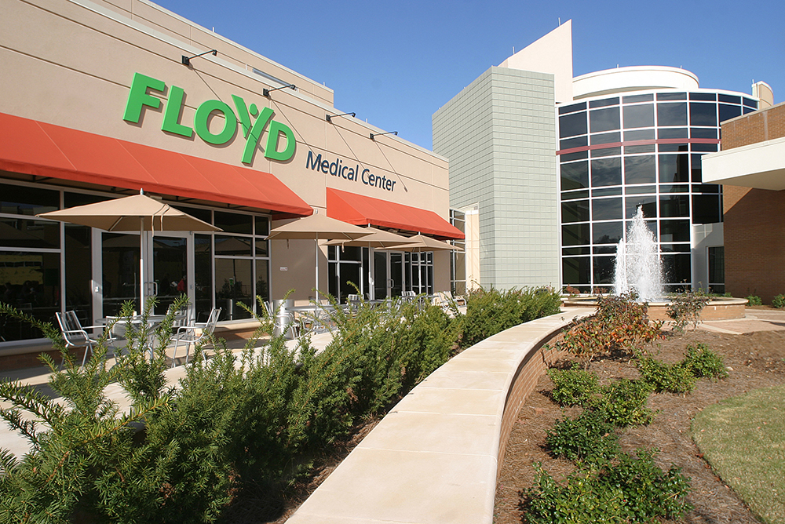
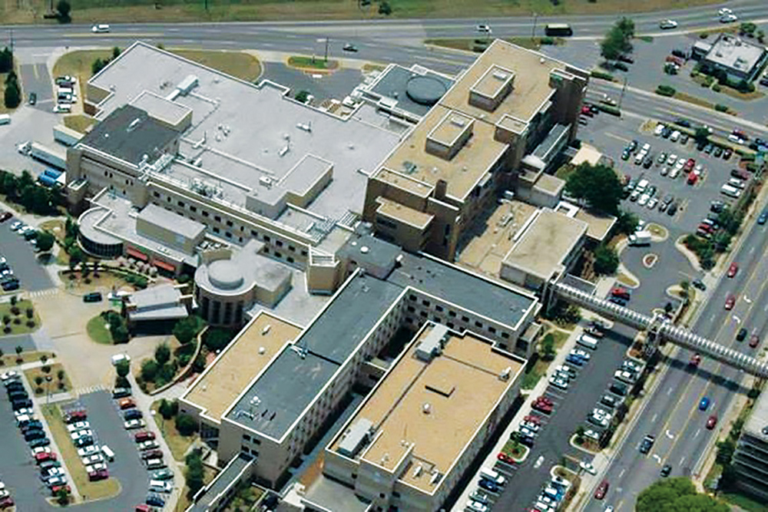
Pinnacle Series - Case Study Example
Floyd Medical Center – Rome, GA
(2) 5,000-CFM Pinnacle units
Pinnacles were chosen, because they would respond to the various combinations of temperature and humidity conditions in surgical suites.
Pinnacles remove moisture so downstream air handling units don’t need to overcool to provide dry air and higher discharge air temperatures mean less energy expended on zone reheat boxes.
Operational savings include improved chiller efficiency, higher supply temperatures, and reduced fan horsepower.
High level of environmental control - surgical comfort and functionality enhanced.

Slide 35

Thank you for your attention!

